Slide 1
Senior Design EXPO– Long Endurance Platform Powertrain Team
Members:
Miguel Cervantes
Anthony Lee
Eric Leon
Alex Maxwell
Ruben Murillo
Brandon Santos (Lead)
Client: Aerospace Corporation - Dr. Yarbrough
Advisor: Mario Medina
Notes:
Slides
Anthony 1-4
Ruben 5-7
Eric 8-11
Miguel 12-18
Eric 19-24
Brandon 25-29
Alex 30-35
Miguel 36-37
Ruben 38-42
Brandon 43-45
Anthony 46-51

Slide 2
Project Scope
To design an efficient hybrid powertrain architecture concept
Utilizing power regeneration techniques
Obtaining sufficient power to maintain flight for 4-12 hours
Obtain sufficient power to meet the onboard system’s requirements
2

Slide 3
Introduction
What is a Hybrid Powertrain?
Consist of components that converts the engine’s power into motion
How is the hybrid powertrain utilized?
To provide the UAV enough power to ascend, descend, hover, and forward flight
Provide power throughout the UAV’s onboard infrastructure
Regenerative power
What is the significance to the current UAV market?
UAV’s usually have a single power source
Can significantly improve fuel efficiency
3

Slide 4
Deliverables
Due to the Covid-19 pandemic:
No access to Makerspace
Run simulations on Simulink
Graphical approach on the Brake-Specific Fuel Consumption (BSFC) for engines
Optimize efficiency
Designed a gearbox setup
Developed a hybrid flight cycle for hover
Update or adjust any component specifications if they failed to meet the requirements
Troubleshoot any failures during simulation
4

Slide 5
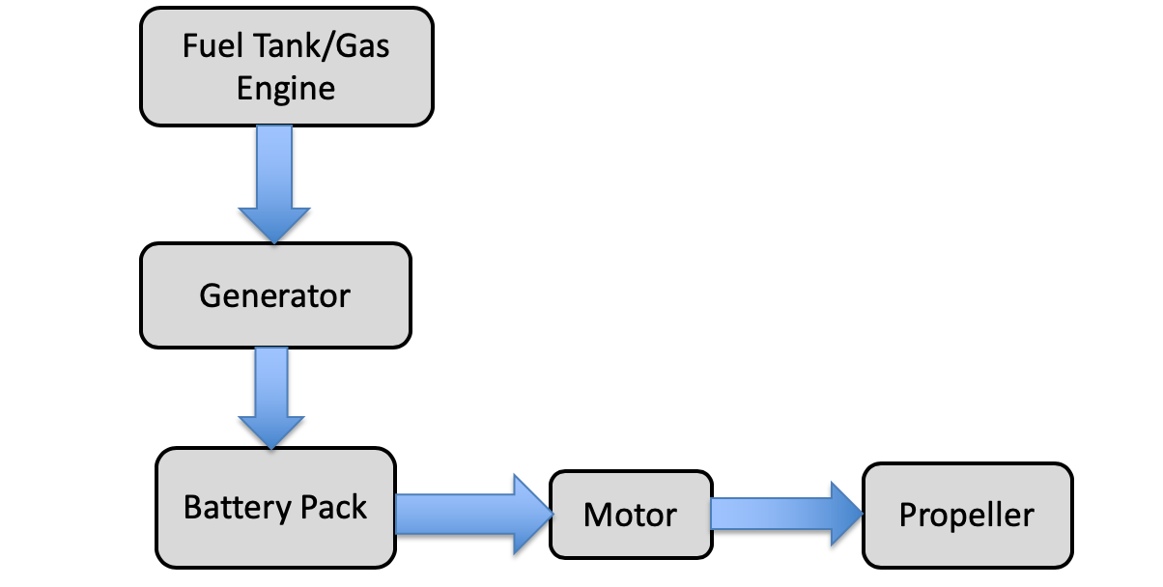
Architecture Design – Trade Studies
Power Source Type: Internal Combustion Engine (ICE)
Series
Figure 1 : Example of Series

Slide 6
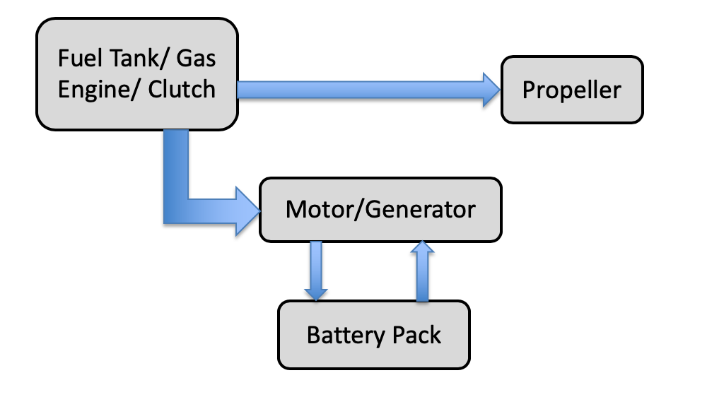
Architecture Design – Trade Studies
Power Sources Type: Internal Combustion Engine (ICE)
Parallel
Figure 2 : Example of parallel configuration

Slide 7
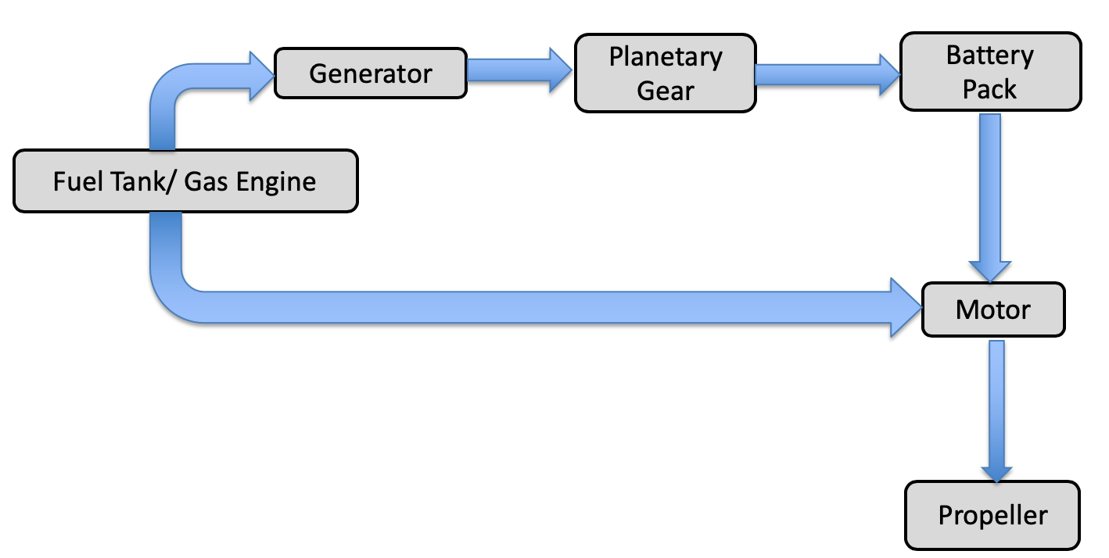
Architecture Design – Trade Studies
Power Sources Type: Internal Combustion Engine (ICE)
Power-split
Figure 3: Example of a Power-split Configuration

Slide 8
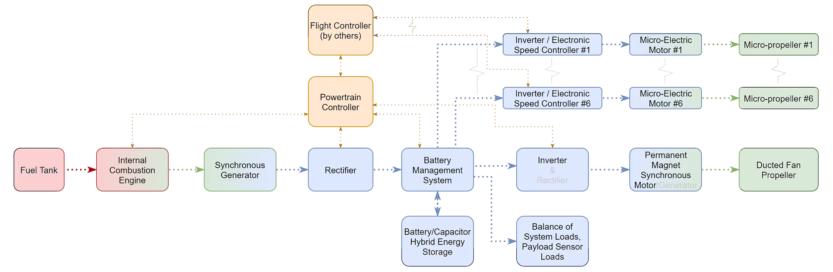
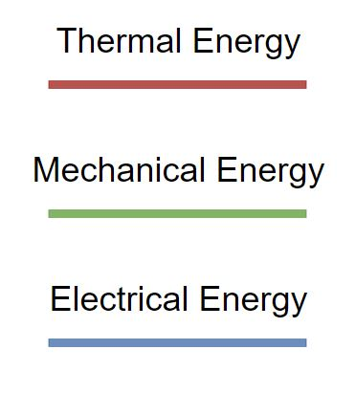
Concept Designs: Mechanical Layout
Battery
Pack Module
Figure 4: Power Split Hybrid Engine Architecture
8

Slide 9
I. Design 1
Architecture Trade Studies
Concept Design Developments
Component Selections
Optimization

Slide 10
Requirements
Table 1: Functional Requirements
Type of Constraint​ | Requirement​ | Applied Body​ | Source​ | Constraint Met​
Weight [lbs.]​ | 20​ | Overall powertrain system​ | Sub-team allocation​ | No​
Volume inside duct [in³​]​ | 900​ | Powertrain within the duct​ | Structures team​ | Yes​
Fuel Volume [in³]​​ | 470​ | Fuel within the ducted walls​ | Structures team​ | Yes​
Power Demand Range [kW]​ | 3.4 - 5.5​ | Propulsion systems​ | Flight team​ | Yes​
Flight Time Range [hrs] | 4​ - 12 | Overall powertrain system​ | Client​ | Yes *​
* Only 4 hours of flight were met.
10

Slide 11
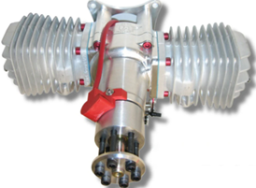
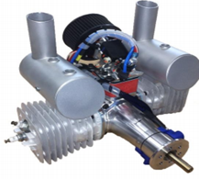
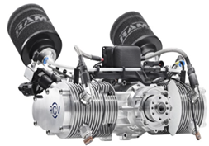
Design 1 engine selection process
Table 2: Previous Engine Considerations [1] [2] [3]
Engine | RCV | Desert Aircraft | Power4Flight *
Power Demand [kW] | 4.2 | 7.3 | 7.5
Weight [lb.] | 6.6 | 5.6 | 9.5
Power/Weight [kW/lb.] | 0.64 | 1.31 | 0.79
Operating RPM | 1100-8500 | 1100-6800 | 1100-7000
Size [in³] | 542 | 304 | 490
BSFC [g/kW-Hr] | 330 | 580 | 470

Slide 12
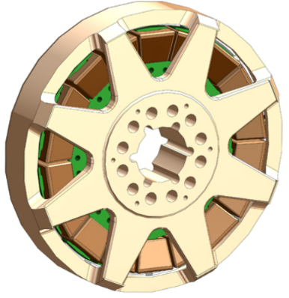
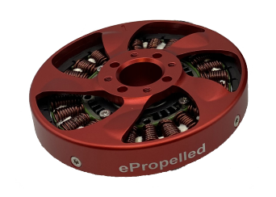
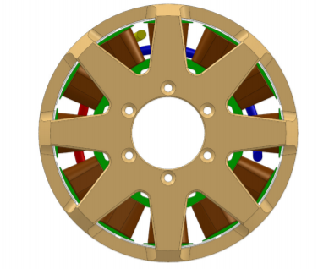
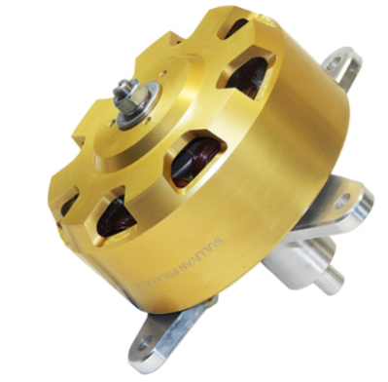
Generators
Table 3: Design 1 Generators [4],[5],[6],[7]
Model | ePropelled | Sullivan-03 | Sullivan-01 | Sullivan-07
RPM Range | 2000-9000 | 2500-7500 | 2500-7500 | 2500-5000
Power Range [W] | 1200-8500 | 3700-11400 | 2300-6750 | 2600-6000
Dimensions [in] | 7.3 x 2.0 | 8.0 x 1.7 | 7.0 x 1.8 | 7.0 x 3.0
Weight [lb] | 5.4 | 8.8 | 6.4 | 11.0
Price | $2,900 | N/A | N/A | N/A

Slide 13

Selection of Engine & Generator
Figure 5: Design 1 Engine & Generator selected [3] [4]
B150i engine with SG6000 generator
Compatibility across electrical components
Fits Power and RPM requirements
Meets volumetric duct constraint
Notes:
Based off of everything we showed you//

Slide 14
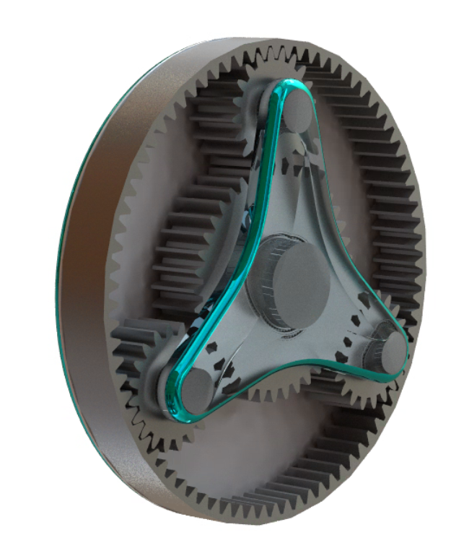
Planetary Gear Box
Ring Gear
Planetary Gears
Designed to keep the engine in optimum conditions
Allows to maintain a better fuel efficiency
Light weight
Compact
Approximately 97 percent efficiency
Carrier
Sun Gear
Figure 6: Design 1 Planetary Gearbox [8]

Slide 15
Planetary Gear Box Location
Step-Down Gear Design:
Engine
Generator
Gearbox
Fan
Figure 7: Planetary Gearbox Location Option 1

Slide 16
Planetary Gear Box
Gearbox Option 1: Step Down Gear
Motive: Ducted fan RPM for hover < engine optimum RPM
Objective: Optimum RPM & power for B150i engine (two-cylinder piston engine)
Outcome: Engine and generator spin at 6500 RPM
Ducted fan spins 3900 RPM
Table 4: Step Down Gear Parameters For Hover
Gearbox Type | Engine RPM | Step Down Gear RPM | Flight RPM | Difference
Step Down Gearbox | 6500 | 3900 | 3553 | 10%

Slide 17
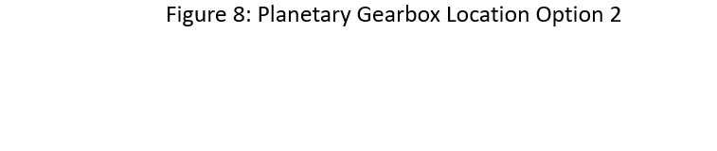
Planetary Gear Box Location
Step-Up Gear Design:
Engine
Gearbox
Generator
Figure 8: Planetary Gearbox Location Option 2

Slide 18
Planetary Gear Box
Gearbox Option 2: Step Up Gear
Motive: Optimum generator RPM > engine RPM capabilities
Objective: Maximizes generator power output
Outcome: Generator spins at 8600 RPM; all components powered electrically
Table 5: Step Up Gear Parameters For Hover
Gearbox Type | Engine RPM | Step Up Gear RPM | Generator RPM Range | Generator Power Range [W] | Difference
Step Up Gearbox | 6500 | 8600 | 2000-9000 | 1200-8500 | 5%

Slide 19
II. Design 2
Requirements
Design 1 vs. Design 2 Comparisons
Component Selections
Flight Analysis
Power management network
Battery Pack Design Alternative
Engine Assembly

Slide 20
Requirements (2nd Design)
Table 6: Functional Requirements
Type of Constraint​ | Requirement​ | Applied Body​ | Source​ | Constraint Met​
Weight [lbs.]​ | 50​ | Overall powertrain system​ | Sub-team allocation​ | Yes
Volume inside duct [in³​]​ | 1150​ | Powertrain within the duct​ | Structures team​ | Yes​
Fuel Volume [in^{3]}​ | 470 | Fuel within the ducted walls​ | Structures team​ | Yes​
Power Demand Range [kW] | 6 - 20​ | Propulsion systems​ | Flight team​ | Yes​
Flight Time Range [hrs] | 4​ - 12 | Overall powertrain system​ | Client​ | Yes *​
* Only 7 hours of flight were met.
20

Slide 21
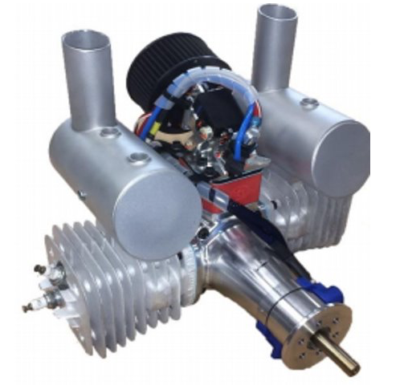
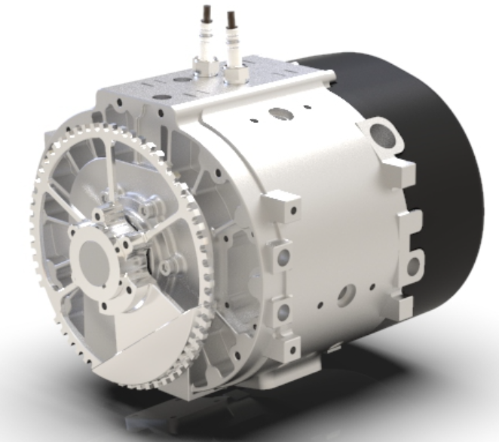
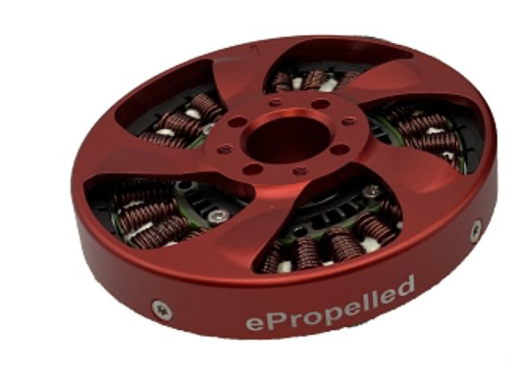
Previous Design Vs. Current Design
Figure 9: B150i Engine 2-Stroke [3] [4]
Figure 10 SkyPower 180-SRE Rotary 4-Stroke [9]
Table 7: Key Design Changes
100lb UAV Design Affects
New Power Range Demand [kW] | New Engine Power Capabilities [kW] | Gearbox | Generator
7-14 | 5-20 | N/a | Integrator
Top Surface Area [in²]
B150i | SkyPower 180-SRE | Area % Decrease
56.4 | 23.2 | 41.2
Mass [lbm]
B150i | SkyPower 180-SRE | Mass % Increase
15.0 | 21.0 | 40

Slide 22
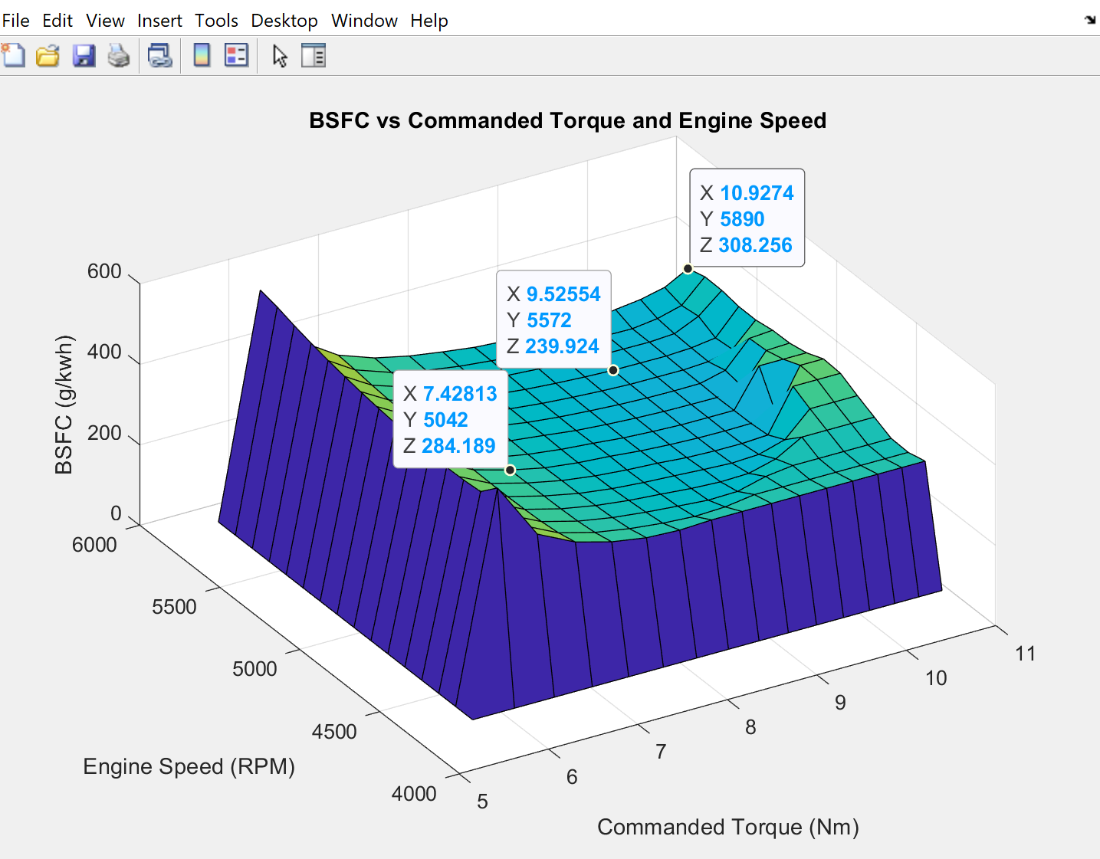
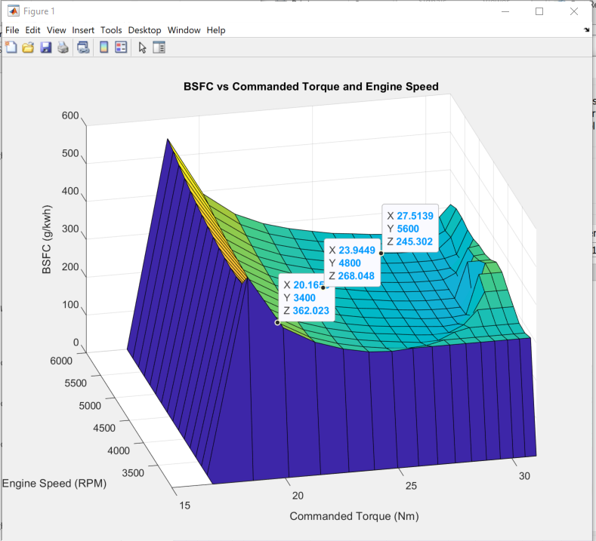
Engine Operating Conditions
Figure 11: 3D Engine Parametric Values
B150i 2-Stroke vs. Wankel 4-Stroke
BSFC graphs for both engines were created for comparison.
Each engine was analyzed at three distinct points.
Graphs allowed a better understanding of an engine only scenario.
Power demand was considered during selection of points.
Each point established a specific time of flight.
Notes:
Left is the 150i, Right is the Wankel 180SRE
**Rounded some of the values to summarize the best and worst cases

Slide 23
Power 4 Flight B150i Engine
Table 8: Power 4 Flight Engine Performance Values [3]
Fuel Flight Time
Scenarios | RPM | BSFC [g/kw-h] | Torque [N-m] | Power [kw] | Flight Time
Worst Case | 5890 | 308 | 11 | 7 | 3 hr. 31min
Acceptable Case | 5570 | 239 | 10 | 6 | 5 hr. 18 min
Best Case | 5050 | 284 | 7 | 4 | 6 hr. 42 min

Slide 24
Sky Power SRE-180 Wankel Engine
Table 9: Wankel 4-Stroke Engine Performance Values [9]
Fuel Flight Time
Scenarios | RPM | BSFC [g/kw-h] | Torque [N-m] | Power [kw] | Flight Time
Worst Case | 5600 | 245 | 27.5 | 16 | 1 hr. 56min
Acceptable Case | 4800 | 268 | 24 | 12 | 2 hr. 21 min
Best Case | 3400 | 362 | 20 | 7.5 | 2 hr. 47 min
24

Slide 25
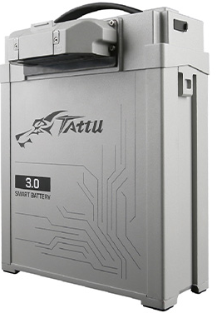
Battery Pack
Table 10: Battery Characterization
Battery Type | Dimensions [in] | Weight [lbs] | Operating Temperature [℃] | Voltage [V] | Amp Hours [AH] | Current [A] | Recharge Rate [A] | Cycle Life
LiFePO4 (14S7P) | 3.6 x 9.3 x 11 | 17.2 | -20 - 80 | 51.8 | 19 | 150 | 57 | 500
Integrated battery management system
1. Operational systems sensors
- Fuel gage, voltage, current, temperature, battery health and number of cycles
Figure 12: Grepow Tattu 3.0 Plus [10]

Slide 26
Power Management Network
Table 11: Power Management Network Flow Chart
Flight Propulsion Components
Qty. | Part Name | Power [W] | Voltage [V] | Current [A]
1 | Ducted Motor | 789 | 33.6 | 23.5
2 | Mini Motor CW | 2360 | 13.1 | 45.2
4 | Mini Motor CCW | 2,368 | 26.1 | 45.4
Power Consumption Total [W]
5790
Is used to find Fuel Flight Time Capacity.
Is used to find Battery Mode Flight Time Capacity.
Current Total [A]
127
On Board Systems
Qty. | Part Name | Power [W] | Voltage [V] | Current [A]
1 | Anti-Collision Light | 1.87 | 3.6 | 0.52
1 | Thermal Camera | 2.82 | 5 | 0.56
1 | Air Quality Sensor | 32.40 | 12 | 2.70
1 | Gimbal System | 58.00 | 14.5 | 4.00
1 | Auto Pilot System | 126.90 | 27 | 4.70
1 | LiDAR Sensor | 6.00 | 30 | 0.20
Voltage Total [V]
30
14
5
Is used to find How many voltage splitters will be needed.

Slide 27
Hover Flight Analysis
Phase 1
Phase 2
Return to Phase 1
Battery On
Engine/Generator On
Battery On
Engine Off
Battery Off/ Recharge Initiation
Engine Off
1 Cycle
Figure 13: 1 Complete Hybrid Cycle

Slide 28
Hover Flight Analysis
Table 12: Flight Time Ratio Break Down
Fuel Tank Volume [in³​] | Fuel Flight Time Capacity [Hrs] | Battery Flight Time Capacity [Hrs] | Total Flight Time [Hrs] | Fuel/Battery Ratio
470 | 3.54 | 3.5 | 7.04 | 50.3/49.7
Table 13: Hybrid Cycling Breakdown
50% Discharge [Min] | 50% Recharge[Min] | Cycle Count Time [Min] | Hybrid Cycle Count | Cycle Life | Number of Flights - End of Life Cycle
4.5 | 10 | 14.5 | 21 | 500 | 23

Slide 29
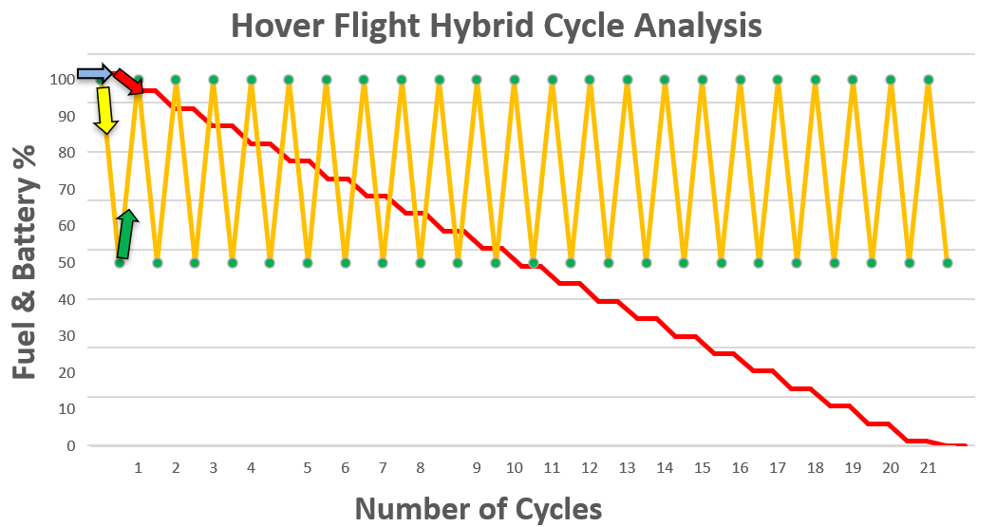
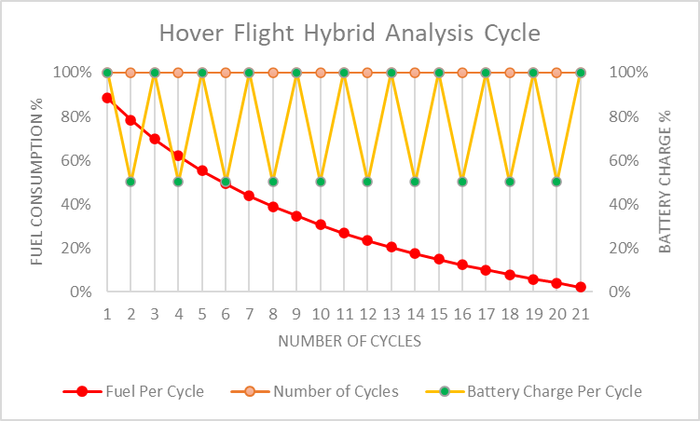
Hover Flight Analysis
LEGEND
Engine Off
Battery On
Engine/Generator On
Battery Off/ Recharge Initiation
Figure 14: Hybrid Cycling Methodology Breakdown

Slide 30
Flight System Network
ECU
Ignition/Starter
SkyPower 180-SRE Rotary Engine
Fuel Injector
Thermostat
Oil Pump
Water Pump
Flight Control Unit
(Electronic Speed Controllers) x 7
(Brushless Electric Motors) x 7
Generator
Anti-Collision Lighting
Infrared Camera
Lidar Sensor
Air Quality Monitor
Gimbal Camera Stabilizer
Battery Pack Module/ BMS
Starter Generator Controller
Figure 15: Power Management Wiring Diagram
Notes:
Auto Pilot System

Slide 31
Battery Pack and BMS Trade Study
Table 14: Advantages and Disadvantages of Battery Pack Sources
Battery Pack Source | Advantages | Disadvantages
Commercial off-the-shelf (COTS) battery pack with BMS | · Shorter lead times (products are readily available) · Plug-and-Play | · Packs are commonly assembled from third-party vendors · Market is flooded with unverified and imitation products · Pack connections aren't configurable · Limited or no communication link to BMS · Unknown BMS operating parameters and features
Custom-assembled battery pack with BMS | · Custom pack configuration · Authentic cells can be verified · Can readily use cutting-edge battery technologies · BMS tailored to vehicle and can be modified on-the-fly | · Longer lead time (cells must be assembled into packs) · Added design complexity

Slide 32
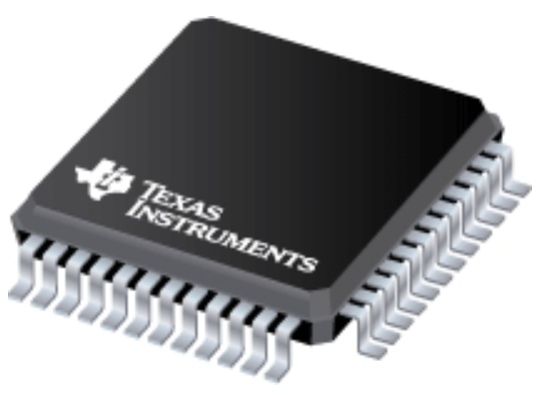
Custom BMS: Texas Instruments BQ76952
3S to 16S high-accuracy battery monitor and protector for Li-ion, Li-polymer and LiFePO4
Features:
Over-current protection (OCP) for charging and discharging
Short-circuit detection
Over-voltage protection (OVP)
Under-voltage protection (UVP)
Over-temperature protection (OTP)
Under-temperature protection (UTP)
Cell balancing
High-side charge and discharge FET drivers
I²C, SPI, and HDQ communications support
Programmable EEPROM
Multiple ADC’s and GPIO’s
Figure 16: Texas Instruments BQ76952 Package [11]

Slide 33
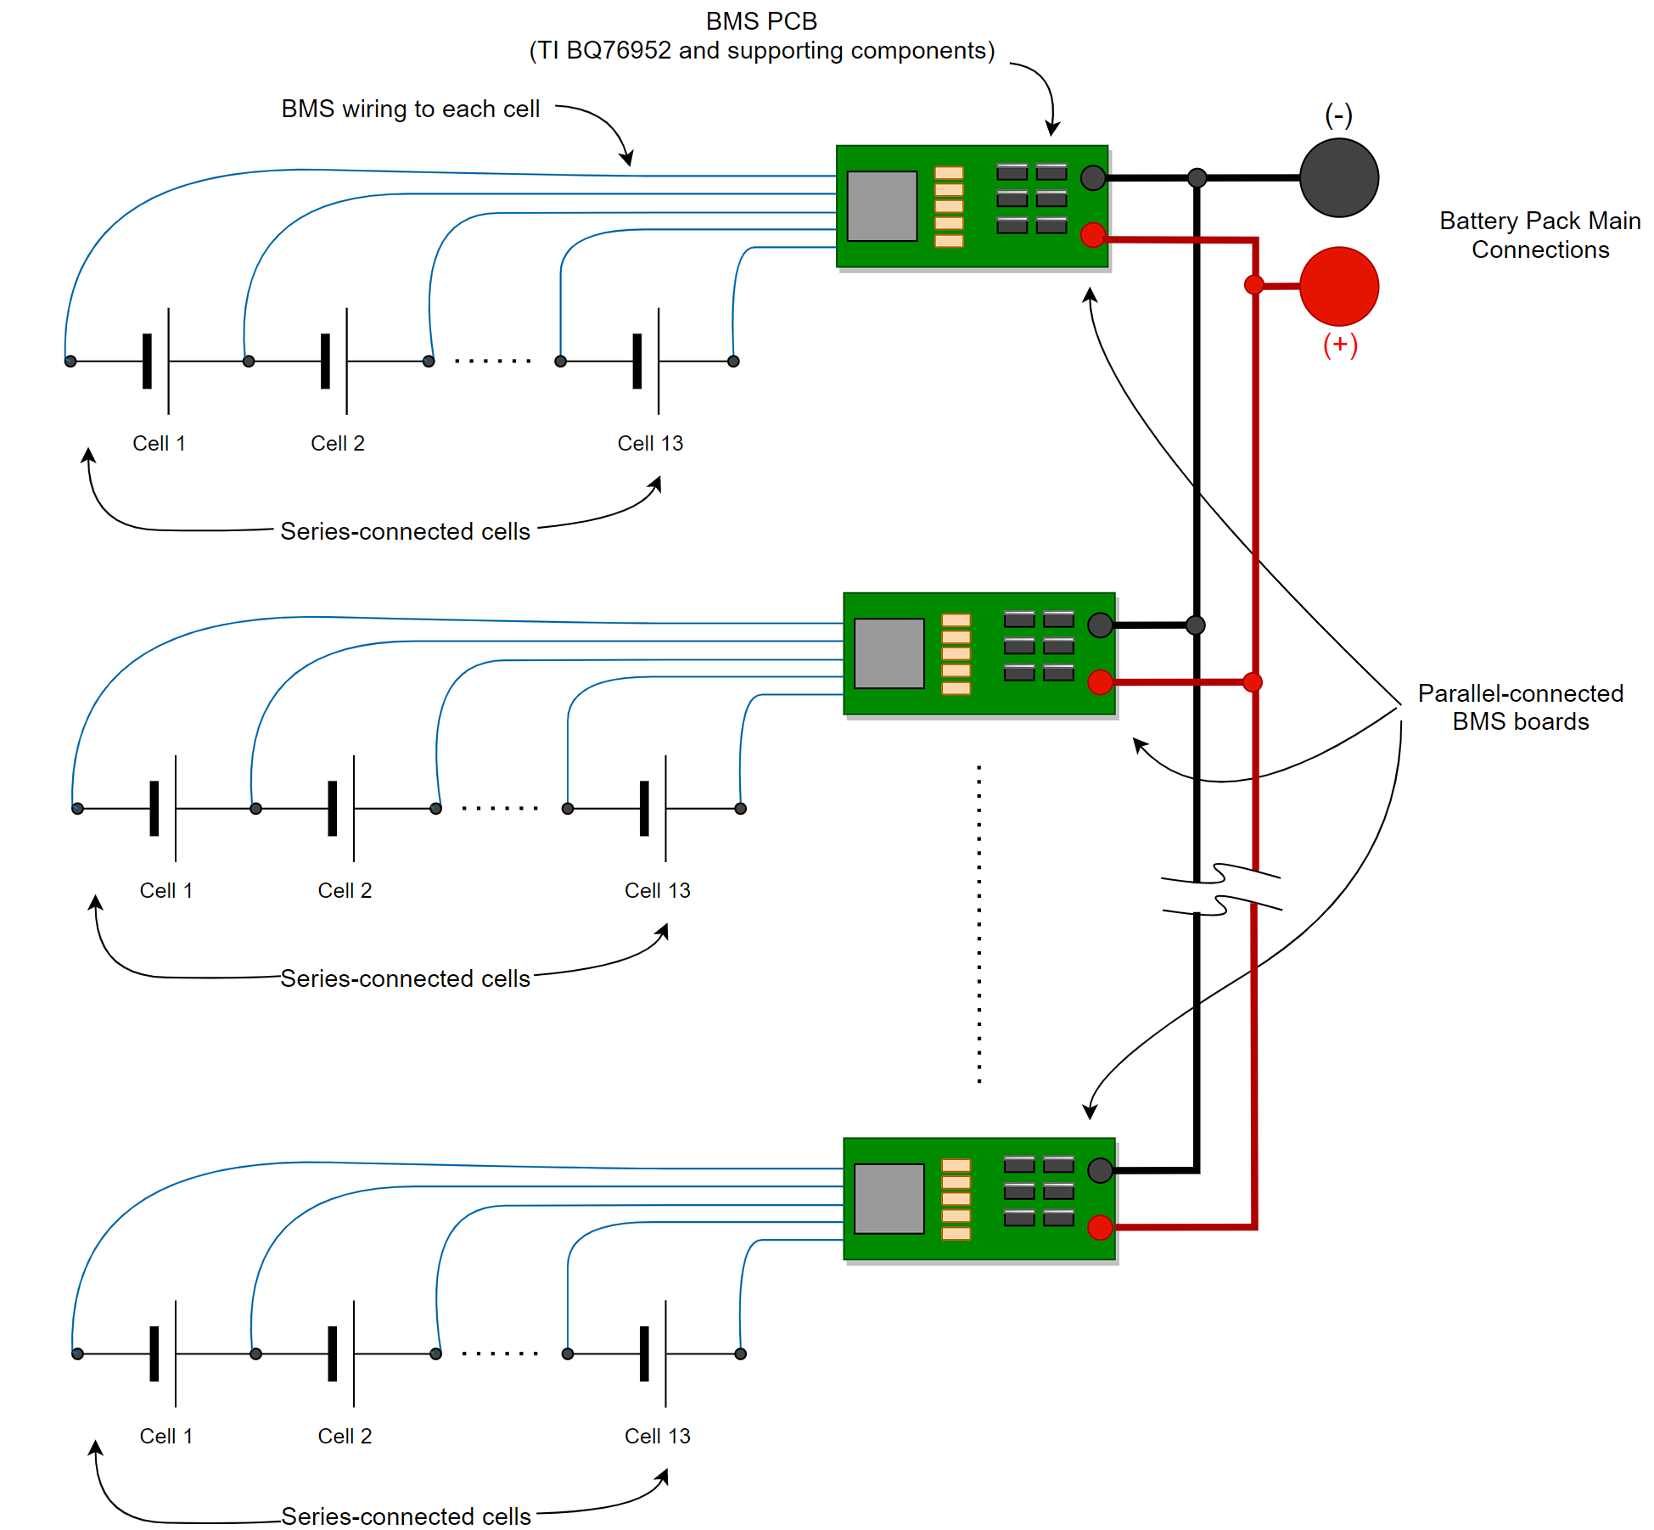
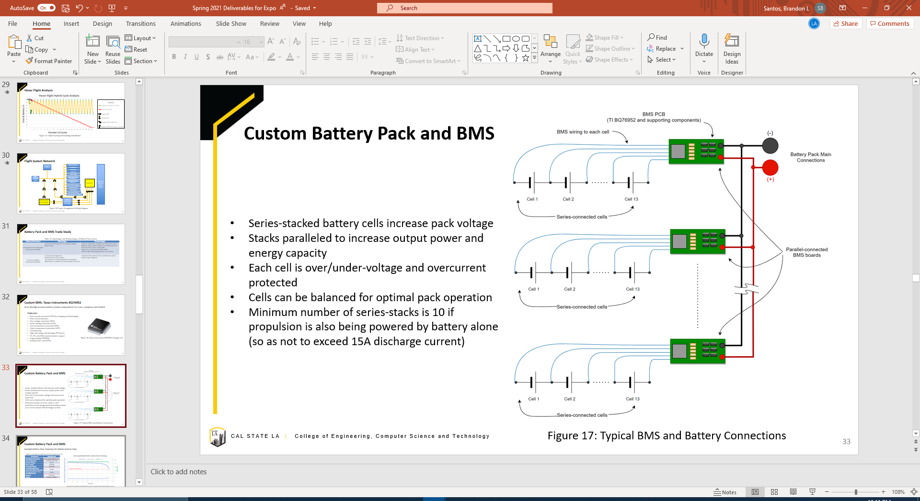
Custom Battery Pack and BMS
Series-stacked battery cells increase pack voltage
Stacks paralleled to increase output power and energy capacity
Each cell is over/under-voltage and overcurrent protected
Cells can be balanced for optimal pack operation
Minimum number of series-stacks is 10 if propulsion is also being powered by battery alone (so as not to exceed 15A discharge current)
Figure 17: Typical BMS and Battery Connections

Slide 34
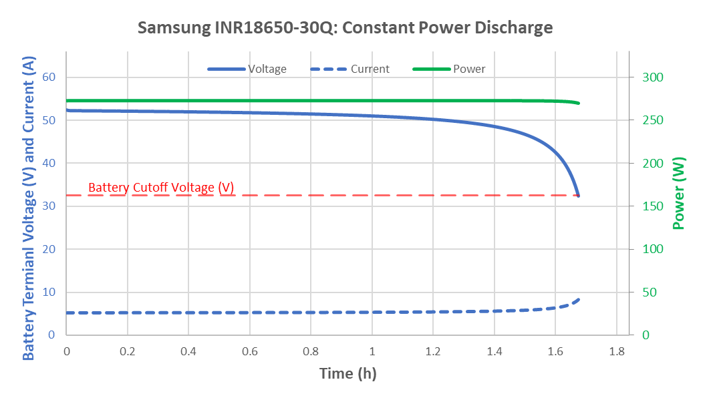
Custom Battery Pack and BMS
Example Battery Pack: Powering On-Vehicle Systems Only
Table 15: Example 39-Cell Battery Pack Configuration [12]
Part Number | INR18650-30Q
Manufacturer/Chemistry | Samsung/INR (LiNiMnCoO₂)
Pack Configuration | 13S-3P (39 cells total)
Nominal Voltage | 46.8 V
Pack Capacity | 10.89 Ah
Energy Discharged | 456.9 Wh
Constant Output Power (On-vehicle systems demand) | 273 W
Average Current per Series-Connected Group | 1.82 A
Duration | 1.67 hours
Weight | 1.821kg (4.015lbs.)
Figure 18: Example 39-Cell Battery Pack, Constant-Power Discharge to V_{cutoff}

Slide 35
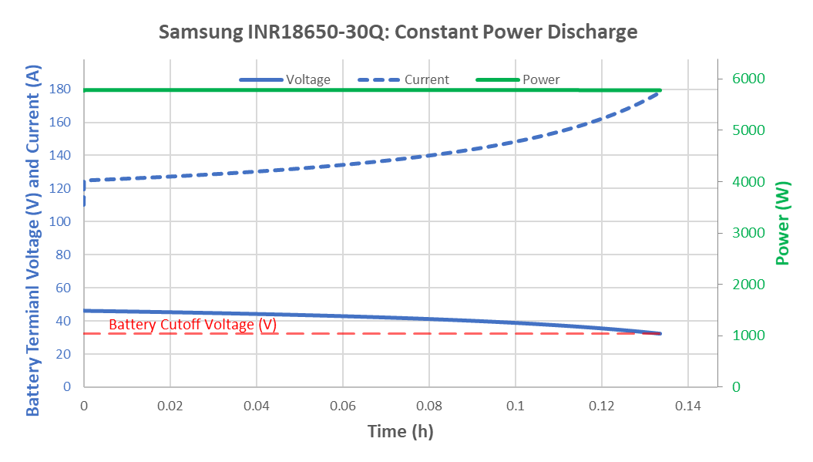
Custom Battery Pack and BMS
Example Battery Pack: Powering On-Vehicle Systems and All Propulsion Electric Motors
Table 16: Example 130-Cell Battery Pack Configuration [12]
Part Number | INR18650-30Q
Manufacturer/Chemistry | Samsung/INR (LiNiMnCoO₂)
Pack Configuration | 13S-10P (130 cells total)
Nominal Voltage | 46.8 V
Pack Capacity | 23.74 Ah
Energy Discharged | 772.9 Wh
Constant Output Power (On-vehicle systems + propulsion demand) | 5.790 kW
Average Current per Series-Connected Group | 14.03 A
Duration | 8.01 minutes
Weight | 6.071kg (13.384lbs.)
Figure 19: Example 130-Cell Battery Pack, Constant Power Discharge to V_{cutoff}

Slide 36
Custom Battery Pack and BMS
Example Battery Pack Discharge Comparison
Table 17: Example Battery Pack Discharge Comparison
Example Pack | 39-Cell Pack | 130-Cell Pack
Pack Configuration | 13S-3P (39 cells total) | 13S-10P (130 cells total)
Pack Capacity | 10.89 Ah | 23.74 Ah
Energy Discharged | 456.9 Wh | 772.9 Wh
Constant Output Power | 273 W | 5.790 kW
Average Current per Series-Connected Group | 1.822 A | 14.029 A
Duration | 1.67 hours | 8.01 minutes
Weight | 1.821kg (4.015lbs.) | 6.071kg (13.384lbs.)
The 130-Cell Pack Compared
2021% increase in output power (vehicle systems + propulsion vs. vehicle systems alone)
233% increase in cell quantity (and thus weight also)
118% increase in amp-hour capacity
69% increase in stored energy
92% decrease in run-time

Slide 37
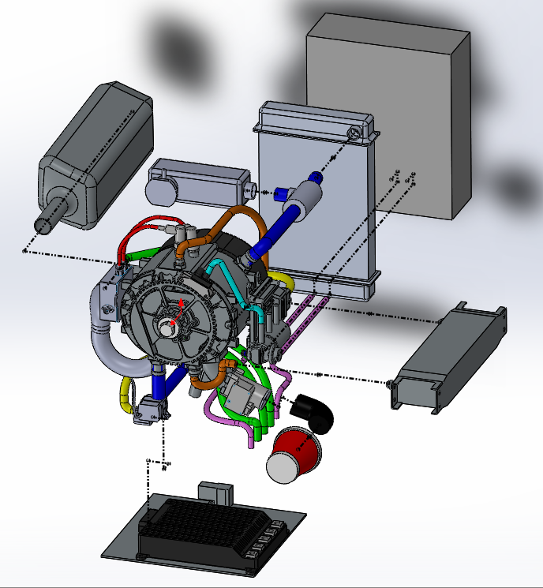
Engine Assembly
Thermostat
Battery Pack
Exhaust
Radiator
ECU
Ignition
Fuel Pump
Exhaust Manifold
Oil Cooler
Engine
Intake Manifold
Water Pump
Starter Generator Controller
Intake Air Filter
Figure 20: Engine Assembly Components [13]

Slide 38
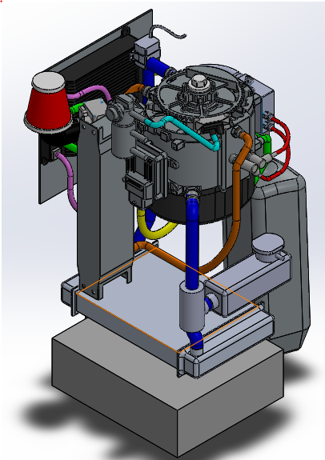
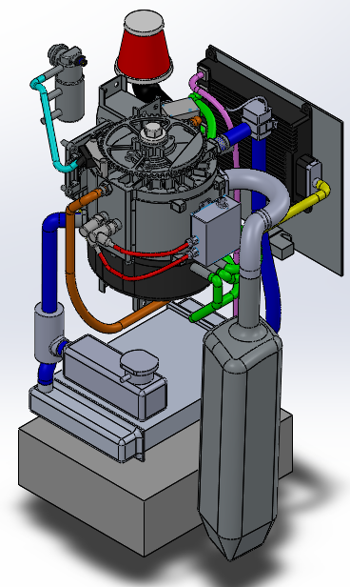
Engine Assembly
Figure 21: Engine Assembly View 1 [13]
Figure 22: Engine Assembly View 2 [13]

Slide 39
III. Future Studies
Fuel cell power source
Thermal efficiency analysis
Thermal effects on components
Intake and exhaust design
Cooling system
Regenerative power
Hybrid flight type cycles

Slide 40
Power Source Types- Fuel Cell
Architecture:
Advantages:
Zero harmful emissions
Longer flight time
Fast refueling
Reliable and efficient
Disadvantages:
Too big
Heavy
Expensive
Fuel Cell
Converter
Ducted Fan
Generator
Battery
Brushless Motor
6 x Propellers
Figure 23 : Example of fuel cell configuration
40

Slide 41
Power Source Types- Fuel Cell
Table 18: Sizing Fuel Cells on the Market [14],[15],[16],[17] ​
Fuel Cell | Power [kW] | Dimensions [in] | Weight [lb] | Power/Weight [kW/in] | Fuel Cell sizing for 3.5 kW [lbs.] | Cost [$]
(2) 2.4 kWFCPM | 2.4 | 5.04x17.4x9.17 | 11.4 | 0.4210 | 16.63 | 11,424
(2) A-1500 (HESEnergy Systm) | 2 | 11.8x4.72x5.71 | 7.7 | 0.5194 | 13.48 | 7,324
G-HFCS | 5 | 18.5x10.2x4.5 | 21.6 | 0.2314 | 15.12 | 22,312
(3) FCair1200 | 1.2 | 17.0x10.5x6.5 | 8.8 | 0.4090 | 25.67 | 5,000
(4)Aerostak1000 | 1 | 7.63x5.00x7.93 | 3.96 | 0.2525 | 13.86 | 4,836

Slide 42
Thermal Efficiency Typical Energy Split in Gasoline Internal Combustion Engines
100% Applied Fuel Energy
25 % Effective Power
5 % Friction Losses
For design 1 hover demand of 7.5kW
2.5 kW of heat to surrounding material via friction
7.5 kW to the cooling system
10 kW to the surrounding material/components via exhaust gas
30 % Cooling
Figure 24 : Thermal Efficiency Diagram
40 % Exhaust Gas
42

Slide 43
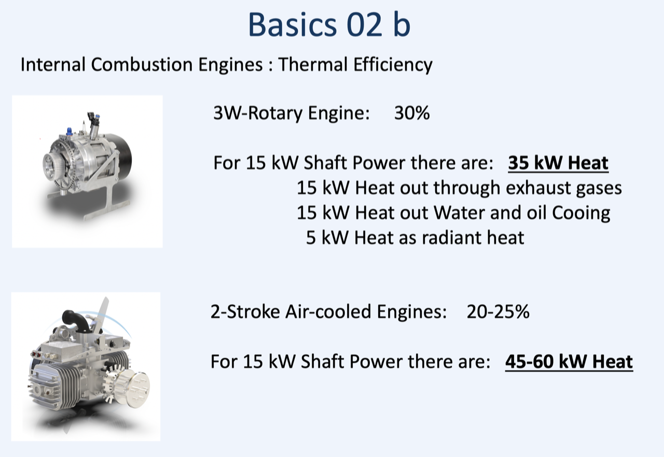
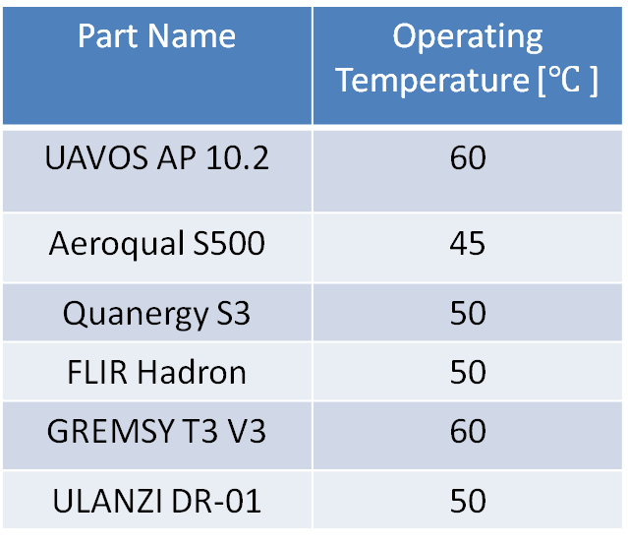
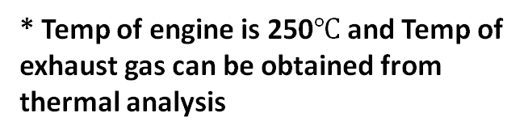
Thermal Effect on Components
Table 19: Onboard components with their operating temperature [18],[19],[20],[21],[22],[23]
Part Name | Operating Temperature [$℃$ ]
UAVOS AP 10.2 | 60
Aeroqual S500 | 45
Quanergy S3 | 50
FLIR Hadron | 50
GREMSY T3 V3 | 60
ULANZI DR-01 | 50
* Temp of engine is 250$℃$ and Temp of exhaust gas can be obtained from thermal analysis
Figure 25 : Engine Efficiency [24]
43

Slide 44
Regenerative Power
Table 20: Regenerative Power
Angle of Flight [Deg] ͦ | Wind Speed [mph] | Ducted Fan [RPM] | Power from Wind [W] | Power from Regen [W] | Regenerative Power [WH] | Coefficient of Performance
20 | 12 | 609 | 65 | 59 | 16.3 | 0.9
45 | 23 | 1,161 | 191 | 306 | 85.3 | 1.6
53 | 28 | 1,568 | 211 | 467 | 130 | 2.2
44

Slide 45
Powertrain Component Designs
Regenerative Power (Spooling Effect)
1. Further analysis using wind turbine theory combined with affects of propeller inside the and the geometry of the propeller itself
2. Rechargeability to battery methodology, affects in power demand increases to outer propeller when turning off ducted fan
Cycle analysis on duct with powertrain inside
1. To find how thrust is affected, how heat affects the sensors and frame.
2. Further study needing to be done via CFD on SolidWorks

Slide 46
Powertrain Component Designs
Designs that dictate engine performance:
1. Intake and exhaust design
- Ability to tune engine to run at optimal BSFC’s at needed Power demands.
- Exhaust orientation away from system components.
2. Cooling system
- Ability to run the engine with out ensuing major loss in efficiency.

Slide 47
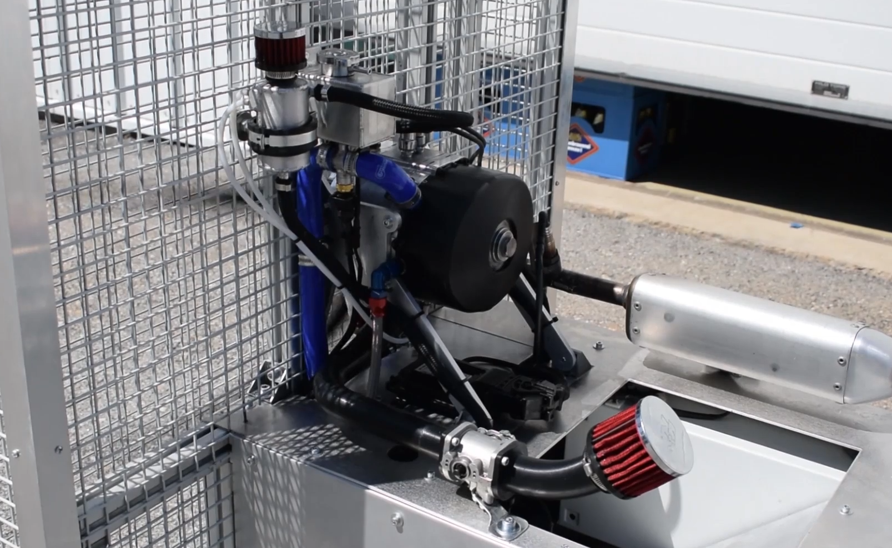
Powertrain Component Designs
Acquiring a test asset from SkyPower
1. Can help with understanding how the powertrain functions and its performance parametric
2. Gather accurate thermal and vibration information
3. Powertrain component placement thus, sizing dimensions inside the duct
Figure 26 : SkyPower 180-SRE Rotary Engine Test Asset [25]

Slide 48
IV. Summary and Conclusions
Functional Requirements
Weight & Cost Budgets

Slide 49
Conclusion
Table 21: Functional Requirements for Design 2
Type of Constraint​ | Requirement​ | Applied Body​ | Source​ | Constraint Met​
Weight [lbs.]​ | 50​ | Overall powertrain system​ | Sub-team allocation​ | Yes
Volume inside duct [in³​]​ | 1150​ | Powertrain within the duct​ | Structures team​ | Yes​
Fuel Volume [in³]​ | 470 | Fuel within the ducted walls​ | Structures team​ | Yes​
Power Demand Range [kW]​ | 6 - 20​ | Propulsion systems​ | Flight team​ | Yes​
Flight Time Range [hrs] | 4​ - 12 | Overall powertrain system​ | Client​ | Yes ​
* Only 4 hours of flight were met.
49

Slide 50
Conclusion
Table 22: Weight/Cost Budget 1st Design
Components | Brand | Power (kW) | Weight (lbs) | Size (in³) | Cost | Total Weight (lb.) | Total Cost
Engine | Power4Flight: B150i | 7.5 | 9.5 | 13.4 x 7.6 x4.8 | $30,000* | 47.506 | $35,868.49
Generator | Epropelled: SG6000 | 8.5 | 5.4 | 7.3 x 2.0 | $2,900.00
Brushless E.M. for D.F. | KDE5215XF-220 | 1.96 | 0.507 | ⌀2.36 " x 2.098" | $205.95
Brushless E.M. for Micro Prop | KDE5215XF-220 | 1.96 | 0.507 | ⌀2.36 " x 2.098" | $205.95
Electronic Speed Controller | KDE Direct KDE-UAS75HVC | 3.33 | 1.757 | 2.84 x 1.38 x 0.394 | $1,120.00
Battery Management System | Sullivan SSGNS-100A-01 | 5 | 3.2 | 7/20 x 5.74 x 2.76 | N/A
Battery | NCR18650GA | 5.3 | 10.1 | ⌀.721 x 3.73 | $400.00
Fuel | Conventional Gasoline | N/A | 14 | 395 | $4/gal
* - represents a price approximation
50

Slide 51
Conclusion
Table 23: Weight/Cost Budget 2nd Design
Components | Brand | Power (kW) | Weight (lbs) | Volume (in³) | Cost | Total Weight (lb.) | Total Cost
Engine/Generator | Sky Power SRE-180 | 20 | 21 | 8.7” x 6.5” x 7.4” | $50,000.00* | 61.3 | $57,029.65
Brushless E.M. for D.F. | KDE5215XF-220 | 1.96 | 0.507 | ⌀2.36 " x 2.098" | $205.95
Brushless E.M. for Micro Propellers | KDE8218XF-120 | 5.7 | 1.86 | ⌀3.504" x .374" | $615.95
Electronic Speed Controller | KDE Direct KDE-UAS75HVC | 3.33 | 1.757 | 2.84” x 1.38” x 0.394” | $1,120.00
Power Management Unit | N/A | N/A | N/A | N/A | N/A
Battery/BMS | NCR18650GA | 5.3 | 10.1 | 3.6” x 9.3” x 11” | $2000.00*
Fuel | Conventional Gasoline | N/A | 16.8 | 470 | $4/gal
* - represents a price approximation
51

Slide 52
Summary
Power-split architecture design allowed for:
1. Battery rechargeability cycles by the engine’s generator
2. Increased flight times
3. Various power distribution combinations with generator and battery to UAV components
Wankel rotary engine provided:
1. Better fuel efficiency at higher power demands
2. Higher power to weight ratio than fuel cell engine or 2-stroke engine
3. Less cross-sectional area inside the duct
Battery pack provided:
1. Battery management system integration
2. High discharge current and fast recharge times

Slide 53
Summary
Hover Flight Analysis Results
1. Hybrid cycling method provided enough power to all UAV components during each power source phase
2. With a 50/50 fuel to battery ratio: 21 hybrid cycles and an estimated 7 hours of flight time can be achieved
Powertrain component design
1. An iteration of the powertrain was assembled in SolidWorks
2. Primary components were specified with respect to weight, dimension, and estimated cost
Trade Studies
1. Alternative architectures were researched to provide additional options to powertrain functionality
2. Gears were studied to convert engine output energy to rotational energy on ducted fan directly
Notes:
Duct Fan & On-Board Systems For Hover
Outer Propellers For Hover
In Bursts For Increase In Power Demands
One option:
If you use battery for duct and onboard systems
You decrease power.. Which decreases thermal output
Flight time is hindered
If you use battery for outer propellers
Heavily decrease power " "~90Amps battery can do 150A.
" “Flight time is hindered even more!
We can run the battery for outer props when moving forward only.. in bursts.
Because most of the time the mission requires HOVER.
Thus turning off engine. And only using engine when at hover ~ most efficient.
flight time = More realistic. Than the hover model only.
BC to turn on and off so many times is not ideal.

Slide 54
References
[1] "RCV," [Online]. Available: https://www.rcvengines.com/rcv-df70/. [Accessed 10 10 2020].
[2] "Desert Aircraft," [Online]. Available: https://www.desertaircraft.com/collections/da- engines/products/da-100l. [Accessed 10 10 2020].
[3] "Power 4 Flight," [Online]. Available: https://power4flight.com/uav-engine-products/uav-engine- systems/b150i-uav-efi-engine-system/. [Accessed 20 11 2020].
[4] "SG6000 Starter Generator," ePropelled, [Online]. Available: https://uavpropulsiontech.com/wp- content/uploads/2020/02/SG6000-121119.pdf. [Accessed 10 December 2020].
[5] Sullivan UV, “S676-800U-03: 3700 to 11400 Watt Alternator" datasheet, Rev. 2017.
[6] Sullivan UV, “S676-700U-01: 2300 to 6750 Watt Alternator" datasheet, Rev. 2017.
[7] Sullivan UV, “S686-600C-07: 2600 to 6000 Watt Alternator" datasheet, Rev. 2017.

Slide 55
References

[8] M. Jaiswal, "Grabcad," 5th December 2020. [Online]. Available: https://grabcad.com/library/planetary- gears-1.
[9] “SP-180 SRE hybrid," SkyPower, [Online]. Available: https://skypower.online/produkt/sp-180-sre-hybrid/ [Accessed 10 December 2020].
[10] “Tattu Drone Battery Case Study," Grepow, [Online]. Available: https://www.grepow.com/page/uav- battery.html [Accessed 2 April 2021].
[11] Texas Instruments, "BQ76952 3-Series to 16-Series High Accuracy Battery Monitor and Protector for
Li-Ion, Li-Polymer, and LiFePO4 Battery Packs" datasheet, Rev. February 2021.
[12] Samsung SDI, "Specification Of Product: Lithium-Ion Rechargeable Cell For Power Tools, Model Name: INR18650-30Q" datasheet, March, 2014.
[13] Diehl, Constantin. “Inquiry: Engine + Powertrain Components” Received by Brandon Santos, 6 December 20th . Email exchanges.

Slide 56
References
[14] Intelligent Energy, "2.4 kW Fuel Cell Power Module: Lightweight power module for UAVs and other portable applications" datasheet, Rev. April 2020.
[15] HES Energy Systems, " Aerostak: Ultra-Light PEM Air-Cooled Fuel Cells " datasheet, Rev. 2020.
[16] “G-HFCS-5kW72V (5kW Hydrogen Fuel Cell Power Generator)”, Fuel Cell Store, [Online]. Available: https://www.fuelcellstore.com/fuel-cell-stacks/high-power-fuel-cell-stacks/g-hfcs-5kw72v-5000w- hydrogen-fuel-cell-power-generator. [Accessed November 2020].
[17] Ballard Power Systems, “FCair: The Complete Hydrogen Solution for Commercial UAVs" datasheet, Rev. April 2019.
[18] UAVOS, Inc., “AP10.2 – Automatic UAV Control System (Autopilot Mini Version)" datasheet, Rev. Unknown.

Slide 57
References
[19] Aeroqual, “Portable Air Quality Meters: Accurate Real-Time Air Quality Information, Made Affordable" datasheet, Rev. MRK-D-0043 V3
[20] Quanergy Systems, Inc., “S3-2 Solid State LiDAR for Industrial Applications“ datasheet, Rev. 2020
[21] “FLIR Hadron," FLIR, [Online]. Available: https://www.flir.com/products/hadron/
[Accessed 15 March 2021].
[22] “GREMSY T3V3," Gremsy, [Online]. Available: https://gremsy.com/gremsy-t3v3-store#
[Accessed 15 March 2021].
[23] “Ulanzi DR-01 Drone Light Flash LED Light 3 Model RGB Drone Location Indicator Light for DJI Night Flight Searching Lighting Drone Accessories Anti-Collision Slow Flash/Strobe”, Ulanzi, [Online]. Available: https://www.amazon.com/Location-Indicator-Searching-Lighting-Accessories/dp/B07YY9KT9K?th=1
[Accessed 15 March 2021].

Slide 58
References
[24] Diehl, Constantin. “CSULA Senior Design Project” Received by Brandon Santos, 8 April 2021 . Email exchanges.
[25] “SP-180 SRE hybrid," SkyPower, [Online]. Available: https://skypower.online/produkt- kategorie/engines/sp-180-series/ [Accessed 12 April 2021].

