Slide 1
Senior Design EXPO – Long-Range Endurance Platform, Structures Team
Client: The Aerospace Corporation
Advisors: Stephen Felszeghy and Ramon Garcia
Team Members:
Eric Anthony (Lead)
Ricardo Chaparro
Evelyn Cortez
Abigail Laguna
Hugo Montanez
Cristian Vera

Slide 2
Agenda
Eric Anthony
  Introduction
  Overall CAD Design
Cristian Vera
  Landing Gear Design
  Gimbal Mount Design
Hugo Montanez
  Stress Analysis Methodology
  Engine Mount Stress Analysis
  Wing Stress Analysis
Ricardo Chaparro
  Propeller Arm Stress Analysis
  Overall System Stress Analysis
Abigail Laguna
  Thermal Analysis (FEA)
Evelyn Cortez
  Thermal Analysis (CFD)
  Conclusions

Slide 3

What is the project?
Long-range hybrid power UAV
Monitor ship emissions at the Port of Long Beach
Minimum 4 hours of flight time

Slide 4
What does the Structures Team do?
Create and manage the CAD model
Stress Analysis
Thermal Analysis

Slide 5
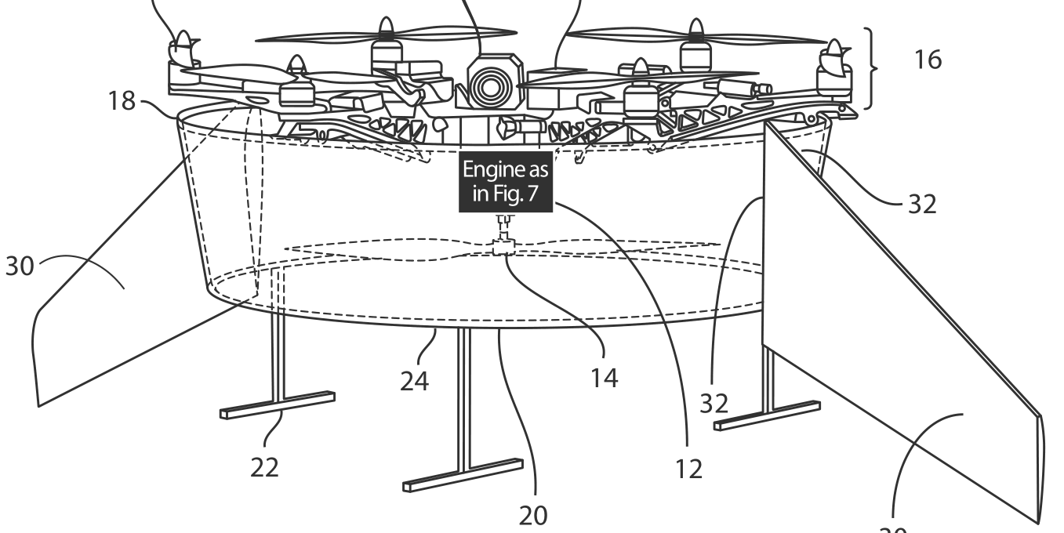
Design Progression: The Aerospace Corporation Patent Drawing

Slide 6
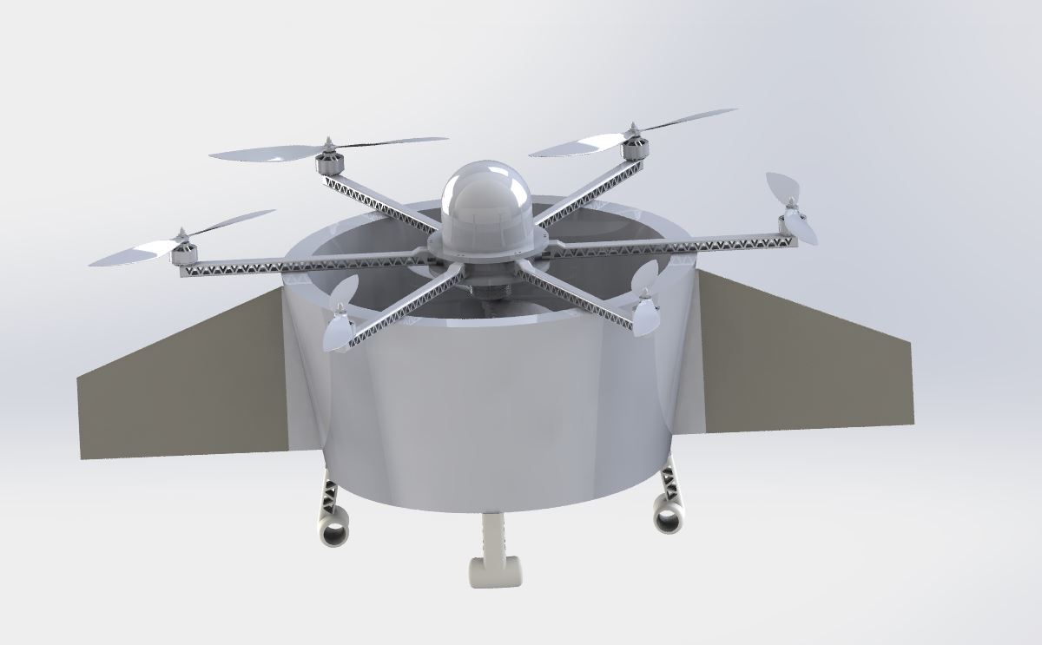
Design Progression: At End of Fall

Slide 7
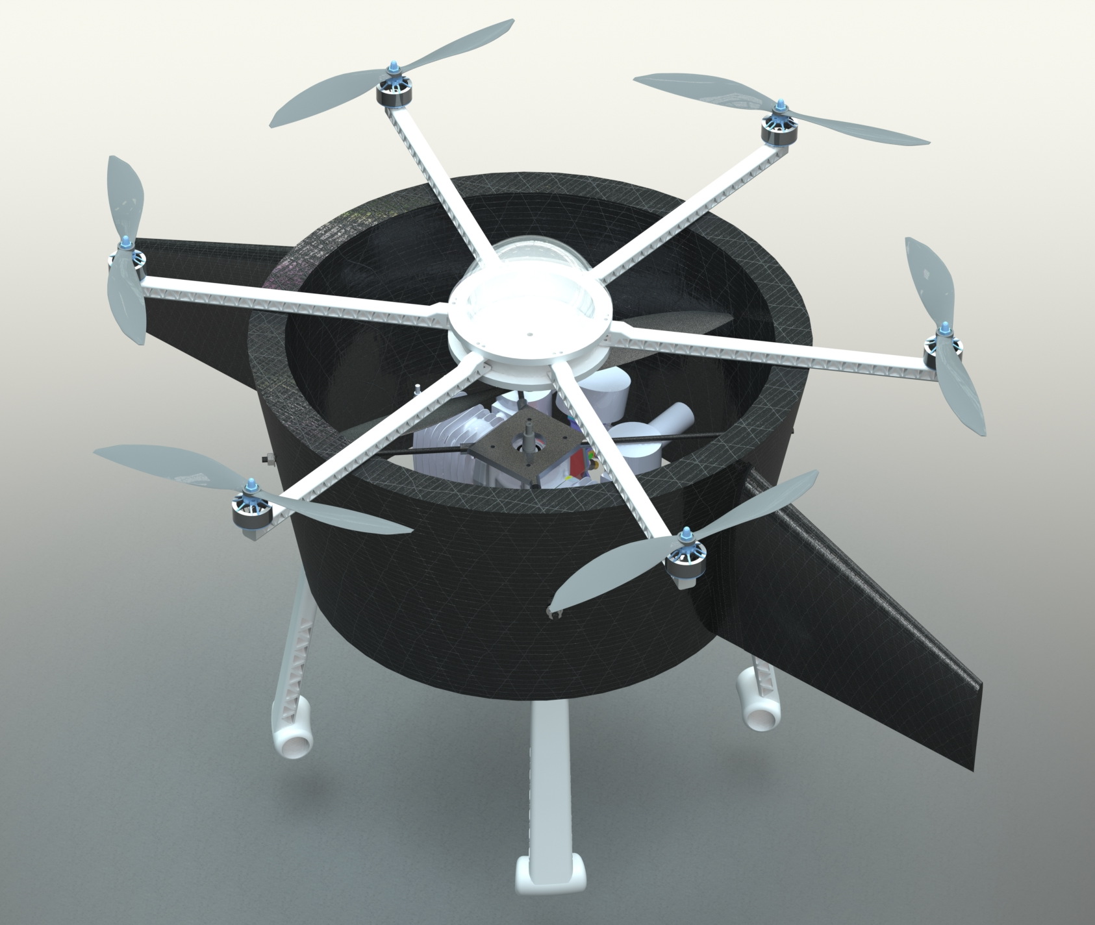
Design Progression: At Mid-Spring

Slide 8
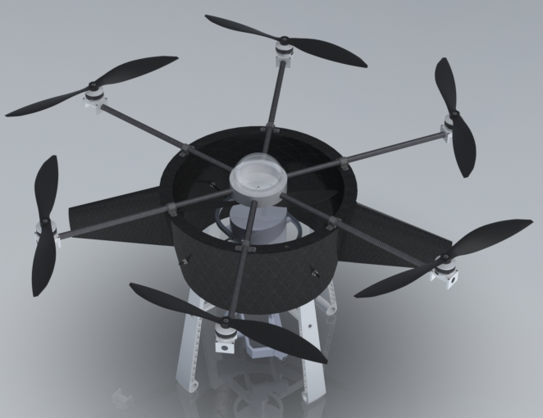
Design Progression: Final Model
Notable Improvements:
  Different engine and engine mount
  Longer propeller arms now carbon fiber rods
  Vibration damping mounts on propeller arms
  Taller landing gear
  Gimbal mount

Slide 9

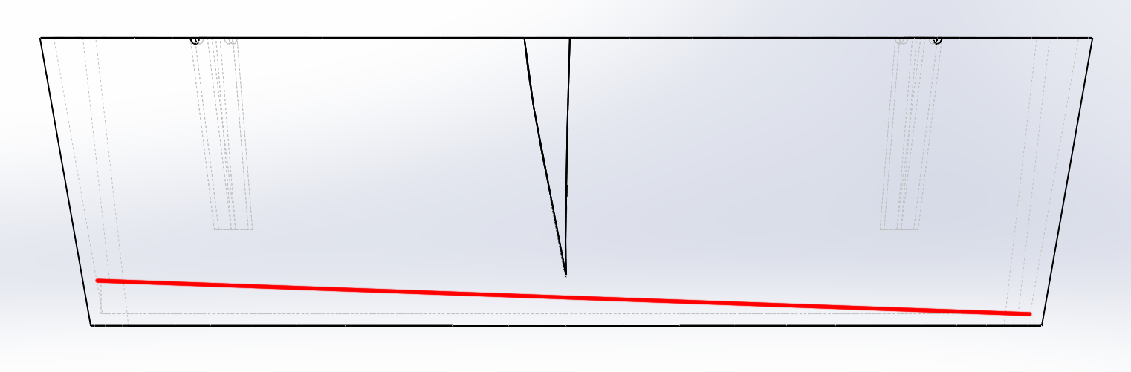
Duct Details
Carbon fiber shell and polyurethane foam composite design
24-inch top outer diameter
19.8-inch bottom outer diameter
Fuel tank capacity of 453 in³
Sloped fuel tank floor
Anti-sloshing dividers

Slide 10
Engine Mount
Threaded carbon fiber rods pass through fuel tank dividers
Held in place with nuts on inside and outside of duct
7075 Aluminum fixture

Slide 11
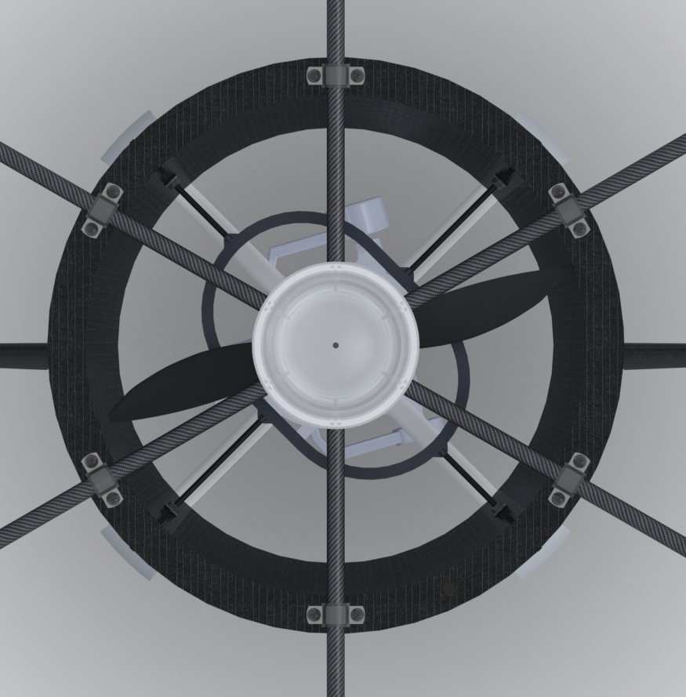
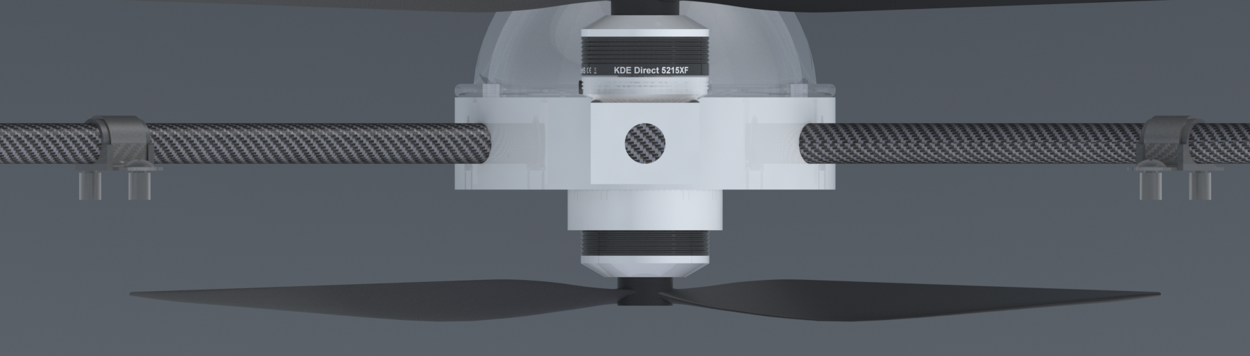
Top Housing Assembly
Threaded sleeves embedded in foam under the carbon fiber
Vibration damping mounts
Housing
  3D-printed PETG infused with carbon fibers
  Holds electronics
  Ducted fan attaches to bottom

Slide 12
Agenda
Eric Anthony
  Introduction
  Overall CAD Design
Cristian Vera
  Landing Gear Design
  Gimbal Mount Design
Hugo Montanez
  Stress Analysis Methodology
  Engine Mount Stress Analysis
  Wing Stress Analysis
Ricardo Chaparro
  Propeller Arm Stress Analysis
  Overall System Stress Analysis
Abigail Laguna
  Thermal Analysis (FEA)
Evelyn Cortez
  Thermal Analysis (CFD)
  Conclusions

Slide 13
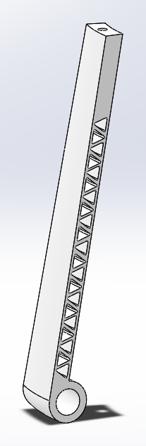
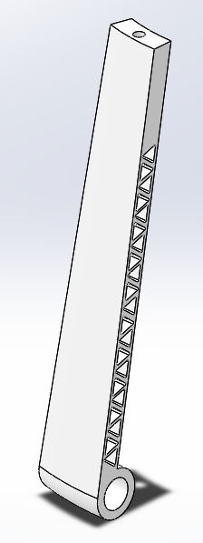
Landing Gear - Design Progression
16 Inches from top to base.
Threaded hole with M4x0.7 thread.
Widened to a 2.75 inch width
Safety Factor when resting (100 lbs) is 53.76
Material is still PETG

Slide 14
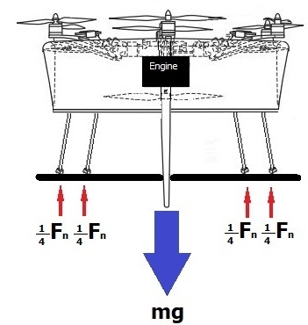
Landing Gear – Stress Analysis

Slide 15
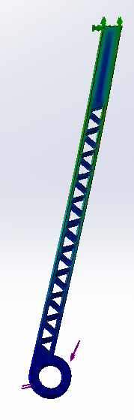
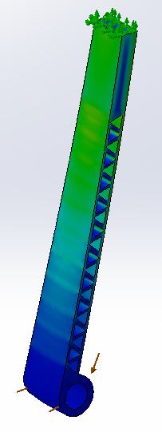
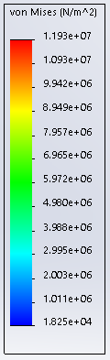
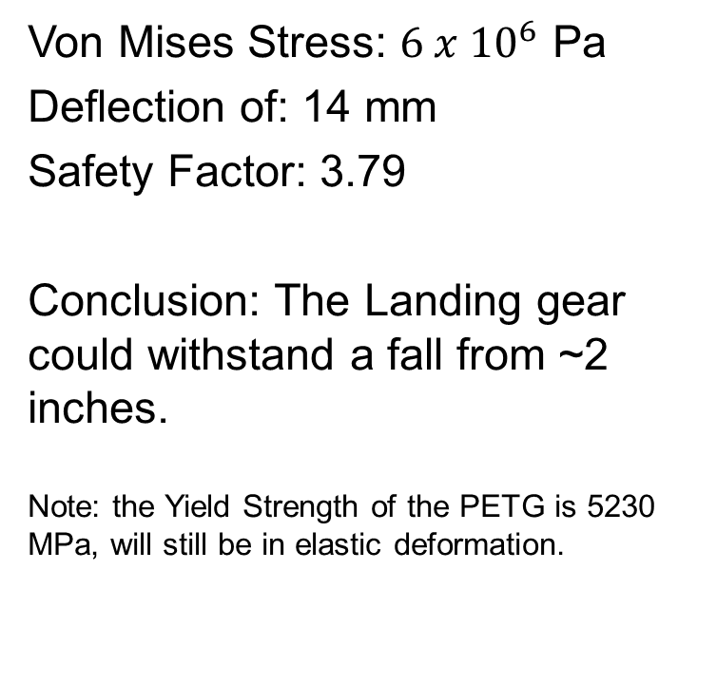
Landing Gear – Stress Analysis: Fall from height
Von Mises Stress: $6 x {10}^{6}$ Pa
Deflection of: 14 mm
Safety Factor: 3.79
Conclusion: The Landing gear could withstand a fall from ~2 inches.
Note: the Yield Strength of the PETG is 5230 MPa, will still be in elastic deformation.

Slide 16

Landing Gear – Stress Analysis
$$350 N Force per leg$$
$$350 x 4=1400 N$$
$$F_{impact}=\frac{mgh}{d}$$
$$1400 N=\frac{45 kg x 9.81\frac{m}{s^{2}}x h}{0.014 m}$$
$$h=0.045 meters \sim 2 inches$$

Slide 17
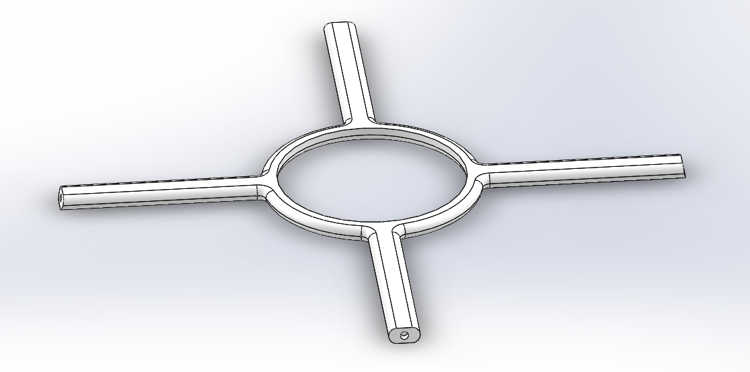
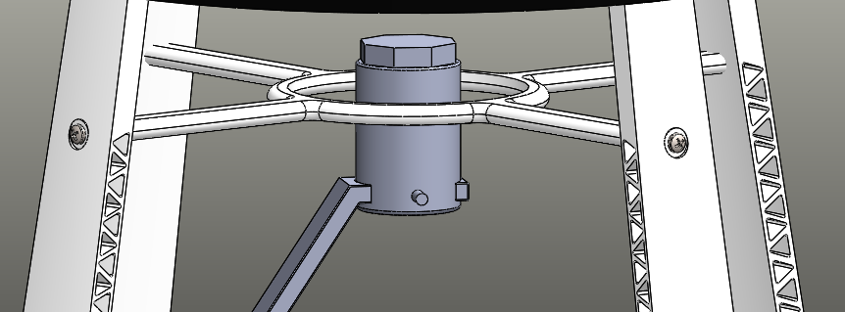
Gimbal Mount - CAD
Changed mounting points to reduce weight
Currently mounts to landing gear via M4x0.7 Screws
Made of PETG

Slide 18
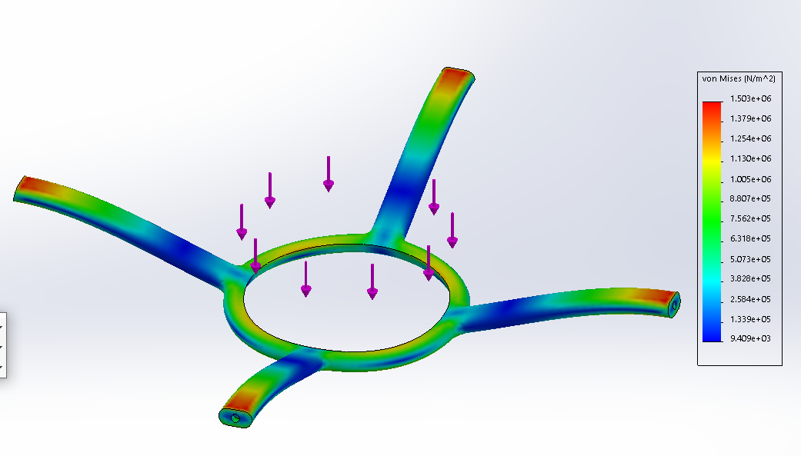
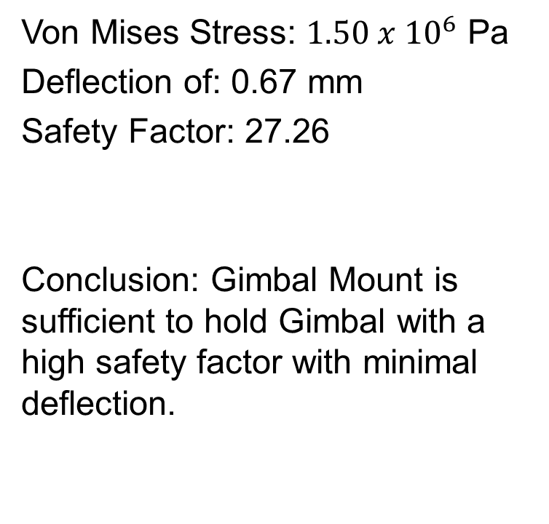
Gimbal Mount – Stress Analysis
Von Mises Stress: $1.50 x {10}^{6}$ Pa
Deflection of: 0.67 mm
Safety Factor: 27.26
Conclusion: Gimbal Mount is sufficient to hold Gimbal with a high safety factor with minimal deflection.

Slide 19
Agenda
Eric Anthony
  Introduction
  Overall CAD Design
Cristian Vera
  Landing Gear Design
  Gimbal Mount Design
Hugo Montanez
  Stress Analysis Methodology
  Engine Mount Stress Analysis
  Wing Stress Analysis
Ricardo Chaparro
  Propeller Arm Stress Analysis
  Overall System Stress Analysis
Abigail Laguna
  Thermal Analysis (FEA)
Evelyn Cortez
  Thermal Analysis (CFD)
  Conclusions

Slide 20
Methodology for Stress Analysis

Slide 21
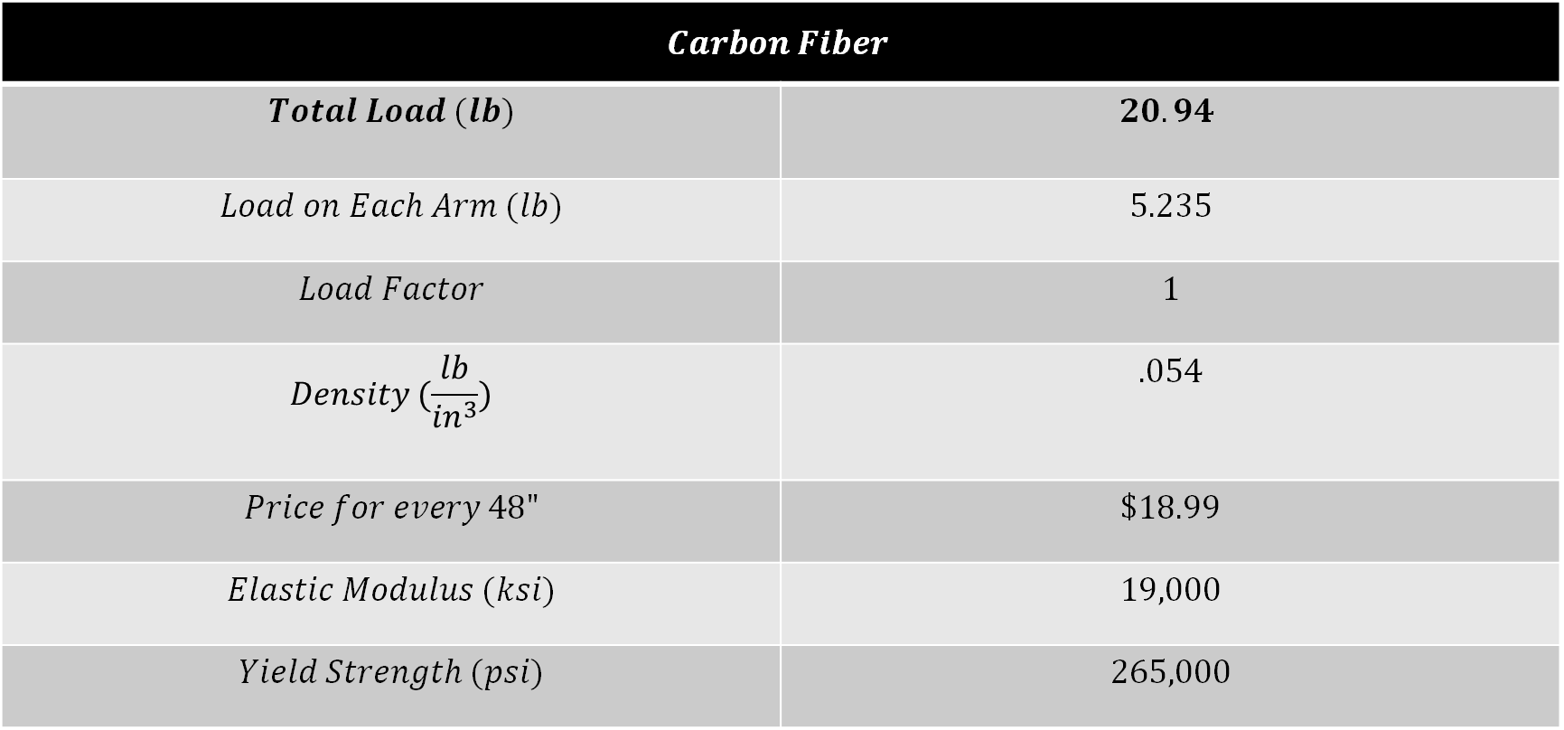
Engine Mounting Arms Material Properties
$$Carbon Fiber$$
$$Total Load (lb)$$ | $$20.94$$
$$Load on Each Arm (lb)$$ | $$5.235$$
$$Load Factor$$ | $$1$$
$$Density (\frac{lb}{{in}^{3}})$$ | $$.054$$
$$Price for every 48"$$ | $$\$18.99$$
$$Elastic Modulus (ksi)$$ | $$19,000$$
$$Yield Strength (psi)$$ | $$265,000$$

Slide 22
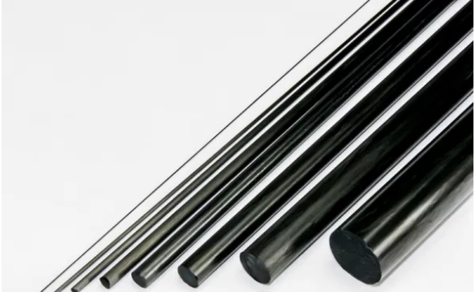
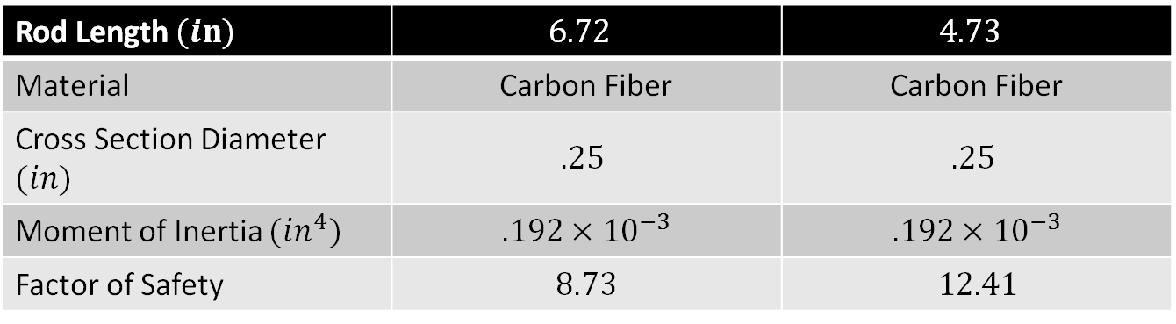
Engine Mounting Arms Stress Analysis
Rod Length $(in)$ | $$6.72$$ | $$4.73$$
Material | Carbon Fiber | Carbon Fiber
Cross Section Diameter $(in)$ | $$.25$$ | $$.25$$
Moment of Inertia $(in^{4})$ | $$.192×{10}^{−3}$$ | $$.192×{10}^{−3}$$
Factor of Safety | $$8.73$$ | $$12.41$$

Slide 23
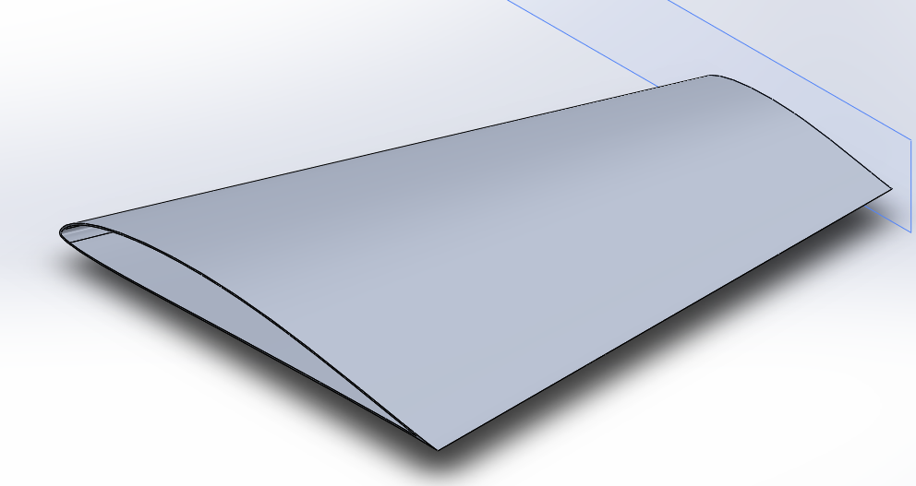
Wings

Slide 24
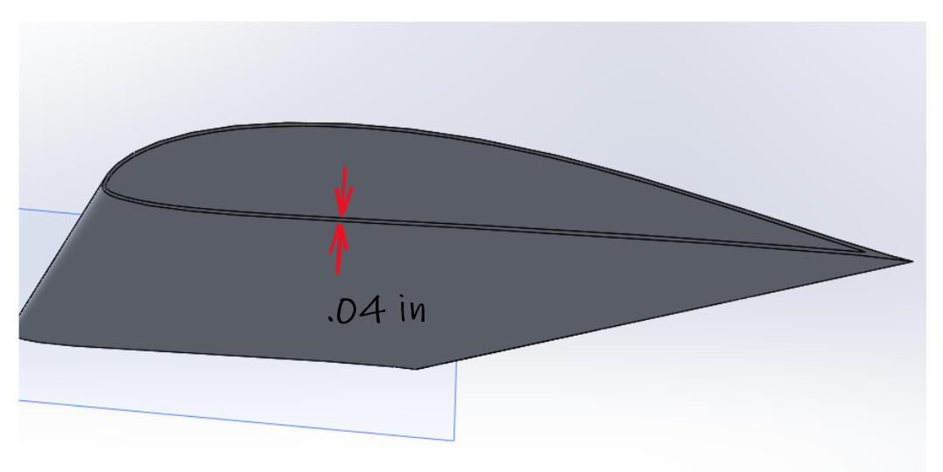
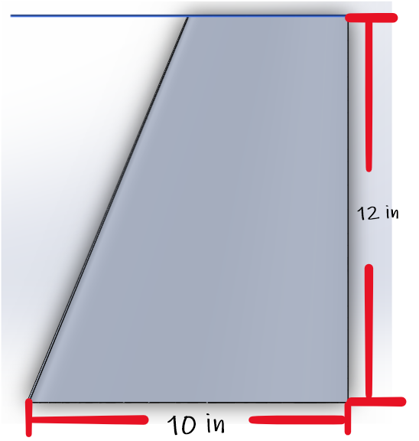
Wings

Slide 25
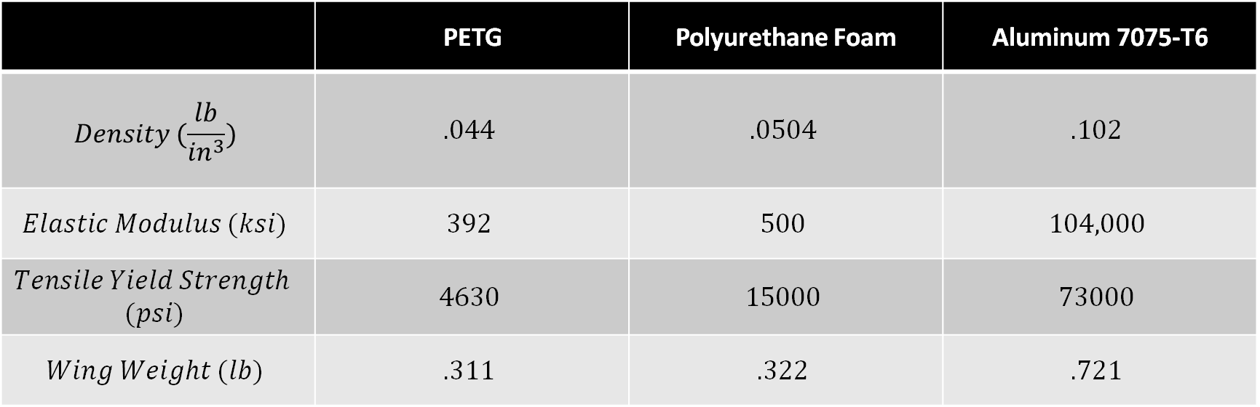
Wings Material Trade Study
 | PETG | Polyurethane Foam | Aluminum 7075-T6
$$Density (\frac{lb}{{in}^{3}})$$ | $$.044$$ | $$.0504$$ | $$.102$$
$$Elastic Modulus (ksi)$$ | $$392$$ | $$500$$ | $$104,000$$
$$Tensile Yield Strength$$ $$(psi)$$ | $$4630$$ | $$15000$$ | $$73000$$
$$Wing Weight (lb)$$ | $$.311$$ | $$.322$$ | $$.721$$

Slide 26
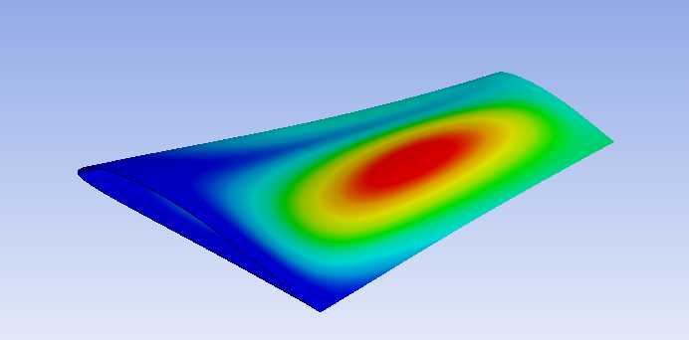
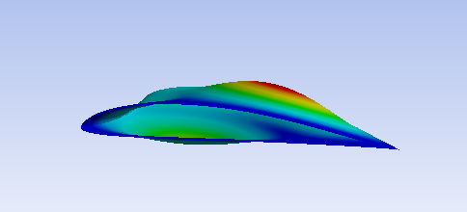
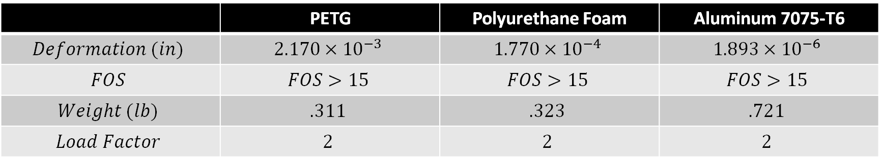
Stress Analysis on Wings at 1G
 | PETG | Polyurethane Foam | Aluminum 7075-T6
$$Deformation (in)$$ | $$2.170×{10}^{−3}$$ | $$1.770×{10}^{−4}$$ | $$1.893×{10}^{−6}$$
$$FOS$$ | $$FOS>15$$ | $$FOS>15$$ | $$FOS>15$$
$$Weight (lb)$$ | $$.311$$ | $$.323$$ | $$.721$$
$$Load Factor$$ | $$2$$ | $$2$$ | $$2$$

Slide 27
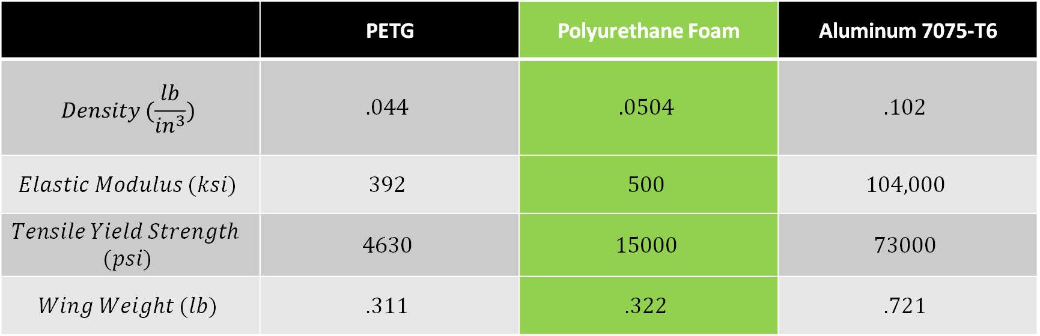
Wings Material Trade Study
 | PETG | Polyurethane Foam | Aluminum 7075-T6
$$Density (\frac{lb}{{in}^{3}})$$ | $$.044$$ | $$.0504$$ | $$.102$$
$$Elastic Modulus (ksi)$$ | $$392$$ | $$500$$ | $$104,000$$
$$Tensile Yield Strength$$ $$(psi)$$ | $$4630$$ | $$15000$$ | $$73000$$
$$Wing Weight (lb)$$ | $$.311$$ | $$.322$$ | $$.721$$

Slide 28
Agenda
Eric Anthony
  Introduction
  Overall CAD Design
Cristian Vera
  Landing Gear Design
  Gimbal Mount Design
Hugo Montanez
  Stress Analysis Methodology
  Engine Mount Stress Analysis
  Wing Stress Analysis
Ricardo Chaparro
  Propeller Arm Stress Analysis
  Overall System Stress Analysis
Abigail Laguna
  Thermal Analysis (FEA)
Evelyn Cortez
  Thermal Analysis (CFD)
  Conclusions

Slide 29
Top Mounting Arms Trade Study
Properties | Carbon Fiber PETG | Overtune PETG | Carbon Fiber Rods | Aluminum T-slots
Density (kg/m^3) | 1,340 | 1,240 | 1,500 | 2,690
Total Weight for 6 Arms (N) | 9.465 | 8.758 | 14.781 | 24.413
Total Weight for 6 Arms (lbs) | 2.128 | 1.969 | 3.323 | 5.489
Yield Strength (Mpa) | 80.0 | 50.0 | 1830 | 241
Elastic Modulus (GPa) | 5.740 | 1.174 | 131 | 70.360
Price per Arm | $ 21.81 | $ 5.81 | $ 76.31 | $ 13.71

Slide 30
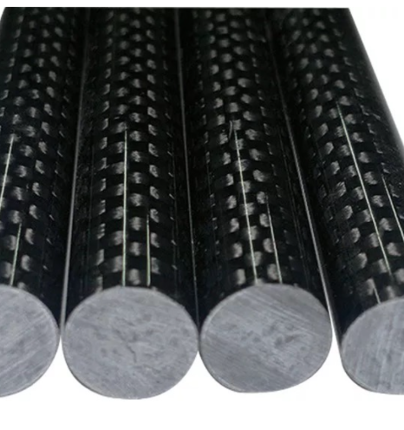
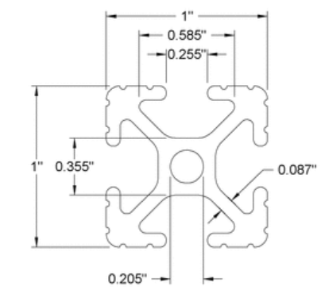
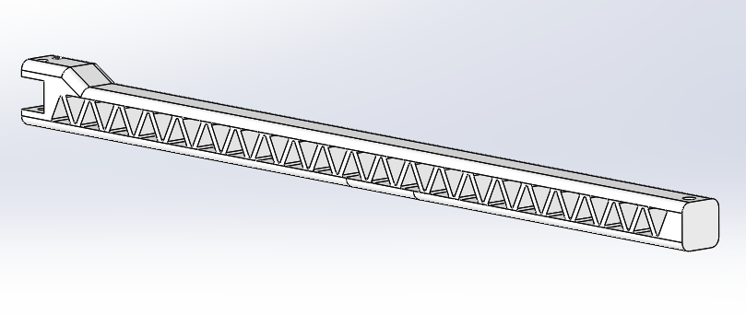
Mounting Arms Stress Analysis for Hover
 | Design # 1 |  | Design # 2 | Design # 3
Material | Carbon Fiber PETG | Overtune PETG | Carbon Fiber Rods | Aluminum T-slots
Moment of Inertia (mm^4) | 26,953 | 26,953 | 6,461 | 19,147
Factor of Safety | 4.68 | 2.93 | 32.22 | 10.02

Slide 31
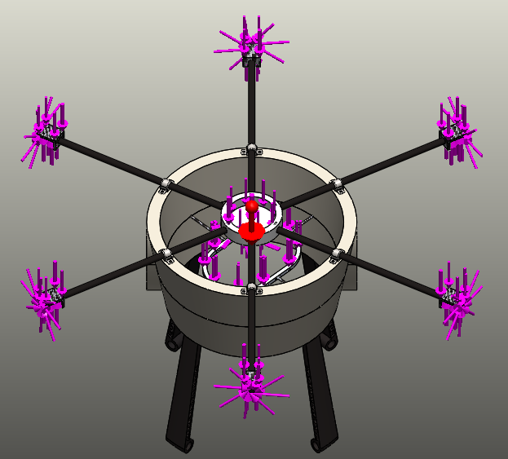
Loading Conditions
Assumptions
  Vertical flight load factor of 2
  Duct includes weight from other parts
Load Source | Type of Load | Load | Quantity
Outer Motors | Thrust (N) | 154.345 | 2
 | Torque (N m) | 2.910 | 2
Outer Motors | Thrust (N) | 91.184 | 4
 | Torque (N m) | -2.067 | 4
Ducted Motor | Thrust (N) | 111.467 | 1
 | Torque (N m) | 2.448 | 1
Duct | Weight (N) | 139.561 | 1
Engine | Weight (N) | 93.408 | 1
Components | Weight (N) | 159.478 | 1
Maneuver | 1G Acceleration * Mass (N) | 392.447 | 1
Total Weight (N) | 392.447
Inertia Force (N) | 392.447
Weight + Inertia Force (N) | 784.894
Total Thrust (N) | 784.894
Total Torque (N m) | 0

Slide 32
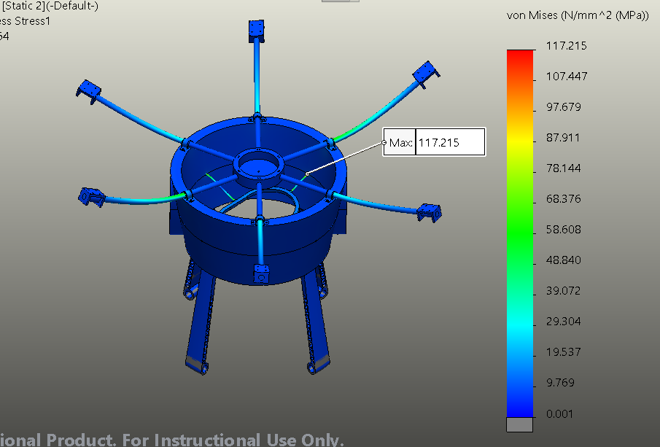
Stresses on UAV

Slide 33
Stress Summary
Location | Part | Material | Load | Failure Mode | Factor of Safety
1 | Outer Top Arms | Carbon Fiber | Thrust & Torque | Bending | 8.38
2 | Engine Mount Rods | Carbon Fiber | Engine Weight | Bending | 4.23
3 | Damping Mounts | 304 Stainless Steel | Mounting Arms & Duct Weight | Tension | 2.12
3
2
1

Slide 34
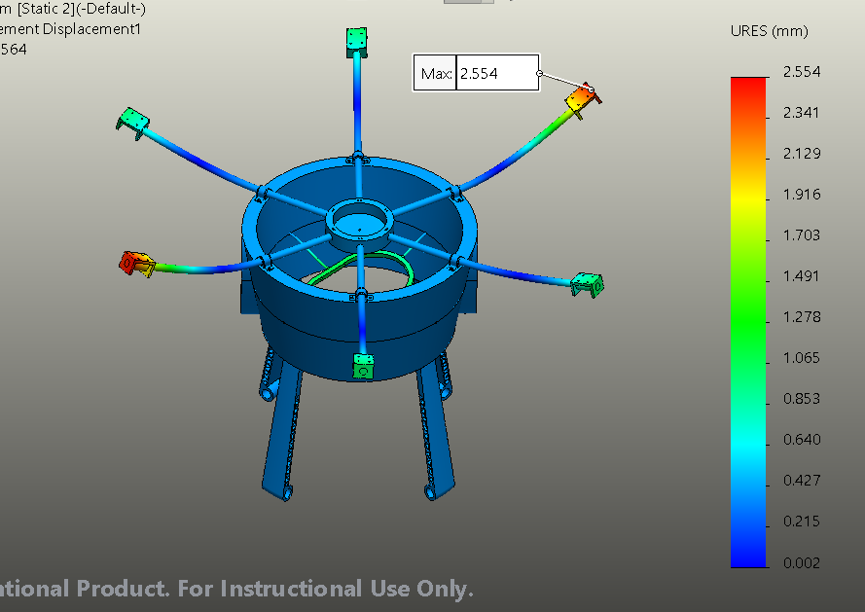
Deflection on UAV

Slide 35
Agenda
Eric Anthony
  Introduction
  Overall CAD Design
Cristian Vera
  Landing Gear Design
  Gimbal Mount Design
Hugo Montanez
  Stress Analysis Methodology
  Engine Mount Stress Analysis
  Wing Stress Analysis
Ricardo Chaparro
  Propeller Arm Stress Analysis
  Overall System Stress Analysis
Abigail Laguna
  Thermal Analysis (FEA)
Evelyn Cortez
  Thermal Analysis (CFD)
  Conclusions

Slide 36
Thermal Analysis
Nodal analysis approach
UAV as a blackbody
Convection, conduction, and radiation relationships
Studied environmental conditions
Calculated air properties at various temperatures and air velocities
Heat transfer coefficients
Calculated radiation heat flux (W/m^2)
Graphed radiation for average monthly temperatures

Slide 37
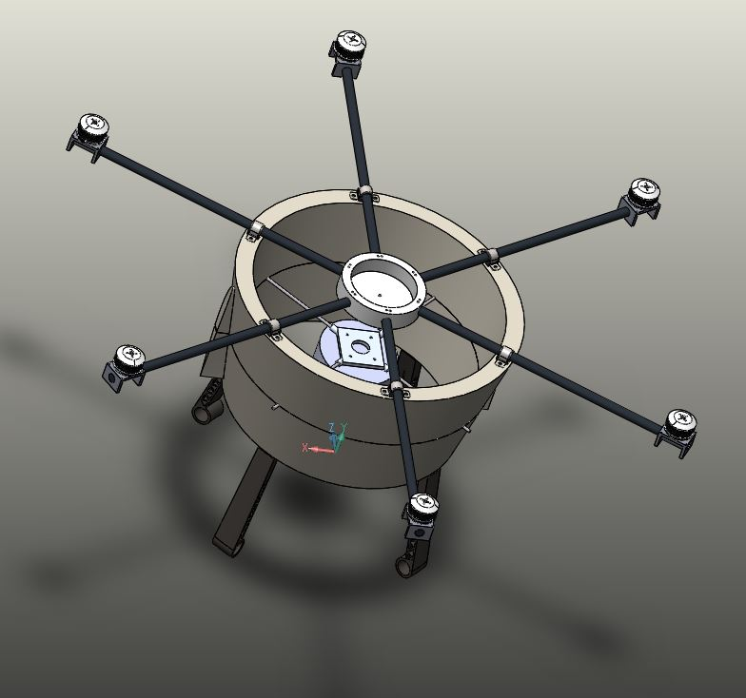
FEA Thermal Analysis
Obtain temperature profile of main components
Simplified model
  Wankel engine, outer-propeller motors, engine mount, duct, landing gear, sensor housing
Hover flight mode

Slide 38
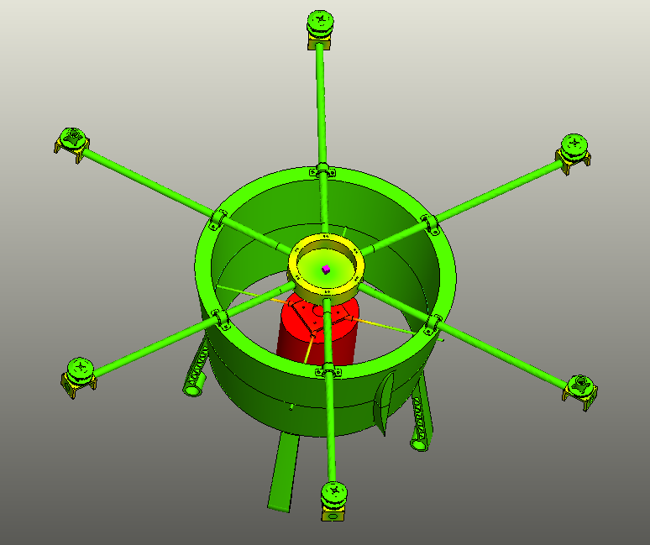
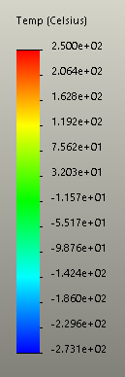
FEA Simulation Results
Hover flight mode simulation
Largest temperature increase in motor brackets, engine mount, and sensor housing
Maximum recorded temperature of 250 °C during hover in engine and mounting plate
Further analysis on engine cooling and sensor housing desired
  Engine: water-cooled housing and oil rotor cooling (active cooling)

Slide 39
Agenda
Eric Anthony
  Introduction
  Overall CAD Design
Cristian Vera
  Landing Gear Design
  Gimbal Mount Design
Hugo Montanez
  Stress Analysis Methodology
  Engine Mount Stress Analysis
  Wing Stress Analysis
Ricardo Chaparro
  Propeller Arm Stress Analysis
  Overall System Stress Analysis
Abigail Laguna
  Thermal Analysis (FEA)
Evelyn Cortez
  Thermal Analysis (CFD)
  Conclusions

Slide 40
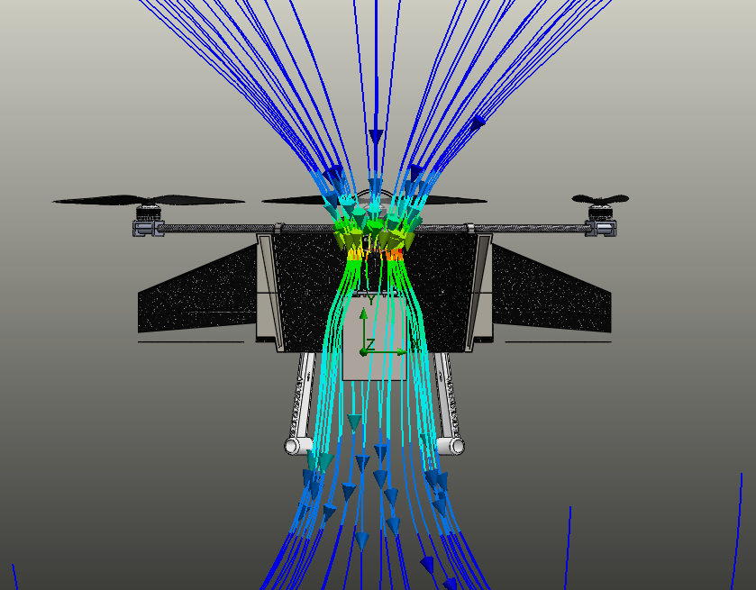
CFD Simulation
Goal: Obtain temperatures of main components while under hover condition
  Angular Velocities of propellers calculated by flight team
  Powers of motors calculated by flight team
  Modified engine model
  Sensors not included in top housing
Performed under two different times of the day:
  At 12:00 pm (noon)
  At 5:00 am (pre-sunrise)

Slide 41
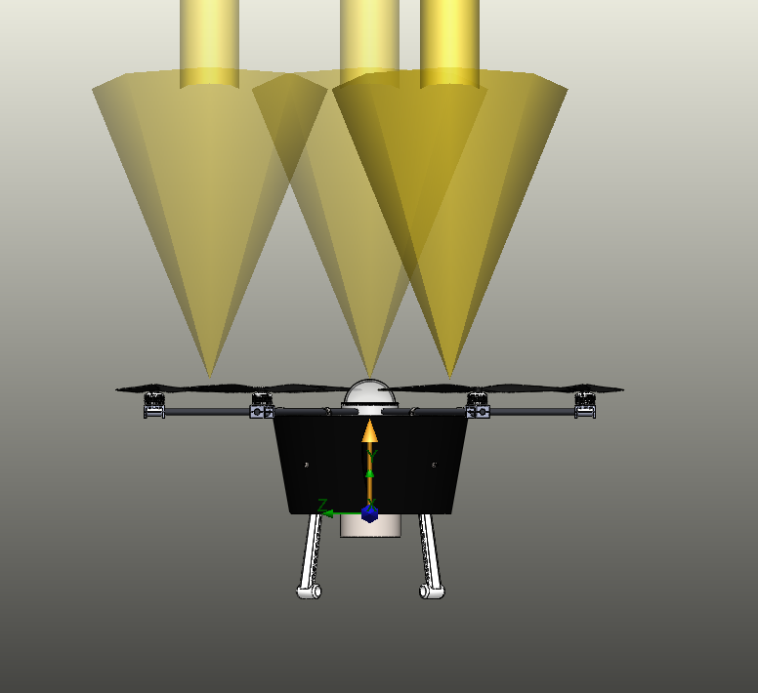
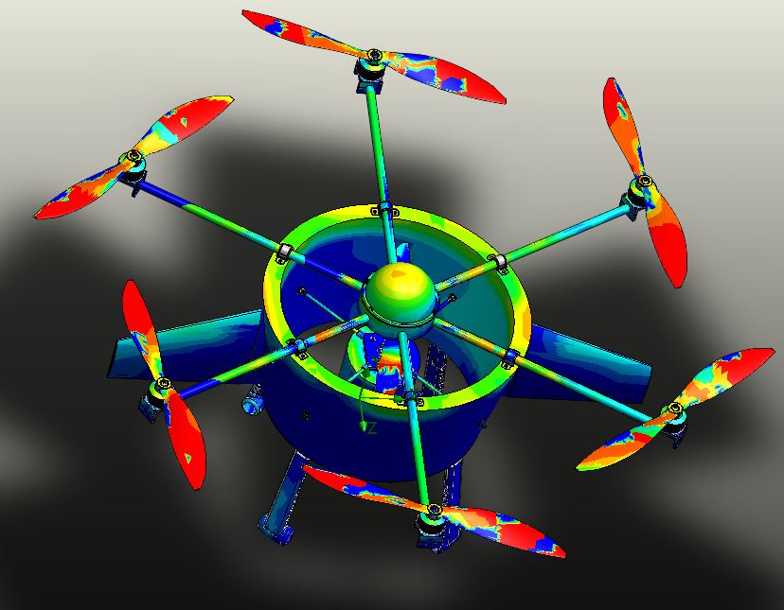

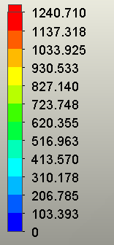
CFD Simulation – Solar Radiation at Noon

Slide 42

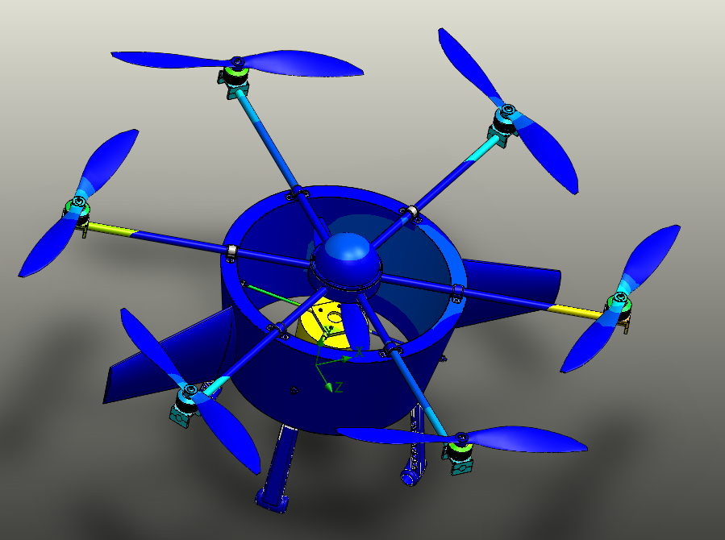
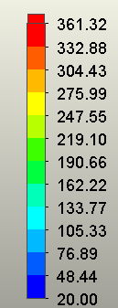
CFD Simulation – Solar Radiation at Noon
Assumptions/Inputs:
Engine temperature constant: 250°C
Inputted heat waste by motors in hover mode
Inputted angular velocities of all propellers in hover mode
Engine mount temperature: 239˚C

Slide 43
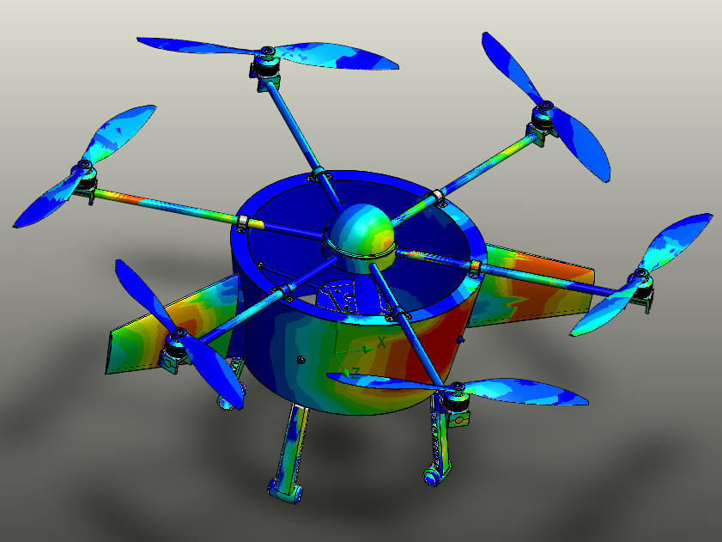

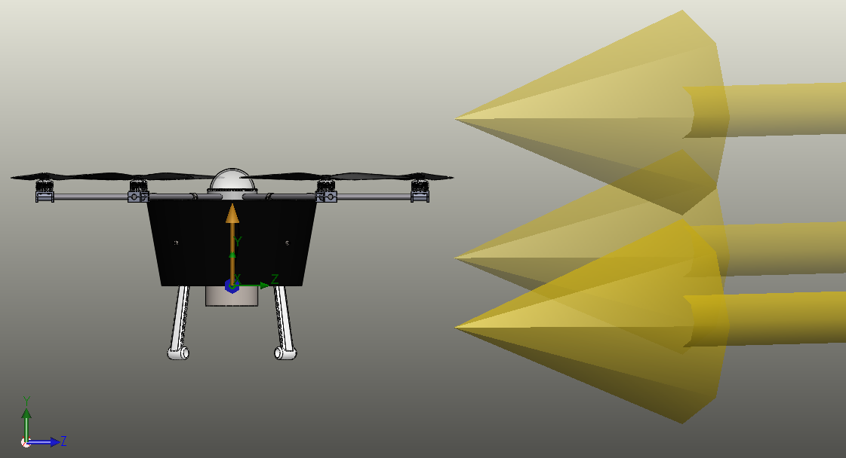
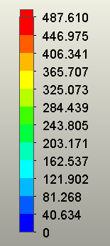
CFD Simulation – Solar Radiation at 5:00 am

Slide 44
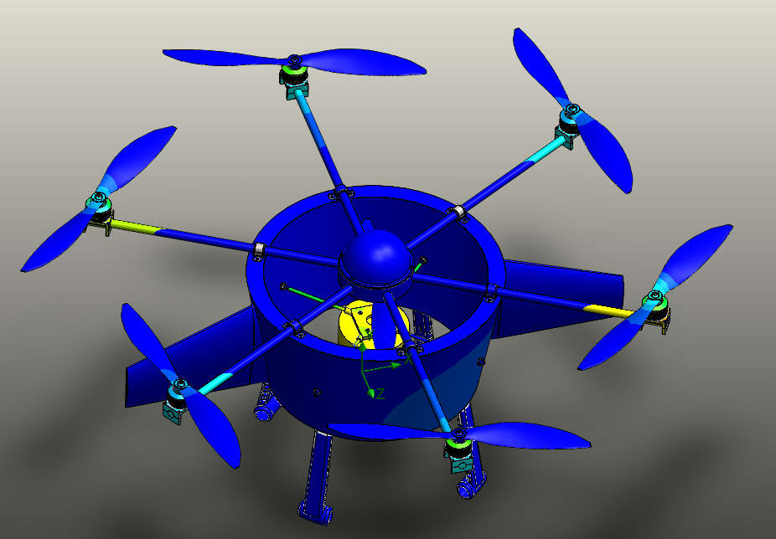
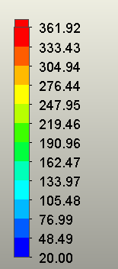
CFD Simulation – Solar Radiation at 5:00 am
Assumptions/Inputs:
Engine temperature constant: 250 ˚C
Inputted heat waste by motors in hover mode
Inputted angular velocities of all propellers in hover mode
Engine mount temperature: 237˚C

Slide 45


CFD Simulation - Motors
149˚C
361.4˚C
261˚C
256˚C
182.6˚C

Slide 46
Conclusions
Overall FOS:
Able to sustain a factor of safety of 2.12
Thermal:
Motor brackets/sensor housing exceeds maximum temperature
  New material or insert cooling mechanism

Slide 47
Weight budget
Quantity | Part | Weight (lb) | Contingency Factor % | Adjusted Total Weight (lb)
1 | Polyurethane Foam Core | 2.5 | 25 | 3.13
4 | Engine Mount Rods | 0.02 | 25 | 0.10
6 | Vibration Damping Mounts | 0.16 | 25 | 1.20
6 | Propeller Mounts | 0.15 | 25 | 1.13
8 | Engine Mount Nut | 0.02 | 0 | 0.14
12 | Threaded Sleeve | 0.01 | 25 | 0.15
12 | Vibration Damping Mount Screw | 0.01 | 0 | 0.11
4 | Gimbal Mount Screw | 0.01 | 0 | 0.04
1 | Engine Mount | 0.83 | 25 | 1.04
1 | Carbon Fiber Shell | 4.48 | 25 | 5.60
4 | Landing Gear Leg | 1.06 | 25 | 5.30
6 | Propeller Arm | 0.59 | 25 | 4.43
 |  |  | Total | 22.35

Slide 48
Future Suggestions
Stress Analysis
  FEA should include other flight conditions
Thermal Analysis
  Take into consideration engine’s water and oil cooling
      Use actual CAD model
      Assume or estimate flowrate of water and oil
  Analyze sensor housing dome with sensors included
  Include gimbal system in analysis

