Slide 1


Formula SAE- Expo Presentation
Team Advisor: Dr. John Christopher Bachman
Team Members: David Arellano, Francisco Calva, Patrick Cho, Hector Coronel,
Frank Garcia, Abel Moreno, Carlos Ochoa & Erick Rojas
CAL STATE LA
College of Engineering, Computer Science and Technology

Slide 2
Agenda
Introduction- Frank
Driver Controls – Abel
Suspension (Front/Rear) – David & Patrick
Powertrain – Francisco, Hector & Frank
  (Intake/Exhaust) – Francisco & Hector
  (Cooling/Exhaust) - Frank
Electrical – Carlos & Erick

Slide 3
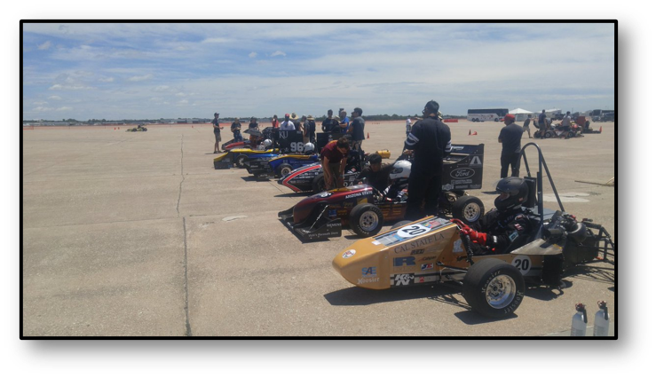
Team Objective
The Senior Design team shall design, manufacture and test the Suspension, Brakes, Powertrain, and Electrical subsystems for the Formula SAE team at Cal State LA for their 2020-2021 competition.

Slide 4
Team Organization
Client: Formula SAE
Team Advisor: Dr. John Christopher Bachman
Team Captain: Frank Garcia
Driver Controls
Electrical
Powertrain
Suspension
Abel Moreno
Carlos Ochoa
Erick Rojas
Francisco Calva
Hector Coronel
Frank Garcia
David Arellano
Patrick Cho
Notes:
4-12-21 notes:
Include pictures of each member? - PC

Slide 5
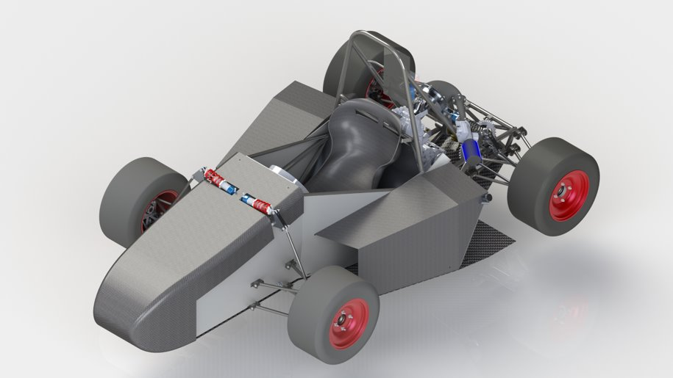
Isometric View

Slide 6
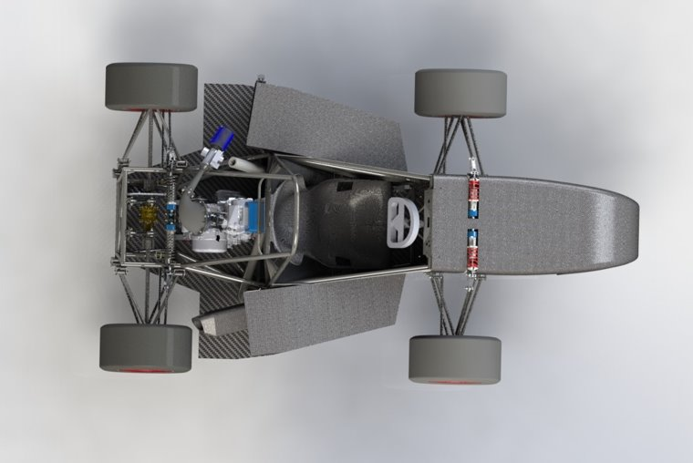
Top-down View

Slide 7
Agenda
Introduction- Frank
Driver Controls – Abel
Suspension (Front/Rear) – David & Patrick
Powertrain – Francisco, Hector & Frank
  (Intake/Exhaust) – Francisco & Hector
  (Cooling/Exhaust) - Frank
Electrical – Carlos & Erick

Slide 8
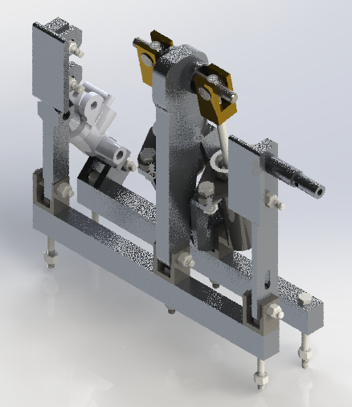
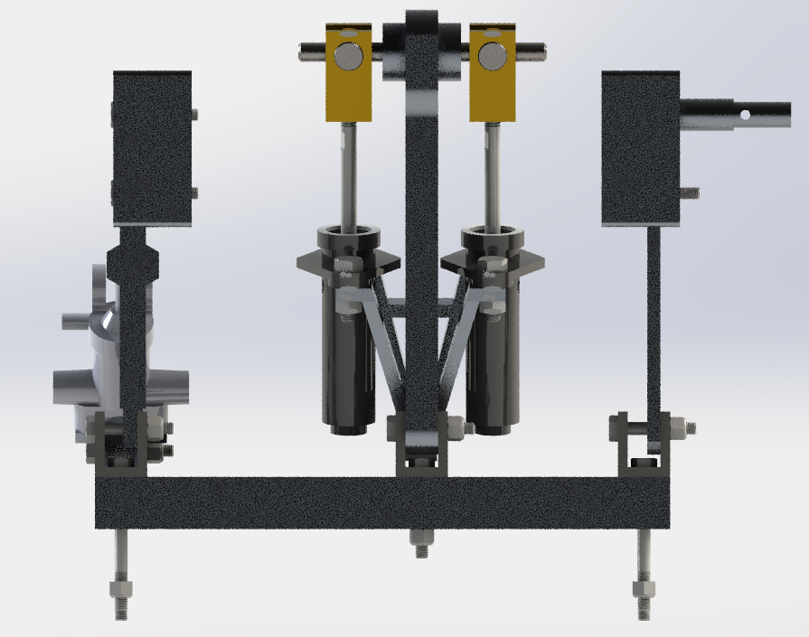
Pedal Assembly
Brake Pedal
Throttle Pedal
Clutch Master Cylinder
Clutch Pedal
Aluminum Railings
Brake Master Cylinders
Master Cylinder Mount

Slide 9
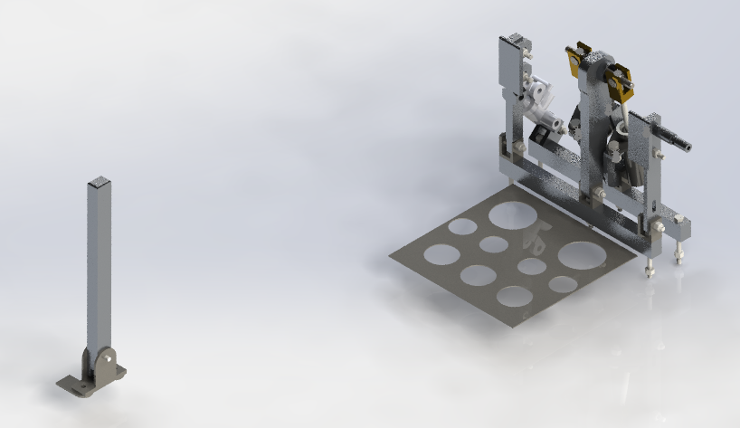
Pedals and Shifter
Left hand Shifter
Footrest

Slide 10
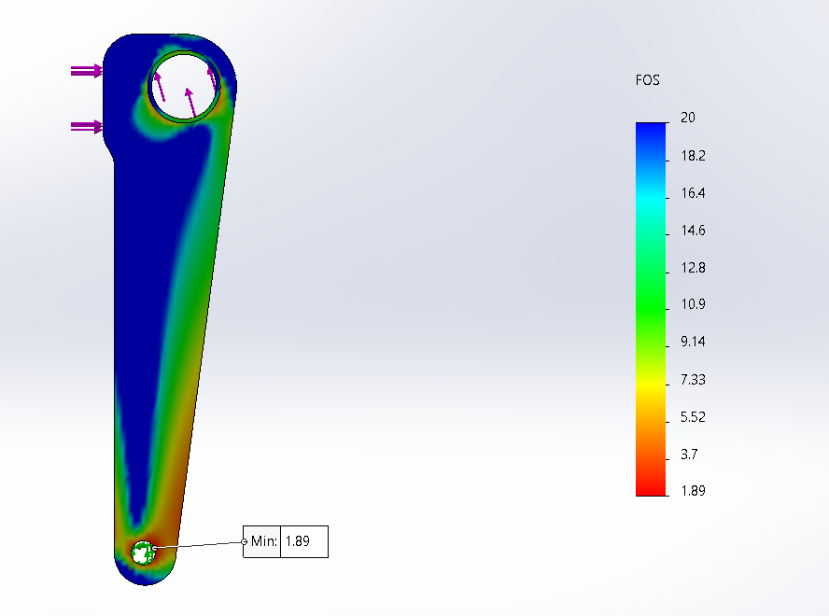
Brake Pedal Analysis
Applied Force: 2000 N
(approx: 450 lbf)
Material | Factor of Safety
Al 6061-T6 | 1.89
Reaction Force: 7480 N
(approx: 1681 lbf)
Fixed
Notes:
Force applied by rules
Reaction force dependent on angle from pedal ratio. This one is based off of a static pedal, I.e. the pedal does not move. As the pedal travels the angle increases and reaction force increases.
Uncertain if anyone would be able to produce 450 lbs of force with just their calf.
Treated as a cantilever beam, fixed at the pivot

Slide 11
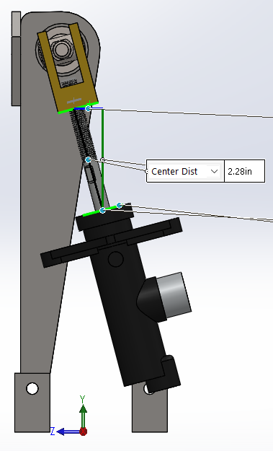
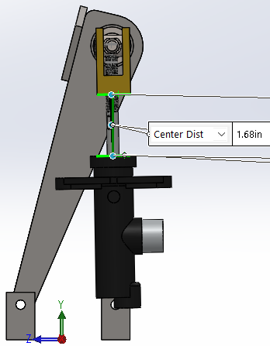
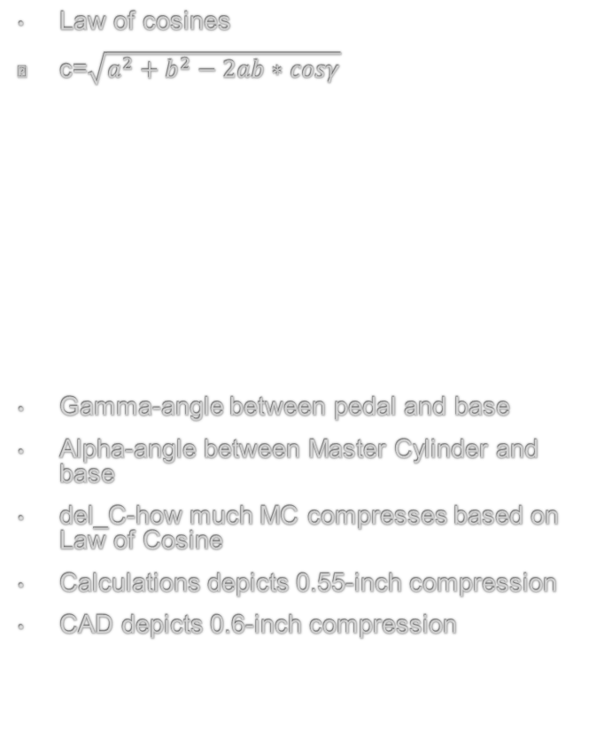


Brake Pedal Kinematics
Law of cosines
c=$\sqrt{a^{2}+b^{2}−2ab∗cosγ}$
Gamma-angle between pedal and base
Alpha-angle between Master Cylinder and base
del_C-how much MC compresses based on Law of Cosine
Calculations depicts 0.55-inch compression
CAD depicts 0.6-inch compression
γ | C | del_C | α
90 | 7.47 | - | 74.47
85 | 7.3 | 0.17 | 79.18
80 | 7.13 | 0.34 | 83.96
75 | 6.96 | 0.51 | 88.88
74 | 6.92 | 0.55 | 89.87
$$γ$$
$$α$$
Notes:
Using the 0.55 inch for travel since it's lower, better safef than sorry.

Slide 12
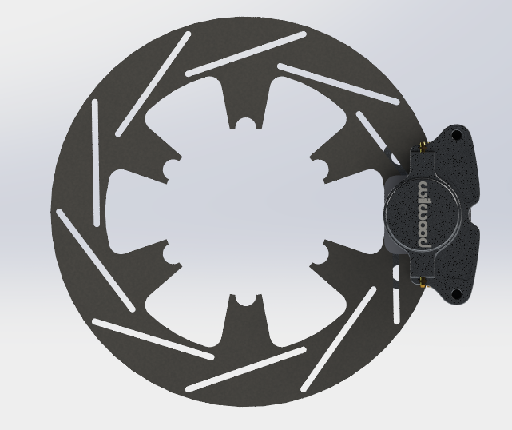
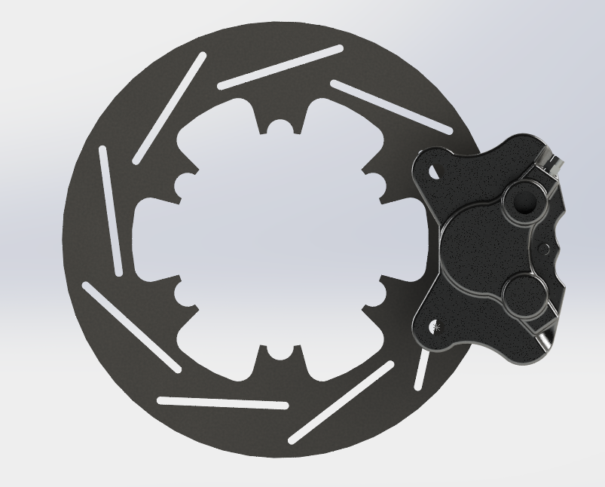
Brake Rotors
Component | Material | Weight (lb) | Diameter (in) | Brake Caliper
Front Brake Rotor | ASTM A36 Low Carbon Steel | 1.44 | 8 | Wilwood GP 200
Rear Brake Rotor | ASTM A36 Low Carbon Steel | 1.14 | 7 | Wilwood PS-1
Front brake rotor with Wilwood GP 200
Rear brake rotor with Wilwood PS-1
Notes:
Floating rotors. Attached to wheel hub and contains the mounting component.

Slide 13
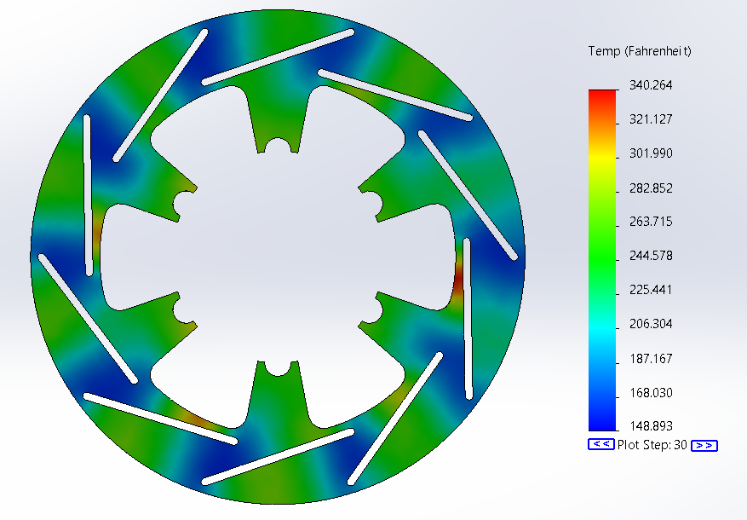
Brake Rotor Thermal Analysis
Simulated under hard braking for 3 seconds
Initial Temperature: 75 F
  All exposed faces
Convection: 91 W/(m^2 K)
  All exposed faces
Heat Power: 26 kW
  Pad contact surface

Slide 14
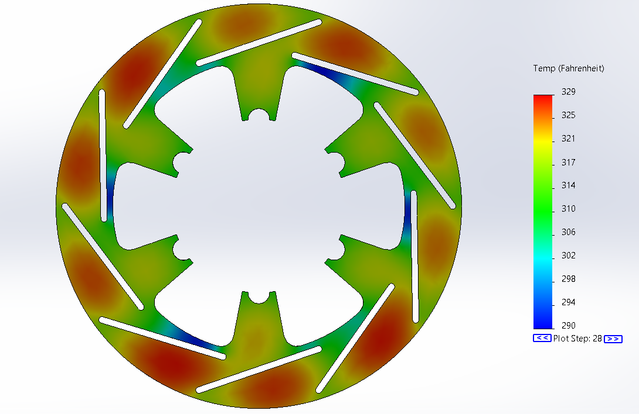
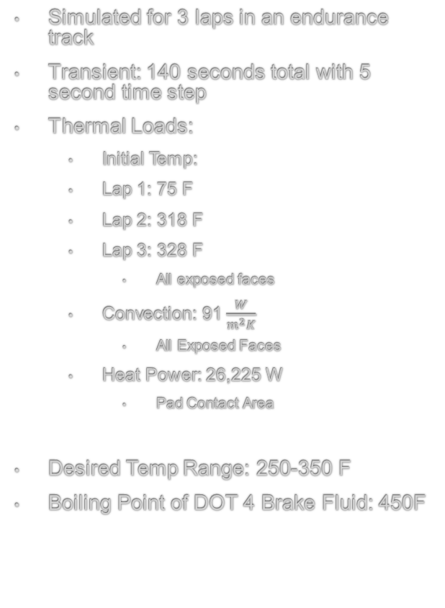
Brake Rotor Thermal Analysis
Simulated for 3 laps in an endurance track
Transient: 140 seconds total with 5 second time step
Thermal Loads:
  Initial Temp:
  Lap 1: 75 F
  Lap 2: 318 F
  Lap 3: 328 F
    All exposed faces
  Convection: 91 $\frac{W}{m^{2}K}$
    All Exposed Faces
  Heat Power: 26,225 W
    Pad Contact Area
Desired Temp Range: 250-350 F
Boiling Point of DOT 4 Brake Fluid: 450F
Results Lap 3 Thermal Simulation

Slide 15
Agenda
Introduction- Carlos
Driver Controls – Abel
Suspension (Front/Rear) – David & Patrick
Powertrain – Francisco Hector & Frank
  (Intake/Exhaust) - Francisco & Hector
  (Cooling/Fuel) - Frank
Electrical – Carlos & Erick

Slide 16
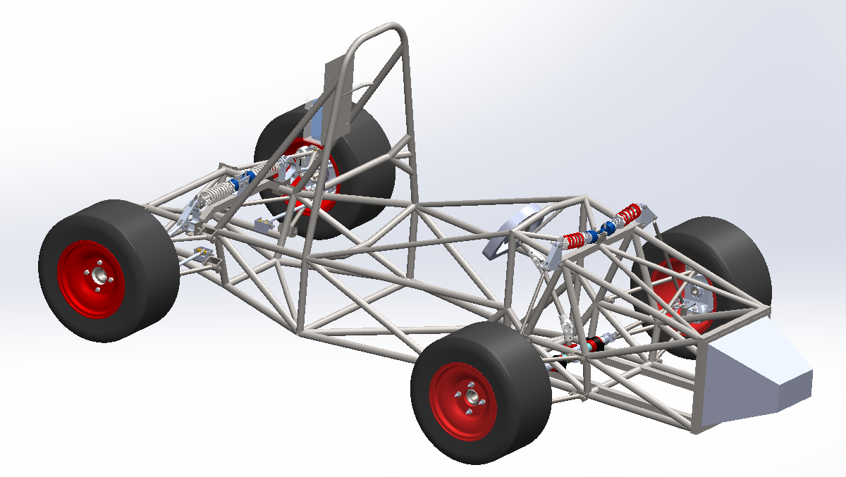
Full Suspension
Notes:
Hello my name is David Arellano I designed the front suspension and Patrick Cho designed the rear suspension.

Slide 17
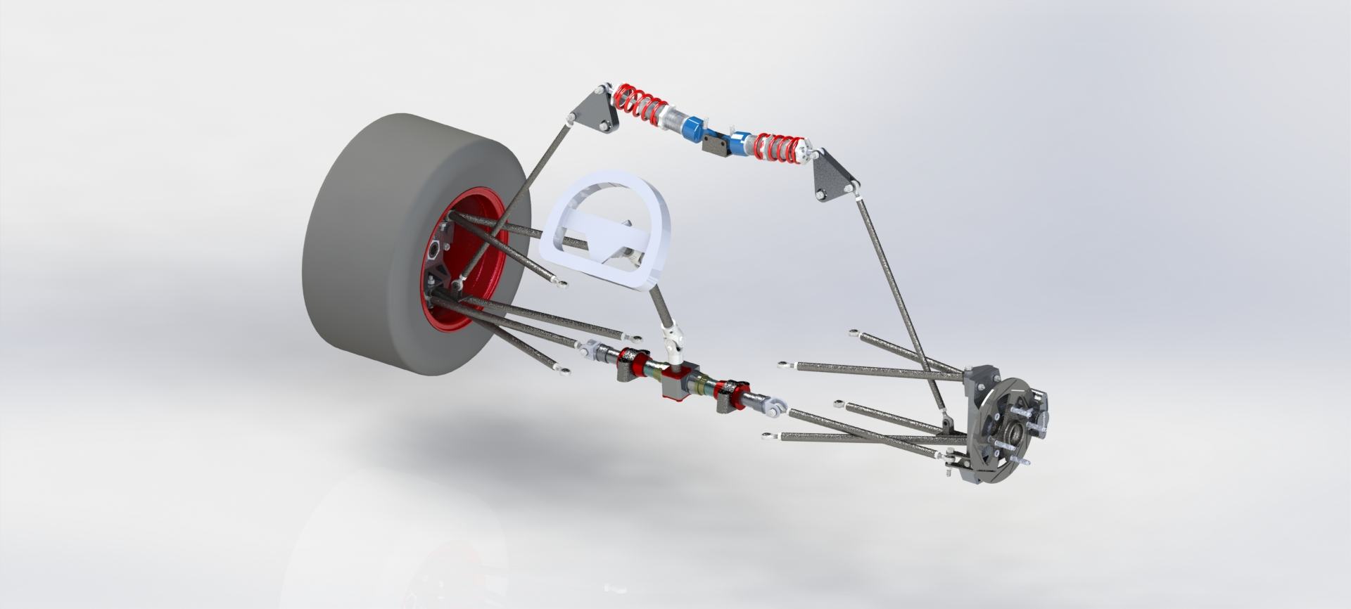
Steering System
Steering Wheel
Steering column
U - Joints
Steering Rack
Steering Linkage
Notes:
This is the steering system that consist of the steering wheel, steering column, U-joint, steering rack and the steering linkages. All this is designed to maximize friction, roll and stability with the ground.

Slide 18
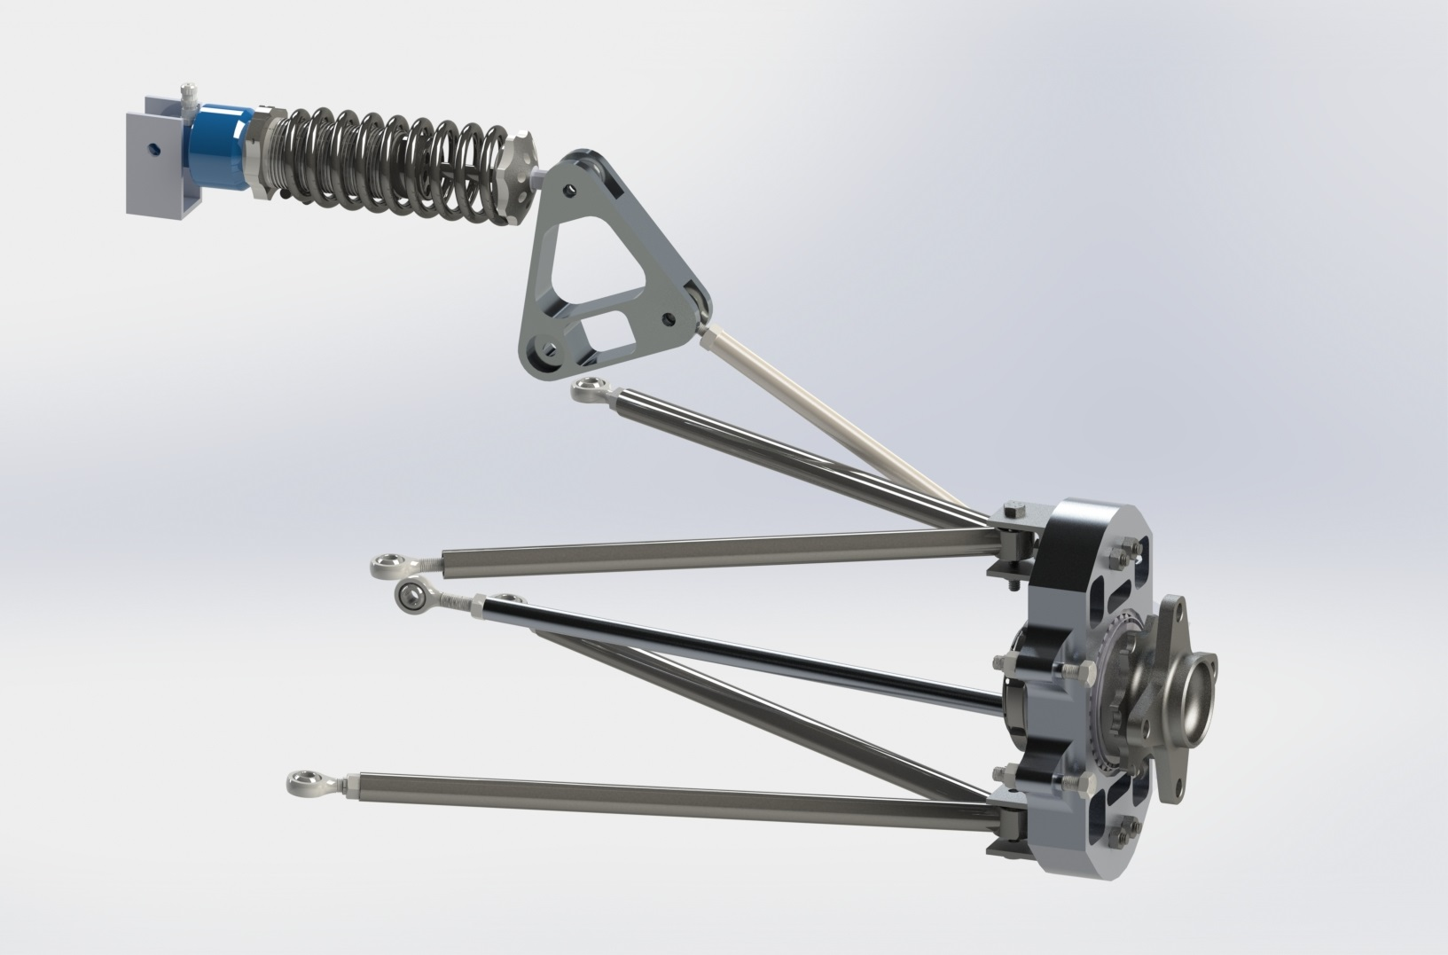
Rear Suspension
Bell crank
Upper control arm
Upright
Wheel hub
Tie/steering linkages
Lower control arm
Notes:
The rear suspension very similar. The only difference is the steering system is a fixed toe arm. They use a similar pushrod system except the rear attaches to the upright.

Slide 19
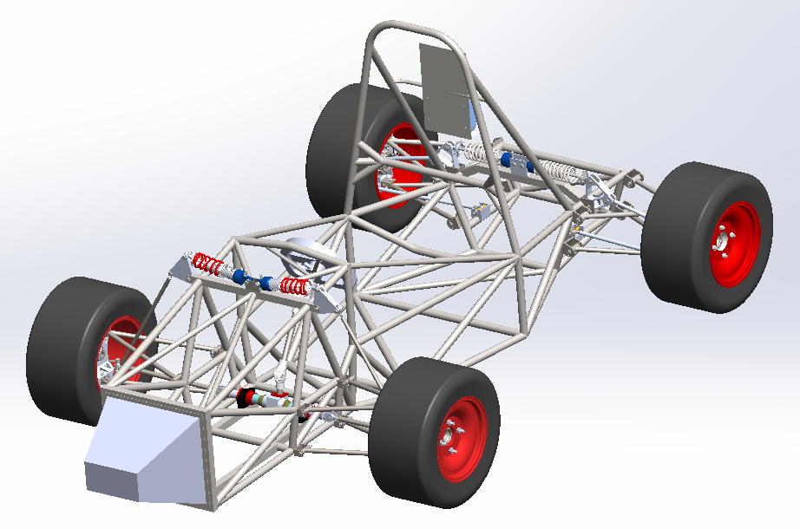
Suspension – Overall specs
Category | Value
Suspension type | Push rod
Control arm type | Double wishbone
Spindle/Hub type | Live spindle/Hub
Ride height | 2.5 in.
Wheelbase | 61 in.
Track width | 52 in.
Rims | 10 in x 8 in.
Tires | Hoosiers R25B
Weight Budget | < 140 lb
Notes:
These are my overall specs that helped guide this year's design.
Many of my design overall specifications revolved around the force produced from my tire.
The biggest change from last years design was to change the front direct attachment,, to a push rod system matching the rear suspension.
The weight budget and ride height was reduce to increase our overall performance from this system.

Slide 20
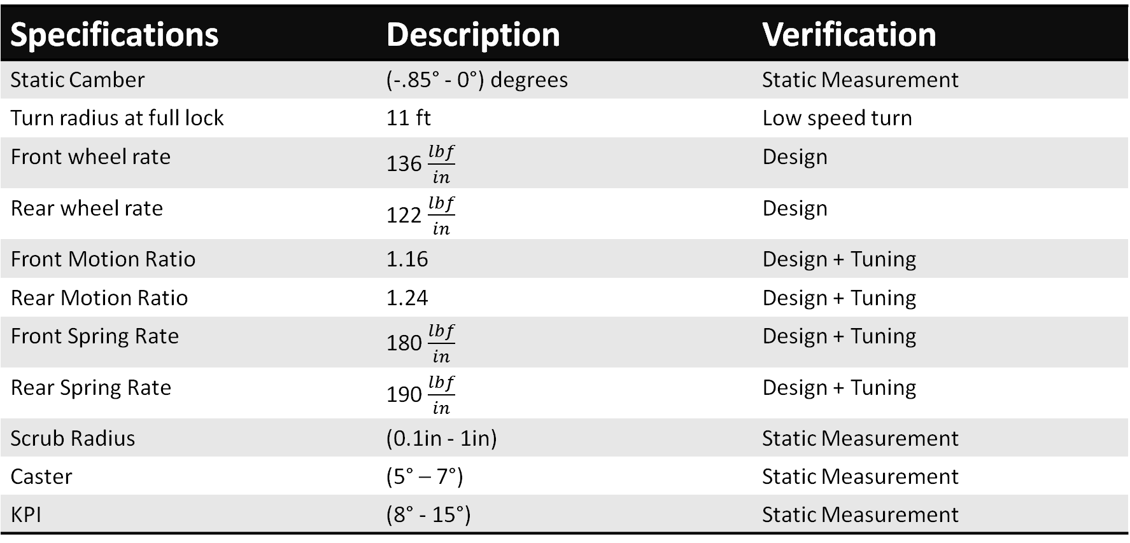
Suspension – Design – Specs
Specifications | Description | Verification
Static Camber | (-.85° - 0°) degrees | Static Measurement
Turn radius at full lock | 11 ft | Low speed turn
Front wheel rate | 136 $\frac{lbf}{in}$ | Design
Rear wheel rate | 122 $\frac{lbf}{in}$ | Design
Front Motion Ratio | 1.16 | Design + Tuning
Rear Motion Ratio | 1.24 | Design + Tuning
Front Spring Rate | 180 $\frac{lbf}{in}$ | Design + Tuning
Rear Spring Rate | 190 $\frac{lbf}{in}$ | Design + Tuning
Scrub Radius | (0.1in - 1in) | Static Measurement
Caster | (5° – 7°) | Static Measurement
KPI | (8° - 15°) | Static Measurement
Notes:
These are the final design specs that helped fine tune the suspension.
These include geometry steering, ride frequencies, motion ratios and spring rates

Slide 21
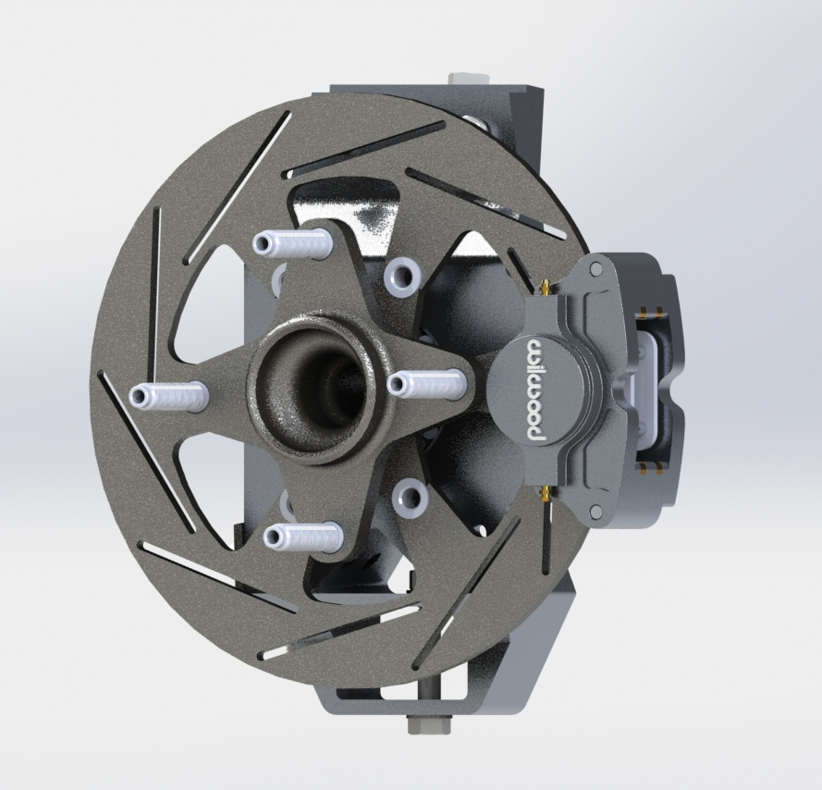
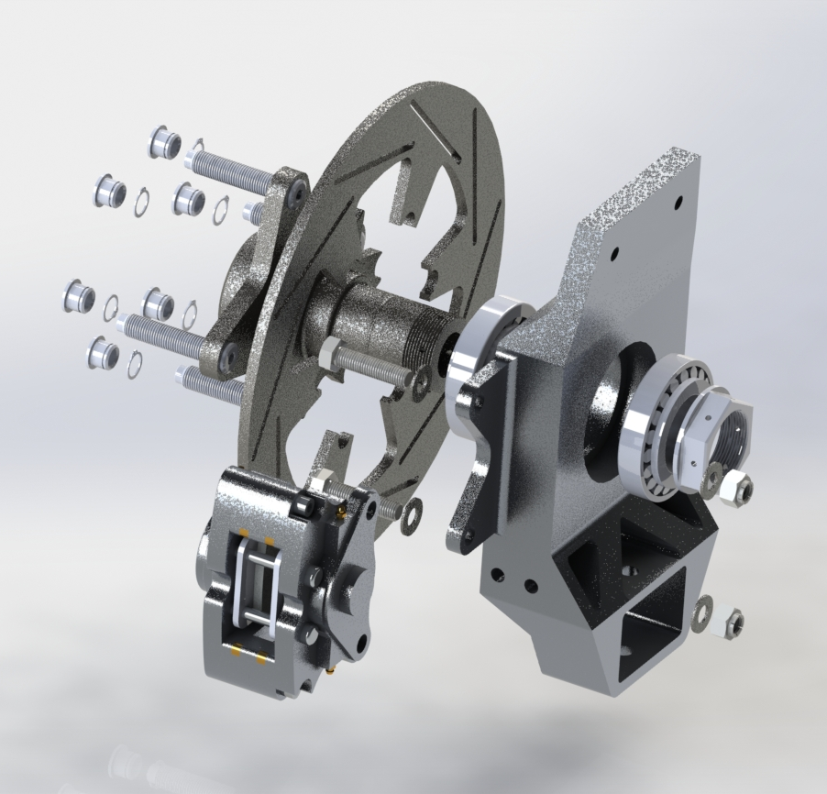
Front Upright
Notes:
This is the front upright design with an exploded

Slide 22
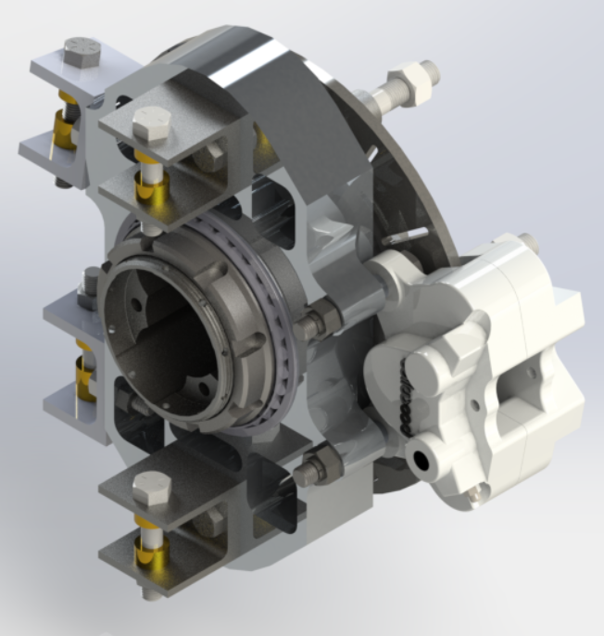
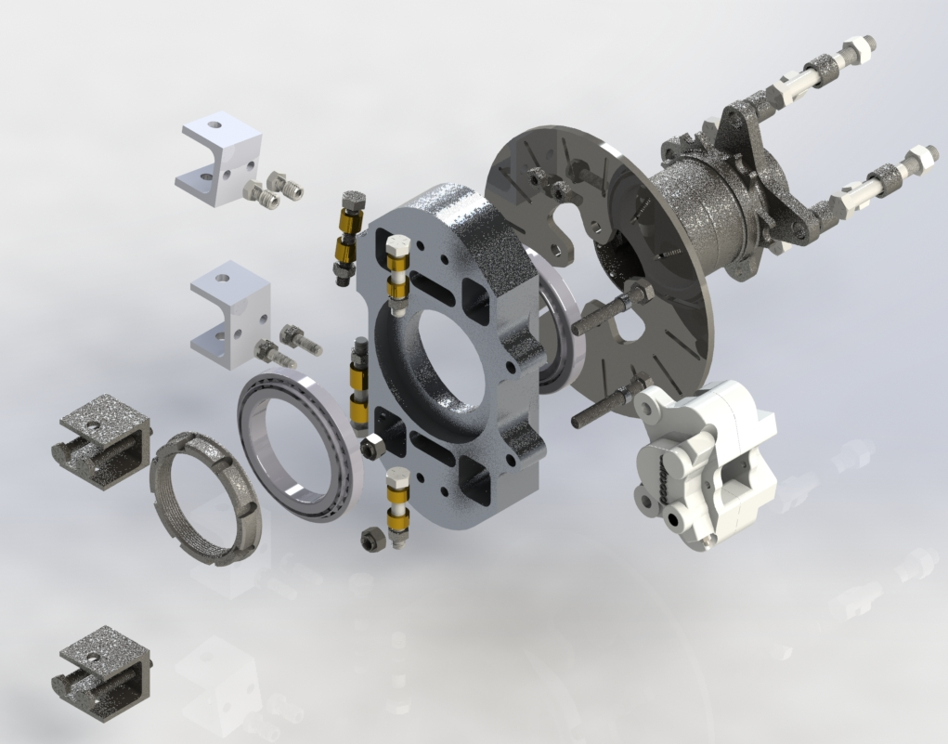
Rear Upright
Notes:
This is the rear upright design with an exploded

Slide 23
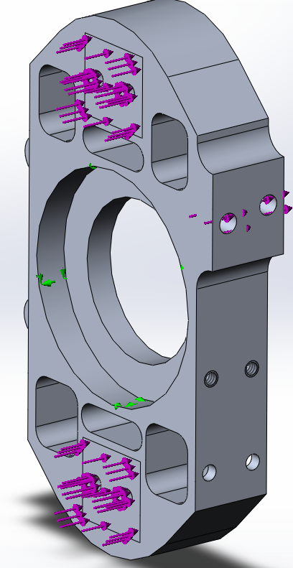
Suspension – Design – Analysis - Upright
Upper control arm reaction force
Pushrod connection
reaction force
Reactant force, rear upright | Load value (lbf)
Upper control arm attachment area | 510
Lower control arm attachment area | 590
Pushrod arm connection point | 370
Fixed, point of analysis
Lower control arm reaction force
Y
X
Notes:
Using the forces on the previous slide this shows
This is ok but we need a better picture showing the forces with arrows to make it easier to understand.. Not everyone knows FEA solid works..
Set up a free body diagram.. Square or rectangle… make it simple.. Show me what is fixed what is not fix and what can rotate

Slide 24
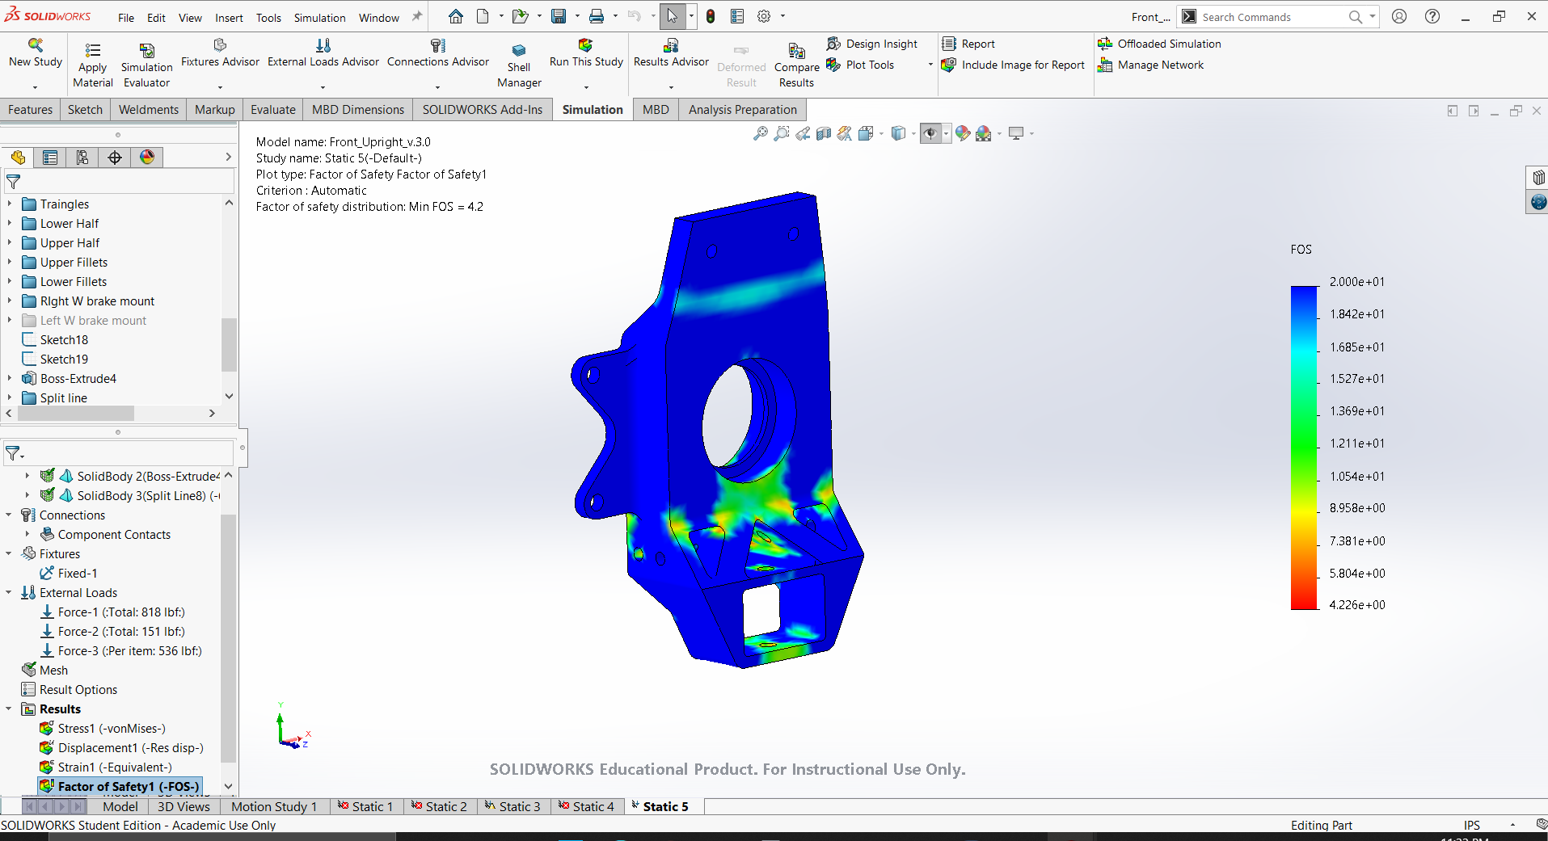
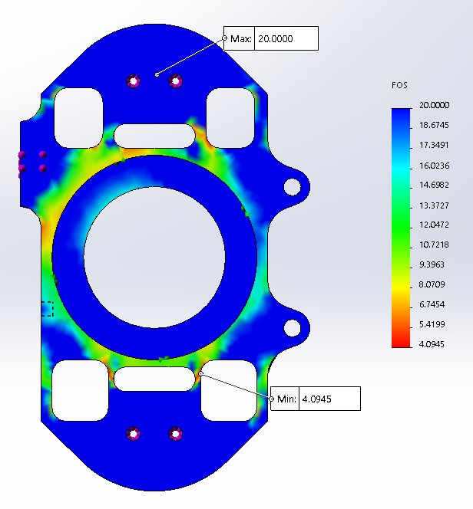
Suspension – Design – Analysis – Uprights
Category | Front | Rear
Factory of safety | 4.45 | 4.2
Notes:
FOS.. Remove
I need to add the margin of safety
Tie it back “from all the scenarios we ran here is the what we ran..” I am making a moment arm.. Or I can reduce the vertical distance and you can beef it up.. Don’t out it in bending and they fatigue..

Slide 25
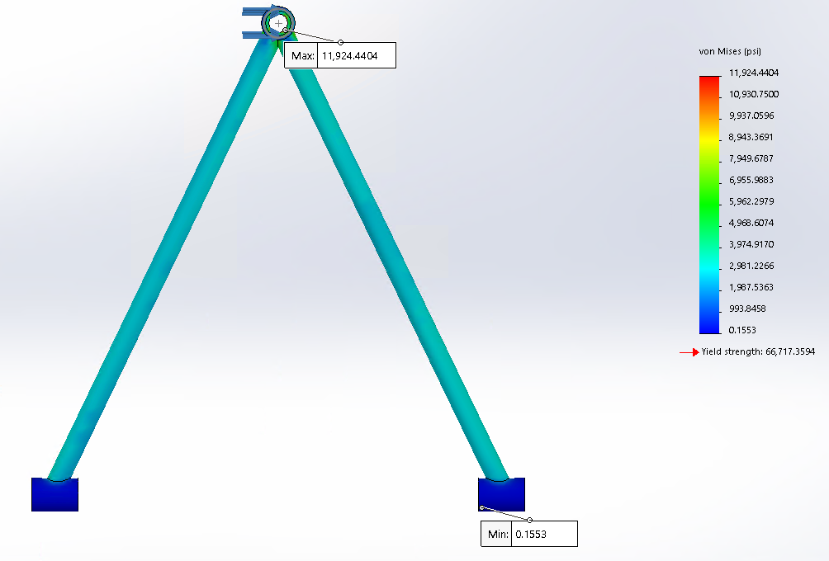
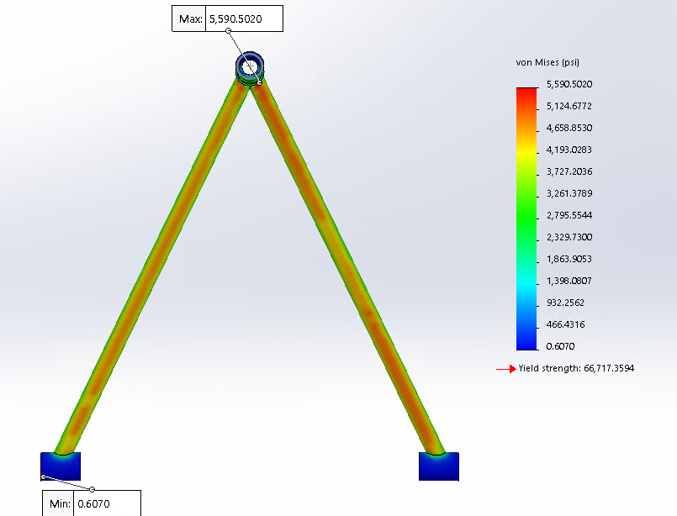
Rear lower A-arm FEA
Acceleration
  Max stress: 11 ksi
  Min FOS: 5.5
Corner
  Max stress: 5.59 ksi
  Min FOS: 12
Y
X

Slide 26
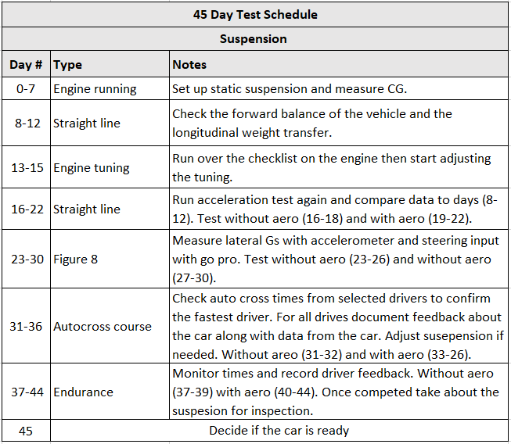
Testing Plan
Method
  Video
  Accelerometers
  Stop watches
  Temperature sensors
Location
  School parking lot
Expectations
  Validate max lateral force
  Validate max roll
  Validate operating temperatures
Notes:
This is the plan for testing in the future to verify our design.
The method of recording data will be to use a video camera, accelerometers, stop watch, and temperatures.
The testing will be done in the school parking lot.
We expect to validate max lateral force, max roll and operating temperatures for the tires.

Slide 27
Agenda
Introduction- Frank
Driver Controls – Abel
Suspension (Front/Rear) – David & Patrick
Powertrain – Francisco Hector & Frank
  (Intake/Exhaust) - Francisco & Hector
  (Cooling/Fuel) - Frank
Electrical – Carlos & Erick
Notes:
Now I will pass it onto Powertrain, covered by fransico, hector and Frank

Slide 28
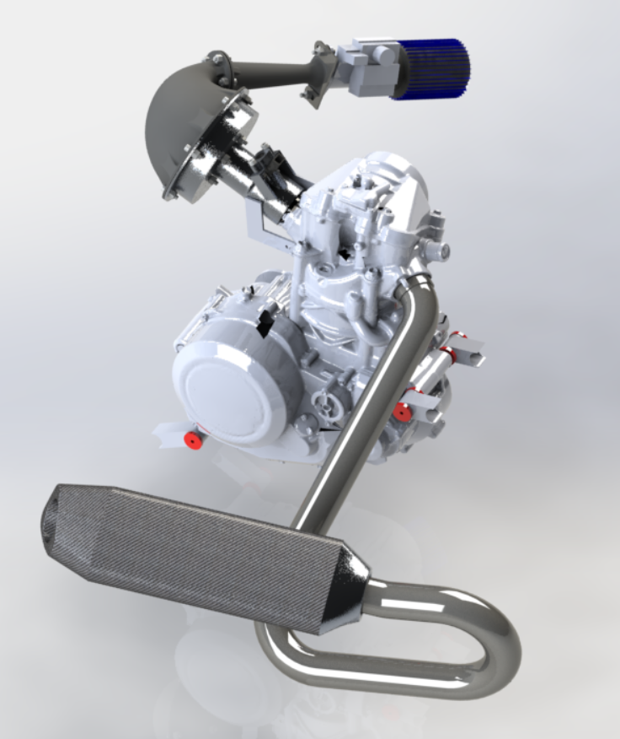
Engine – Design – Overview and Concepts
2015 KTM 690 Duke
Single cylinder
Engine Displacement 690cc
Goal:
  Produce 53.81 HP
  Produce 37.71 ft-lb

Slide 29
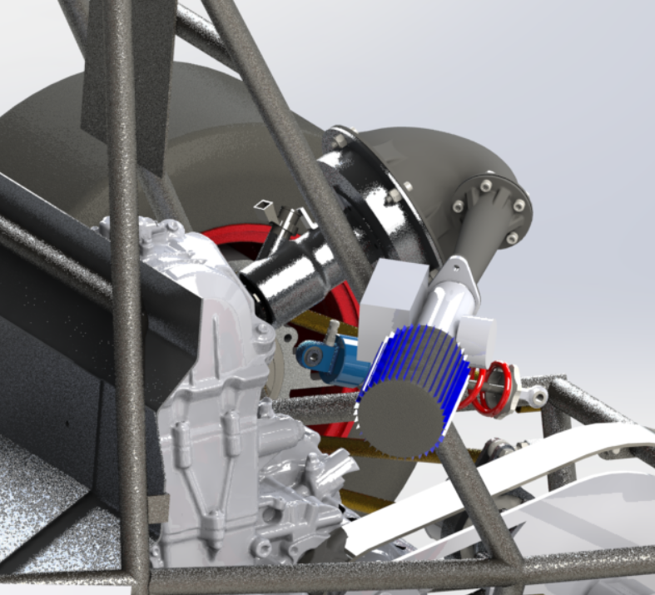
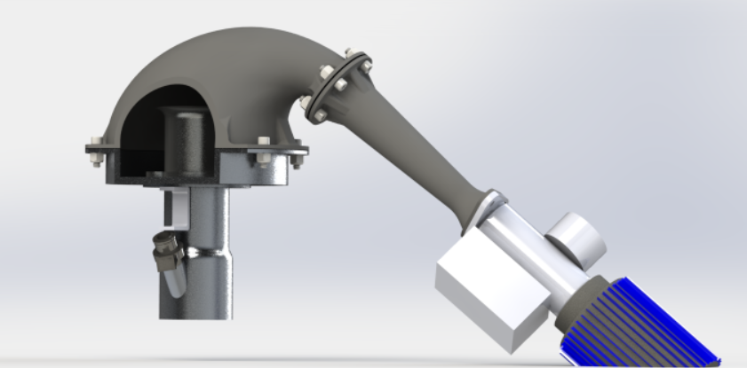
Intake System
Upper Plenum
Restrictor
Velocity Stack
Air Filter
Lower Plenum
Runner
Throttle body

Slide 30
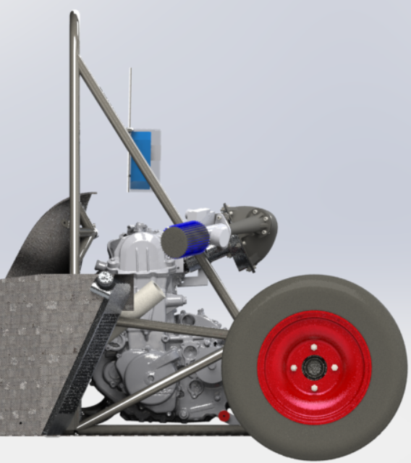
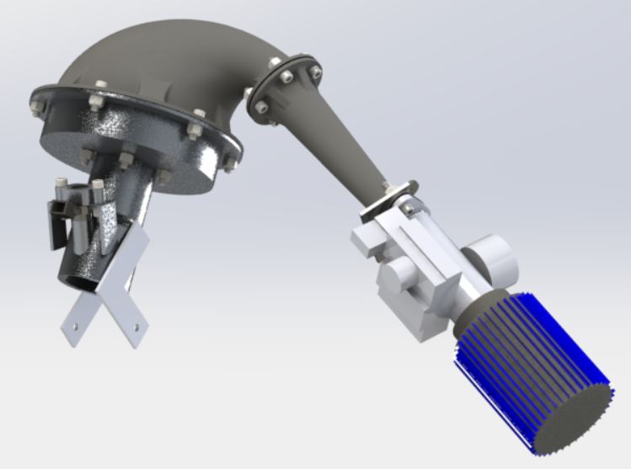
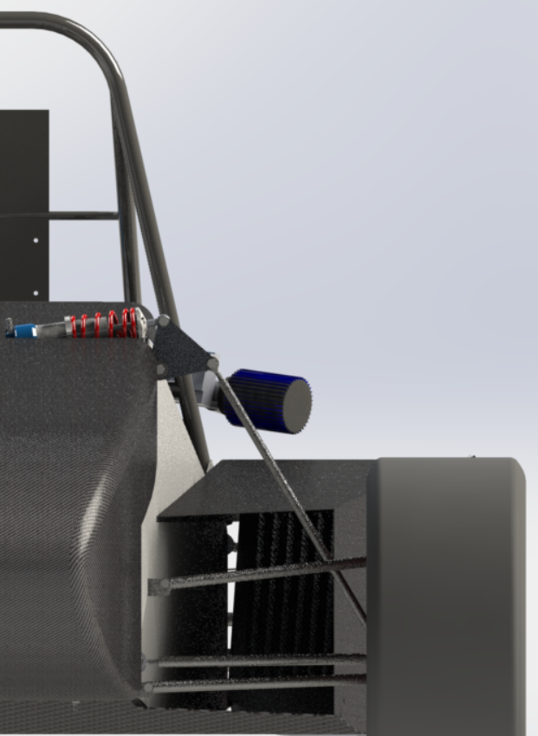
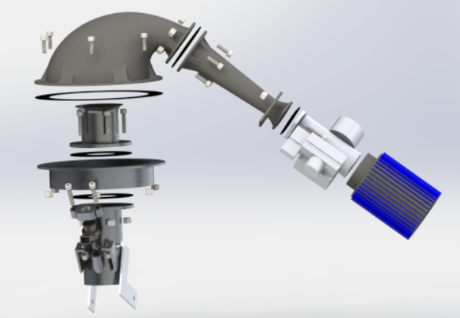
Engine – Design – Intake System
Design Criteria:
  Packaging (Intake Envelope)
  Optimum Runner Length (6000RPM)
  Plenum Volume >1.5x690cc
  Restrictor profile best pressure recovery
Intake System Specs:
Specification | Value
Runner Length | 6.93 in.
Plenum Volume | 1486cc (2.15*690)
Restrictor Diameter | 20 mm
Throttle Body | 33 mm

Slide 31
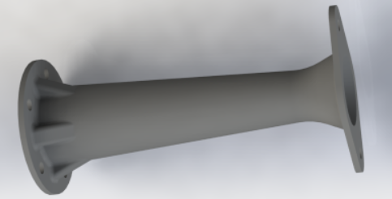
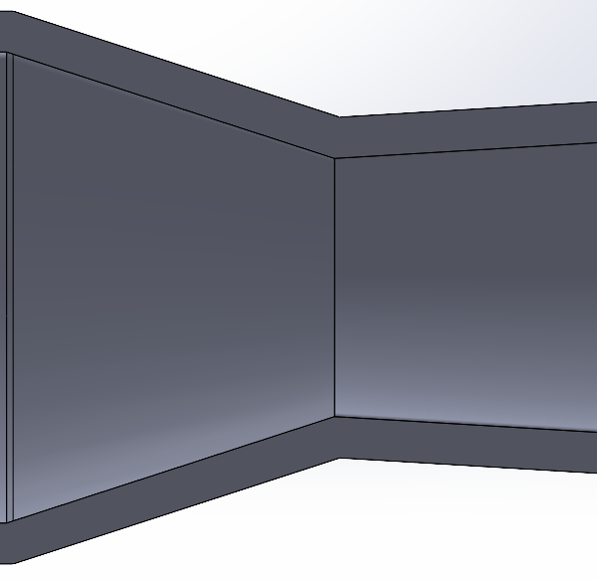
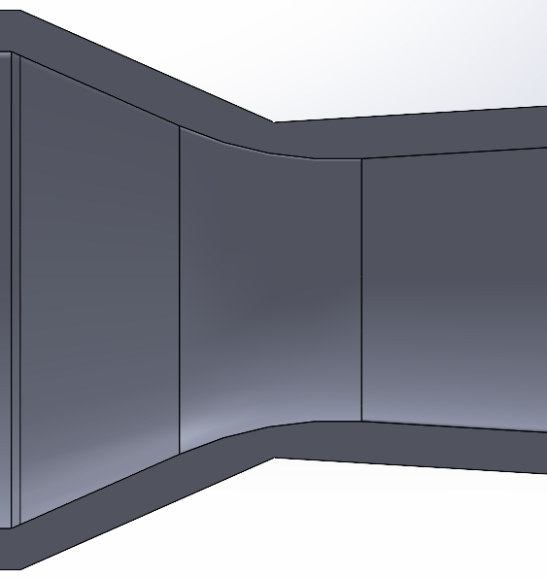
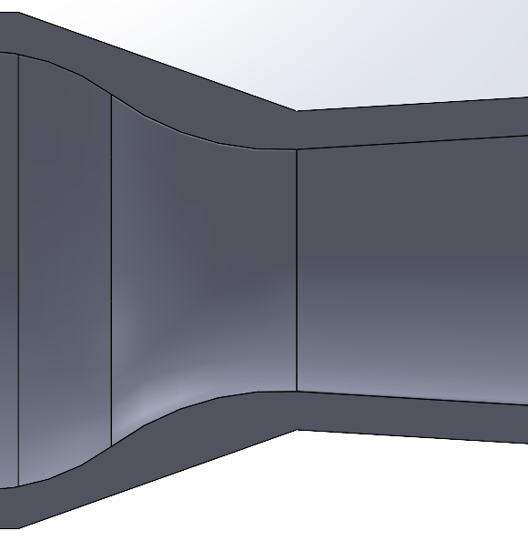
Restrictor Design
Section | Dimension
Inlet | 3.65 cm
Throat | 2 cm
Outlet | 3.65 cm
Length | 16.38 cm
Converging | 47.68°
Diverging | 6.86°
(1) Sharp Corner
(2) Fillet
(3) Hourglass

Slide 32
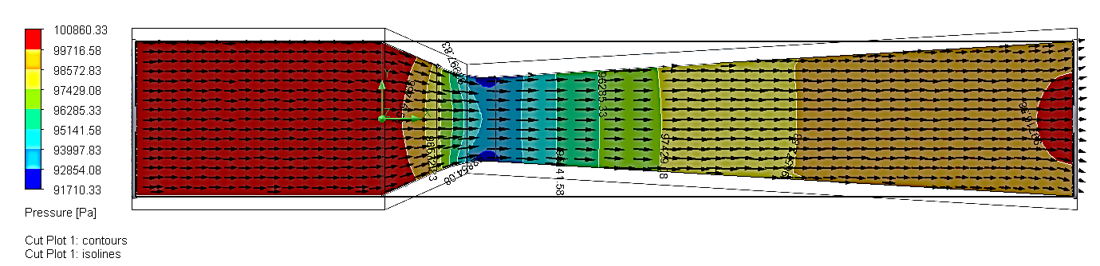
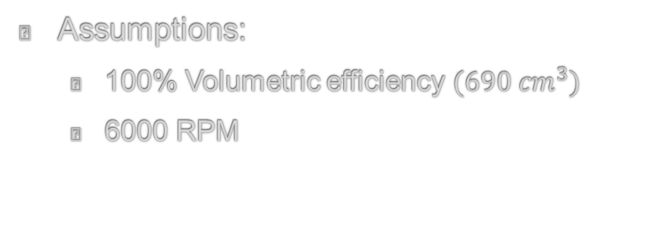
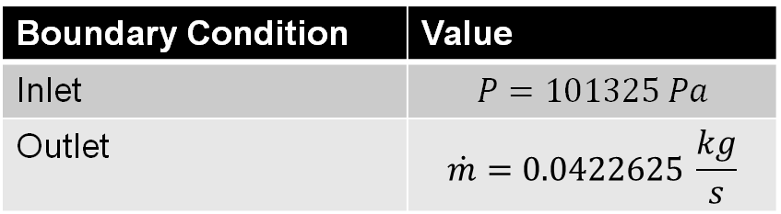
Restrictor Analysis
Assumptions:
  100% Volumetric efficiency ${(690 cm}^{3})$
  6000 RPM
Boundary Condition | Value
Inlet | $$P=101325 Pa$$
Outlet | $$\dot{m}=0.0422625 \frac{kg}{s}$$
Key
Background Contour = Pressure Readings
Arrows = Velocity of Pressure

Slide 33
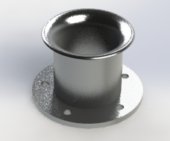
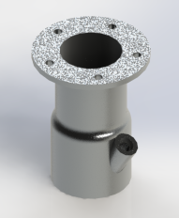
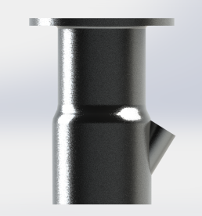
Runner Length Final Design
Velocity Stack
Runner
Flange
Flange
Injector Bung
Material | Inner Diameter (in) | Length (in)
1/8 Aluminum 6061-T6 | 1.86 | 2.33
Material | Inner Diameter (in) | Length (in)
1/8 Aluminum 6061-T6 | 1.86 | 4.55

Slide 34
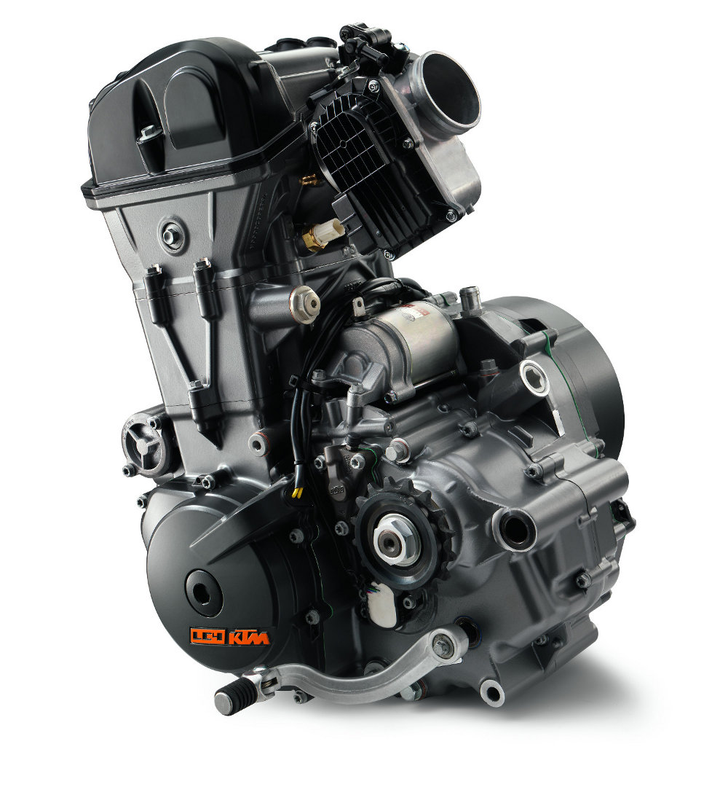
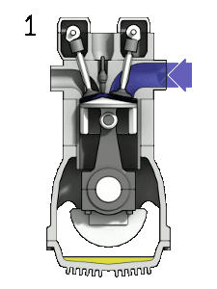
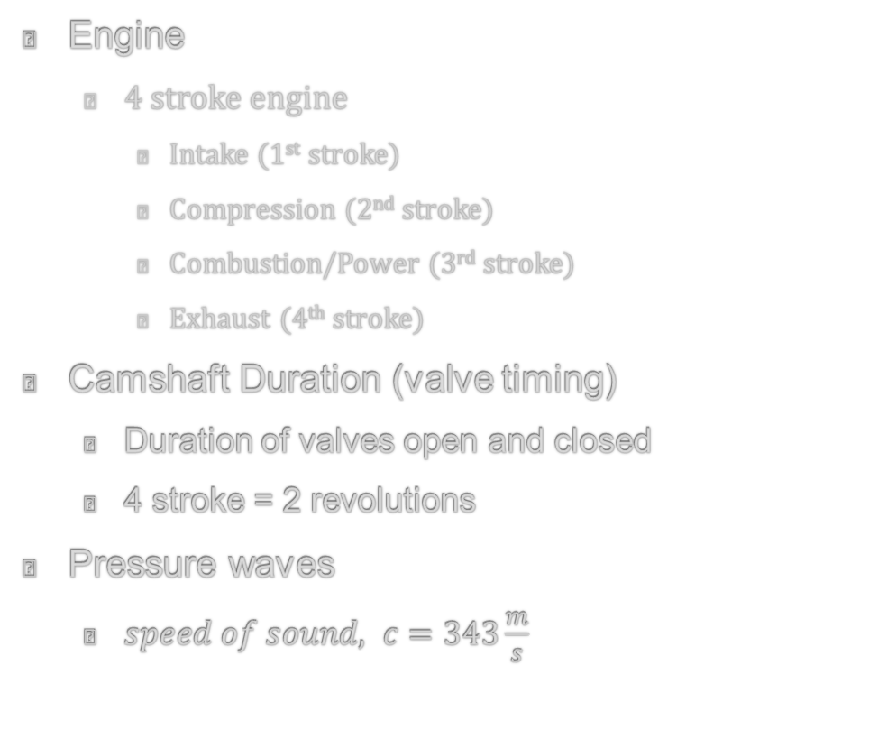
Runner Length Analysis
Engine
  4 stroke engine
    Intake (1st stroke)
    Compression (2nd stroke)
    Combustion/Power (3rd stroke)
    Exhaust (4th stroke)
Camshaft Duration (valve timing)
  Duration of valves open and closed
  4 stroke = 2 revolutions
Pressure waves
  $speed of sound, c=343\frac{m}{s}$

Slide 35


Runner Length Results
Dial Indicator
Runner Length
  Intake Valve Timing of pressure waves (pulses)
    Valve Open= 228 degrees
    Valve Closed= 492 degrees
    Valve lift = 0.420 inches
  Location in RPM of peak Power (power band)
    Peak engine power at 6000 RPM
  Runner Length
    Pressure wave (pulse): 5th
      Ideal Runner Length = 6.84 inches
      Final Runner Length = 6.93 inches
Degree Wheel

Slide 36


Runner Length Manufacturing
Velocity Stack
Runner

Slide 37




Engine – Design – Exhaust System
Design Criteria:
  Packaging
  Optimum Header Length (6000RPM)
  Noise Reduction
Exhaust Specs:
Specification | Value
Header Length | 49.1 in.
Header Inner Diameter | 1.75 in.
Material | Stainless Steel 304

Slide 38


Engine – Design – Exhaust System – Analysis
Header Length
  Organ Pipe Theory
    Eq: $L=\frac{V∗T}{R}$
    L = Length of pipe from valve to outer end, in inches
    V = Velocity of sound in the gas
      13509.9 in/sec
    T = Crankshaft degrees
      120 crankshaft degrees
    R = Rev/min
      6000 RPM=36000 deg/sec
 | Calculated | Actual
Header Length | 45 in. | 49.1 in.

Slide 39
Agenda
Introduction- Frank
Driver Controls – Abel
Suspension (Front/Rear) – David & Patrick
Powertrain – Francisco C. Hector & Frank
  (Intake/Exhaust) - Francisco & Hector
  (Cooling/Fuel) - Frank
Electrical – Carlos & Erick

Slide 40


Cooling system
Radiator
Sidepod

Slide 41


Engine – Design – Cooling System
Design Criteria:
  Use with sidepod design
  Effective cooling for prolonged use both statically and dynamically
  Keep engine temperature below 257 °F
Cooling System Specs:
Specification | Value
Fan | 10 in. Diameter
Austin Mini cooper Radiator | 10.63 in x 10.16 in x 1.96 in

Slide 42


Radiator
Specification​ | Value​
Fan​ | 10 in. Diameter​
Austin Mini cooper Radiator​ | 10.63 in x 10.16 in x 1.96 in ​
Austin Rover Mini Cooper Radiator
Final radiator chosen for use of the vehicle from simulations
  Austin rover mini cooper​
Radiator is made of aluminum
  Austin: 2 rows within for larger area of cooling
  Can support a 10-inch diameter fan

Slide 43



Radiator analysis
Graphs based off both radiator 1
  Using assumptions of components and the engine
Parameters set: Steady State
  Aluminum Thermal Conductivity $k=205\frac{W}{m}∗k$
  Water $C_{p}=4.18\frac{kJ}{kg}∗K$
  Hot fluid $C_{p_{h}}=3.16\frac{kJ}{K}∗s$
$$q=k∗A_{s}∗(T_{cool}−T_{air})$$
  $$Temp=\frac{Power∗1000}{C_{p_{h}}∗1000}+T_{out}$$
  $$Heat rejection= \dot{V}∗C_{p}∗\left(Temp−T_{out}\right)+(\frac{q}{1000})$$

Slide 44


Engine – Design – Fuel System
Design Criteria:
  Packaging
  Full endurance track
Fuel System Specs:
Specification | Value
Fuel | 91 Octane
Volume | 2 gallons
Aluminum 5052-H32 | 4.3 lb

Slide 45


Fuel Tank
Fuel Tank is made of Aluminum 5052-H32
  Tank volume is 2 gallons
  Based off average RPM given through simulations run on excel for an endurance run
Internal components of the tank:
  4 baffles (Aluminum 5052-H32)
  Holley mat (internal filter)
External fuel pump
40-80 psi
  Mounted on top of fuel tank
baffle
Holley mat

Slide 46
Engine Testing
Type | Notes
Restrictor | Flow bench will be used to compare/validate pressure readings from CFD flow simulations
Engine Performance | Engine or chassis dyno will be used to determine the horsepower and torque of our engine
Noise monitoring | Decibel meter will monitor the noise level of our engine under a variety of RPM’s
Engine Temperature | Monitor the engine temperature as to stay under 257 °F
Endurance | Run the vehicle on practice course for 13.2 miles to check fuel consumption
Methods
  Flow Bench
  Engine or Chassis Dyno
  Temperature Sensors
  Decibel meter
  Practice course
Location
  School parking lot
Expectations
  53.81 HP & 37.71 ft-lbs
  CFD Validation
  Engine does not overheat
  Desired noise levels
  Enough fuel for 13.2 miles

Slide 47
Agenda
Introduction- Frank
Driver Controls – Abel
Suspension (Front/Rear) – David & Patrick
Powertrain – Francisco Hector & Frank
  (Intake/Exhaust) - Francisco & Hector
  (Cooling/Fuel) - Frank
Electrical – Carlos & Erick

Slide 48



Electrical – Power Distribution Specs
Item | Description/Value
Fuses | Range of 10-40A depending on the component/sensor specs
Relays | Stock, Three relays (Main, Fuel Pump, Fan)
Ground Bus | Implemented on the fuse box to reduce materials use and reduce space used
Battery | Shorai Lithium Ion
Voltage Rectifier/Regulator | Stock

Slide 49


Electrical – Power Distribution Layout
Fuse Box Mount
Battery
Seat
Free space for microcontroller/other component
Relay Mount
Rectifier/Regulator

Slide 50

Electrical – Harness Specs
Item | Description/Value
Signal and Signal Grounds | SAE rated 16 and 20-gauge wire
Power and Grounds from power distribution box | 14-gauge wire to handle more current
Grounds from the battery to chassis | 6-gauge to ensure solid grounding
Power cable to starter motor | 6-gauge to ensure it can deliver the necessary current to turn the engine over
Connectors | 2 Sixteen pin connectors were used to have a modular harness for troubleshooting
ECU
RPM and other Sensors
Power Distribution
Brake Temp sensor
Connector 1
Connector 2

Slide 51
Electrical - Simplified Harness Schematic
EngCon
Relay 10A
PPow-10
10
SSC2-13
∞
13
SSC1-14
14
Cshft -16
∞
16
Cshft-17
17
FnS-21
21
SGnd-22
22
SGnd-24
24
CTS-38
∞
38
AEM Infinity 506
ATS-39
39
OTS-40
40
FPS-41
41
MRS-47
47
ISP-48
48
GPS-70
70
OPS-73
73
FIP-78
78
PDCon

Slide 52
Electrical - Harness Legend
PPow-10 = Permanent Power Pin 10 on ECU
SSC-2 = Signal Smart Coil 2 Pin 13 on ECU
SSC-1 = Signal Smart Coil 1 Pin 14 on ECU
Cshft-16 = Crankshaft – Pin 16 on ECU
Cshft-17 = Crankshaft + Pin 17 on ECU
FnS-21= Fan Signal Pin 21 in ECU
SGnd22 = Signal Ground Pin 22 on ECU
SGnd24 = Signal Ground Pin 24 on ECU
CTS-38= Coolant Temp Sensor Pin 38 on ECU
Abbreviations were made to make the schematic easier to read
After every schematic, a legend follows for guidance
Each wire has a specific label as shown by the key
They symbol in between the signal wires indicate that the wires need to be twisted for a better signal and cancels impedances

Slide 53

Electrical – ECU and Data Acquisition Specs
Item | Description/Value
AEM Infinity 506 | Aftermarket ECU with the ability to add multiple sensors and external DAQ system if needed
RPM Sensor | Mainly for shifting purposes and RPM matching with the ECU
4 digit 7-Segment Display | Used to display engine RPM
LEDs | Indicators used to notify drivers about the engine such as engine temperature
Temperature Sensors | Temp range –70°C to 380°C . Used to capture brake rotors and engine temperature, 15 samples/sec
Data Storage | Will be stored on an SD card which will go in the raspberry pi
Headrest
ECU mount/enclosure
ECU

Slide 54

Electrical - ECU Pinout
Pins 1-80 documented on an Excel sheet along with the pin's purpose
Table made for pins being used and not being used
The table is color coated with respect to the wire being used on the actual harness

Slide 55


Electrical – Data Acquisition Layout (Brake Temp)
Front Upright
Rear Upright
Brake Temp Sensor mount
Rotor
Brake Temp Sensor mount

Slide 56
Questions?

Slide 57
Appendix

Slide 58

Throttle Pedal
Pedal height: 7.25-inches
Manufactured from plate of aluminum 6061-T6
Dual torsion spring to stiffen the pedal
0.75 diameter tube machined down to size

Slide 59

Clutch Pedal
Pedal height: 7.25-inches
Manufactured from 0.75-inch-thick block of aluminum 6061-T6
Utilizing the OEM hand clutch as master cylinder
Both pedal/master cylinder pivot
Torsion spring to stiffen the pedal

Slide 60

Brake Pedal
Pedal height: 8.5-inches
Manufactured from a block of Al 6061-T6
Utilizing two independent master cylinders
Both pedal/master cylinders pivot
Pedal ratio: 3.74
  Dependent on angle of master cylinders

Slide 61

Manufacturing Plan
Front View
General Information:
Planned Manufacturing:
CNC, machining, waterjet, notching and welding.
Weight (pounds):
Front: 57 lb Rear: 59 lb
Design Notes:
Drawings for all parts
Notching paper on A-Arms
Arm jig for welding
Waterjet all tabs
Press fit bearings
Notes:
The plan to manufacture this vehicle is, CNC the uprights, machining

Slide 62


Brake Pedal Kinematics
Law of cosines
  c=$\sqrt{a^{2}+b^{2}−2ab∗cosγ}$
Law of sines
  $\frac{a}{sinα}=\frac{b}{sinβ}=\frac{c}{sinγ}$
  a→ Brake pedal, fixed
  $γ$→ angle between brake pedal and base
  b→ distance between pivots
  $β$→ angle between Brake pedal and MC
  c→ Master cylinder length, varies
  $α$→ angle between MC and base

Slide 63
Pedal Box Trade Study
Material | Cost | Weight | Strength | Total
3/16 in A36 steel plate | 2 | 2 | 3 | 7
¼ in Al 6061-T6 plate | 3* | 3 | 1 | 7
0.75 in Al 6061-T6 block | 1 | 1 | 2 | 4
*Reusing material from previous year

Slide 64


Caliper Selection
Wilwood GP 200
  Piston Area: 1.23 in^2
  Weight: 0.9 lbs
  Rotor compatibility:
    0.19-0.25 inches thick
    8-11 inches diameter
Wilwood PS-1
  Piston area: 0.99 in^2
  Weight: 1.1 lbs
  Rotor compatibility:
    0.15-0.2 inches thick
    6-9 inches diameter

Slide 65
Volumetric Displacement
Front System
Caliper Piston Area: 1.23 in^2
Caliper Volumetric Displacement: 0.0492 in^3
Master Cylinder Area: 0.31 in^2
Master Cylinder Travel: 0.159 in
Rear System
Caliper Piston Area: 0.99 in^2
Caliper Volumetric Displacement: 0.396 in^3
Master Cylinder Area: 0.78 in^2
Master Cylinder Travel: 0.051 in

Slide 66


Throttle Body / Air Filter
Throttle Body
Air Filter
Throttle Body Size (mm)
48,33,28,26
Air Filter
Oil vs Dry
Pro 5R vs Guard 7 vs Pro 10R

Slide 67


Intake Assembly (Runner Length)
Velocity Stack
Runner

Slide 68

Velocity Stack Design
(1) CAD Model
(2) Model
Design | Inner Diameter (in) | Length (in)
(1) | 1.86 | 2.33
(2) | 1.73 | 2.25
Material | Cost | Machineability | Weight | Strength | Total
1/8 Aluminum 6061-T6 | 5 | 3 | 4 | 3 | 15
Nylon 12 (3D print) | 2 | 4 | 4 | 4 | 14

Slide 69
Runner Design
Section | Dimension (in)
Runner | Length | 4.5
 | Inner Diameter | 1.86
Injector Bung | Inner Diameter | 0.453
 | Outer Diameter | 0.75
Flange | Inner Diameter | 1.86
 | Outer Diameter | 3.527
Flange
Injector Bung

Slide 70

Restrictor Analysis
Design | Inlet Pressure (Pa) | Outlet Pressure (Pa) | Pressure Difference (Pa)
(1) Corner | 101325 | 99488 | 1837
(2) Fillet | 101325 | 99717 | 1608
(3) Hourglass | 101325 | 99688 | 1637

Slide 71


Runner Length Analysis
4 stroke engine
  $4 strokes=2 revolutions=2\left(360°\right)=720°$
Cam Duration (valve timing)
  Duration of valves open and closed
Pressure waves
  $speed of sound, c=343\frac{m}{s}$
Tuning for Peak Power
  Engine Power Band
  Target RPM

Slide 72



Restrictor Analysis
Computational Fluid Dynamics (CFD)
Boundary Conditions:
  Inlet: $P_{atm}=101325 Pa$
  Outlet: $P, \vec{v}, \dot{m}$
    Assumptions:
      100% Volumetric efficiency $(690{cm}^{3}=0.00069m^{3})$
      Target RPM $(6000 RPM)$
    4 Stroke Engine (Intake, Compression, Combustion, Exhaust)
      Intake involved in 2 strokes $\left(\frac{6000}{2}\right)=3000 RPM$
      $\frac{3000 rev}{min}∗\frac{min}{60 sec}=50 rev/s$
Volumetric Flow Rate
  $\dot{Q}=\frac{V}{t}=0.00069m^{3}∗50\frac{rev}{s}=0.0345 \frac{m^{3}}{s}$
Mass Flow Rate
  $\dot{m}=ρ\dot{Q}=1.225\frac{kg}{m^{3}}∗0.0345\frac{m^{3}}{s}$
  $\dot{m}=0.0422625\frac{kg}{s}$
Boundary Condition | Value
Inlet | $$P=101325 Pa$$
Outlet | $$\dot{m}=0.0422625 \frac{kg}{s}$$

Slide 73


Runner Length Analysis
Sample Calculations:
  Target RPM = 6000
  Cam Duration = $228°$ (open valve)
    4 Stroke Engine
      $4 strokes=2 revolutions=2\left(360°\right)=720°$
      $closed valve=720°−open valve=492°$
    RPM @ Peak Power
      $\left(6000\frac{rev}{m}\right)\left(\frac{1 min}{60 sec}\right)\left(360\frac{deg}{rev}\right)=36,000\frac{deg}{sec}$
    Time (s) @ closed valve
      $\frac{492 deg}{36000\frac{deg}{sec}}=0.016 sec$
    Speed of sound
      $c=(343\frac{m}{s})\left(39.3701\frac{in}{m}\right)=13,503.94\frac{in}{s}$
    Time at RPM
      $L=\left(13,503.94\frac{in}{s}\right)\left(0.0137 s\right)=219.06 in$
      $L=6.84 in @ 5th pulse$
Pressure wave | Target RPM | Ideal Runner (in)
5th Pulse | 6000 | 6.84

Slide 74

Fuel tank volume
Fuel tank volume determined with use of MATLAB
  Values: Cylinder size (gallon) = 0.182279
    Total distance driven for Endurance run = 13.6702 miles
    Average RPM = 6943
    Air to fuel ratio = 14.7
  Using these values some of the equations that were setup;
  $$mf=\frac{Cylinder size}{(\frac{Air to Fuel}{Air density})}$$
  $$Vdf=Average RPM∗Cylinder size∗\frac{\frac{mf}{2}}{fuel density}$$
  $$Vtank=Vdf∗track time$$

Slide 75
Engine Build
System | Component | Material | Manufacturing Method
Intake | Restrictor/Velocity Stack | Carbon Fiber Nylon Fillament | 3D print (open printer)
 | Upper Plenum | Nylon 12 Powder | 3D print (Multi Jet Fusion)
 | Lower Plenum | Aluminum 6061-T6 | CNC Mill
 | Runner | Aluminum 6061-T6 | Machine (Lathe), weld
Exhaust | Exhaust Header | Stainless Steel 304 | Tube bender, weld
 | Muffler | N/A | Purchased
Fuel | Gas Tank | Aluminum 5052-H32 | Machine, weld
Cooling | Fan | N/A | Purchased
 | Radiator | N/A | Purchased

Slide 76

Wheel hub trade study
Category​ | In house ​ | RCV​
Cost (1-5)​ | 3​ | 5​
Lead time (1-10)​ | 8 | 2
Packaging (1-5)​ | 4 | 3​
Total | 15 | 10
Rear RCV wheel hub Front RCV wheel hub

Slide 77

Safety factor, RCV wheel hub
Category​ | Front​ | Rear​
Bump​ | ​ | 7.33​
Corner​ | ​ | 4.96​
Acceleration​ | ​ | 20​
Braking​ | ​ | 16.6​
Front Wheel Hubs
Rear Wheel Hubs

Slide 78
Suspension requirements
Category ​ | Requirement​ |  | Value ​ | Method of Verification ​
​ Design​ | Meets design rules set by FSAE​ |  | FSAE Rules​ | Design​
 | Dynamic Travel ​ |  | 2 in.​ | Inspection, Design ​
 | Factor of safety​ | Major component​ | 3​ | Force Analysis​
 |  | Minor component​ | 2​
Loading​ | Cornering Force​ |  | 300 lbs.​ | Force Analysis​
 | Bump Force​ |  | 600 lbs.​ | Force Analysis​
 | Braking Force​ |  | 506 lbs.​ | Force Analysis​
 | Acceleration Force​ |  | 450 lbs.​ | Force Analysis​

Slide 79
Suspension Kinematics
Category​ |  | Value​
Track width​ |  | 52 in.​
Turn radius​ |  | 12.18 ft​
Camber​ | Front​ | ​-.85 deg
 | Rear​ | 0 deg​
Roll center height​ | Front​ | 1.90 in​
 | Rear​ | 3.50 in ​
Motion Ratio​ | Front​ | 1.16 ​
 | Rear​ | 1.35 ​
Spring stiffness ​ | Front​ | 150 lbs./in.​
 | Rear ​ | 210 lbs./in​
LLTD​ |  | ~.75​

Slide 80
Engine Harness (Cost and Material)
Item | Amount | Cost | Rating
20 AWG Wire | 171 ft. | ~$20 | SAE Rated
14 AWG Wire | 8 ft. | ~$2.50 | SAE Rated
8 AWG Wire | 4 ft. | ~$3.50 | SAE Rated
Mesh | ~15 ft. | ~$5.00 | Automotive/ATV
16 Pin Connectors | 4 pairs | ~$16.00 | Automotive/ATV
Other Fasteners |  | ~$15.00
Total | 198ft | ~$62.00

Slide 81
Electrical – Harness Requirements
Requirement | Description | Verification
Stress relief on pins and wires | Avoid any kinks and stress on the harness and pins | Visual/Inspection
Weight | Weight for the overall harness should be 10 lb. or less | Weight scale
Reliable ground connections | Grounds and signals should be less than 1 Ω of resistance to ensure a good connection | Multimeter
Automotive/SAE rated wires and connectors | Wires and connectors should be rated for automotive use | Controlled Test
Color coated and labeled wires | To help with organization and workability | Visual/Inspection
Accessibility and workability | The harness should have enough space to be troubleshot on the vehicle | Visual/Test
Clean and Organized schematic | Any member should be able to easily understand and follow the schematic | Visual
Weather Proofing | Use necessary materials so ensure weather doesn’t affect the harness | Visual/Controlled Test
Master Switches | Powers the whole electrical system | Test

Slide 82
Electrical – Power Distribution Requirements
Requirement | Description | Verification
Power all the sensors on the engine | All sensors such as the TPS and MAP should receive their required voltage | Multimeter
Power all components on the engine | Components such as the injectors and smart coils should receive their required voltage | Multimeter
Protection from surges/spikes | Implementing fuses and relays will prevent current and voltage spikes from damaging sensors and components | Controlled Test/Multimeter
Battery Supply | Must be able to crank the engine over, minimum of 200 CCA | Manufacturer/Ammeter
Weather Proofing | Must provide weather proofing up to some degree (water, dust, heat) | Visual/Controlled Test

Slide 83
Electrical – ECU and Data Acquisition Requirements
Requirements | Description | Verification
All sensors must be functioning and connected to its proper pins | When connected sensors will give readings to help engine run and for tuning | Multimeter/Visual/Test
Engine/Throttle Control | Engine performance will be carried out by the ECU, having a tuned engine ensure maximum performance | Visual/Test
RPM reading | Reading will be placed on a dash to be displayed for the driver, must be as accurate as the AEM reading | AEM Tuning Software/Tachometer
Accurate Temperature readings | Data will be collected and analyzed for brake fluid verification | IR thermometer
Engine Temperature indicator | Indicator will light when engine is approaching max temperature | AEM Tuning Software/IR thermometer

Slide 84



Electrical - Brake Temperature Sensor
Sensor: MLX90614
Small and compact, relatively cheap ~ $11​
Easy to integrate​
Has high heat resistance (-40°C→380°C)which makes it ideal for our applications
Sensor is rated for automotive use
We can modify the frequency to our need allowing us to collect up to 100 samples per seconds
Given the option to integrate up to 127 sensors using one single multiplexer chip via 2 wire SMbus protocol

Slide 85

Electrical - Data Acquisition
Component​ | Requirements​ | Values​ | Verification​
Microcontroller​ | Input and Output Data​ | 3.3V operating voltage, 32-bit OS​ | Multimeter​/Test
Dash Display​ | Integrate 3 external sensors ​ | Size (TBD )​ | Pass cross section template​
Brake Temp Sensor​ | High temperature range​ | Operating Voltage: 3 Vdc >200°C​ | IR Thermometer, thermo camera​
Engine Temp Sensor​ | High temperature range​ | Operating Voltage: 3 Vdc ≥220°F​ | IR Thermometer, thermo camera​
RPM Sensor​ | Read engine speed​ | Voltage Range: 4-24 Vdc 0 to 8500 RPM​ | AEM ECU Software Comparison​

Slide 86


RPM Sensor
Sensor: Honeywell SNDH-H3C-G03 RPM​
Easy to integrate
Used and tested for vehicles
  Withstands vibration
  Reads high temperatures (-40°C → 150°C)
  Will read the teeth of the gear
High frequency switching capability (up to 15 KHz) allows the device to handle high RPMs
This sensor will be purchased for testing purposes, end goal is to splice into the Crankshaft Position Sensor on the Engine

Slide 87

Fuel tank Trade Study

Slide 88







Camber
Tire: Hoosiers R25B
Max grip at 0 inclination angle
Actual Lateral Force: 1.64 Gs
Static camber: - .85 degrees
Fsae Tire Consortium Data
Camber of the tire
Real world movement of a tire
Notes:
Purpose: How you first design a suspension from the outside in. Look at the tire friction. State where I got my tire data. Explain the TTC test. Tell reason why we can use the full tested Lateral force. Friction loss. *raise tire 0.85 inches and see how much of an angle the wheel will be at. That angle will be how much static camber I will use. Show a picture of the shims..
Always want tire to be in full contact of the ground. Max friction in a corner = camber set to max roll
Max displacement during max roll = 1 in
Max Lateral Force= 2.9 Gs
Due to sand paper like dyno test use 60% of that is 1.64 Gs
Max Longitudinal Force = 3.2 Gs
Actual Longitudinal = 1.92 Gs
Less weight = more grip

Slide 89



Steering Geometry
Suitable for tight course
Ackerman
Turning radius: 11 ft.
Rear steer
Old design
New design
Turning radius Geometry
Notes:
Show steering geometry and how my design has improved

Slide 90

Rear Suspension
Notes:
Label this

Slide 91

Electrical – Harness Layout
Power Distribution Box will be located by the front roll hoop and ECU on the back of the headrest to ensure there is enough space to troubleshoot

Slide 92


Upright safety factor analysis
Category​ | Front​ | Rear​
Bump​ | ​8.5 | 7.33​
Corner​ | ​4.2 | 4.96​
Acceleration​ | ​19 | 20​
Braking​ | ​15.8 | 16.6​
Front Upright
Rear Upright

Slide 93
Electrical – Overview and Concept of Operations​
Composed of Power Distribution System, Harness, ECU and Data Acquisition
Simple and exposed routing of the harness to ensure workability and ease of access
AEM Infinity 506
External sensors implemented for data logging

