Slide 1
Team 29 – EXPO Presentation
Advisor: Curtis Wang
Team 29: Telemedicine Robot
Team Members: Andres Saavedra | Christian Velez | Erick Alvarez
Henry To | Jose Martinez | Manuel Ibarra
Mario Martinez Cisneros | Miguel Cano | Reynaldo Aguirre
Steven Vu | Ye Nyi Aung
Notes:
Ye

Slide 2
Agenda
1) Introduction & Background Andres
2) Technical Progress
Base Platform Miguel, Erick
Central Chassis/Sterilization Christian, Reynaldo
Central Controller Mario, Steven
Robotic Arm (Electronics) Jose, Andres, Ye
Robotic Arm (Mechanical) Manuel, Henry
3) Future Plans, Summary Ye
Notes:
Ye

Slide 3

Project Background / Problems
What is Telemedicine?
  Remote healthcare for patients in real-time
  No physical contact required
Why is telemedicine necessary?
  Recent increases in Telemedicine
      Before Covid: Increase from 35% to 76.8% from 2010 to 2017.
      During Covid: 154% increase in telehealth visits from March 2019 to March 2020.
  Eliminate the need for unnecessary doctor's visits.
      Reduces spread of infectous diseases
  Use to determine if face-to-face appointment is necessary
      Remotely evaluate current health status
      Provide diagnosis of issues
Notes:
Ye

Slide 4
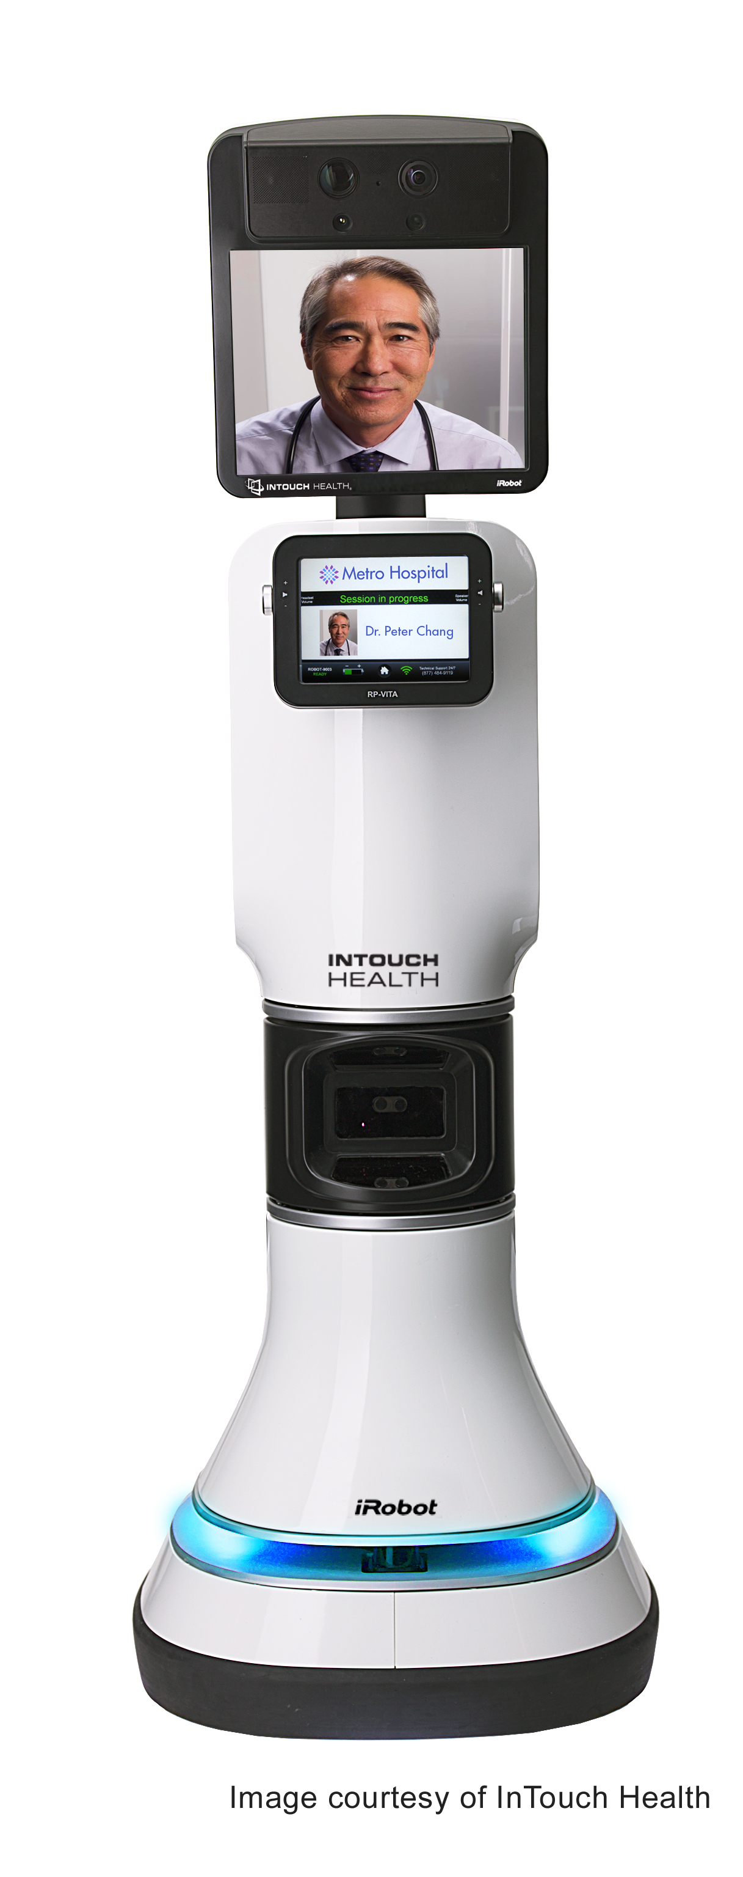
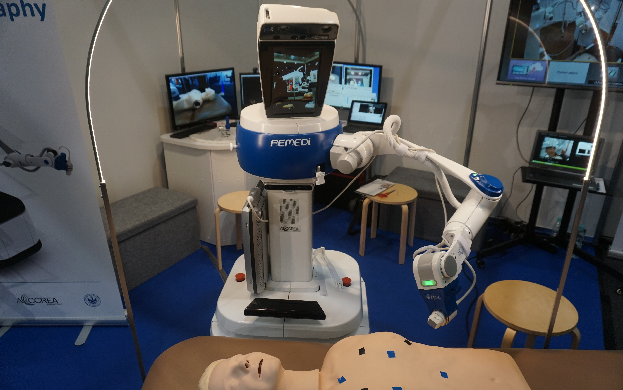
Current State of Telemedicine
Design
  Real-time Audio/Video
  Mobility
  Surgical Care Robots
    In development
    Higher Liability
More widely available
Costs?
  Remote monitoring robot costs: an average of $4,000 for
  basic functionalities and up to $80,000 for more equipped robots.
  Demand for cost-effective telemedicine robots.
Notes:
Ye

Slide 5
Scope
Design and development of a low-cost Telemedicine Robot with the following capabilities:
Driving Capabilities
  Safely maneuver through patients' homes.
Extendable torso
Wireless network capabilities
  Transmit audio and video in real time.
  Transmit controls from host to robot.
Conduct procedures using a robotic arm and end effectors
  Manipulate gripper
  Measure body temperature
Notes:
Ye

Slide 6
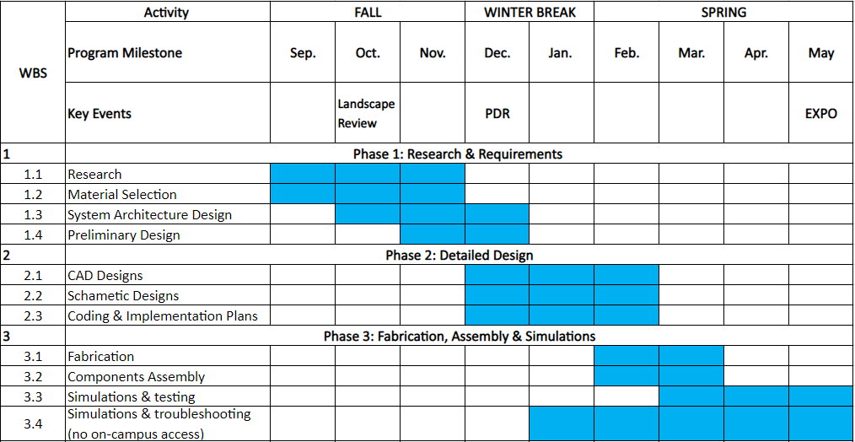
Schedule
Notes:
Ye

Slide 7
Requirements
Number | Requirements | Team Issued | Teams To Work With | Evaluation Method
1 | The total weight limit of the robot must not exceed 60lb | Base Platform | Every Team | Compliant / Not Compliant
2 | The on-board power supply must power all electronics | Base Platform | Every Team | Compliant / Not Compliant
3 | The base platform of the robot must be able to maneuver stairs and hallways | Base Platform | Central Controller | Compliant / Not Compliant
4 | The robot must be able to detect and warn about obstacles | Central Controller | Arm, Base Platform | Compliant / Not Compliant
5 | The robot must have low latency communication | Central Controller |  | < 150 ms
6 | The robot must be able to send and receive files | Central Controller |  | Compliant / Not Compliant
7 | The robot must be capable of two way color calibrated video communication with 1080p quality at 24 FPS | Central Controller |  | Compliant / Not Compliant
8 | The robot arm must be constructed with lightweight material | Arm | Telescopic Torso | Compliant / Not Compliant
9 | The robot must be able to control the arm at high precision | Arm | Central Controller | < 3 mm
10 | The robot arm dimensions must be long enough to reach the patients | Arm | Telescopic Torso | Between 2 feet and 4 feet long
11 | The robot end effectors must be capable of manipulating small medical equipment | Arm | Central Controller | Compliant / Not Compliant
12 | The robot arm must have a good spatial object detection and avoidance system | Arm | Central Controller | > 3cm
13 | The robot must be able to perform basic medical checkup procedures such as measuring body temp, blood pressure, etc. | Arm | Central Controller, Telescopic Torso | Compliant / Not Compliant
14 | The robot torso must be able to extend its height up to 2 feet using a telescopic mechanism to reach the patients in certain scenarios | Central Chassis | Base Platform | Compliant / Not Compliant
15 | The robot must be able to sterilize with relative ease after each deployment | Central Chassis | Every Team | Compliant / Not Compliant
16 | The robot's torso must accommodate mounting of arms, necessary sensors and cameras | Central Chassis | Arm, Central Controller | Compliant / Not Compliant
Notes:
Ye

Slide 8
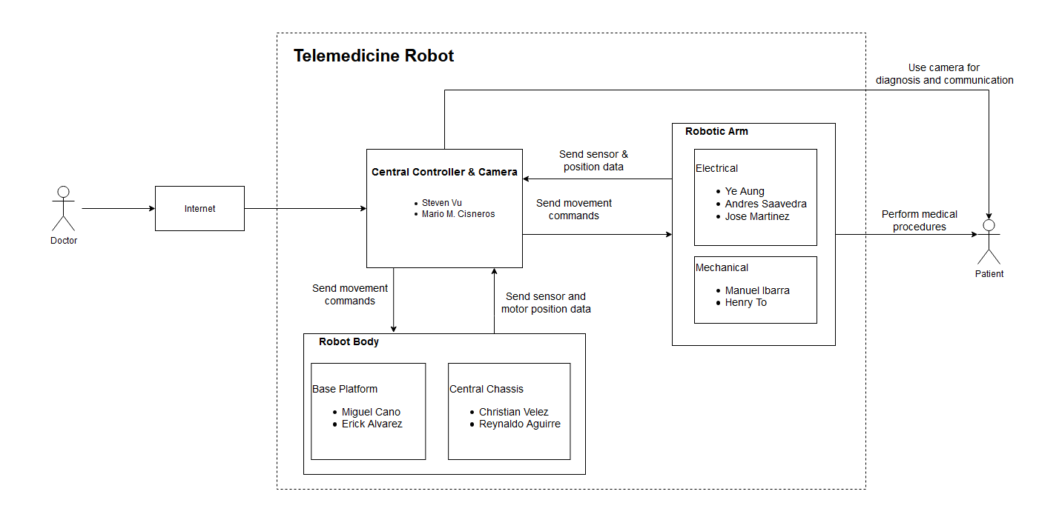
Project Organization
Notes:
Ye

Slide 9
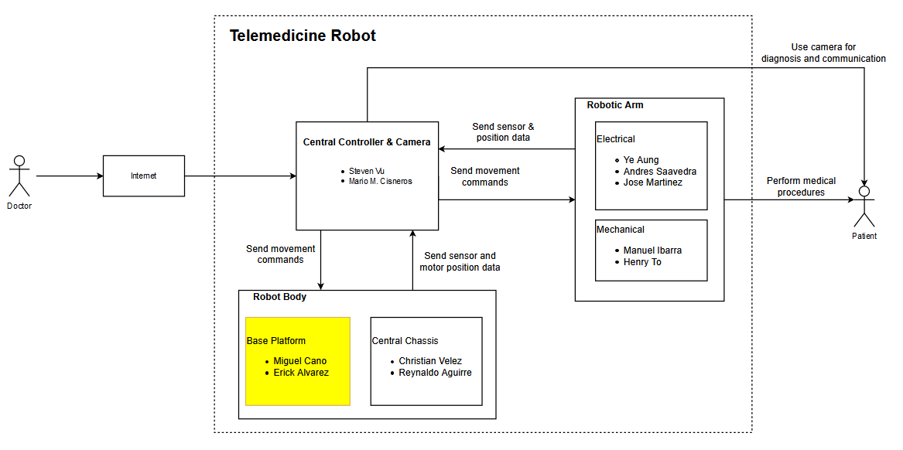
Base Platform
Notes:
Ye

Slide 10
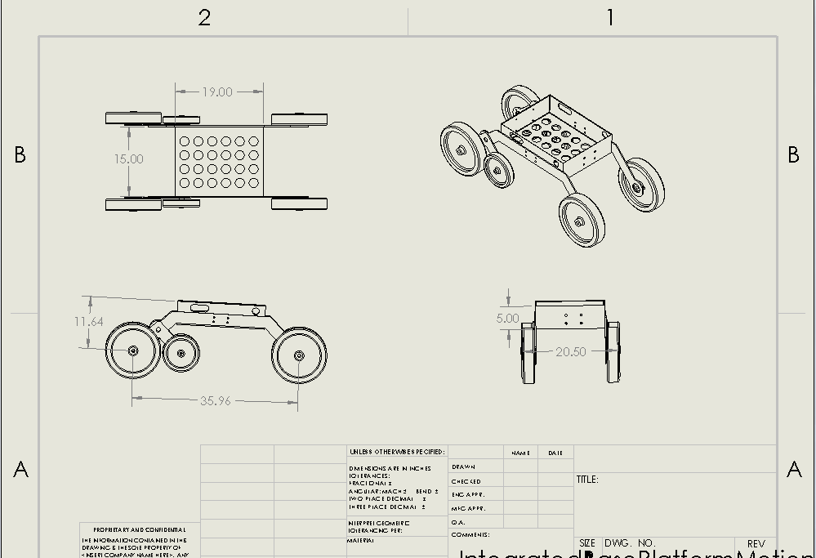
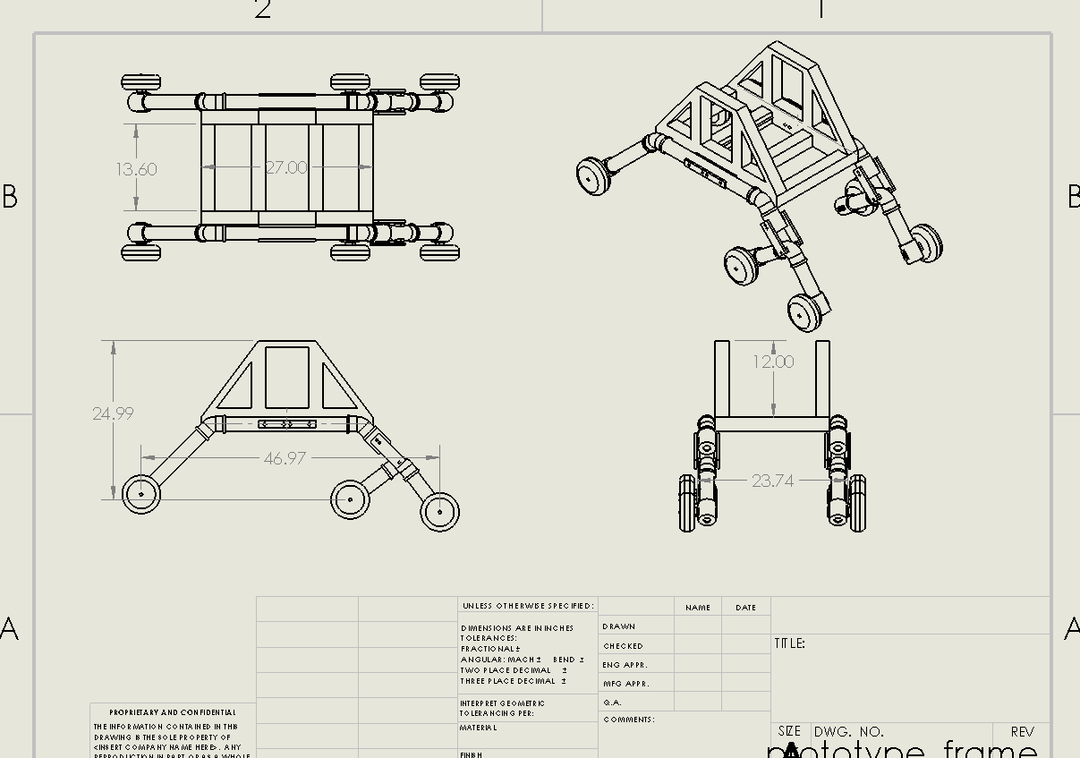
Base Vehicle Platform Design
Current Design:
Total Weight: 16.18 lbs
Total Cost: ~$34.42
Previous Design:
Total Weight: 33 lbs
Total Cost: ~$203.89
Weight difference: 16.82 lbs (7.63 kg)
Cost difference: $169.47

Slide 11
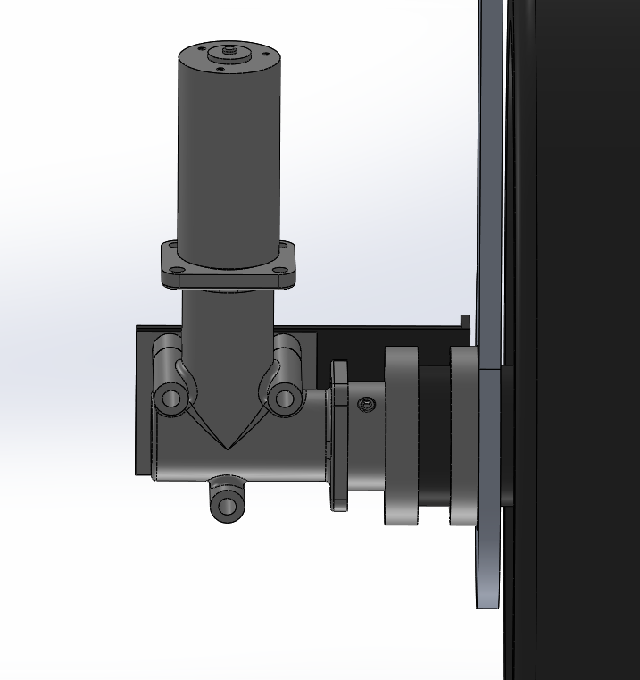
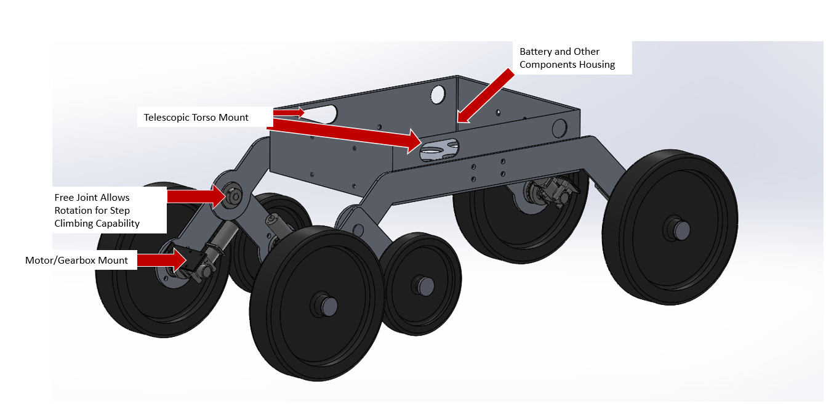
Base Vehicle Platform Design
Base Platform Design Concept
DC motor and gearbox mount

Slide 12
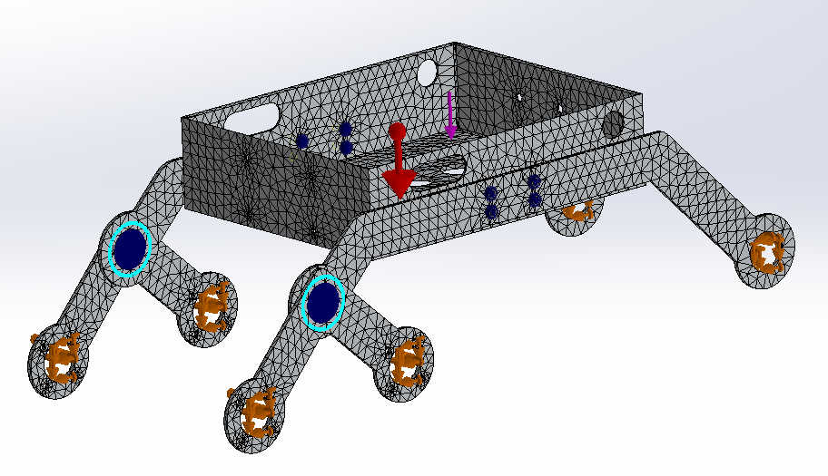
FEA Simulations
Aluminum 7075 material.
Fixed on wheel mount.
Gravity and 80 lbf (356 N) applied.
Pin and Bolt Connections.

Slide 13
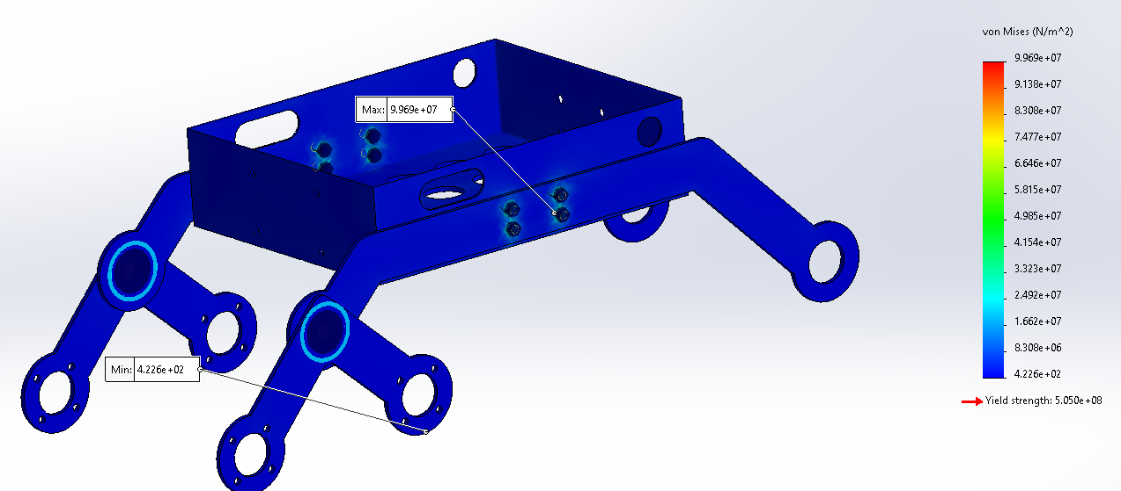
Stress Plot
Yield Strength = 505 MPa
Max Stress = 99.6 MPa
Min Stress = 423 Pa

Slide 14
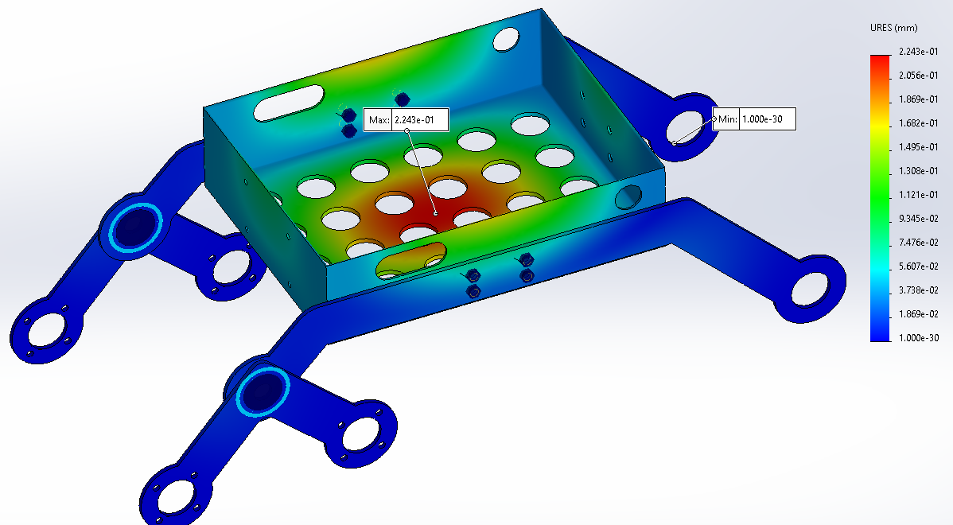
Displacement Plot
Max Displacement = 0.223 mm
Min Displacement = 1e-30 mm

Slide 15
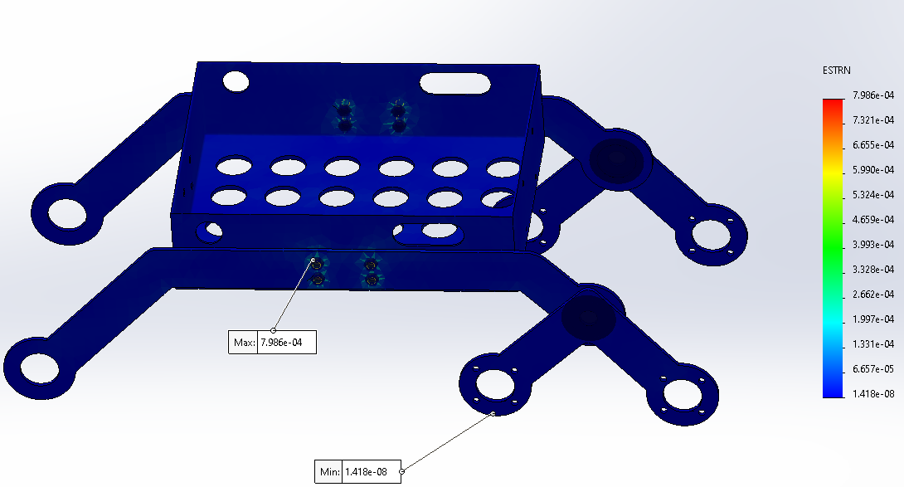
Strain Plot
Max strain = 7.98e-4
Min Strain = 1.42e-8

Slide 16
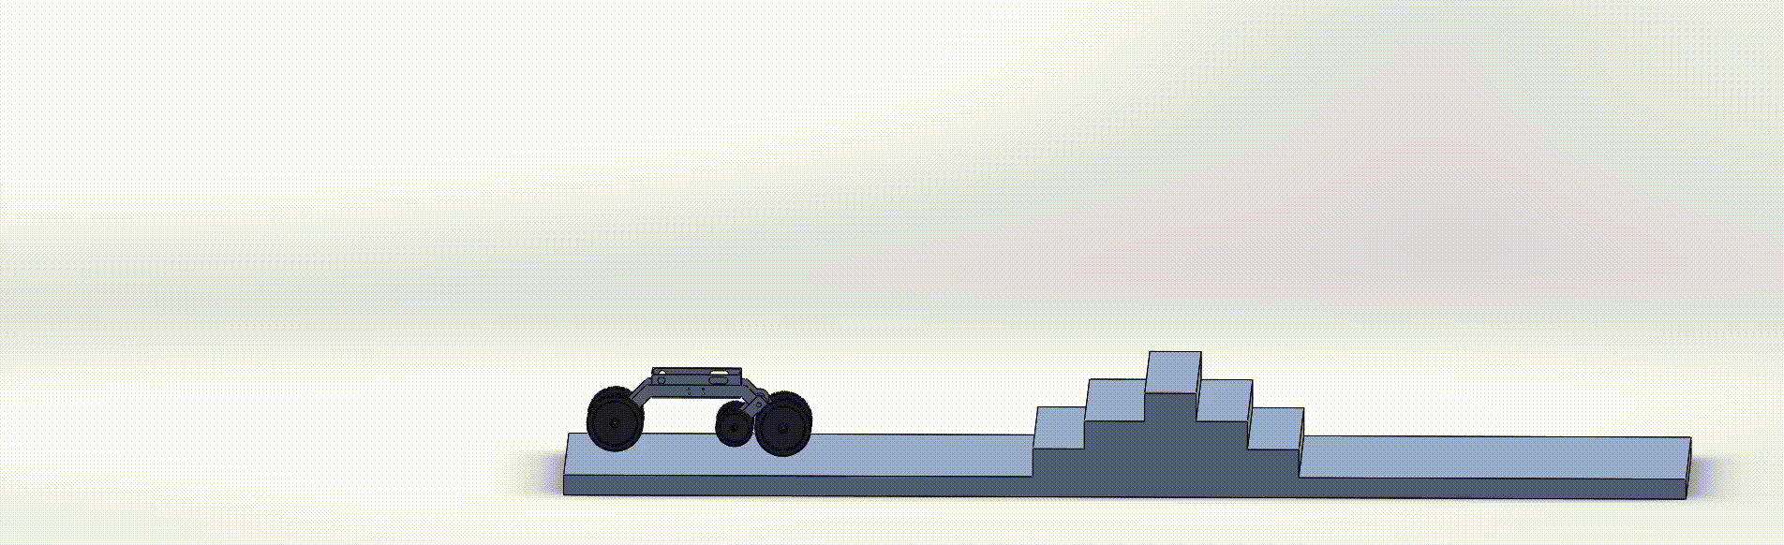
Motion Analysis

Slide 17
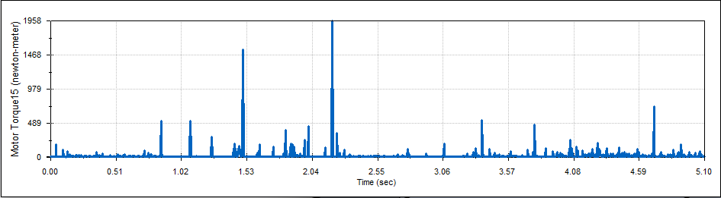
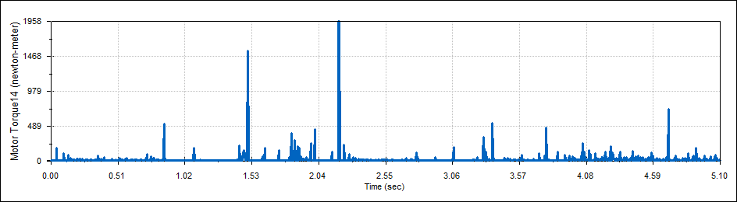
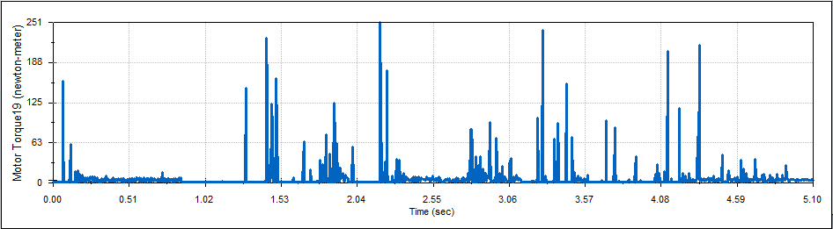
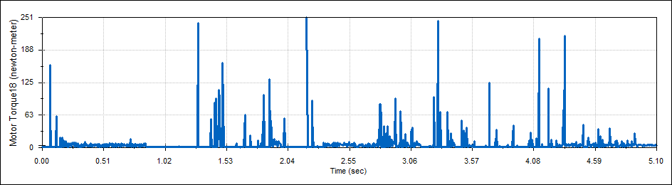
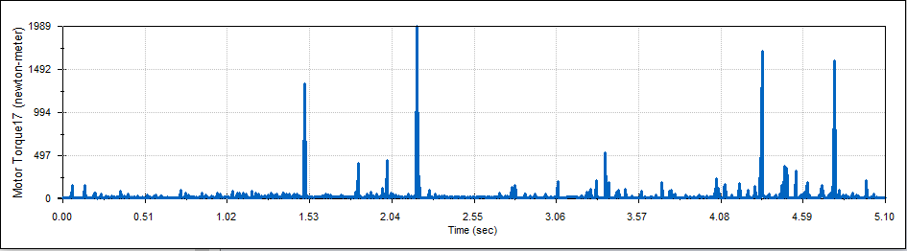
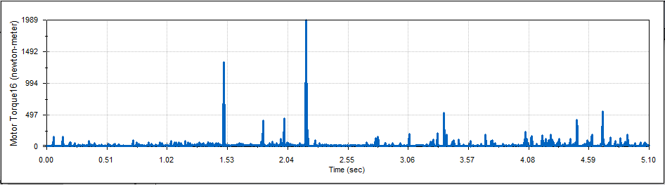
Motor Torque Plots
Front Left Wheel (12 in diameter)
Front Right Wheel (12 in diameter)
Left 8 in diameter wheel
Right 8 in diameter wheel
Back Left Wheel (12 in diameter)
Back Left Wheel (12 in diameter)

Slide 18
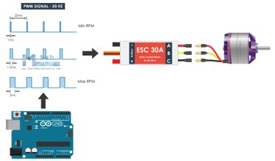
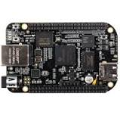
Vehicle Base Platform – DC Motor Control
BeagleBone Blue
Able to control DC motors using PWM
ROS compatible, provides software libraries and tools ​
Wi-Fi and Bluetooth compatible
4 DC Motor Drivers
Many functions can be coded onto beaglebone most importantly a "kill switch"
If robot gets too close to an object the code will tell it to "freeze" and then "retract" (move away from object).

Slide 19
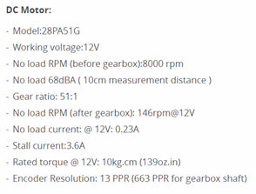
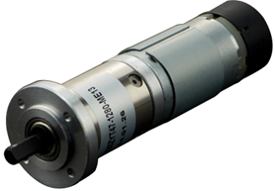
Vehicle Base Platform – DC Motor
Torque is high, which is good because that will be need when the robot is climbing stairs.
This DC motor also comes with a optical encoder which can be used create a "kill switch" so that the robot does not run into obstacles.
The robot needs 70 N-m torque to move up a step. This motor can produce up to 10 kg-cm at 12V which converts into 103 N-m
The fact that the motor is allowed more torque, means that there will be less stress on the motor over time.

Slide 20
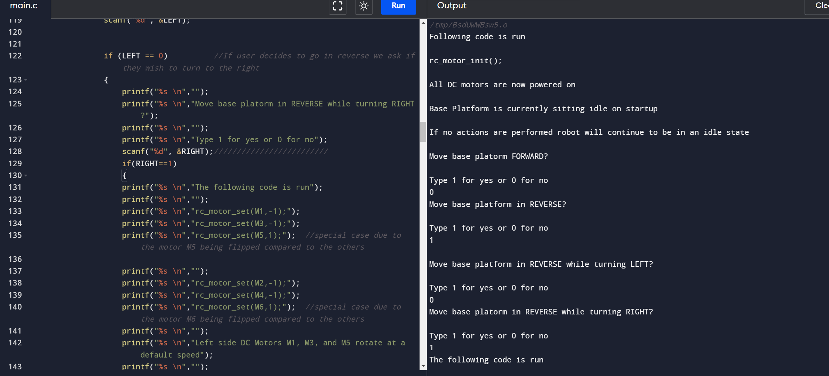
Vehicle Base Platform – DC Motor Code
Notes:
All motors are now initialized leaving all DC motors powered on, currently base platform is idle. We decide to not move forward here but, instead to go in reverse while going in reverse to the right.

Slide 21
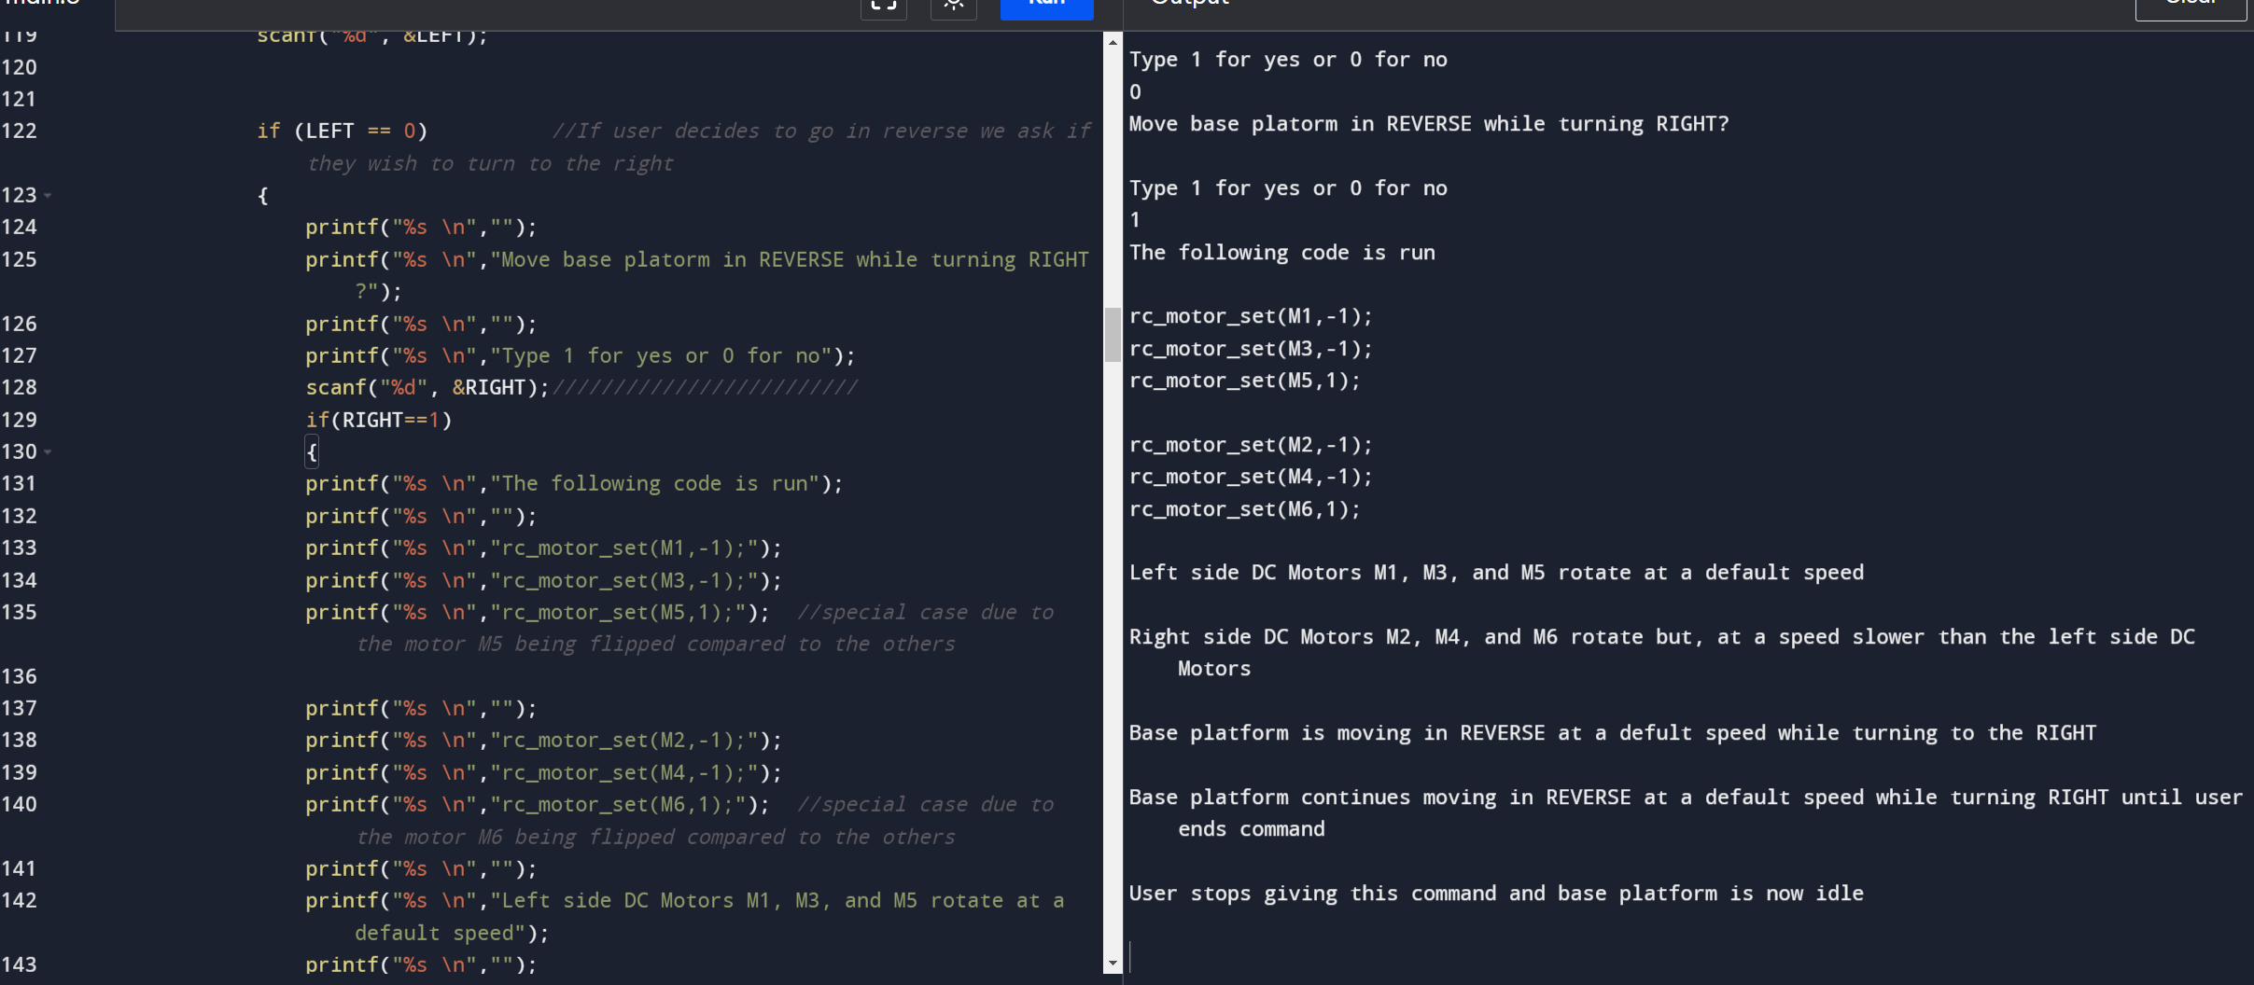
Vehicle Base Platform – DC Motor Code
Notes:
All motors are now initialized leaving all DC motors powered on, currently base platform is idle. We decide to not move forward here but, instead to go in reverse while going in reverse we decide to turn to the right. SLIDE 2 We can now see which motors begin to rotate forward or in reverse. After user decides to let go of controls the base platform sits idle again.

Slide 22
Power Consumption – Worst Case Analysis
Sub-Team | Component | Current Draw (max) | Power Consumption (max)
Arm | BeagleBone Blue | 4 A | 48 W
 | Servo Motors | 5.6 A | 41 W
Base Platform | BeagleBone Blue | 4 A | 48 W
 | Brushless DC motor (6motors) | 42 A | 504 W
Central Chassis | Brushless DC Motor | 0.6 A | 4.5W
Central Controller | Google Coral | 3 A | 15 W
Total Microcontroller Power Consumption |  | 11 A or 11000 mA | ~111 W
Total Motors Power Consumption |  | 48.2 A or 48200 mA | ~ 550 W
The system will require at least 120 W power supply for microcontrollers at 600W for motors.
7600mAh battery for microcontrollers last 40 minutes minimum.
20000 mAh battery for motors will last 25 minutes minimum.

Slide 23
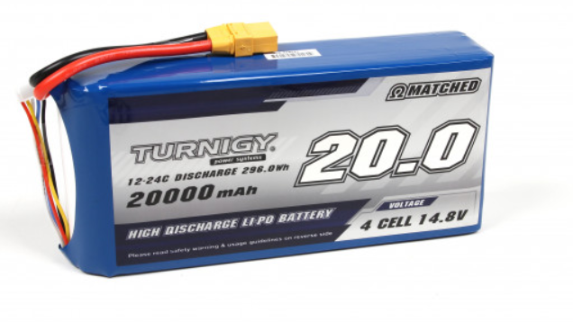
Vehicle Base Platform – Power Supply for Base Platform
Turnigy High Capacity 20000mAh 4S 12C Lipo Pack w/XT90
Easy to integrate with DC motors
Ultra-high capacity and designed for multi-motor use
20,000 mAh capacity
4S 14.8 Volts
Weight: 1775 g
Price: $128

Slide 24
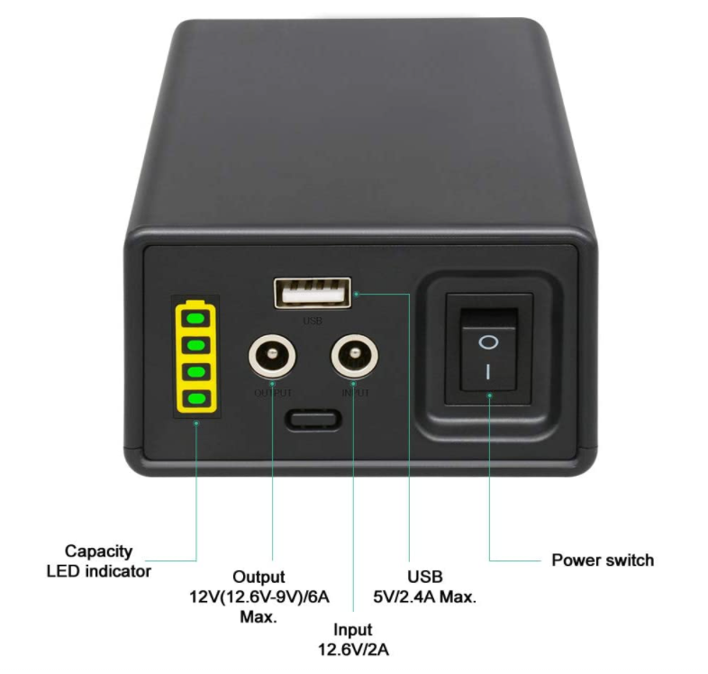
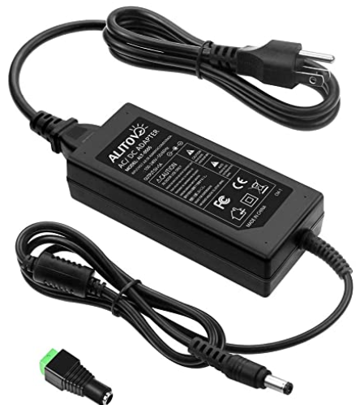
Vehicle Base Platform – Power Supply for Entire robot
TalentCell 12V Lithium-ion Battery PB120B1
Rechargeable 38400mAh 142.08Wh Li-ion Battery Pack with DC 12V and 5V USB Output will last about 152 minutes
A 5V power supply will be needed to regulate the output to convert the 12V into 5V
Weight: 730 g
Price on Amazon: $89.99

Slide 25
Vehicle Base Platform – Lesson Learned
Need a stronger motor
A lighter aluminum alloy could be based on our FEA simulations
A better gearbox design is needed to increase torque output for affordable DC motors.
Wheel size and type is important for step climbing

Slide 26
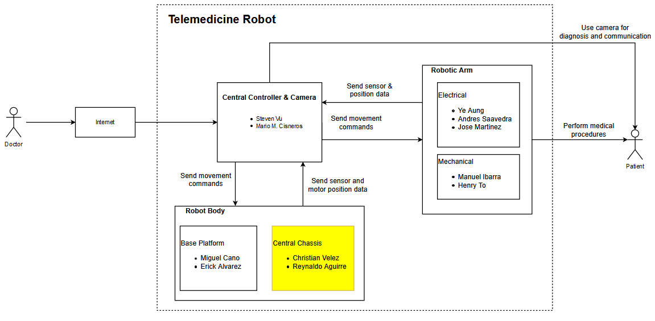
Central Chassis/Sterilization
Notes:
Ye

Slide 27
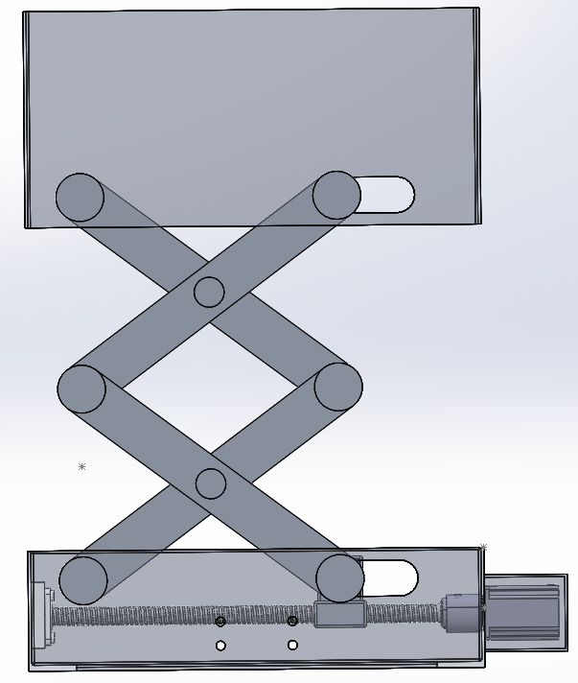
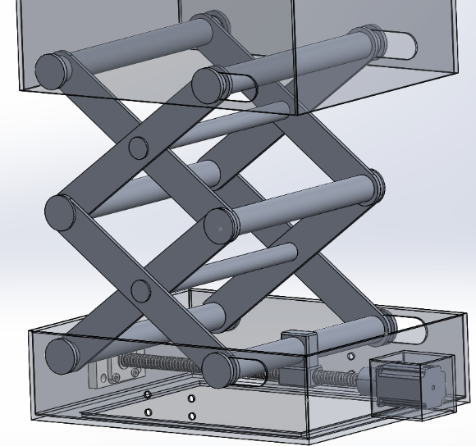
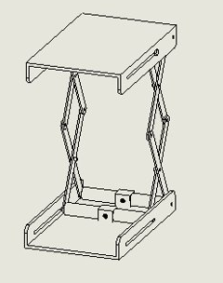
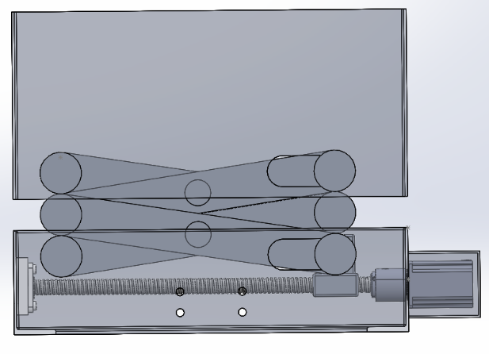
Central Chassis Design (Current)
Type | Level 2 Electrical Scissor Lift
Application | Extends and retracts with an electric motor power screw as the actuator
Material | Aluminum 7075
Weight | ~ 30 lbs
Max Height | > 2 ft.
Minimum Height | ~ 6 and 10 inches
Changes made
Base of Lift
Space
Rods for added support

Slide 28
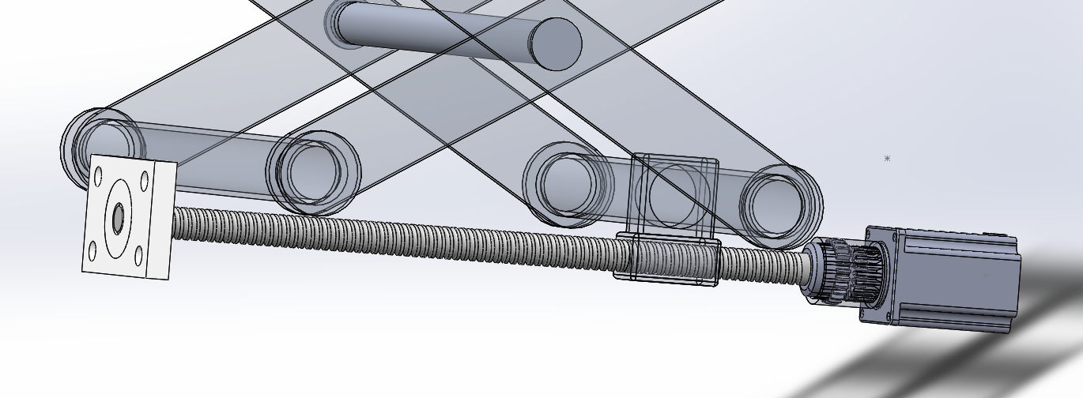

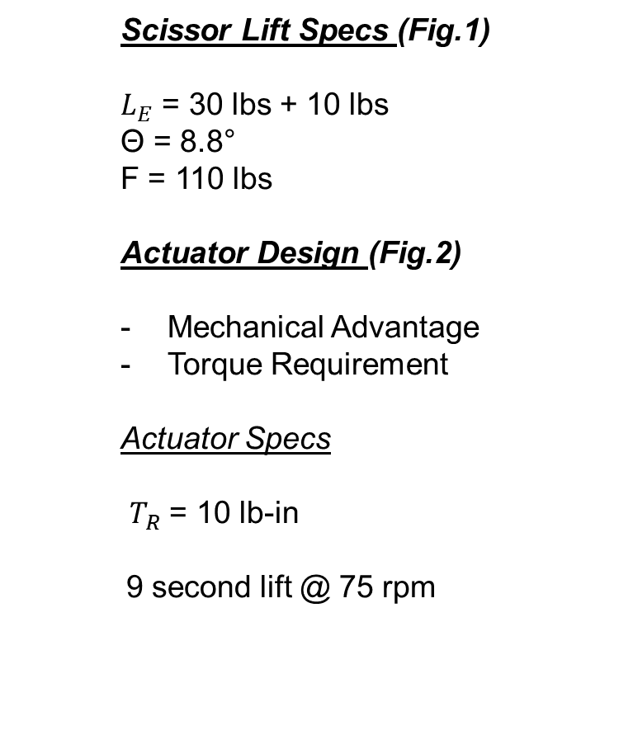
Central Chassis Design
L
  Scissor Lift Specs (Fig.1)
  $L_{E}$ = 30 lbs + 10 lbs
  Θ = 8.8°
  F = 110 lbs
  Actuator Design (Fig.2)
  Mechanical Advantage
  Torque Requirement
  Actuator Specs
${ T}_{R}$ = 10 lb-in
9 second lift @ 75 rpm
θ
F
x
Figure 1
$$T_{R}$$
Motor
Supported End
Threaded Fastener
Figure 2
Ball Screw
Shaft Coupling

Slide 29
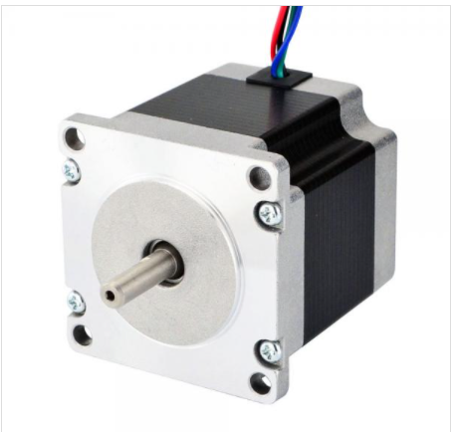
Central Chassis Design

Slide 30
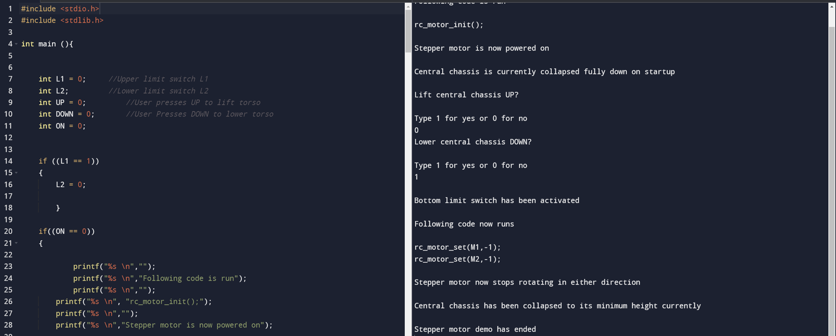
Central Chassis – Simulation Code Demo 1

Slide 31
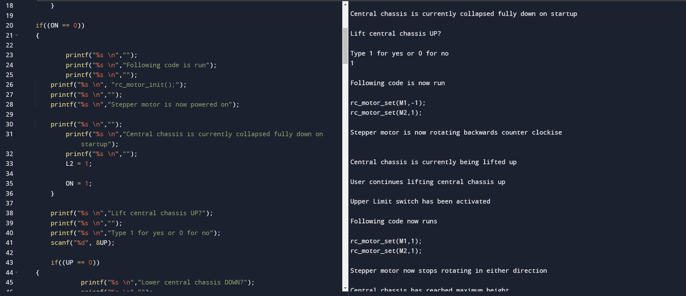
Central Chassis – Simulation Code Demo 2

Slide 32
Central Chassis – Lessons Learned
Attempt to use a different micro-controller besides BeagleBone Blue due to being incompatible with central chassis components.
For sterilization methods previously found conducting actual field testing on their effectiveness.

Slide 33
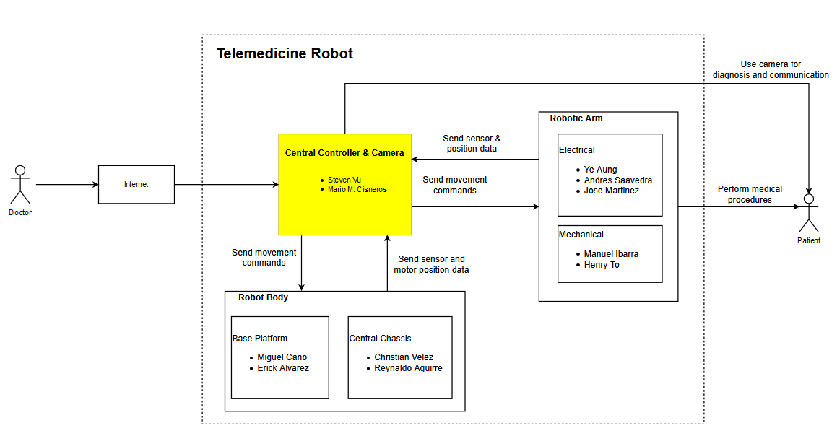
Central Controller
Notes:
Ye

Slide 34
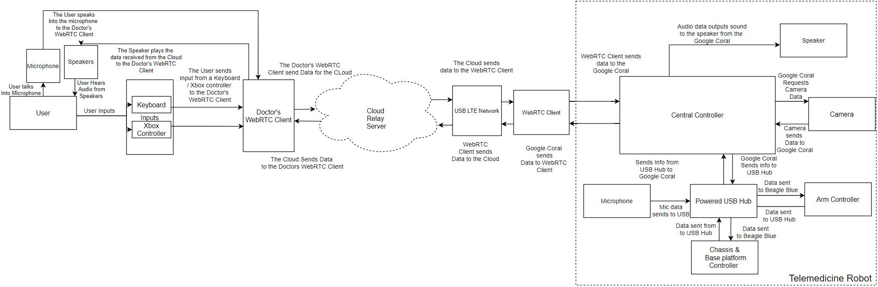
Networking Flowchart
34
Notes:
Steven -> Pass to Jose

Slide 35
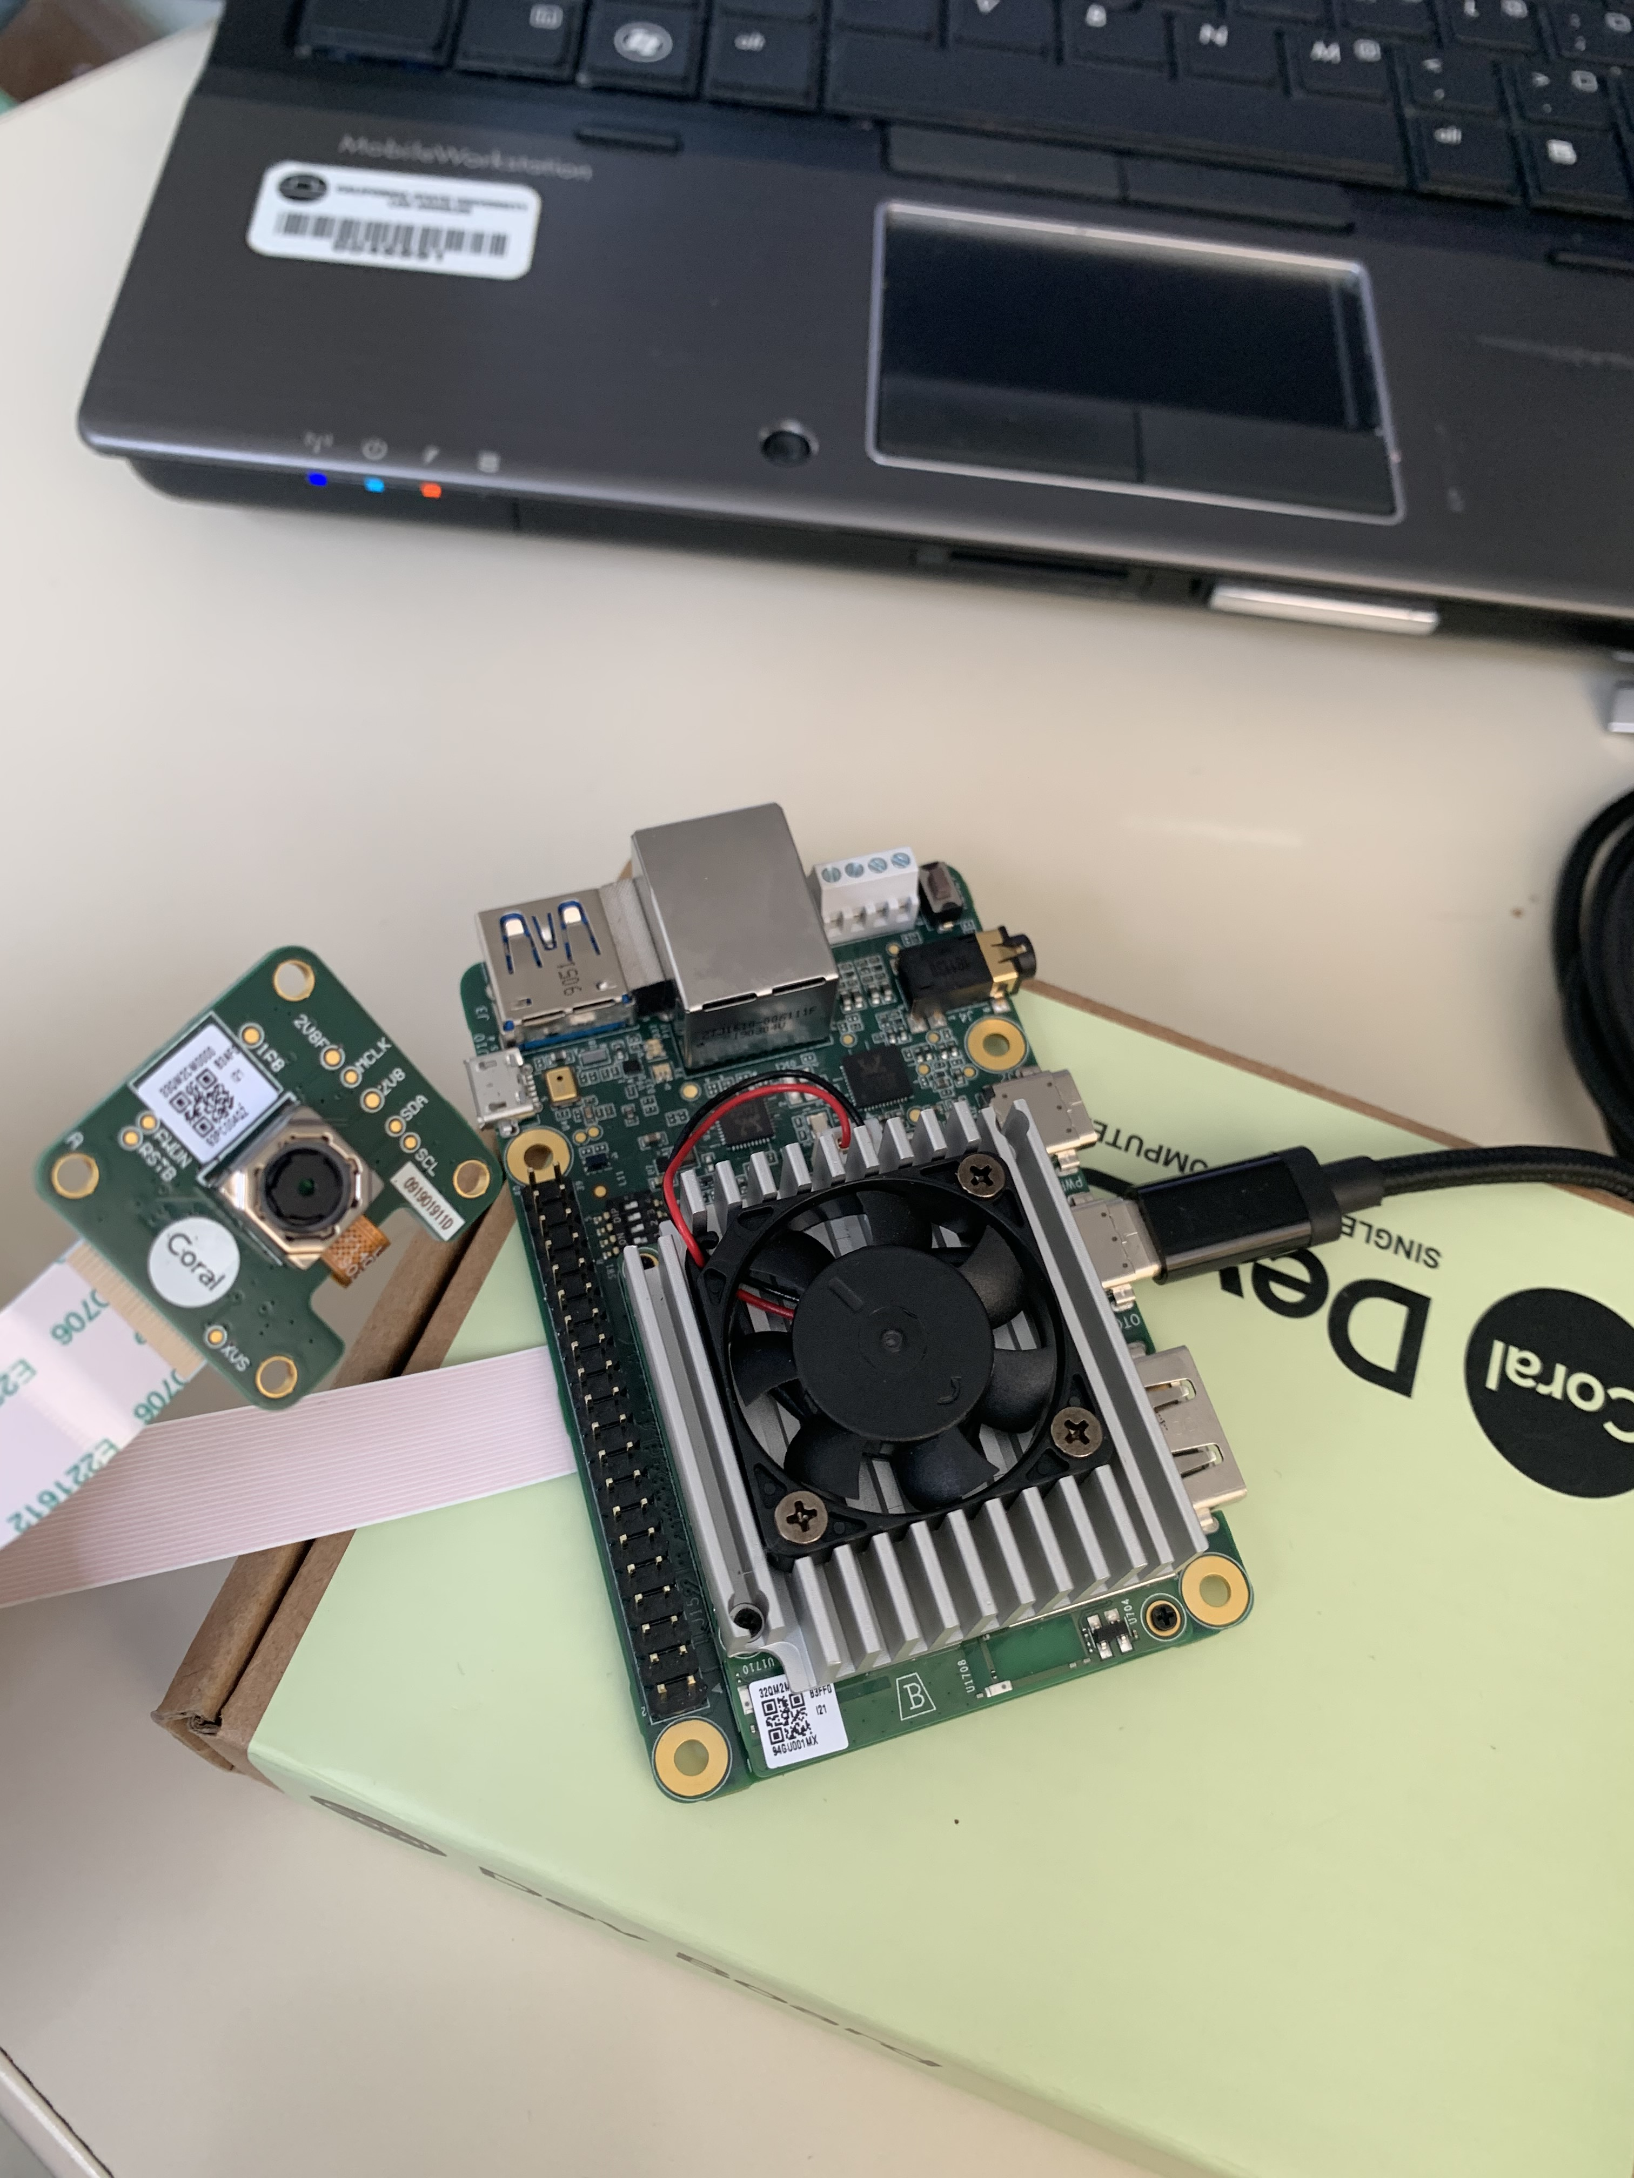
Google Coral Dev Board and the Google Camera
Object Detection was successful using pre-compiled models along with the Google Coral and the Google Camera
Image Classification inferencing was successful using pre-trained models, Google- Coral/Pycoral Git directory along with the Google Coral and it's Edge TPU.

Slide 36
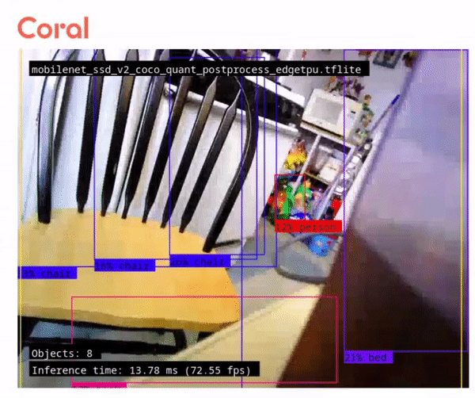
Object Detection Demo

Slide 37
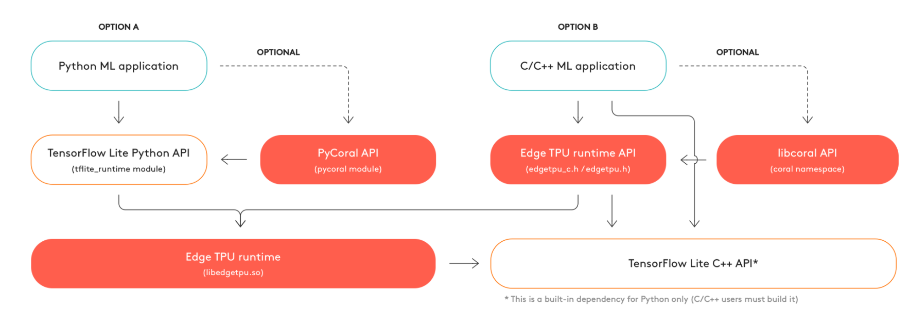
Inferencing Flow Chart from Google Coral (3 options)

Slide 38
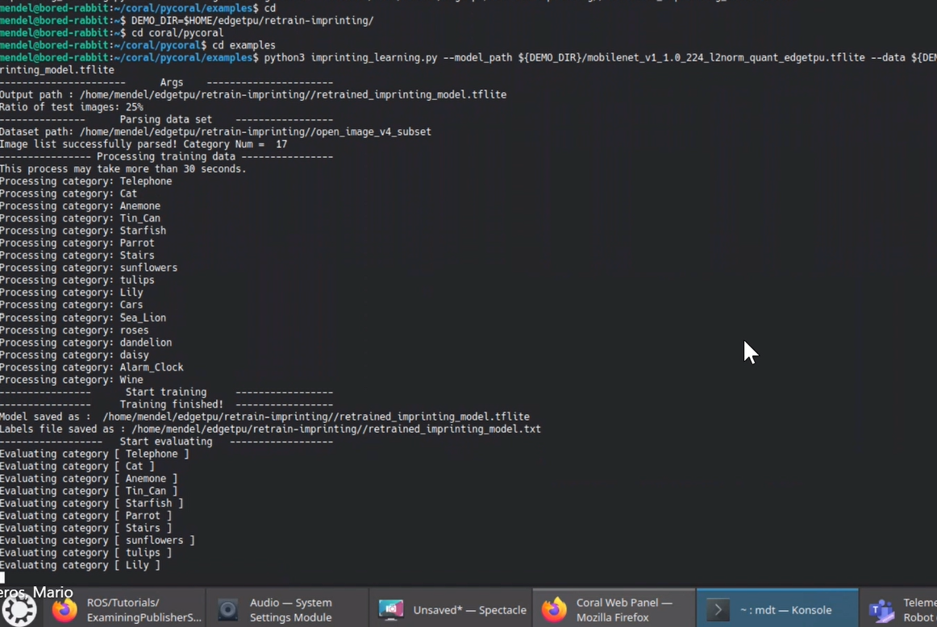
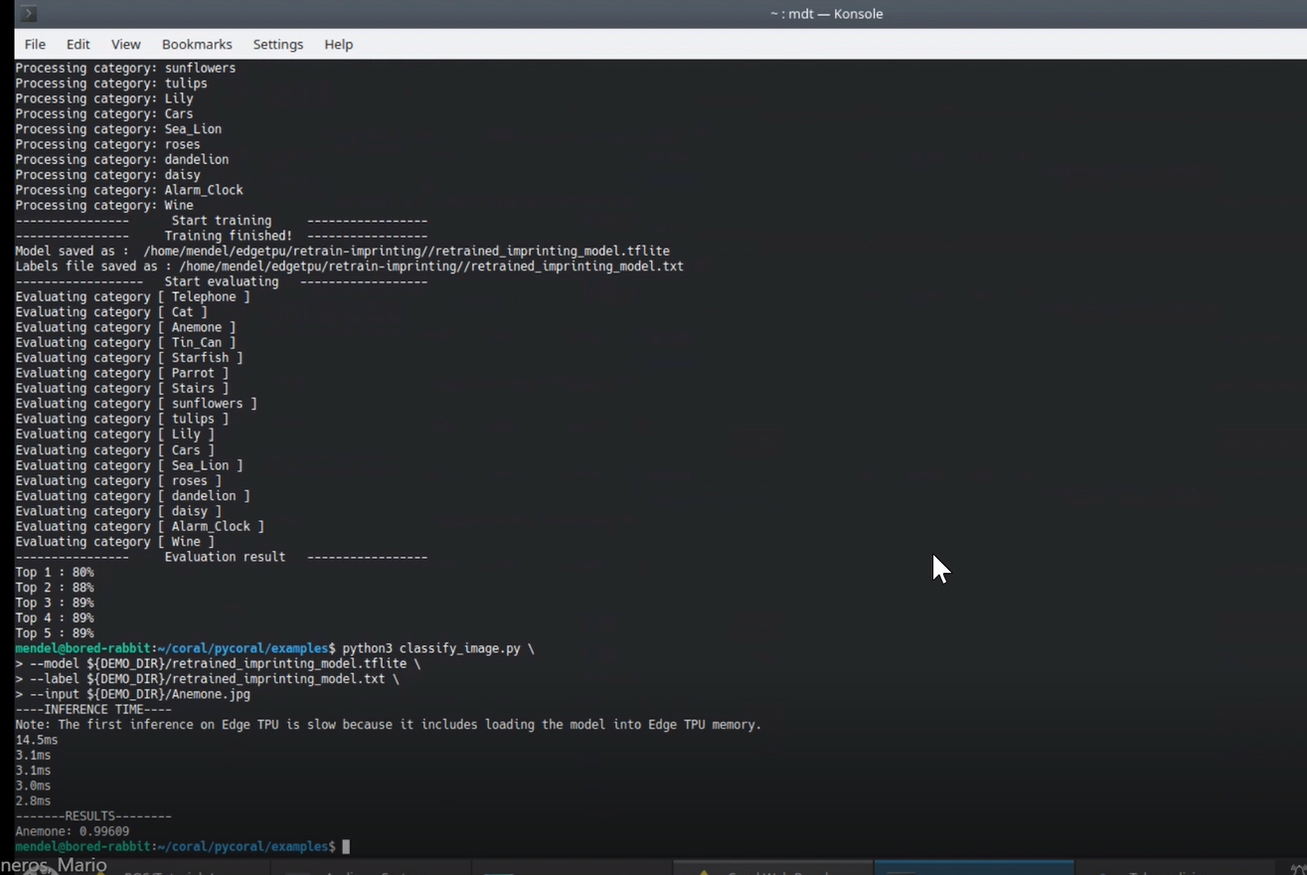
Classification Model Retrained on-device with Weight Imprinting

Slide 39
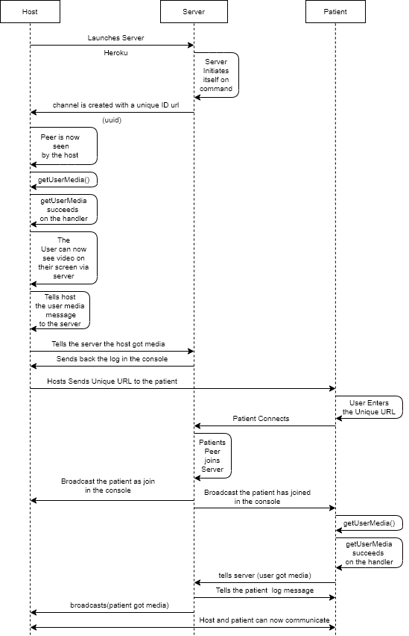
WebRTC Protocol

Slide 40
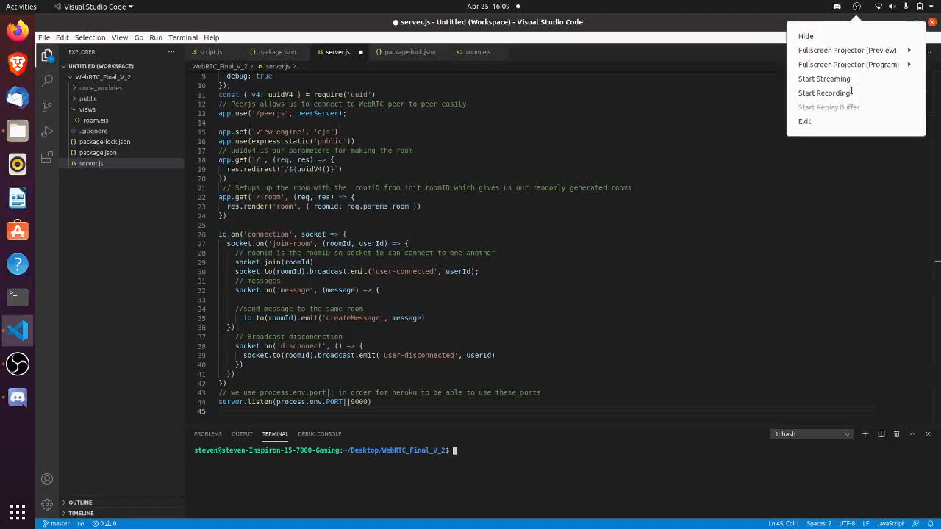
WebRTC Demo

Slide 41
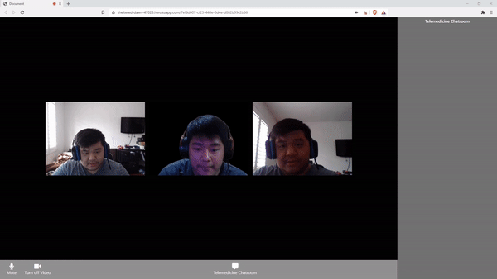
WebRTC Demo cont.

Slide 42
Lesson Learned (Central Controller)
The server is coded to where both the patient and the user must have a camera with a hardware ID to join the server; otherwise, they cannot enter the server. Fixing this issue would require a server to be entirely recoded.
Although the server had been self-certified, some issues were apparent as the peers were still not connecting correctly until I attempted to host the server onto a cloud-based server when trying to test the server through the network.
Had trouble using the MDT to communicate with the Coral board but was able to use the tool with help from our advisor and was able to learn and use this tool.
Had trouble using Pycoral API's in the Coral board but kept trying to implement these functions by reading more about them on the coral webpage until I was successful.

Slide 43
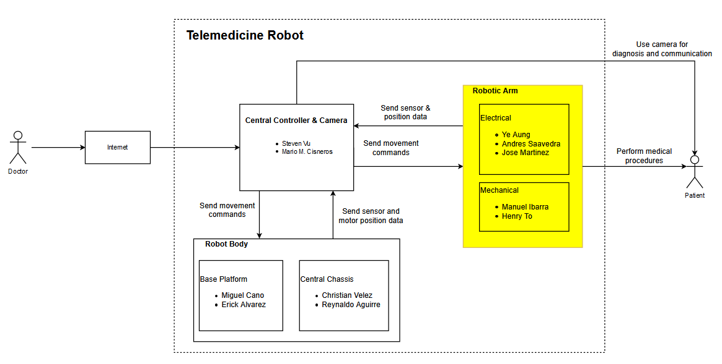
Robotic Arm
Notes:
Ye

Slide 44

Arm Electronics – Block Diagram
Notes:
Ye

Slide 45



Arm Controls – State Machine
Notes:
Ye

Slide 46


Arm Controls – State Machine Cont.
Notes:
Ye

Slide 47

Servo Motor Code Flowchart
Notes:
Ye

Slide 48

Mapping ADC Voltage to Motor Position
Position = 2.3767 (Volt) – 2.021
ADC Resolution: 0.04 degree per ADC step
Notes:
Ye

Slide 49


Servo Motor Testbench Setup
Servo motor
External Power Source
BeagleBone Blue
Notes:
Ye

Slide 50

Servo Motor Demo
Notes:
Ye

Slide 51

Distance Sensors / Contactless Thermometer Schematic
Notes:
Ye

Slide 52

TOF Sensor Testbench Setup
Distance sensor
MUX Chip
Arduino
Temperature sensor
Notes:
Ye

Slide 53

VL53L0X Code Flowchart
Notes:
Ye

Slide 54

Truth Table for 8x1 MUX
XSHUT High = Sensor on (connected to Common Z)
XSHUT Pin Low = Sensor off
When the Enable pin = High, the state of the select pins do not matter and all sensors are shut off
Notes:
Ye

Slide 55

VL53L0X Distance Sensor Demo
Notes:
Ye

Slide 56
Lesson Learned (Robotic Arm – Electrical)
BeagleBone Blue can be unreliable and can overcomplicate some systems.
  Sensor data acquisition was delayed due to defective BeagleBone Blue units
  Distance sensor data acquisition was easier to integrate on Arduino compared to BeagleBone Blue
MLX90614 temperature sensors can’t be easily integrated with microcontroller
  I2C signals are not very well soldered on the breakout board
  Alternative sensors will be recommended in the final report

Slide 57
Robotic Arm
Notes:
Ye

Slide 58


Robotic Arm – Mechanical Design
Robotic Arm Design
End Effector Design

Slide 59
Trade Study – Material
Material Comparison
Material | Premium PLA | 6061 Aluminum
Tensile Strength (MPa) | 64.4 | 276
Elongation Break (%) | 15.3 | 12.0-17.0
Price | $58/1kg | $3.85/0.5"x1"x12"
Production | 3D Printing Arm/Hand | Machined Arm/Hand

Slide 60

Technical Drawing/CAD - Arm

Slide 61


Gear Box @ the Shoulder

Slide 62


Gear Box @ the Elbow

Slide 63

FEA Analysis - Stress
Stress:
Maximum – 0.153 MPa
Minimum – 1.90e⁻³ Pa

Slide 64

FEA Analysis - Displacement
Displacement:
Maximum – 1.47e⁻³ mm
Minimum – 1.00e⁻³ mm

Slide 65

Torque Analysis at the Shoulder

Slide 66

Torque Analysis at the Elbow

Slide 67
Trade Study – End Effectors
Gripper Comparison
Name | Worm gear driven 4-bar link | Direct servo drive 4-bar linkage
Complexity | Complex with more moving parts | Simple design with less moving parts
Control | Dependent on gearing and motor | will depend largely on servo used.
Material | can be made of metal or plastic | can be made out of metal or plastic
Industry use | design has been used in industrial robots | application only seen in other low budget projects
Cost | more expensive only if using metal gears | Requires less parts, will be more affordable
Capability | with proper gearing has a higher potential for producing more force | force limited to type of servo used
Voltage | can range depending on motor used | limited to a range of 5V to 7.2V
Worth Mentioning | this design can be upscaled into a larger or more powerful form. | Servo motors can easily be changed out
Notes:
Ye

Slide 68

Technical Drawing/CAD – End Effector
Notes:
Ye

Slide 69






End Effector’s Features

Slide 70



Rubber gripper Analysis

Slide 71


Extra Feature – Camera Arm

Slide 72


Technical Drawing/CAD – Camera Arm

Slide 73




Camera Arm Features

Slide 74
Near Future Plans (Mechanical)
Perform Solidworks simulations using PLA material instead of aluminum
Perform entire robot assembly simulation
Work on calculations to determine certain design specifications
Decrease weight of overall robot
Increase the amount of DOF
Design new gear boxes to improve performance

Slide 75
Near Future Plans (Electrical)
Develop testbench and test scripts for FSR and IMU
  Development was delayed due to defective BeagleBone Blue unit
Implement MUX integration with multiple sensors
Implement ROS between for primary and secondary communication in order to send commands and retrieve data from secondary boards
Work on retraining an Object Detection Model using Docker
Complete documentation of test scripts and codes for easier knowledge transfer

Slide 76
Future Development Plans (Next Team)
Integrate ROS to sensors and motors for sending movement commands and receiving sensor data.
Distance and temperature sensor data acquisition will be migrated to Arduino and transmitted with ROS Serial due to reliability issues on BeagleBone Blue.
Integrate different electronic subsystems via sensor hub PCB
Perform Solidworks simulations using PLA material instead of aluminum
Decrease weight of overall robot
Increase the amount of DOF
Perform a physical assembly of the robot

Slide 77
Summary
Completed CAD design of mechanical parts and performed analysis (FEA and motion study)
Electrical components were tested individually in testbench environments
Due to COVID restrictions, it was not possible to integrate different subsystems of the robot or manufacture the parts

Slide 78
Q & A
Notes:
Ye

Slide 79
Thank you for your time!
Notes:
Ye

