Slide 1

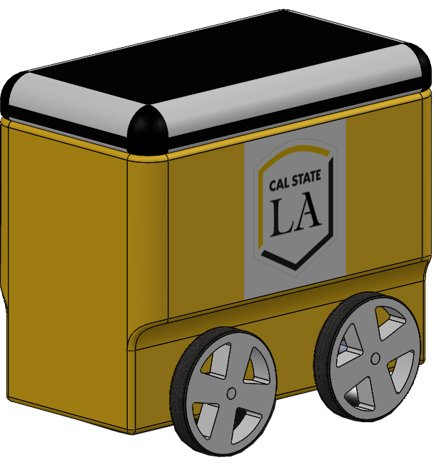
Team 27.1 Delivery Robot Expo Presentation April 26, 2021 California State University, Los Angeles

Slide 3
Agenda
Introduction
Project Structure
Approach
Design Process
Results
Conclusion

Slide 4
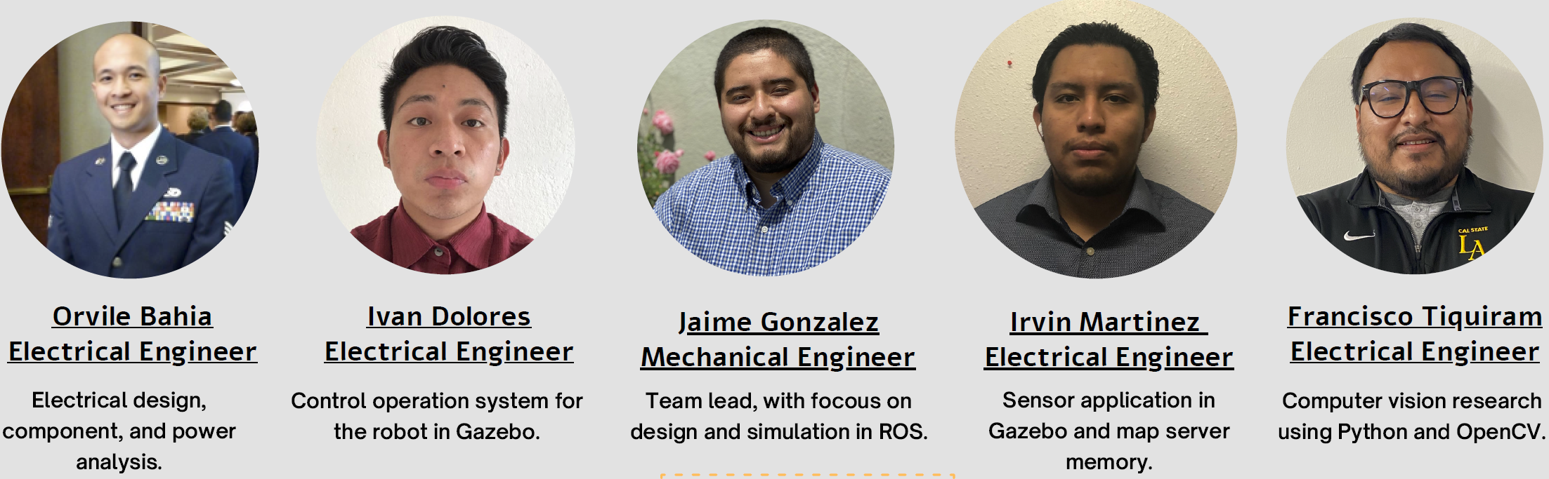
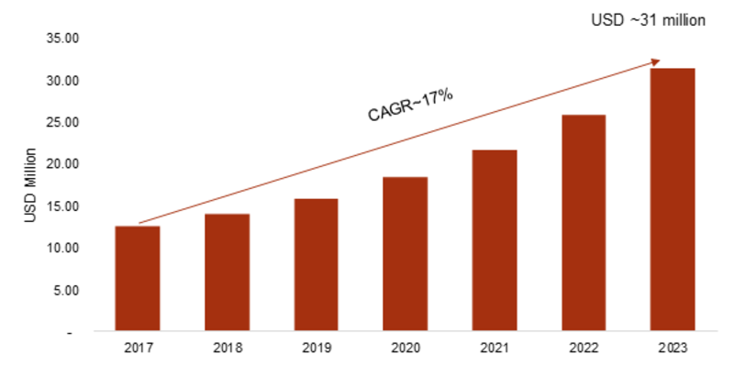
Last Mile Delivery
Delivering items from a transportation facility to its last destination such as a consumer’s household
Amazon, USPS, FedEx, UPS
Current cost of each package is on average 1.60 USD
Delivery with autonomous robots can average around 0.06 USD
Autonomous Robot Delivery Market

Slide 5
Project Scope
Plan and design a fully autonomous delivery robot that can navigate through Cal State LA campus in an efficient and safe manner
Use a real-world simulation engine to demonstrate capability
Both the robot and environment will be developed through software to simulate autonomous delivery capabilities

Slide 6
Deliverables
Design and simulate a four-wheel robotic vehicle capable of autonomous delivery
Capable of obstacle avoidance, navigation, Computer Vision.
Create simulated environment resembling Cal State LA for testing
Perform all measures with prioritizing safety of stakeholders

Slide 7
Agenda
Introduction
Project Structure
Approach
Design Process
Results
Conclusion

Slide 8
Requirements
Functional Req. # | Requirement Group/Statement
 | Speed Control
FR-2.1 | Maximum linear velocity of 1 m/s (walking speed)
FR-2.2 | Maximum angular velocity of 0.5 rad/s
FR-2.3 | Manuel Teleop Keyboard Control program
FR-2.4 | Automatic steering capability
FR-2.5 | Forward reverse drive capability
 | Obstacle Avoidance Program (LIDAR based)
FR-4.1 | Max closing distance to obstacle of 1 meter
FR-4.2 | Robot stoppage time of < 30 milliseconds
FR-4.3 | Receive data in obstacle stoppage of 10-meter radius
FR-4.4 | Maneuver towards largest area without obstacles
 | Autonomy
FR-5.1 | Capable of Laser based localization
FR-5.2 | Save internal mapping capability
FR-5.3 | User based navigation goal
FR-5.4 | Implement OpenCV algorithms for camera detection
FR-5.5 | Automatic return to original departure location

Slide 9
Project Road Map
2020-2021 Calendar Tasks | 2020
 | 9/11 | 9/18 | 9/25 | 10/2 | 10/9 | 10/16 | 10/23 | 10/30 | 11/6 | 11/13 | 11/20 | 11/27 | 12/4 | 12/11 | 12/18
1.1 Solidworks
1.2 URDF/XML
1.3 Gazebo
1.4 Strain/Stress Analysis
2.1 Electrical Design
2.2 PCB
2.3 Simulink
2.4 PCB/KiCAD
3.1 Research
3.2 Software
3.3 Python & OpenCV
3.4 Simulation
4.1 Gazebo
4.2 Sensors
4.3 Subscribers
4.4 Publishers
5.1 Gazebo
5.2 Motion Planning
5.3 Visual Data
5.4 Obstacle Avoidance
- Break
- Finished
- In progress

Slide 10
Project Road Map
2020-2021 Calendar Tasks | 202121
 | 1/29 | 2/05 | 2/12 | 2/19 | 2/26 | 3/05 | 3/12 | 3/19 | 3/26 | 4/02 | 4/09 | 4/16 | 4/23 | 4/30 | 5/07
1.1 Solidworks
1.2 URDF/XML
1.3 Gazebo
1.4 Strain/Stress Analysis
2.1 Electrical Design
2.2 PCB
2.3 Simulink
2.4 PCB/KiCAD
3.1 Research
3.2 Software
3.3 Python & OpenCV
3.4 Simulation
4.1 Gazebo
4.2 Sensors
4.3 Subscribers
4.4 Publishers
5.1 Gazebo
5.2 Motion Planning
5.3 Visual Data
5.4 Obstacle Avoidance
- Break
- Finished
- In progress

Slide 11
Work Breakdown Structure
0.0 Delivery Robot
1.0 Navigation, Mechanical Lead
Jaime Gonzalez
1.1 SolidWorks/URDF
CAD design XML scripts
1.2 Gazebo/RViz
Develop launch files for visualization
1.3 SLAM
Implement Gmapping with desired parameters
1.4 Navigation Stack
Path planning autonomous feature
2.0 PCB Design, Electrical lead Orville Bahia
2.1 Electrical Design
Find electrical components
2.2 KiCAD
Develop electrical board/schematics
2.3 Simulink
Converter/Load Analysis
2.4 PCB/KiCAD
Power circuit design
3.0 Computer Vision
Francisco Tiquiram
3.1 Research
Understand how image recognition works.
3.2 Software
Implement Python
3.3 OpenCV
Implement OpenCV.
3.4 Simulation
Develop Human Detection code
4.0 Robot Description
Irvin Martinez
4.1 Gazebo
Research sensors
4.2 Sensors
Implement sensors to robot
4.3 Subscribers
Receive data/transform for laser scan
4.4 Publishers
Map server memory
5.0 Control
Ivan Dolores Salazar
5.1 Gazebo
Build environment
5.2 Motion planning
Manuel control
5.3 Visual Data
Analyze data from movement orientation in 3-D space
5.4 Obstacle avoidance
Set parameters to allow the robot to detect obstacle

Slide 12
Agenda
Introduction
Project Structure
Approach
Design Process
Results
Conclusion

Slide 13


System
Ubuntu Linux 18.04 Operating System
Robot Operating System (ROS) is a software platform for robotics development from software to hardware
Compatible with Raspberry Pi

Slide 14
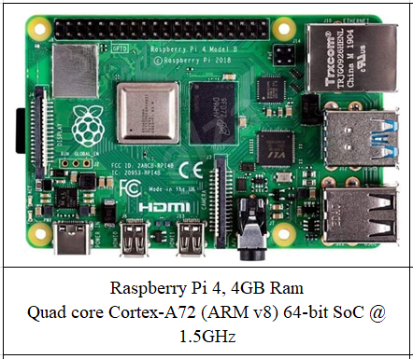
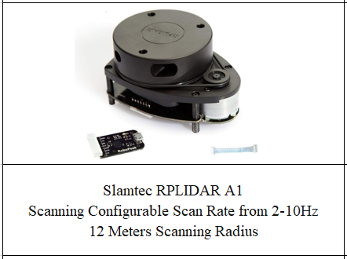
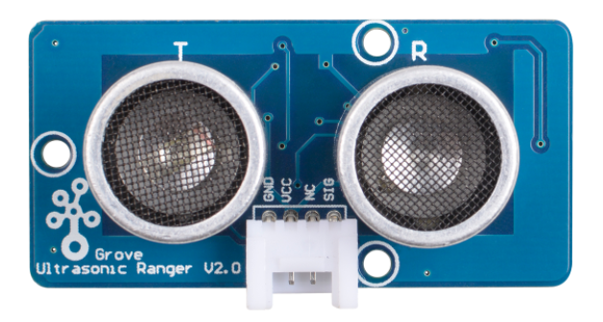
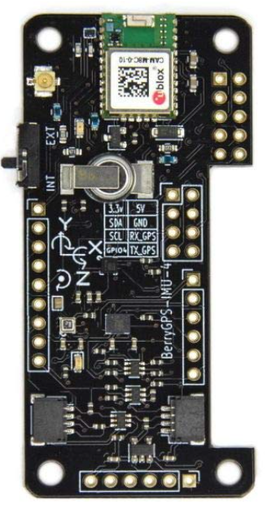
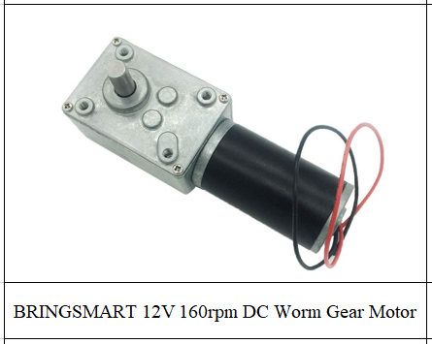
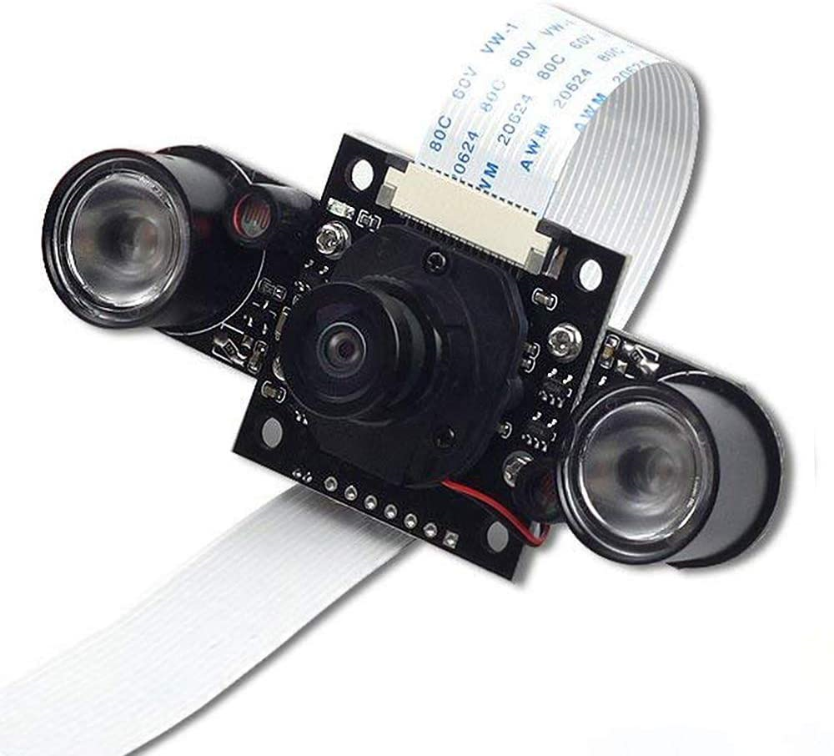
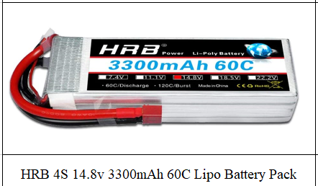
Electrical Components
Grove Ultrasonic Sensor
BerryGPS IMU and GPS Module
ArducamNight-Vision

Slide 15
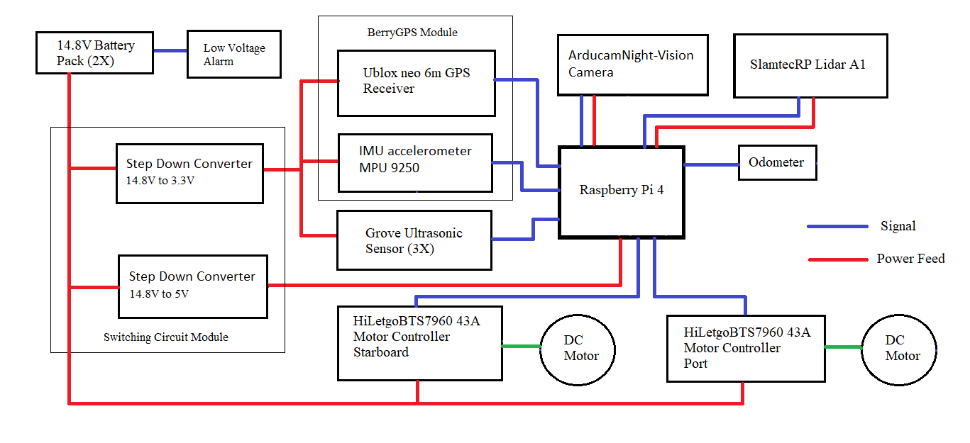
Electrical Block Diagram

Slide 16
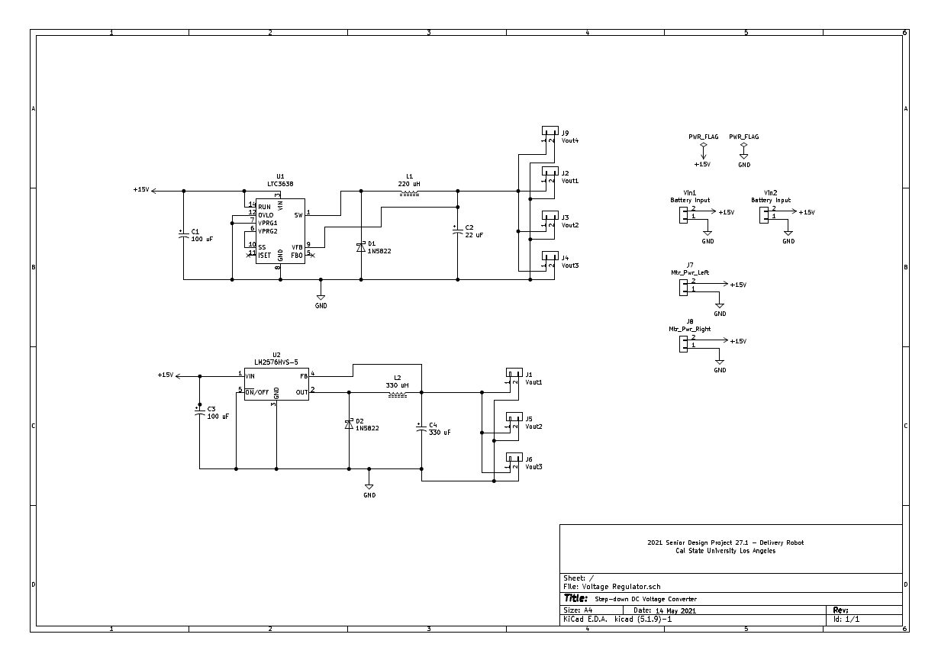
Step-down Converter Schematic

Slide 17
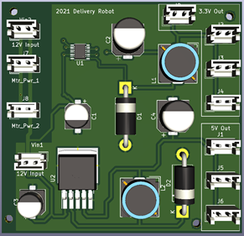
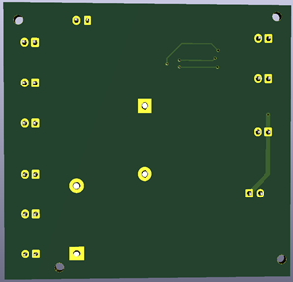
Step-down Converter PCB
Front side
Rear side

Slide 18
Electrical Block Diagram

Slide 19
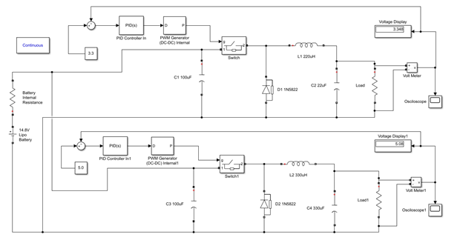
Step-down Converter PCB (cont')
Circuit Simulation in MATLAB Simulink

Slide 20
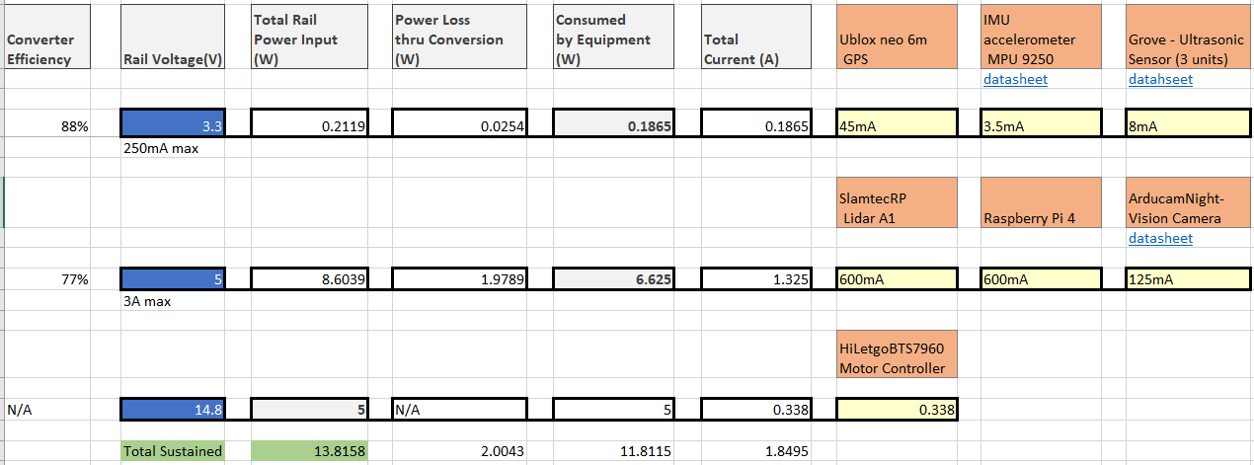
Power Analysis

Slide 21
Agenda
Introduction
Project Structure
Approach
Design Process
Results
Conclusion

Slide 22
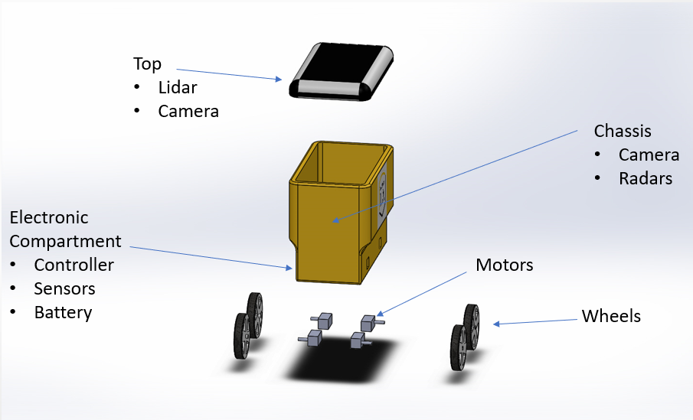
CAD Design

Slide 23
Sensor
Robot
Gazebo
ROS
Computer Vision
Control
Navigation
Rviz
Localization

Slide 24
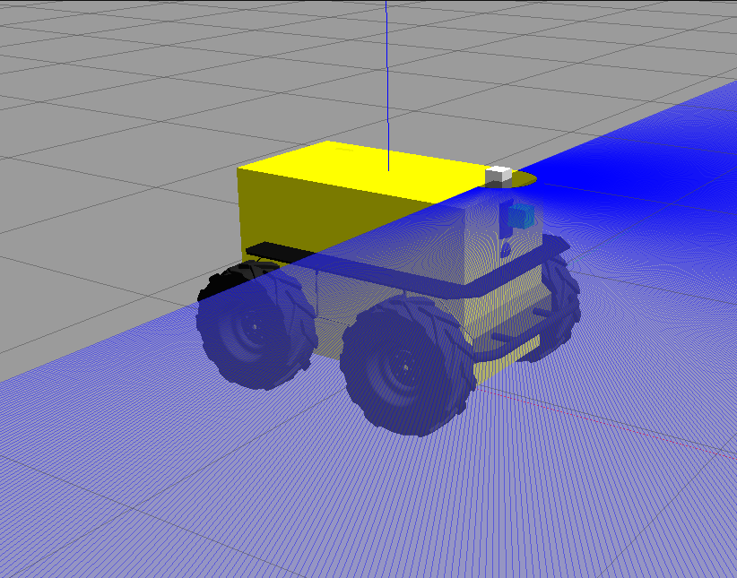
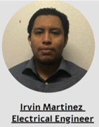
Robot
URDF: Universal Robot Description File
XML script
URDF = define robot appearance that will be displayed in simulator such as Gazebo.

Slide 25
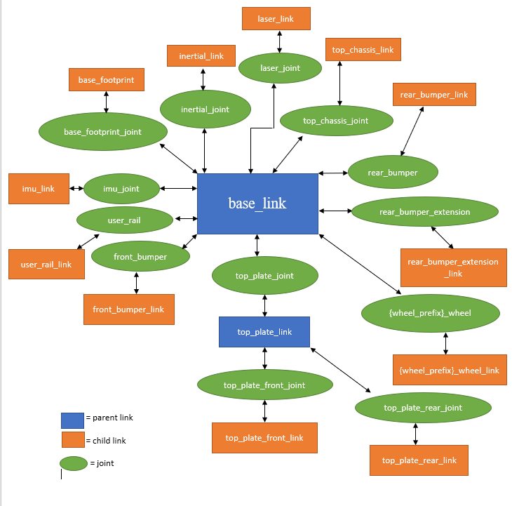
Robot
URDF --> links + joints
Link: component of delivery robot
Joints: connects one link to parent link
Ex 1:
base_link: center of robot's bottom plate
Ex 2
top_chassis_joint: attaches top chassis to delivery robot

Slide 26
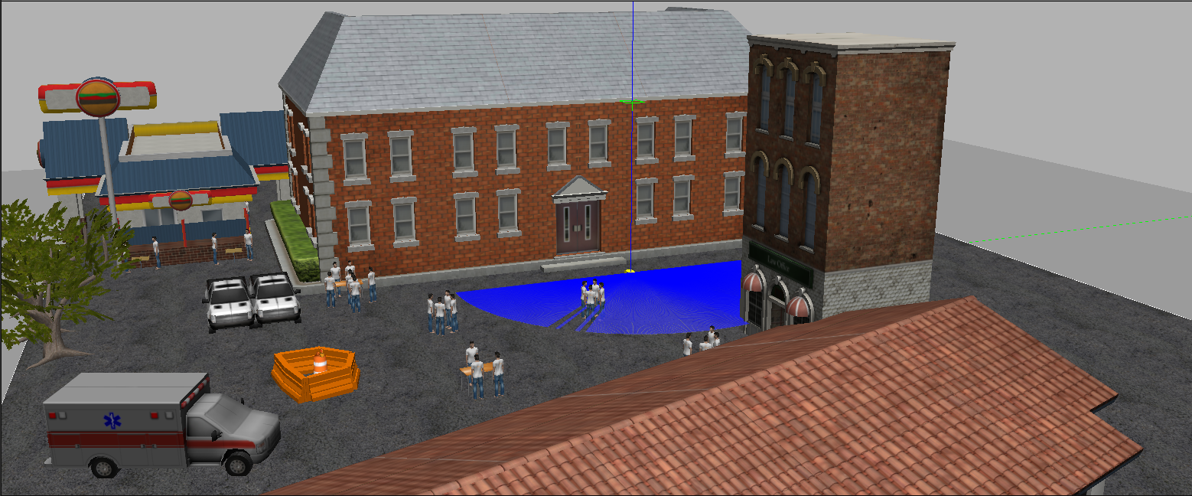

Gazebo
3D robotics simulator
ODE: Open Dynamics Engine
Create simulated environments that loosely resemble real-world locations

Slide 27
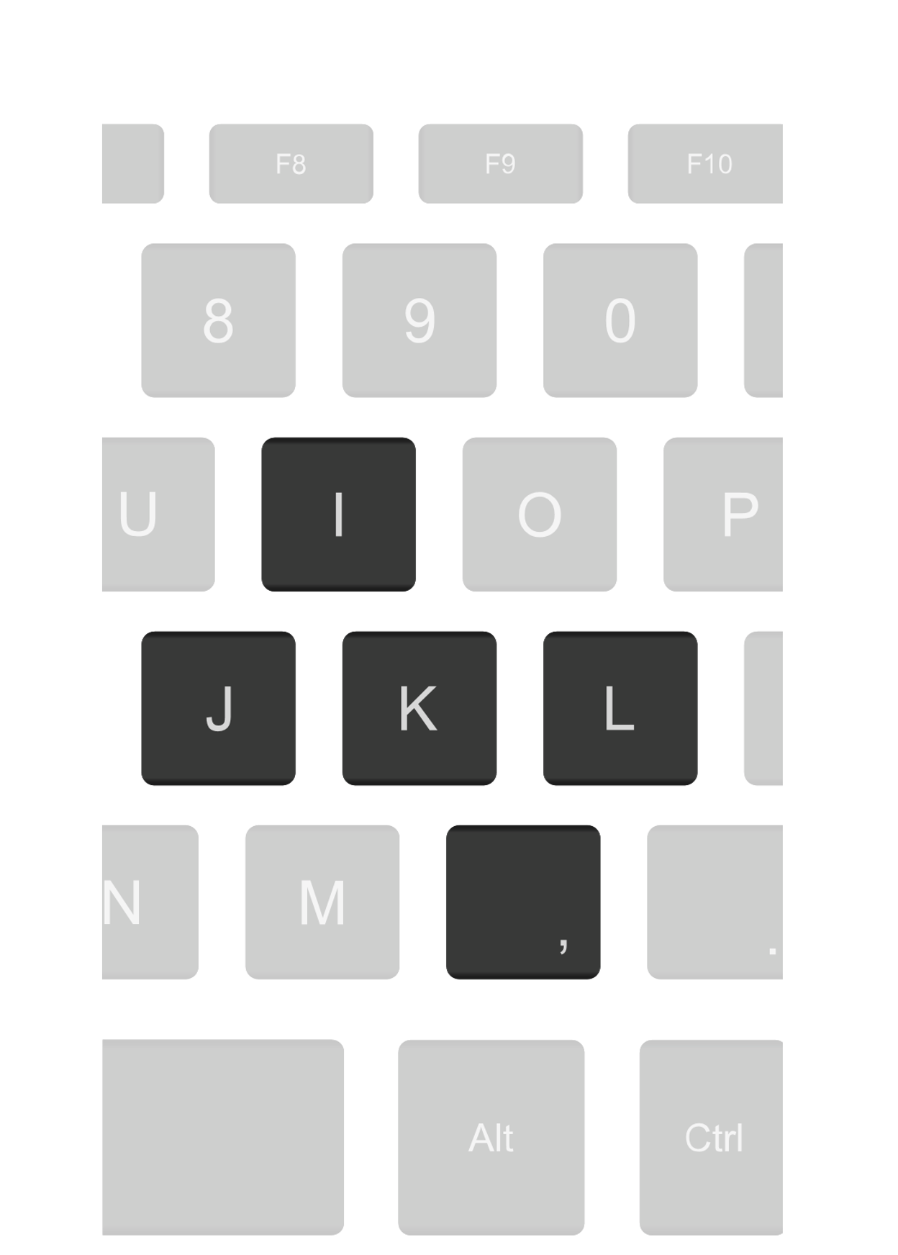
Control
The teleoperator was used to control the robot manually
Different keys made the robot move accordingly
This was the first step in learning how to
navigate
K

Slide 28
Control
Run Obstacle Avoidance Program
LIDAR reads distance
The obstacle avoidance was achieved
using Python code and a LIDAR
The code can be changed to
address the bugs that may occur
in the simulation
false
true
gap < 1m?
Robot starts rotating until gap is > 1m
Robot continues moving forward

Slide 29
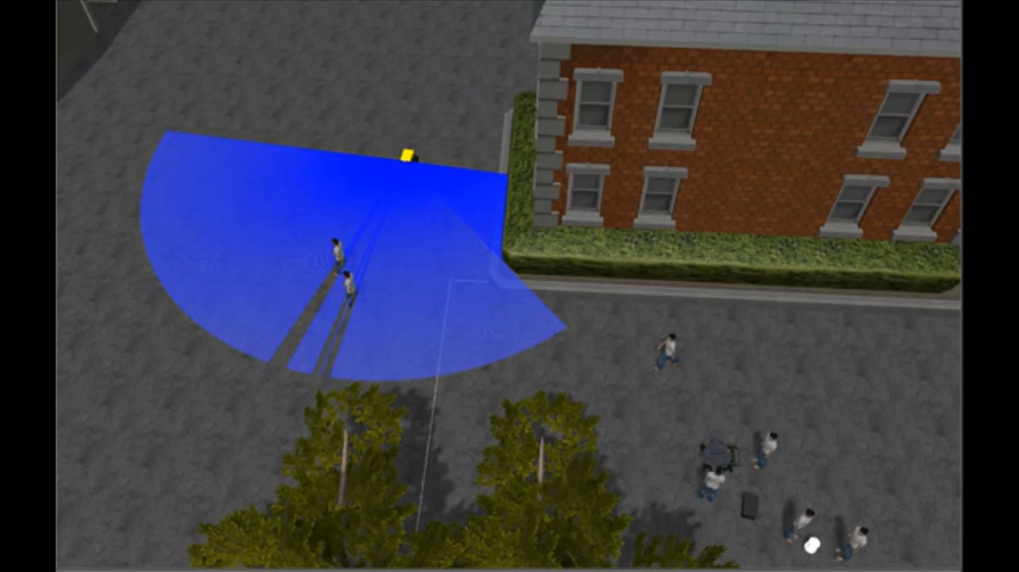
Control Demo

Slide 30
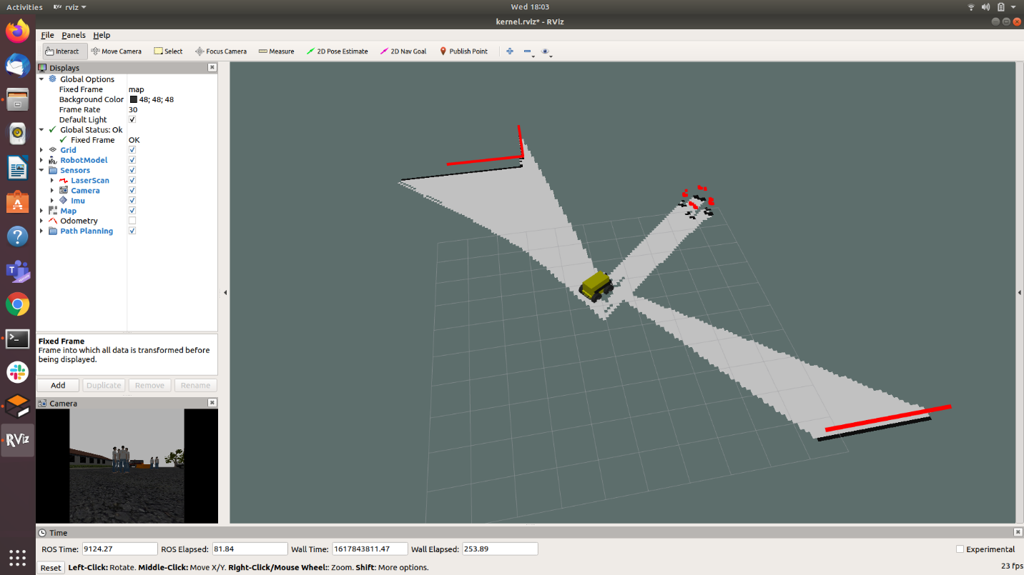
RViz with Simultaneous Localization and Mapping
ROS Visualization (RViz) receives transform data from Robot State Publisher
Gmapping package provides laser-based SLAM
Node receives topic data from LIDAR laser scan, IMU, and Odometry
Robot will create Internal Map

Slide 31
Navigation Node Network
Internal Map
Publishes velocity commands to controller
Map Server
Acquires Robot State in Gazebo
Development of local and global paths
Gazebo
Robot State Publisher
TF data
RViz
AMCL
Move Base
Localization
Odom
Velocity Controller
SLAM_Gmapping

Slide 32
Navigation Node Network
Internal Map
Publishes velocity commands to controller
Map Server
Acquires Robot State in Gazebo
Development of local and global paths
Gazebo
Robot State Publisher
TF data
RViz
AMCL
Move Base
Localization
Odom
Velocity Controller
SLAM_Gmapping

Slide 33
Navigation Node Network
Internal Map
Publishes velocity commands to controller
Map Server
Acquires Robot State in Gazebo
Development of local and global paths
Gazebo
Robot State Publisher
TF data
RViz
AMCL
Move Base
Localization
Odom
Velocity Controller
SLAM_Gmapping

Slide 34
Navigation Node Network
Internal Map
Publishes velocity commands to controller
Map Server
Acquires Robot State in Gazebo
Development of local and global paths
Gazebo
Robot State Publisher
TF data
RViz
AMCL
Move Base
Localization
Odom
Velocity Controller
SLAM_Gmapping

Slide 35
Navigation Node Network
Internal Map
Publishes velocity commands to controller
Map Server
Acquires Robot State in Gazebo
Development of local and global paths
Gazebo
Robot State Publisher
TF data
RViz
AMCL
Move Base
Localization
Odom
Velocity Controller
SLAM_Gmapping

Slide 36
Navigation Node Network
Internal Map
Publishes velocity commands to controller
Map Server
Acquires Robot State in Gazebo
Development of local and global paths
Gazebo
Robot State Publisher
TF data
RViz
AMCL
Move Base
Localization
Odom
Velocity Controller
SLAM_Gmapping

Slide 37
Navigation Node Network
Internal Map
Publishes velocity commands to controller
Map Server
Acquires Robot State in Gazebo
Development of local and global paths
Gazebo
Robot State Publisher
TF data
RViz
AMCL
Move Base
Localization
Odom
Velocity Controller
SLAM_Gmapping

Slide 38
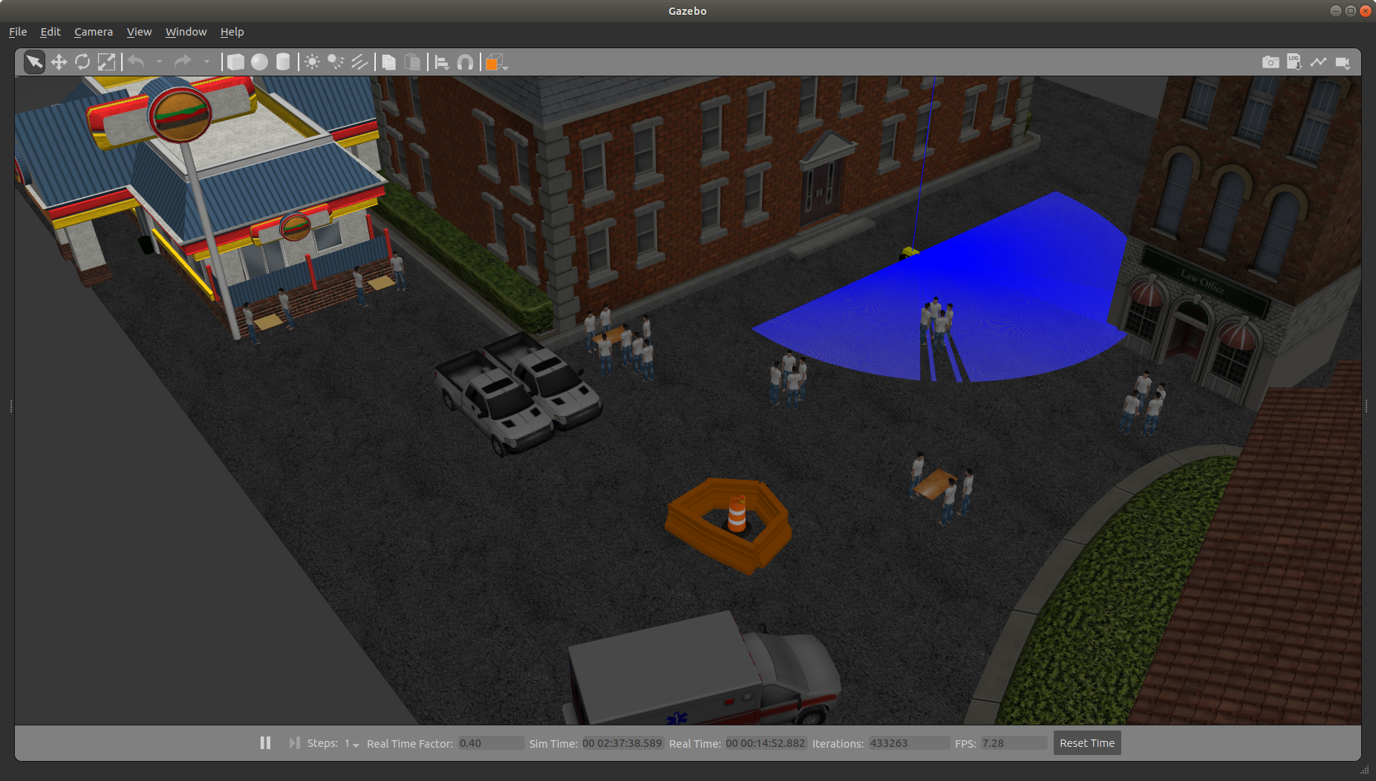
Navigation Test Run
Initial Position
Navigation Goal

Slide 39
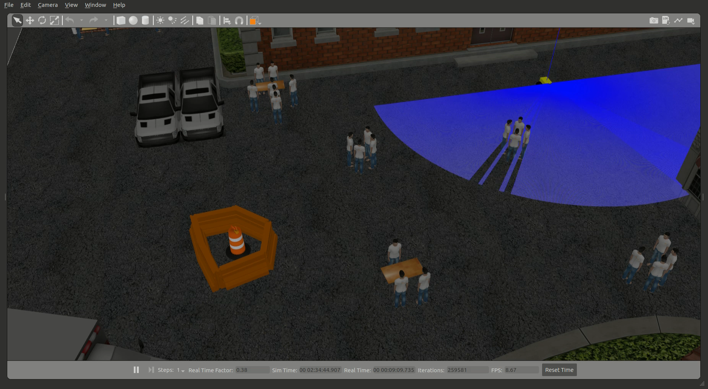

Slide 40
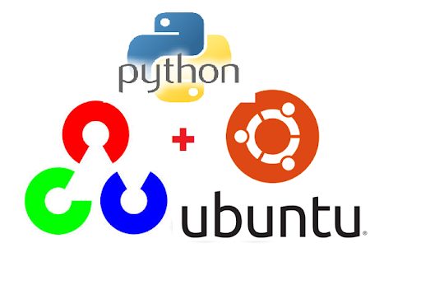

Computer Vision
What is computer vision?
Who uses computer vision?
Ubuntu, Python, OpenCV, and Notepad++

Slide 41
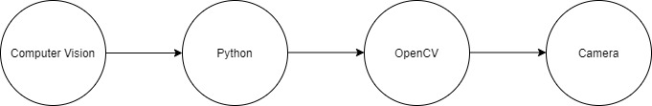
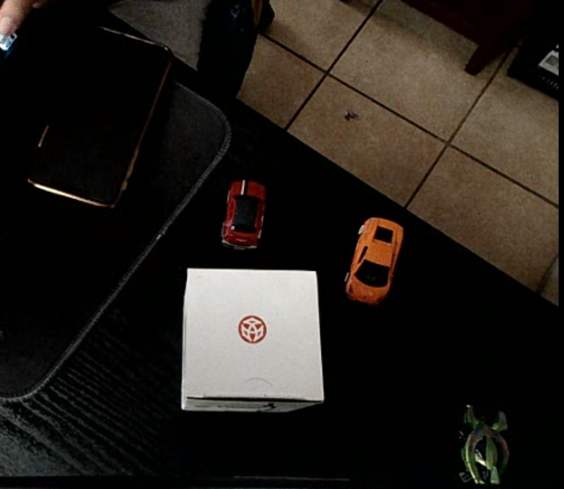
Computer Vision
Basics of computer vision
Cv2.VideoCapture(0) is a form of processing data to the computer.
The camera is the visual aid for the robot.

Slide 42
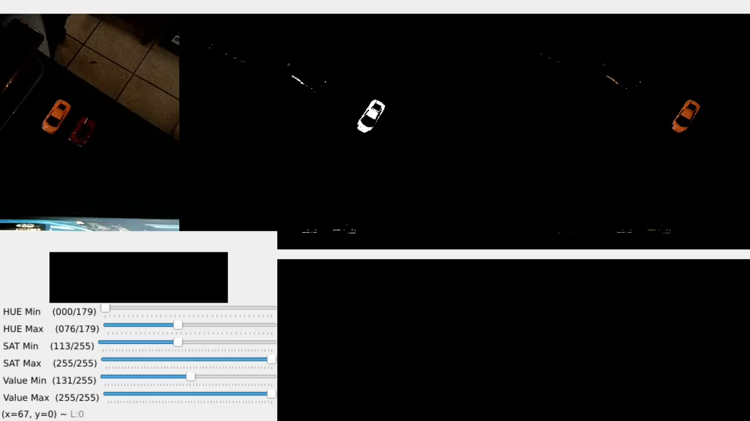
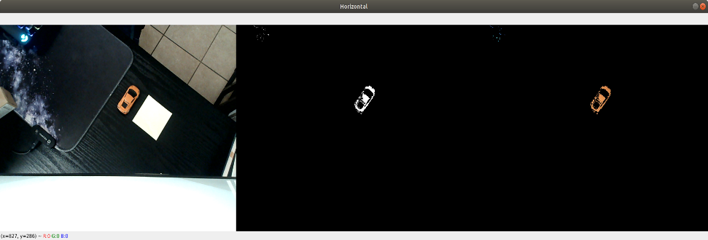
Computer Vision
Demos

Slide 43
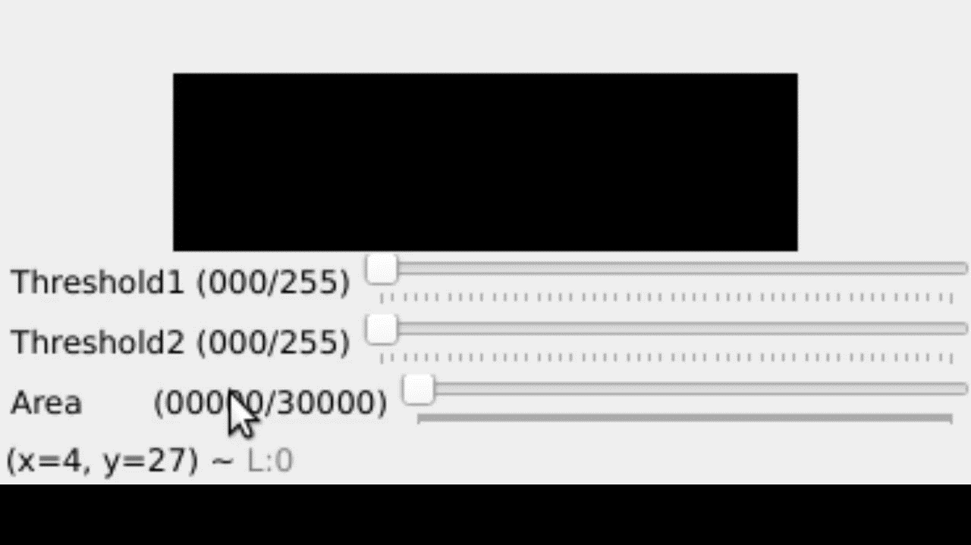
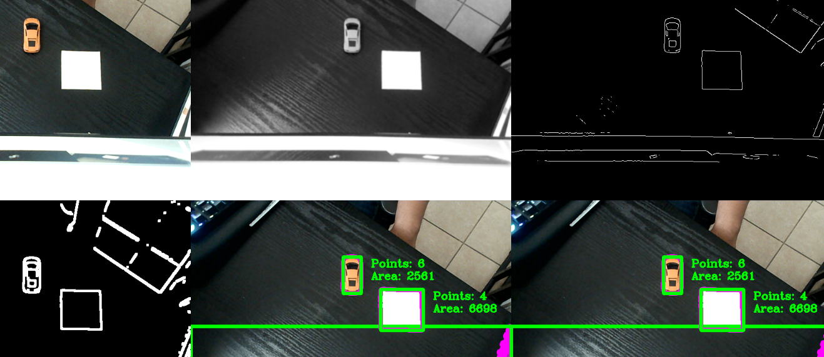
Computer Vision
Demos

Slide 44
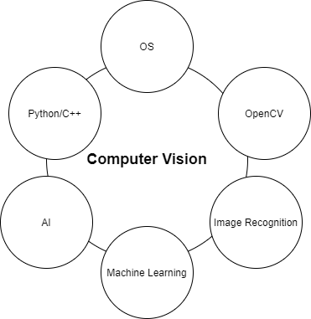
Computer Vision
Future Implementations
Robots need training

Slide 45
Agenda
Introduction
Project Structure
Approach
Design Process
Results
Conclusion

Slide 46
Task Completion %
Tasks | Description | Completion %
Hardware
CAD Design | SolidWorks model of prototype | 100
Chassis/Wheels | Material and wheel model selection | 100
Mechanical Diagram | Mechanical layout and sensor positioning | 100
Sensors | Lidar, IMU, GPS etc. | 100
Battery | Models selected | 100
Motors | Motor selection with desired output | 100
Software
URDF | Design of robot in simulation | 100
Sensors | Implementation of sensors into robot | 100
World | Create Simulated environment student union path | 100
Manuel Control | Keyboard Teleop user control | 100
Obstacle Avoidance | Python code using lidar to divert from obstacles | 100
Localization | Utilize ROS package laser-based SLAM g-mapping | 100
Navigation Stack | Robot travels to user published navigation goal/returns | 75
OpenCV | Camera detects objects / people | 50
Autonomy | Full operational software for Delivery robot prototype | 75

Slide 47
Risk Analysis
Risk Description: | Consequence: | Risk Mitigation: | Likelihood of Risk: | Impact of Risk:
Sensors + Camera do not account for objects impacting delivery robot from above. | A sufficiently heavy object will disrupt the robot’s functionality, such as localizing itself. | Reinforce delivery robot with a more impact-resistant material. | 1 | 2
A moving obstacle that moves faster than the delivery robot can identify and avoid it. | Moving obstacles such as cars or people riding a bicycle will collide with delivery robot. | Increase the distance threshold in obstacle avoidance algorithm. | 2 | 4
Inaccurate sensor readings which affect robot’s obstacle avoidance capabilities. | Delivery robot cannot properly identify and avoid incoming obstacles, resulting in collision. | Adjust sensor locations to prevent overlap leading to inaccurate data. | 2 | 3

Slide 48
Agenda
Introduction
Project Structure
Approach
Design Process
Results
Conclusion

Slide 49
Conclusion
ROS was our solution to creating a simulated robot
With the combination of the sensors, control system, navigation, localization, and computer vision; a fully autonomous vehicle is accomplished
Delivery robots are essential for business and are a solution for delivery services during a pandemic

Slide 50
Resources
[1] “Delivery Robots Market Demand, Size, Share: Forecast 2027,” Delivery Robots Market Demand, Size, Share| Forecast 2027. [Online]. Available: https://www.marketresearchfuture.com/reports/delivery-robots-market-7551. [Accessed: 01-Apr-2021].
[2] “Delivery Robots Market,” Market Research Firm. [Online]. Available: https://www.marketsandmarkets.com/Market-Reports/delivery-robot-market-263997316.html. [Accessed: 01-Apr-2021].
[3] Delivery Robot Team, “mitto90/husky_ws,” GitHub. [Online]. Available: https://github.com/mitto90/husky_ws.git. [Accessed: 06-Apr-2021].
[4] “Wiki,” ros.org. [Online]. Available: http://wiki.ros.org/gmapping. [Accessed: 08-Apr-2021].
[5] “Wiki,” ros.org. [Online]. Available: http://wiki.ros.org/navigation. [Accessed: 08-Apr-2021].
[6] “Wiki,” ros.org. [Online]. Available: http://wiki.ros.org/robot_state_publisher. [Accessed: 08-Apr-2021].
[7]” OpenCV,” opencv-python-tutroals.readthedocs.io/en/latest/.[Online]. Available: https://opencv-python-tutroals.readthedocs.io/en/latest/py_tutorials/py_gui/py_video_display/py_video_display.html#display-video. [Accessed: 21-Apr-2021].

Slide 51
Thank You!

