Slide 1

Final Senior Design Presentation
Spring, 2021
Team 23 - Development of a 3D Printer for Cementitious Materials
Advisor - Dr. Mohsen Eshraghi
Team Members:
Arturo Caton, Son Quang, Zachary Morris, Siggifredo Aguilar, Jason Chien
Notes:
sig

Slide 2





Team Members
Arturo Caton - M.E. Son Quang - M.E. Zachary Morris - M.E. Siggifredo Aguilar - E.E. Jason Chien - E.E.
Notes:
sig

Slide 3
Agenda
Background and Objectives Zach
Mechanical Components, Overview, & Testing Art
Mechanical Current & Future Progress Son
Electrical Components and Overview Siggi
Electrical Operation and Testing Jason
Conclusion Zach
Notes:
sig

Slide 4
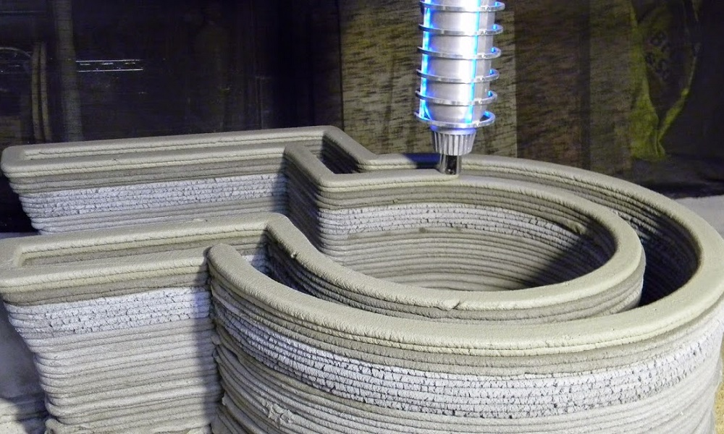
3D printer for cementitious material: Background
3D printing has been used to build structures which are more affordable than building with conventional materials
The structure printed can be highly customized
3D printers are being used in
space and are planned to be
used on future missions
4
Notes:
sig

Slide 5
3D printer objective
The printer is to use a 10’x10’x10’ print area
The printer is to be of a modular design which is easy to assemble and disassemble
The printer will have the ability to print various cementitious materials
5

Slide 6
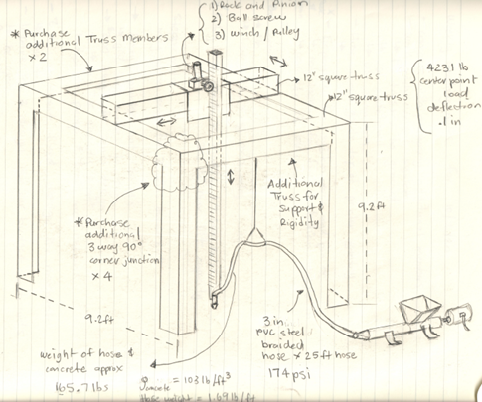
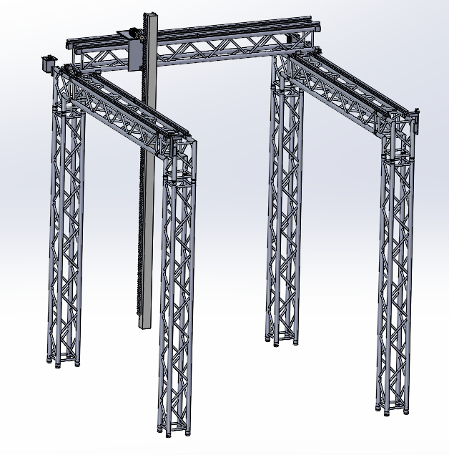
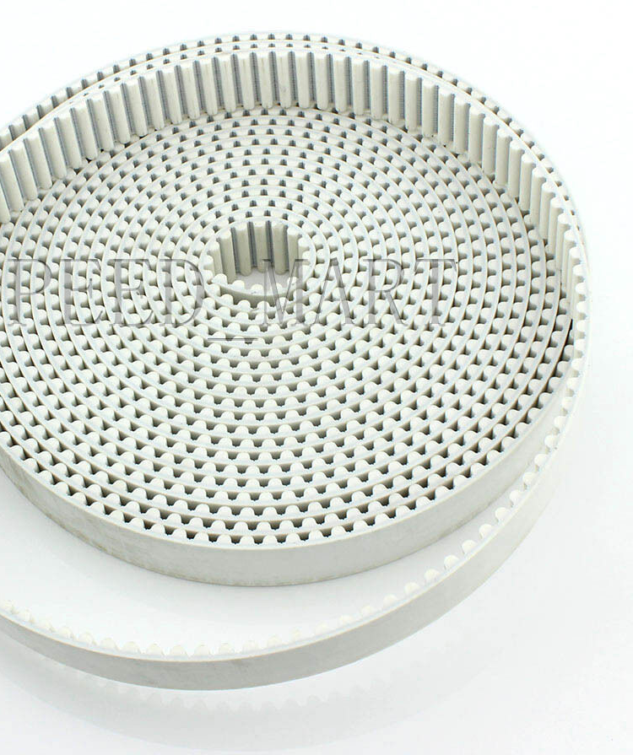
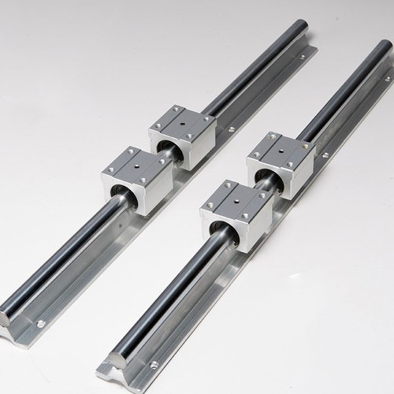
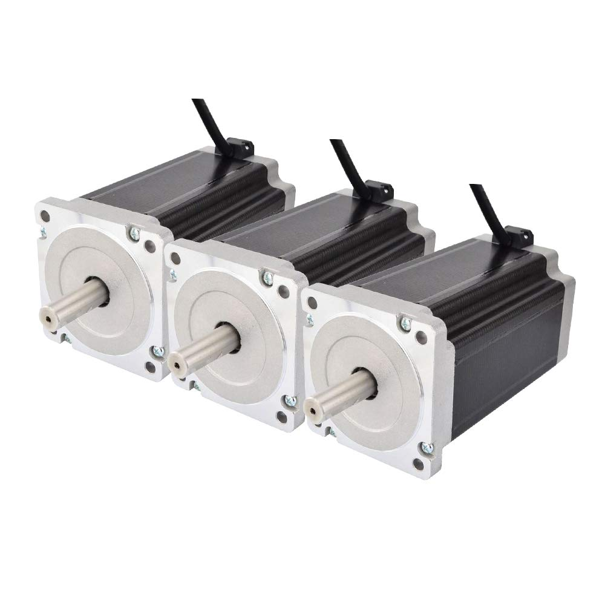
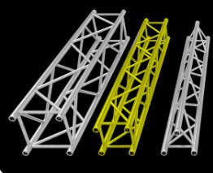
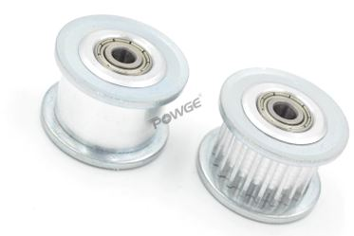
Large Gantry Equipment Overview
Large Gantry Model made up of 12 inch truss members approximately 10 ft in length.
Three Nema 34 motors responsible for x, y, and z motion.
Linear rails and linear bearing
Timing belt and gears
Figure 6: Initial Gantry Design
Figure 1: 3cm wide 5mm pitch timing belt
Figure 2: SBR20 Linear rail and bearings
Figures 3: 24 Tooth Idler Pulley and tensioner
Figure 4: NEMA 34 High torque stepper motor
Figure 5: F34 12 inch wide truss members
6
Figure 7: Final Large Gantry Model

Slide 7
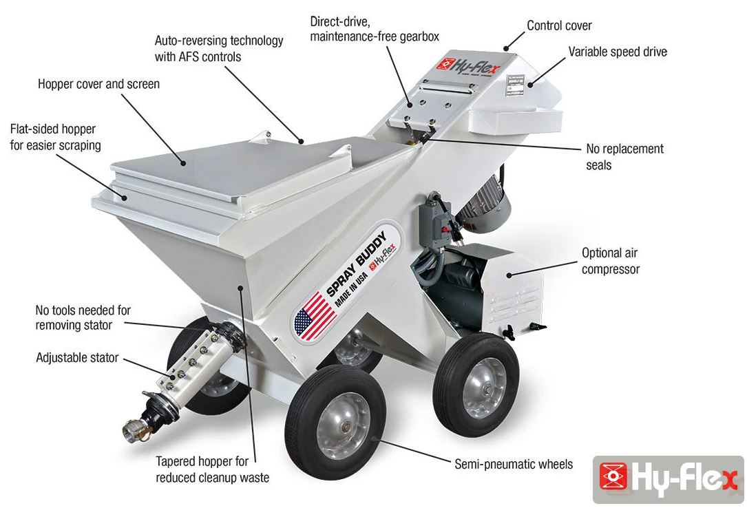
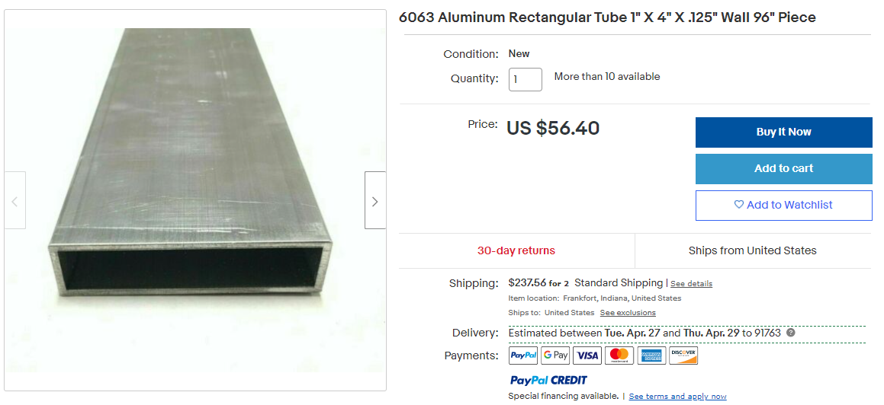
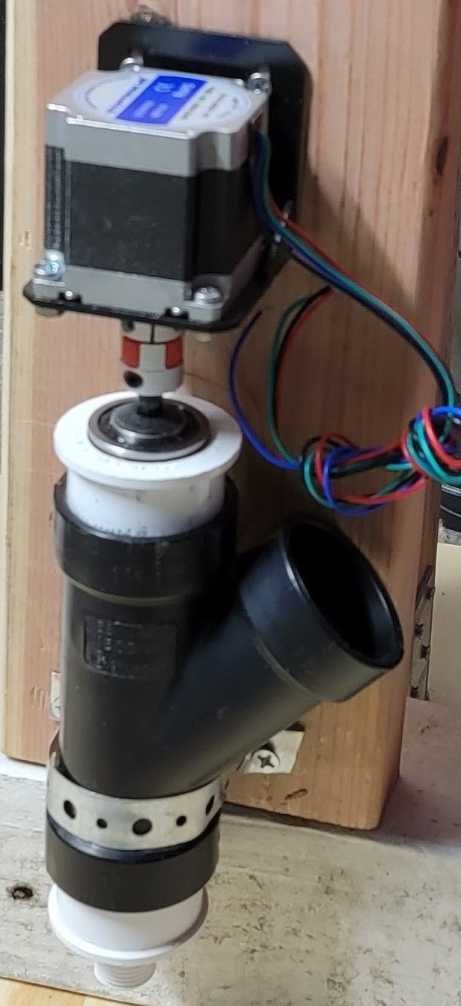
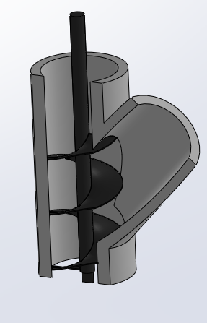
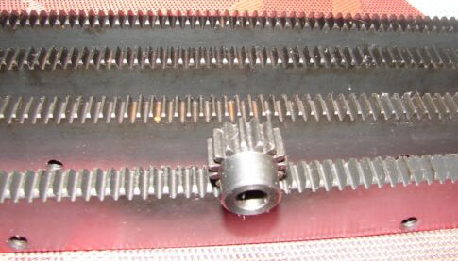
Large Gantry Equipment Overview Cont.
Z-axis Rack and Pinion Gear
Z-axis support upright
Cementitious Material Pump
Cementitious Material Extruder with NEMA 17 stepper motor
Figure 1: 20 tooth Pinion Gear and 6.35 teeth per inch with 20 degree pressure angle
Figure 2: Extruder with Nema 17 motor, 2 inch PVC and auger bit
Figure 3: 3 x 4 x 120 inch aluminum z-axis tubing
Figure 4: 1 HP motor, 110V cementitious materials pump for z-axis extrusion

Slide 8
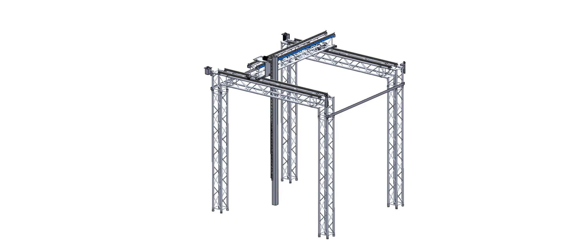
Large Gantry Model Final Design
Video 1: Final Gantry Model showing x, y, and z axis movement.

Slide 9
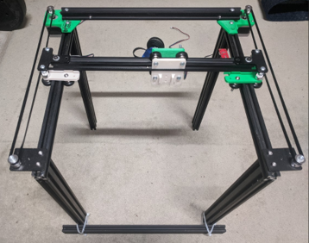
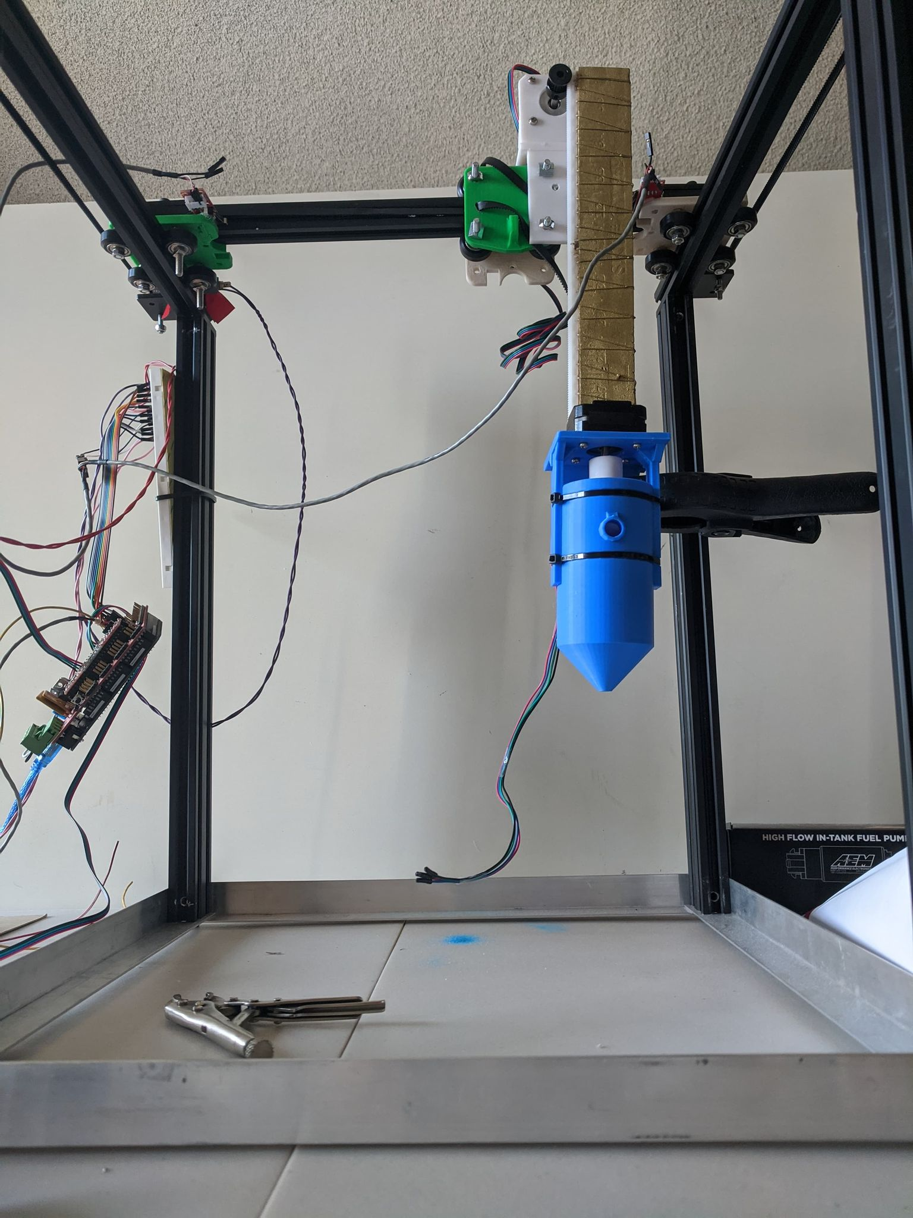
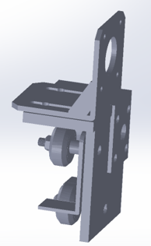
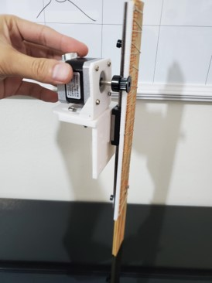
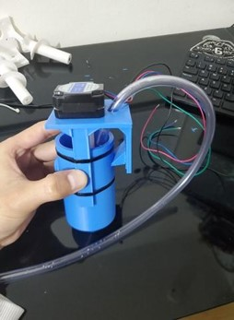

Small Gantry Prototype
Small 3D filament printer modified to resemble large gantry for testing
Z-axis designed to simulate actual model for code testing
3D printed small extruder with NEMA 17 motor
Figure 5: Final 3D printer assembly
Figure 1: Z-axis motor mount
Figure 2: Z-axis motor and assembly
Figure 3: Z-axis extruder model
Figure 4: Final z-axis and extruder assembly
Figure 6: Final extruder model assembly

Slide 10
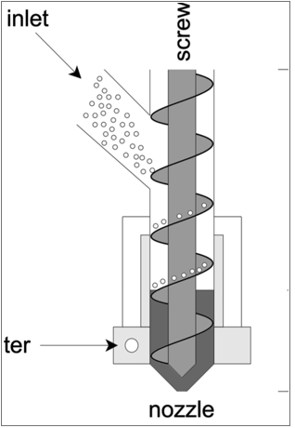
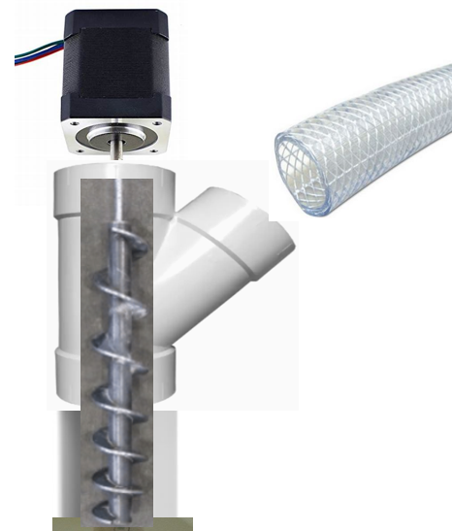
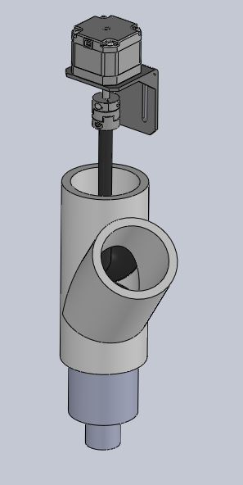
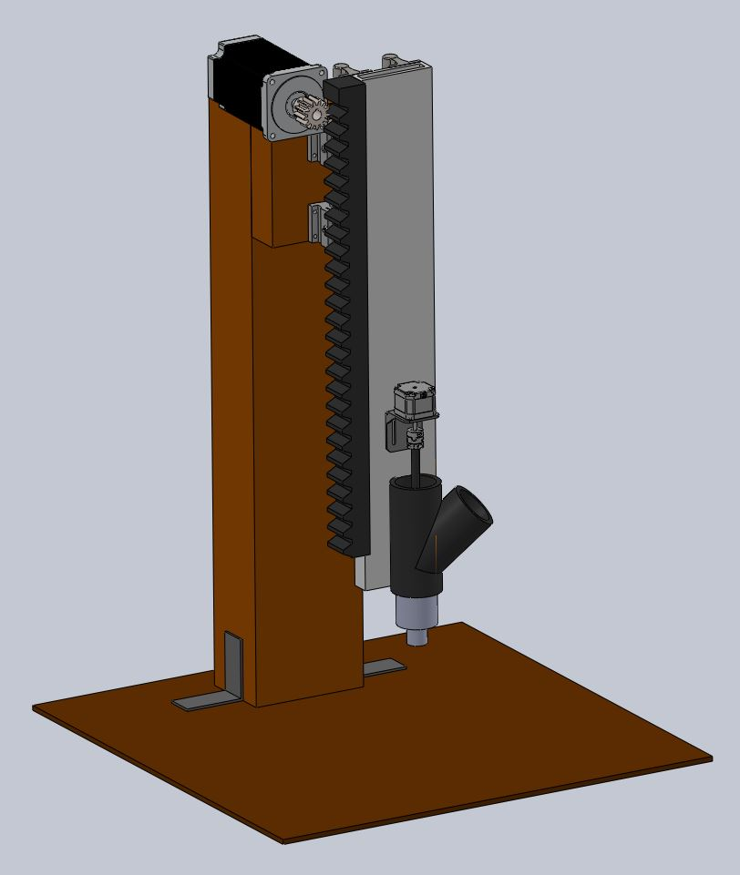
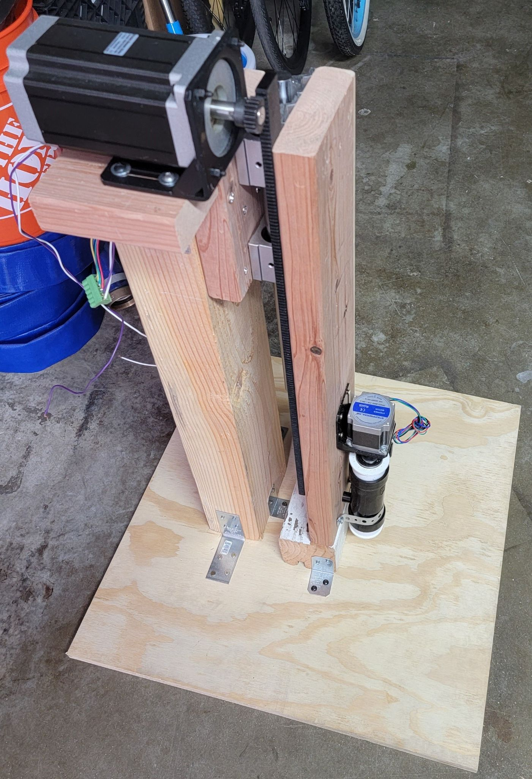
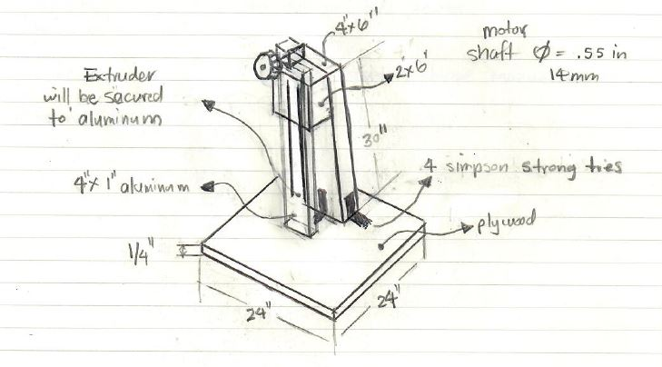
Large Gantry Prototype
Large Z-axis and Extruder prototype designed to mirror the larger unit in order to provide a working model for the E.E. team to code
Actual Z-axis rack and pinion gear as well as NEMA 34 motor incorporated into model
Actual designed Extruding system assembled and used in large prototype
Figure 1: Large Extruder Design Concept thru modeling
Figure 2: Large z-axis and Extruder Modeling thru Fabrication

Slide 11
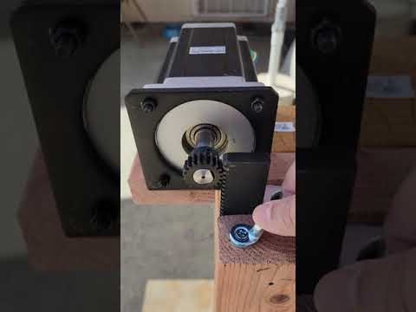
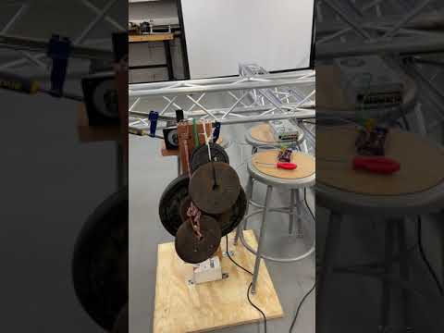
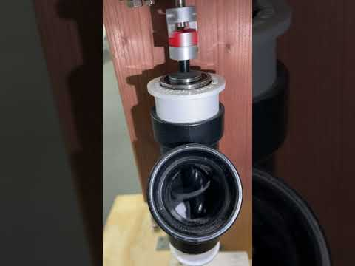
Video 1: Final z-axis system test model
Video 2: Model being tested with 100lbs.
Video 3: Extruder Model testing

Slide 12
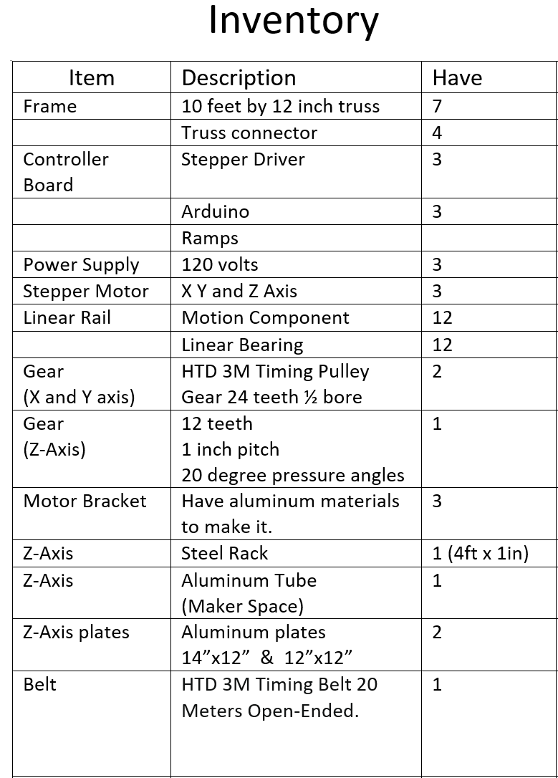
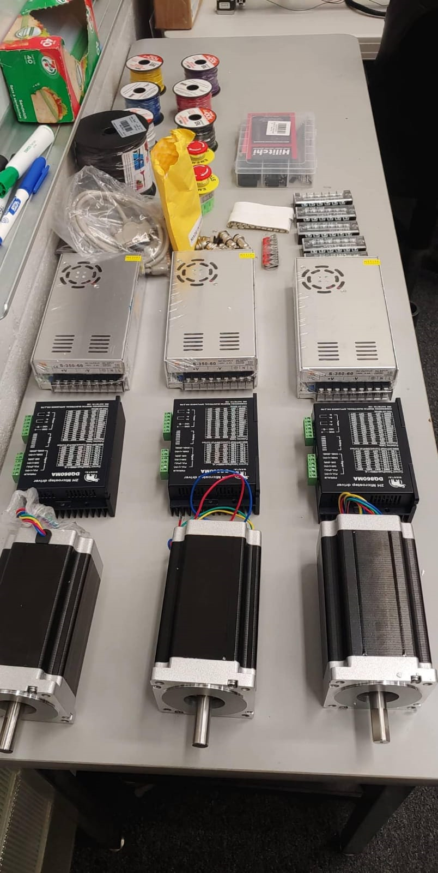
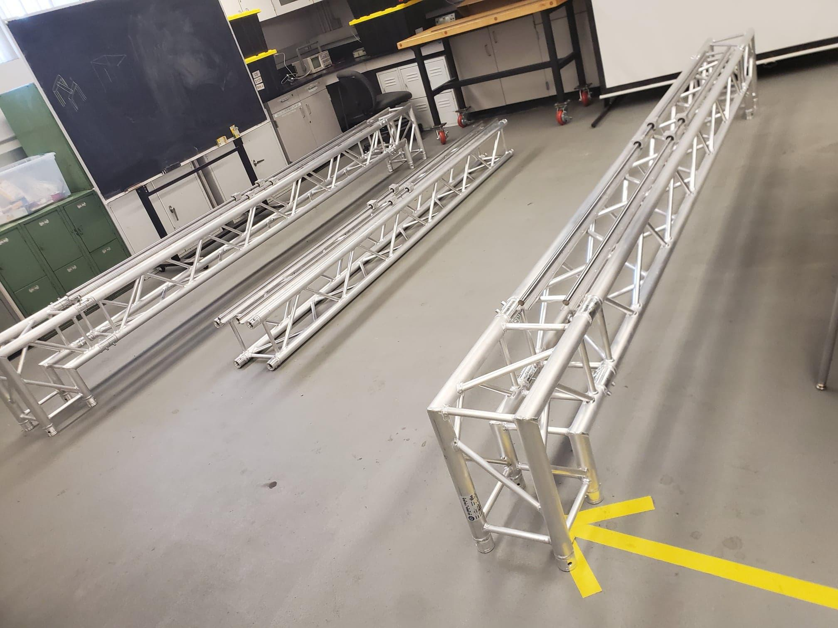
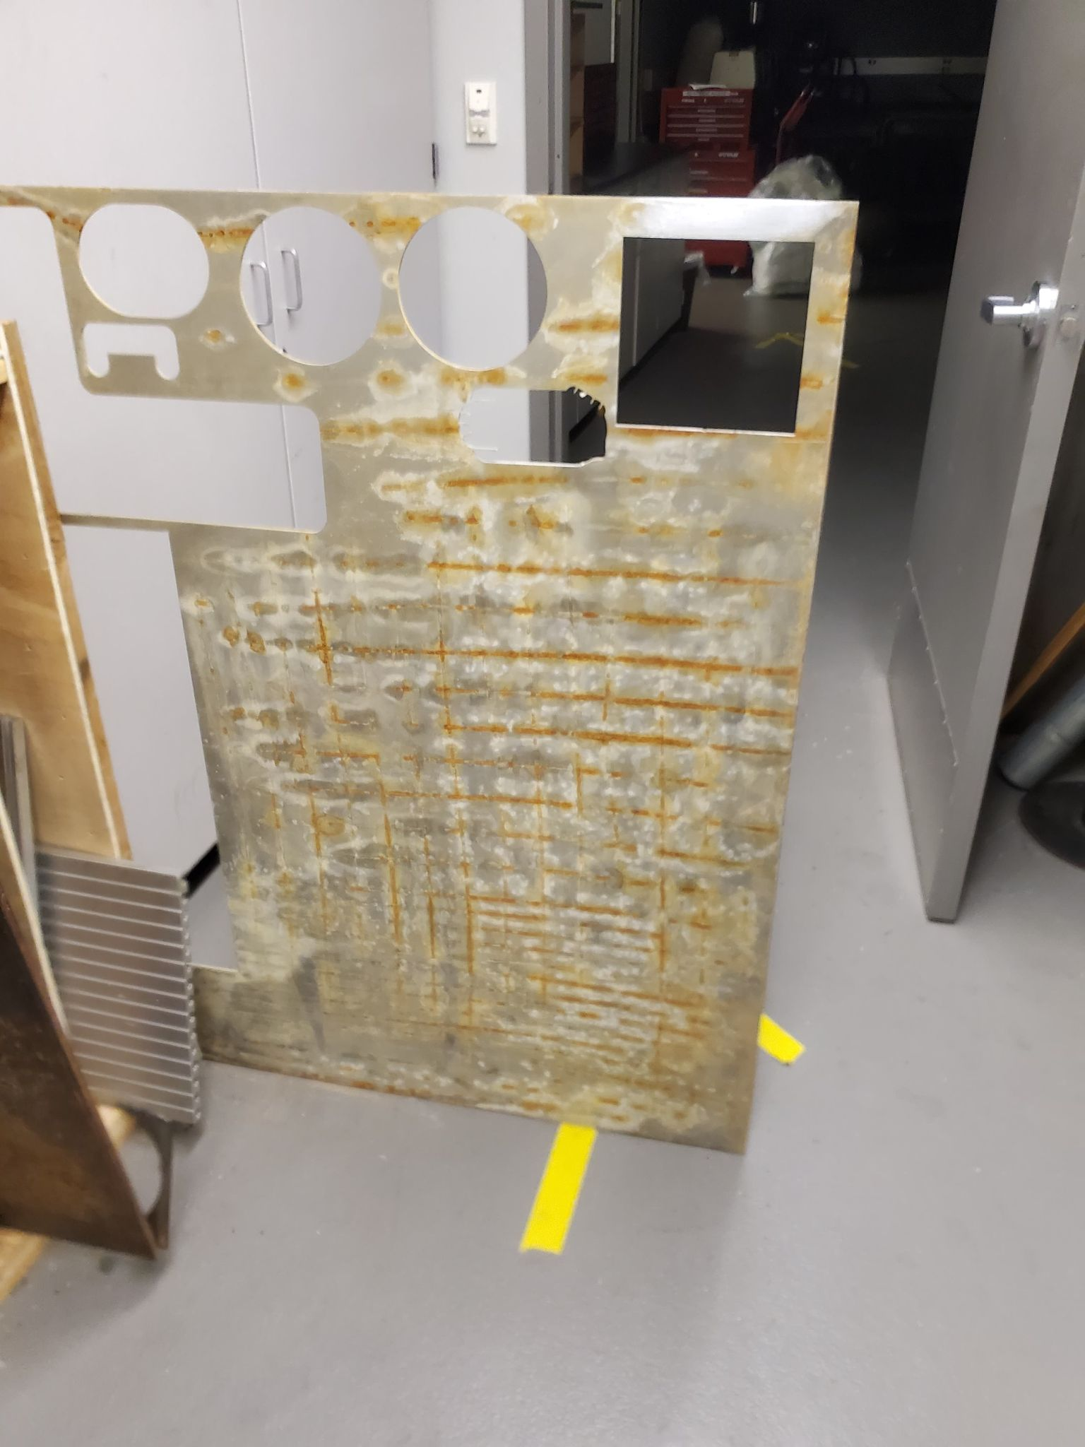
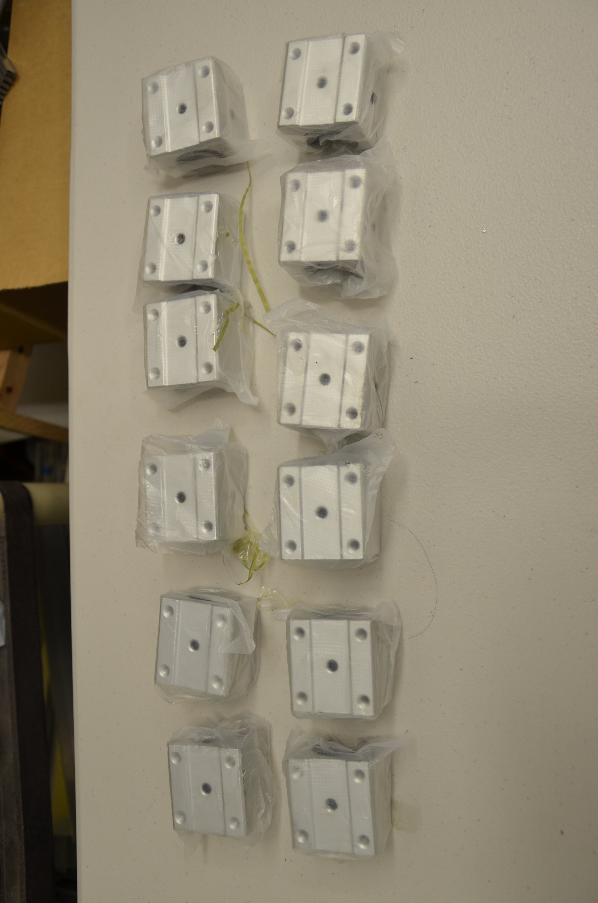
Makerspace

Slide 13
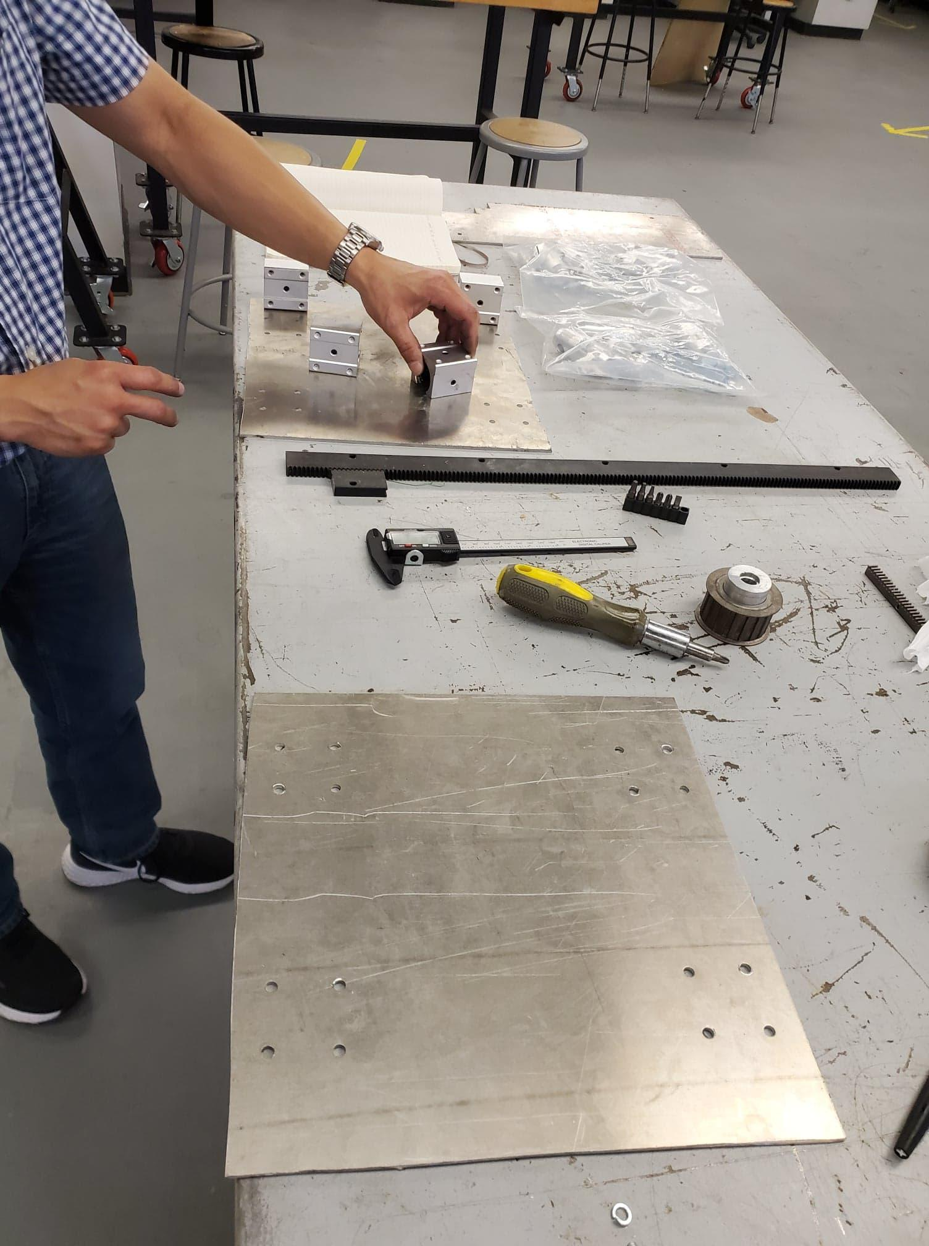
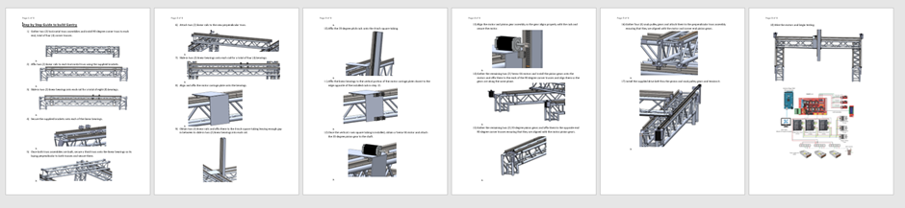
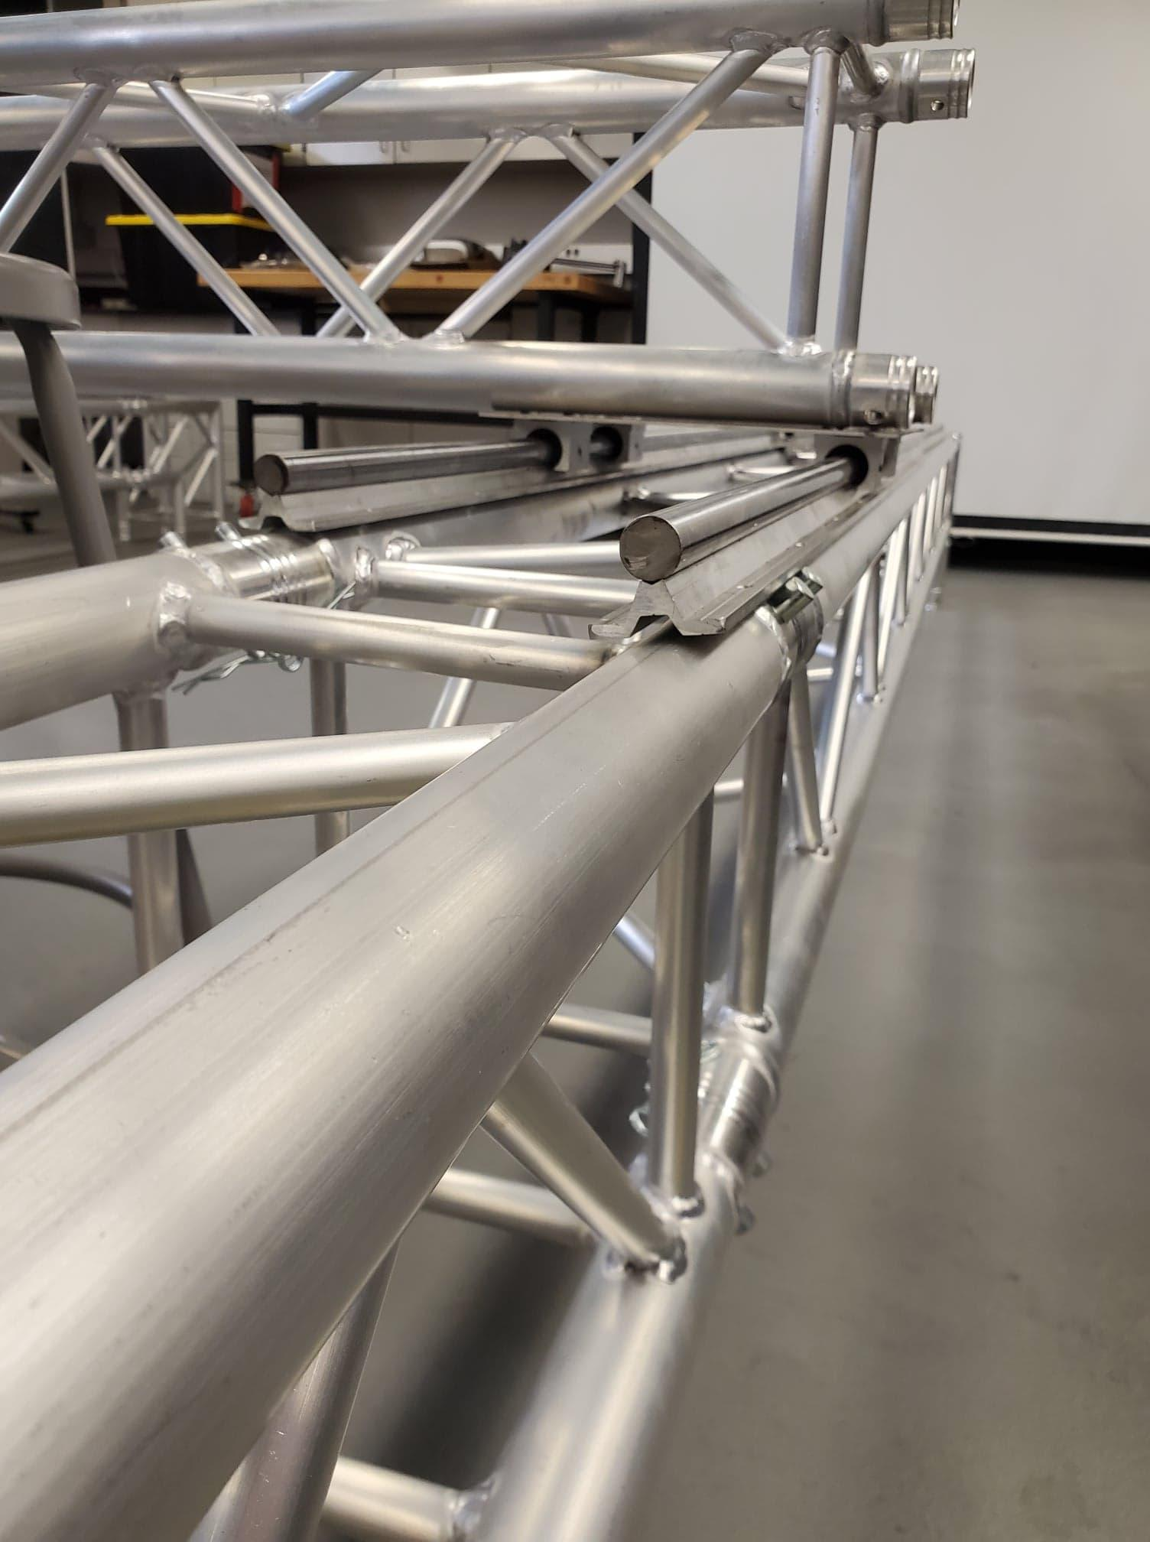
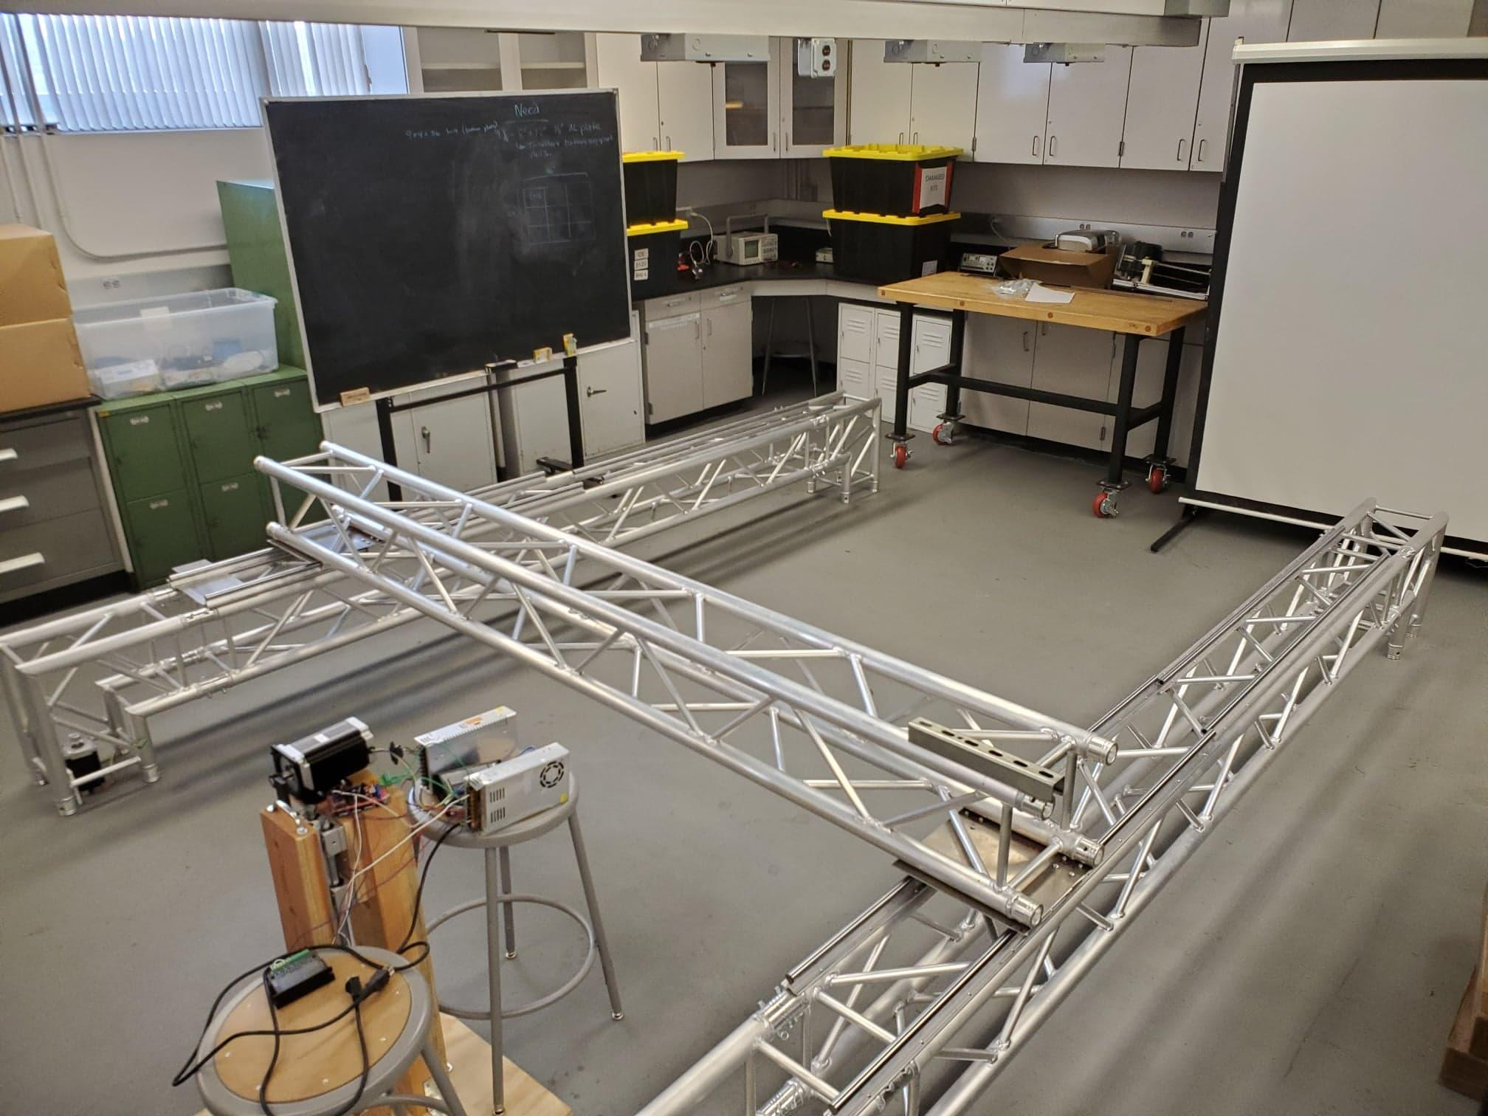
H-Bot Setup and Fabrication
Figure 1: Mount bearing to plate
Gantry Setup Instruction
Figure 3: Linear Rail to Truss
Figure 2: Mount truss to plate

Slide 14
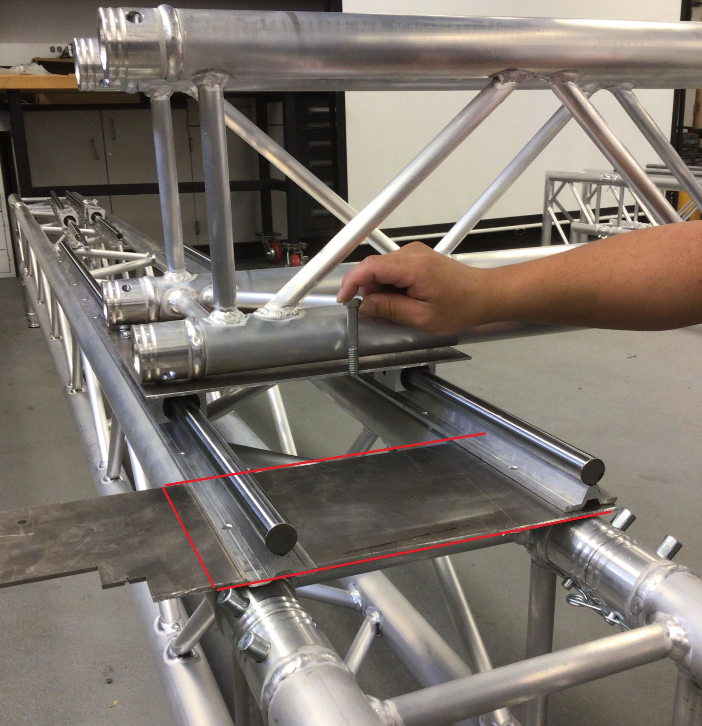
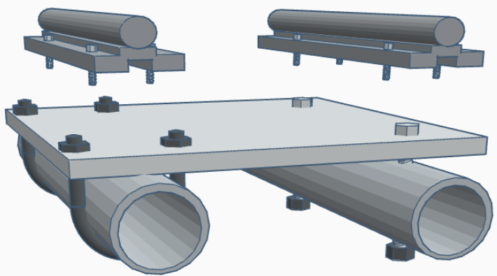
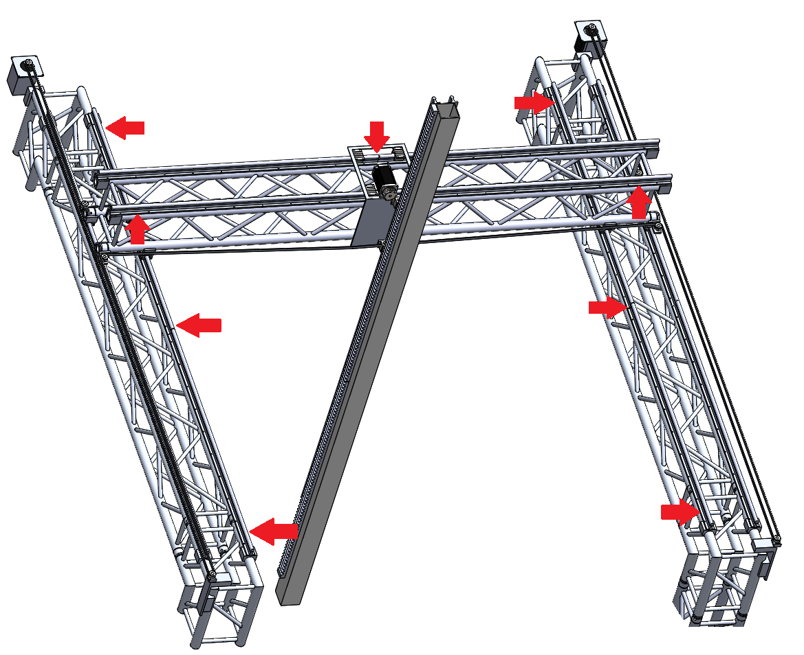
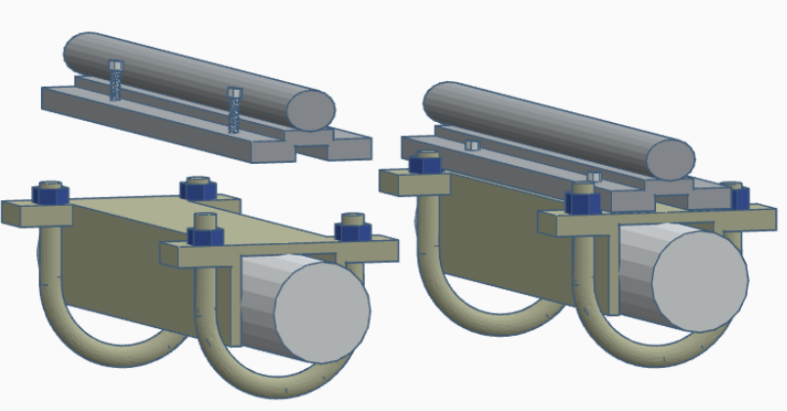
Mounting Option
Option 1:
Pro: Preserve Truss
Con: Cost and Time
Option 2:
Pro: Cost and Time
Con: Drill through Truss
Option 3:
Pro: Preserve Truss
Con: Cost and Time
-9 pieces of ⅛” x 8” x 12”
(Mount linear rails to truss)
8 inch
12 inch
Figure 2: Plate Mount
Option 1: U-bolt Option 2: Screw & Nut
Figure 2:
Option 3: C-Channel & U-bolt

Slide 15
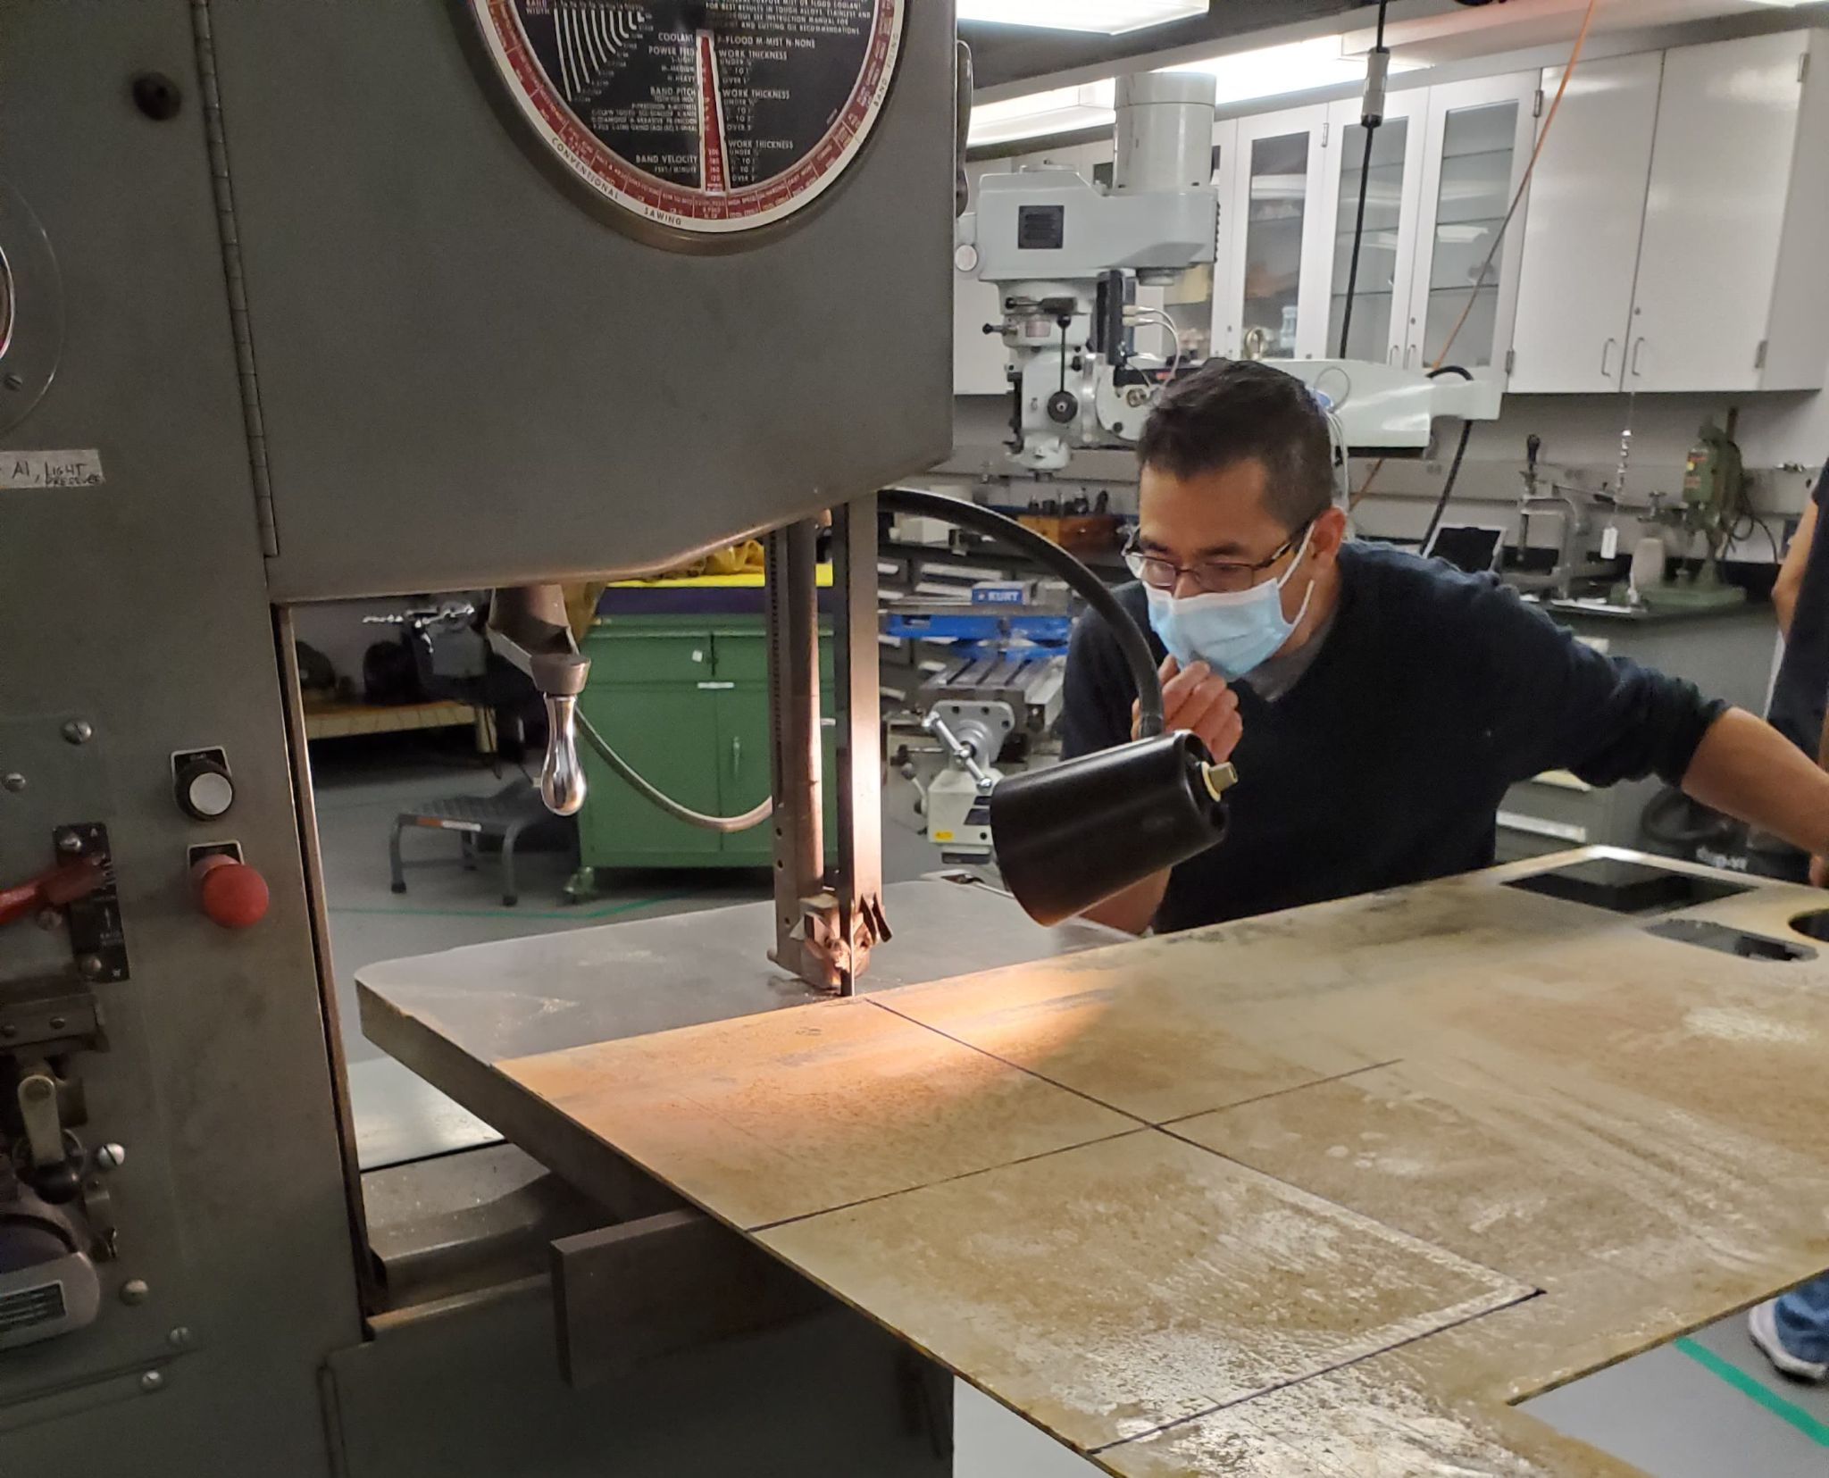
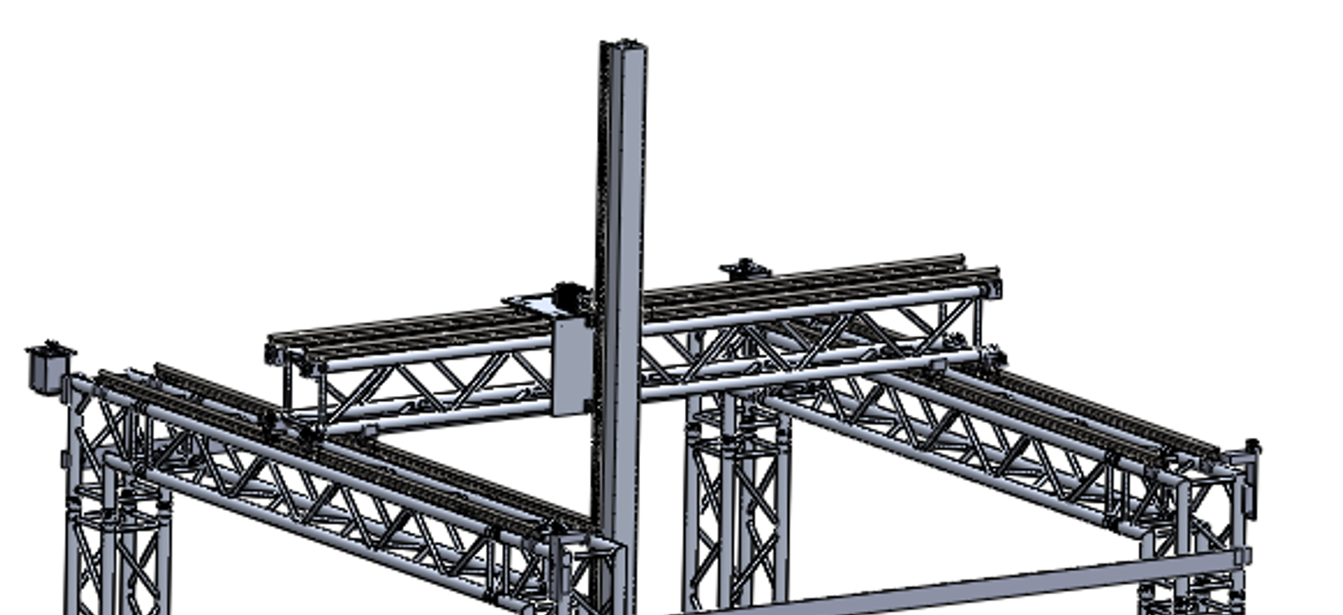
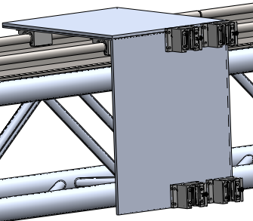
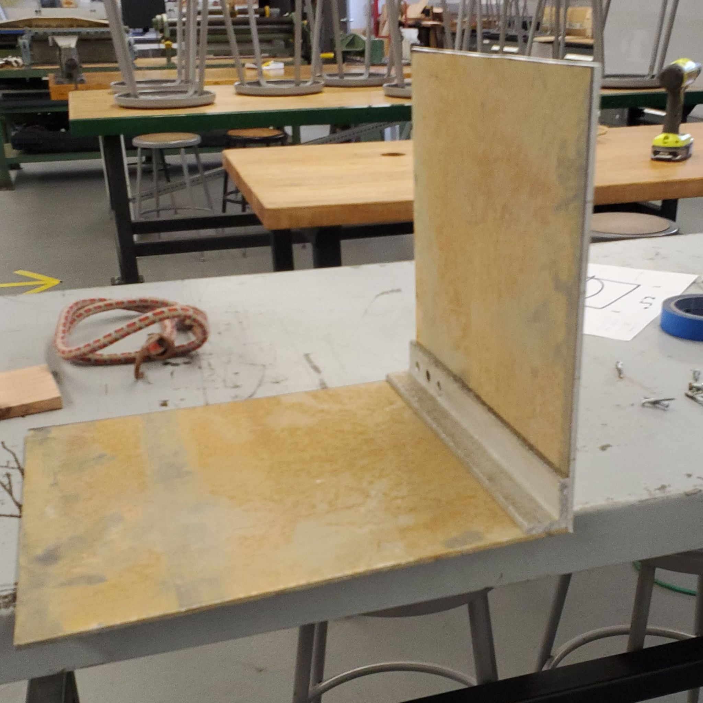
Carriage Plate Design
Carriage plate is designed to support the rack pinion gear, aluminum tube support and the z-axis motor.
Mount linear bearing to plates
Aluminum Angle
⅛” x 14” x 12”
⅛” x 12” x 12”
Figure 1: Top Portion Gantry
Figure 2: Carriage Plate (Solidwork)
Figure 3: Aluminum Carriage Plate

Slide 16
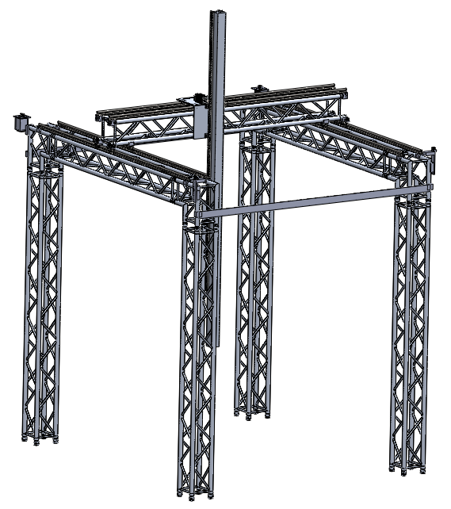
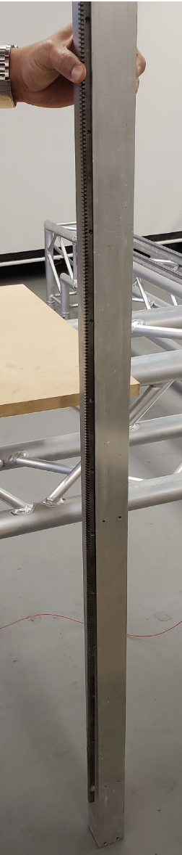
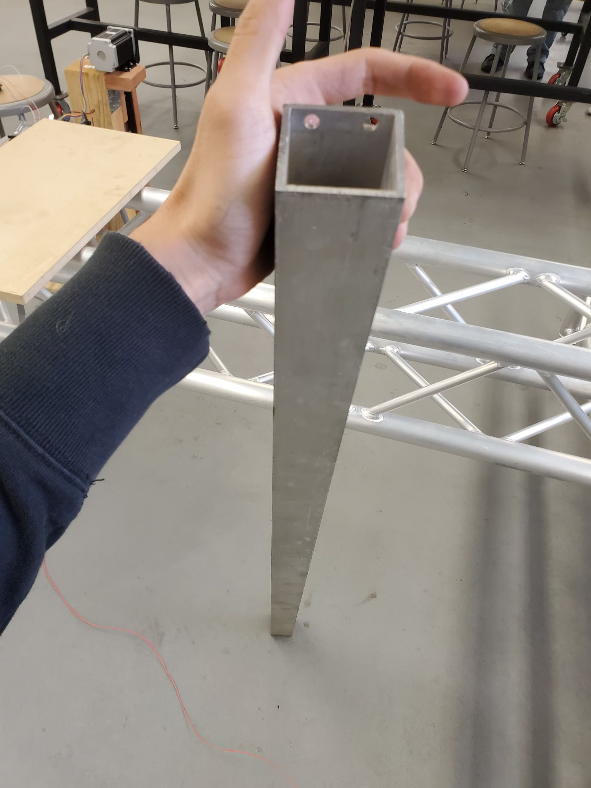
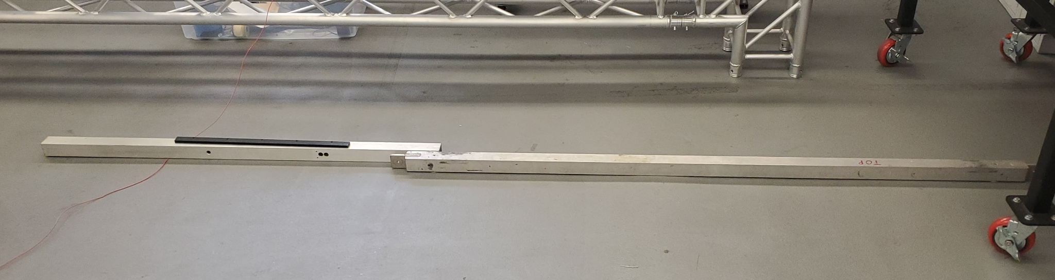
rack
Future Plan : Completing the Z-Axis
Mount rack 4ft rack to the 4ft aluminum tube.
Attach linear rail to aluminum tubes.
Complete the assembly for the z-axis
10 feet aluminum tube
Figure 1: 4 ft aluminum tube & rack

Slide 17
Material needed for Gantry
Linear Support Rail and Linear motion bearings | 2X SBR20-3000m 20mm Fully Supported Jointed Linear Rail + 4 SBR20UU Block Bearings | 1 Set | $495.00 + Tax | Free Shipping | $495.00 +Tax
POWGE 24 TEETH HTD 3M Idler No Teeth Pulley Gear (9mm Pulley Bore) | 24-8mm-15mm wide No teeth | 1 (set of 10pc) | $59.99 + Tax | Expedited $13.39 | $73.78+ Tax
Pinion Gear Rack | 96 inch Rack | 1 (Set of 4) | $119.95 + Tax | Expedited $21.99 | $141.94 + Tax
Aluminum plates to mount Linear bearings | 1/8" 8" x 12" | 9 plates | $66.69 + Tax | Shipping $8.00 | $74.69 + Tax
NEMA 34 steel bracket |  | 2 brackets | $9.99 + Tax | Free Shipping | $19.99 + Tax

Slide 18
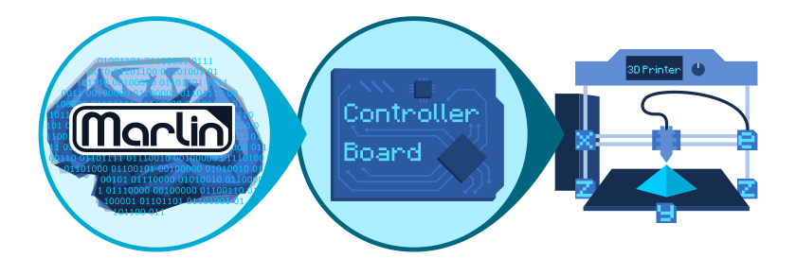


Marlin Firmware:
Open source code utilized by numerous 3d printers as well as CNC machines or laser cutter application
Operates on Arduino Mega 2560 and Ramps 1.4 board
Integrated Gcode commands which can disable certain functions of the printer or command the printer to act on predefined functions
Defines printer and motor parameters such as bed size, step sizes, and drivers types
Figure 1: Arduino MEGA (Blue)
& Ramps 1.4 (Red)
Figure 2: A few Gcode commands out of the multiple that are available
Notes:
Quick summary of marlin and what’s its use with our project

Slide 19




Printer coding and its support with G Commands
When going into the coding aspect of the project every section of code had some Marlin Command associated
Malin is based of FDM printers so code such as temperature can get in the way of printing and testing
Gcode commands as the one seen prevent cold extrusion code to tamper with our project
Since these printers are based on smaller motors, step sizes must be adjusted for the larger scale motors
Figure 1: Marlin Temperature coding
Figure 2: Gcode command
Figure 3: Marlin code for defining step size
Figure 4: Gcode command to switch between Inches or mm
Notes:
Overview of the needed electrical components

Slide 20


Wiring Schematic
1
2
1.Arduino Mega 2560
2.Ramps 1.4 board
3.DQ860MA Driver
4.NEMA 34 Bipolar Stepper Motors (XYZ)
5.60 V Power Supply
Drivers and motors are different varying from our large scale gantry to prototype model
4
3
5
Figure 1: Electrical Wiring Diagram for XYZ Axis
Notes:
The wiring of the project along with an electrical schematic

Slide 21


XYZ Axis electrical configuration: Large Scale
Dependant on 3 NEMA 34 Motors
The Nema 34 motors operates based off of a DQ860MA Driver which is rated from 24-80V DC
Power supply of 60V DC to the motor driver
Arduino/Ramps 1.4 board combination
Power supply of 12V DC to the Ramps 1.4 board
Figure 1: NEMA 34 Motor (6.8 A)
Figure 2: DQ860MA driver for our motors
Notes:
Go over the motors & drivers which are most essential for our project

Slide 22


Extrusion System electrical configuration: Large Scale
Dependant on 1 NEMA 23 Stepper Motor
Utilizes a Driver similar to the DQ860MA, but is rated at much lower DC Voltage and Current
Doesn’t need an additional power supply, since its rated at 9-42V DC, then we can use the 12V Power Supply that the Ramps 1.4 uses
Figure 1: NEMA 23 Stepper Motor Driver
Figure 2: NEMA 23 Stepper Motor (2.8 A)

Slide 23



XYZ + Extrusion electrical configuration: Prototype Model
Utilizes 4 NEMA 17 Motors to operate the whole prototype model
Requires only 1 power supply, which is the 12V DC powering the Ramps 1.4 board
All NEMA 17 Motors utilize A4988 Drivers, which connect directly to the Ramps 1.4 board
Figure 2: A9888 Stepper Motor Driver
Figure 1: Nema 17 Motor
Figure 3: Ramps 1.4 with XYZ A4988 driver
Notes:
Slicing tools as well as simulation tools

Slide 24



Electrical Operations and Testing - Jason

Slide 25


Electrical Operation - Jason
Full Scale Diagram
Prototype Diagram

Slide 26


XY Movement tests - Jason
Testing the Firmware by printing test squares. We were able to move from 2D to 3D by printing in sand.

Slide 27

XY Movement tests - Jason
Full scale XY motor testing.

Slide 28

Extrusion Tests - Jason

Slide 29
Full Scale Z-motion testing
Z-Axis testing with 100lbs weight

Slide 30
Conclusion
The team has designed a full scale printer as well as a small prototype which was used for testing.
3 options have been proposed to mount the gantry together.
The team has put together a final list of parts we need as well as a guide to assemble the printer

Slide 31
Thank you

