Slide 1
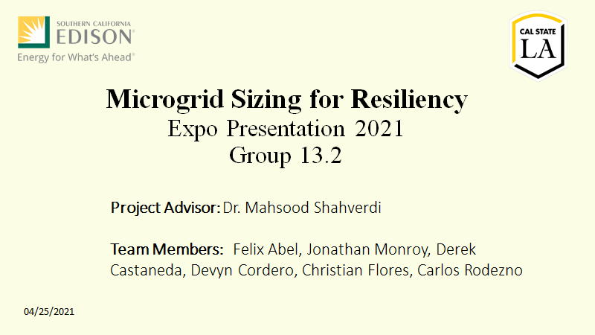

Slide 2
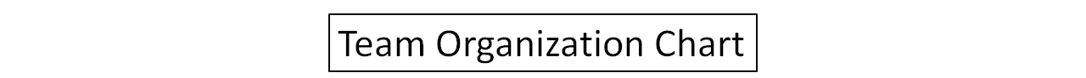

Advisor: Mahsood Shahverdi
Photovoltaic System
Christian Flores
Energy Storage System
Team Lead: Christian Flores
Christian Flores
Felix Abel
Felix Abel
Droop Control
Devyn Cordero
Jonathan Monroy
Derek Castaneda
Operations
Carlos Rodenzo
Felix Abel
Christian Flores

Slide 3
Agenda
Introduction/Background
Statement of Work
Emergency Diesel Generator
Component Modeling ​
Sizing Microgrid ​
Microgrid Operation Cost
Summary
Derek Castaneda
Christian Flores
Devyn Cordero/ Carlos Rodezno
/Jonathan Monroy/ Derek Castaneda
Christian Flores
Felix Abel
Felix Abel
Felix Abel

Slide 4
Introduction
WHAT IS A MICROGRID?
•A local energy grid with control capability
•EVERYONE is affected when repairing a traditional grid
WHY RENEWABLE-ENERGY-BASED OPTIONS?
•We need to maximize the penetration of renewable-energy-based generations
•Provides reliable power supplies and fuel diversification
•Enhances energy security
•Helps conserve natural resources

Slide 5
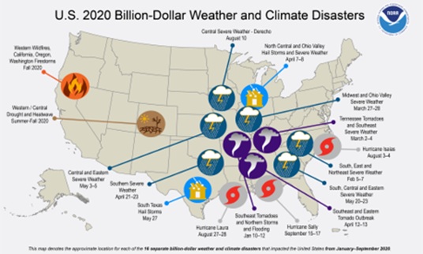
Problem
RESILIENCY
•Power outages are now an accepted practice
•In 2019, SoCal Edison cut the power to about 200,000 customers
•The resiliency of a system is defined as its ability to return to a stable operation point after a major disruption event
•Microgrids are considered as a potential solution to deal with major power disruption events

Slide 6
Agenda
Introduction/Background
Statement of Work
Emergency Diesel Generator
Component Modeling ​
Sizing Microgrid ​
Microgrid Operation Cost
Summary
Derek Castaneda
Christian Flores
Devyn Cordero/ Carlos Rodezno
/Jonathan Monroy/ Derek Castaneda
Christian Flores
Felix Abel
Felix Abel
Felix Abel

Slide 7
Objective
Create a model of a microgrid.
Includes Photovoltaic plus a battery storage system.
Manage the cost of operation.
Develop an operation scheme.
Maintain functional operation to supply power to load.

Slide 8
Requirements
Functional Requirements:​
Frequency stability of the microgrid system​
Shall provide cost effective operational strategy​
Shall provide simulation of microgrid system​
Performance Requirements:​
Maintain 60Hz within +- 5% using Linear Droop Control by finding failure points with different loads​
Develop daily costs of operational strategy and maintenance​
Microgrid system must be resilient for 4 hours

Slide 9
Agenda
Introduction/Background
Statement of Work
Emergency Diesel Generator
Component Modeling ​
Sizing Microgrid ​
Microgrid Operation Cost
Summary
Derek Castaneda
Christian Flores
Devyn Cordero/ Carlos Rodezno
/Jonathan Monroy/ Derek Castaneda
Christian Flores
Felix Abel
Felix Abel
Felix Abel

Slide 10
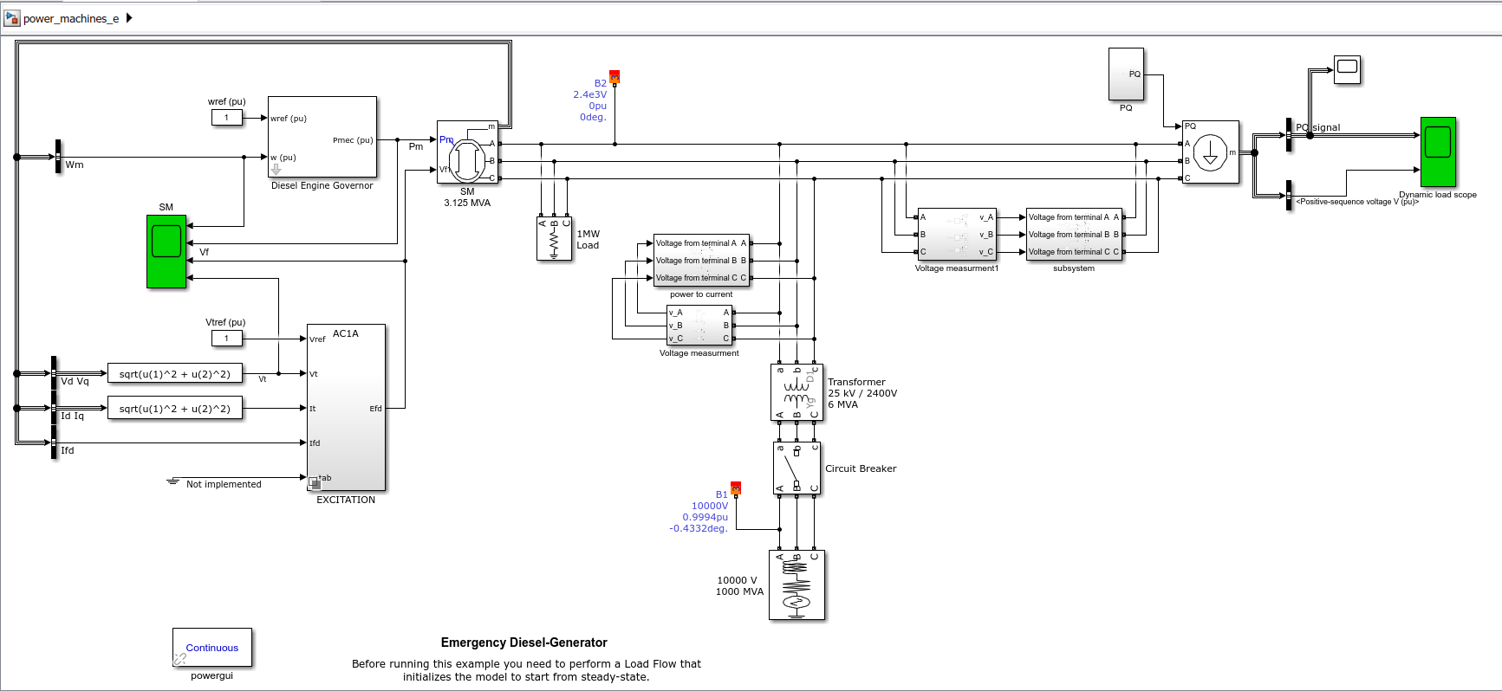
Emergency Diesel Generator
Simulation of Emergency diesel Generator in islanded mode
To determine the limitations of the microgrid system

Slide 11
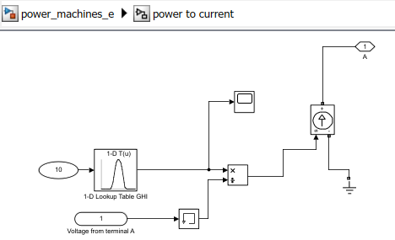
Power to Current
A 1-D Lookup table was used that contained an excel sheet with GHI information that was converted to Real Power.
The real power simulates the inclusion of a Photo-voltaic solar panel.

Slide 12
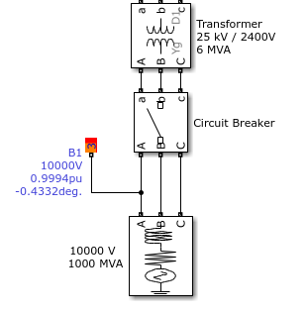
Disconnection from Grid
Circuit Breaker is open to simulate "islanded mode"
1000MVA/10kV used to emulate power grid
Includes a 25kV/2400v step-down transformer

Slide 13
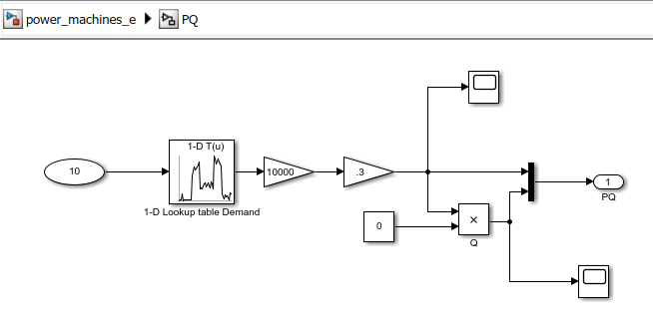
Load Demand
A 1-D lookup table was used containing 24 hours' worth of real power data
The data was acquired from National Renewable Energy Laboratory (NREL)
It was decided to put a gain of 10,000 to make the net load equal to the nominal power of the diesel generator

Slide 14
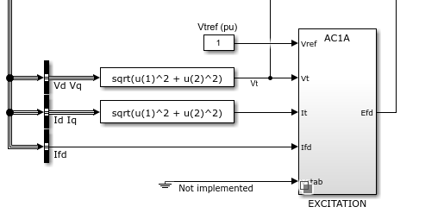
Excitation Block
Block models an AC Alternator driving a diode rectifier to produce the field voltage required by the SM
We chose AC1A Excitation block because its voltage regulator gave a voltage in p.u. with a lower limit of zero

Slide 15
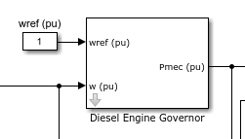
Diesel Engine Governor
Controls fuel to engine cylinders in order to control the speed of the unit
Speed is held constant for all loads imposed on the generator being driven by the engine
The first input (wref) is the reference speed and the second input (w) is the measured speed
Output is the diesel engine mechanical power

Slide 16
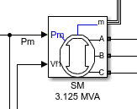
Synchronous Machine
AC motor, at steady-state, the rotation of the shaft is synchronized with the frequency of the supply current.
It is often used where precise constant speed is required
Can operate at leading or unity power factor
Provides power factor correction

Slide 17
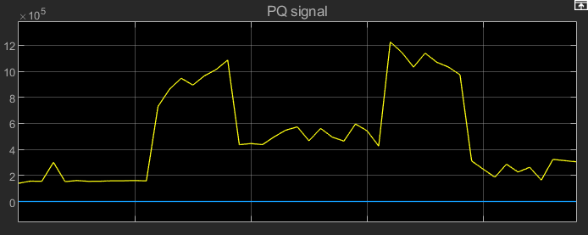
Dynamic load scope-24 Hours
This is the graphical representation of the PQ load information mentioned earlier.
We are considering a 100% power factor for simulation purposes which is why the blue line (Q signal) is zero

Slide 18
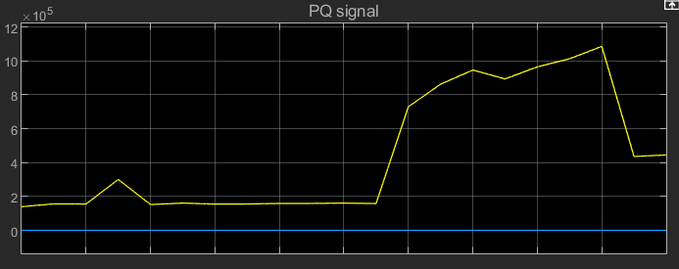
Dynamic load scope-10 hours
When running the simulation, it was advised that we set the stop time to 10 seconds so the simulation can simulate efficiently.
The graph represented to the right is the data we used from the PQ signal for our simulation which represents 10 hours.

Slide 19
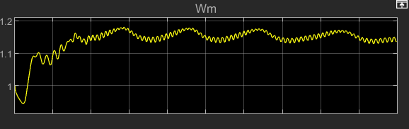
Synchronous Machine Speed
Wm is the machine speed of the Synchronous Machine
When the diesel generator kicks in the speed of the synchronous machine should be as close to 1 as possible in order to keep it in unity factor

Slide 20
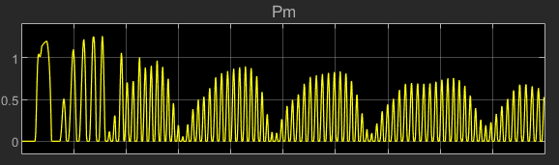
Synchronous Machine Mechanical Power
This graph shows the mechanical power at the machines shaft
The mechanical power is the speed times the torque

Slide 21
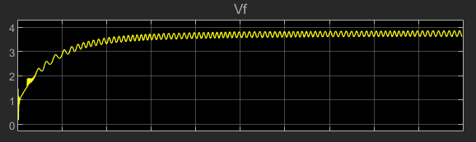
Synchronous Machine Field Voltage
Vf represents the field voltage
This voltage is supplied by a voltage regulator as an input
This value is usually constant

Slide 22
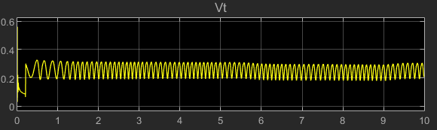
Synchronous Machine Terminal Voltage
Vt graph represents the terminal voltage of the system
The terminal voltage is 0 when there is no load in the circuit
This measures the potential difference between the terminals

Slide 23
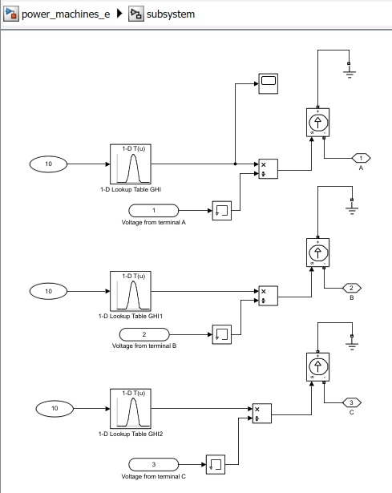
Negative current subsystem
This subsystem was created because the Dynamic load has a negative current (arrow facing down)
To make our current a negative current we decided to connect the positive side to ground and the negative to the system

Slide 24

Why is this important?
Allows for operational costs to be analyzed
Operational strategy limitations can be studied and improved upon
Provides frequency stability for the microgrid system

Slide 25
Agenda
Introduction/Background
Statement of Work
Emergency Diesel Generator
Component Modeling ​
Sizing Microgrid ​
Microgrid Operation Cost
Summary
Derek Castaneda
Christian Flores
Devyn Cordero/ Carlos Rodezno
/Jonathan Monroy/ Derek Castaneda
Christian Flores
Felix Abel
Felix Abel
Felix Abel

Slide 26
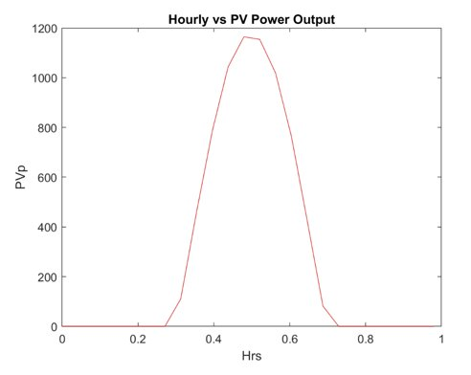
Photovoltaic Model​
Average hourly power profile for a day
​
Model is sized with battery to provide 200kWh to load
Peak power output during midday
Photovoltaic model outputs average hourly solar energy generation

Slide 27
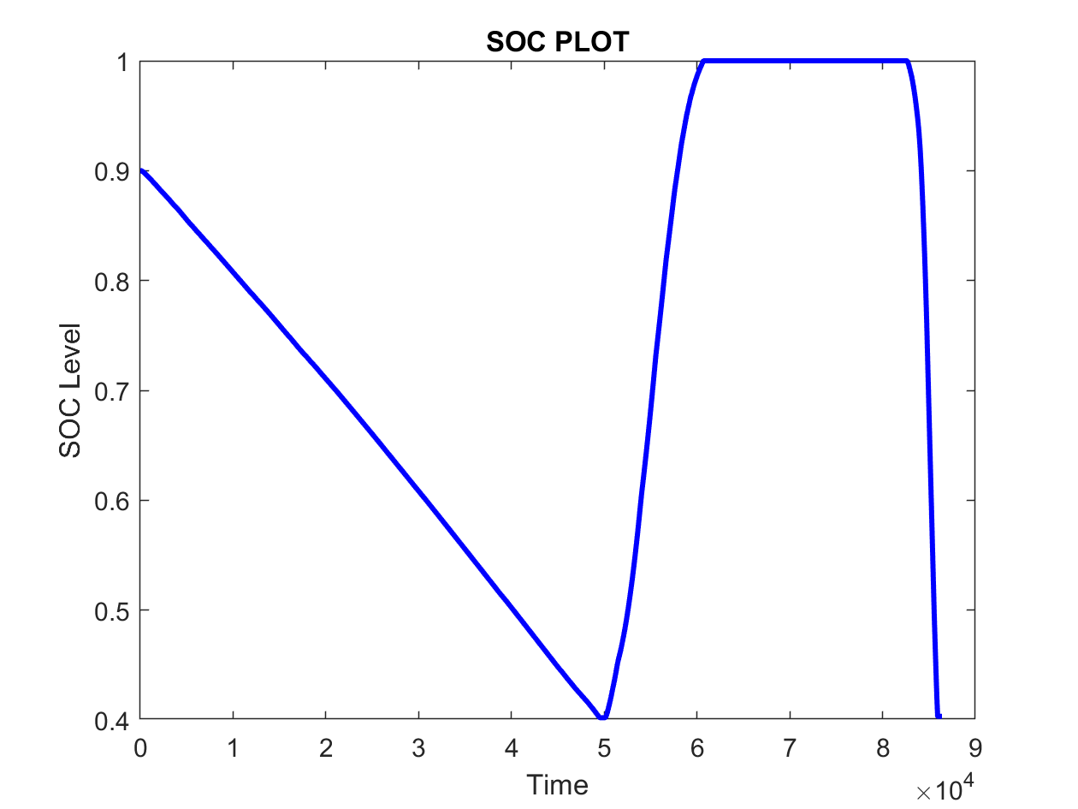

Battery Model
Excess Energy
The equation relates current to battery state of charge
Charge/Discharge current profile
Simulink battery model
Battery efficiency of 80%
Limit

Slide 28
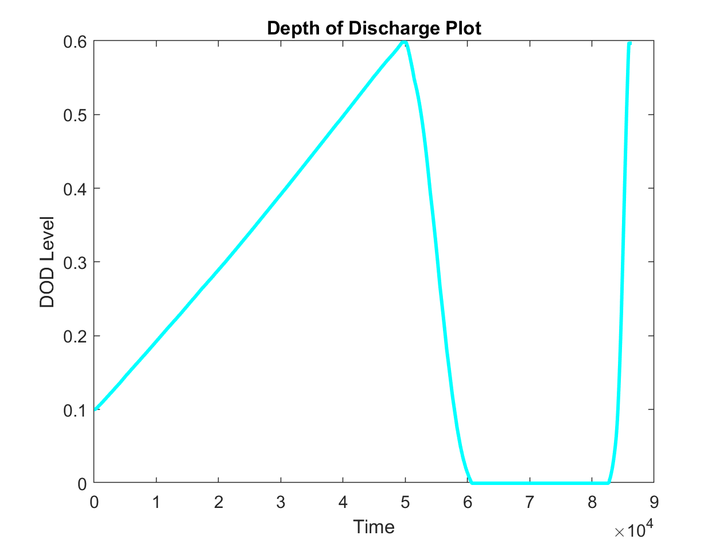
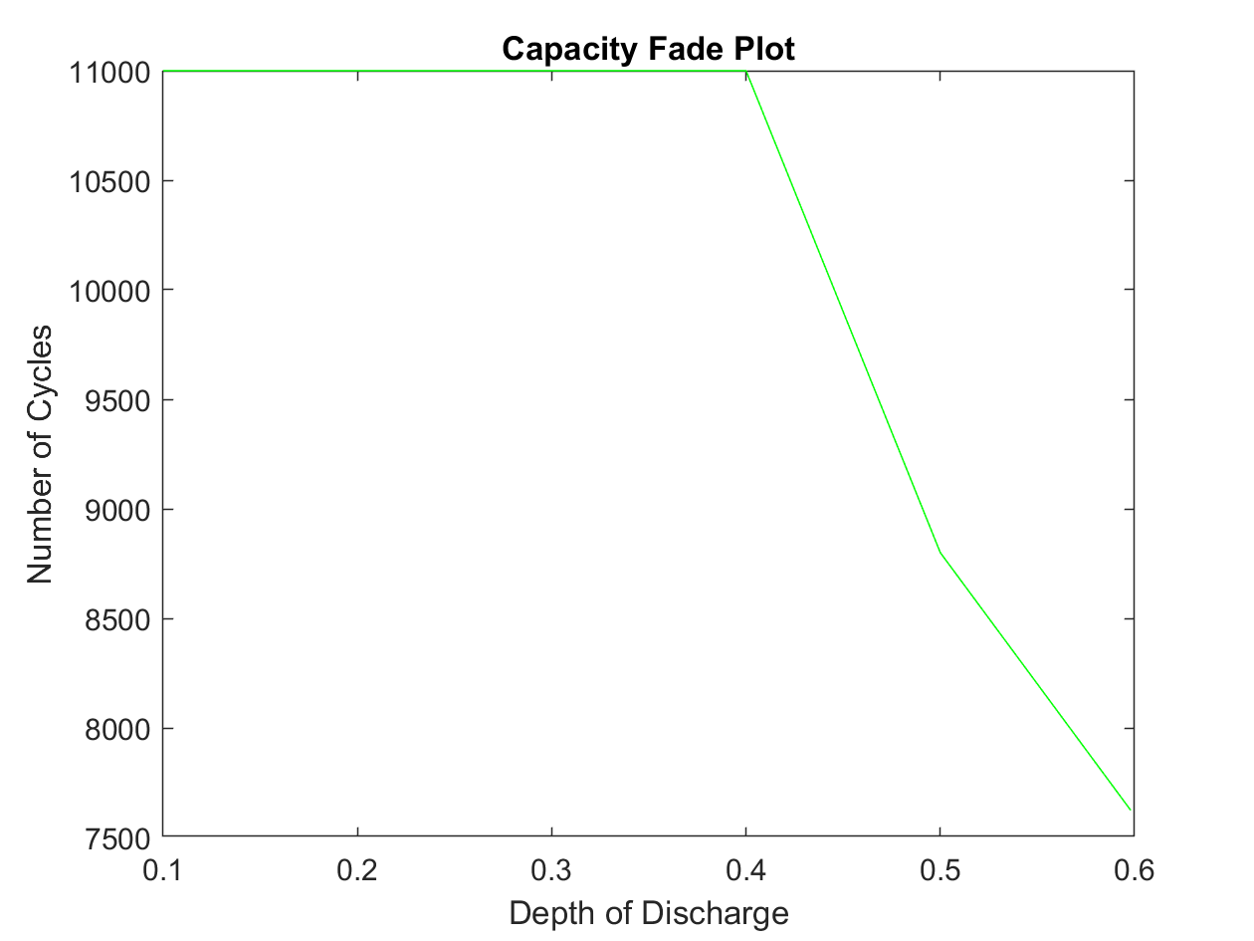
Battery Degradation Model
Depth-of-Discharge can be calculated from State-of-Charge data​
DOD inverse of SOC
Capacity fade data used for battery modeling
Charging cycles of battery contribute to capacity fade
Cost of battery degradation

Slide 29
Agenda
Introduction/Background
Statement of Work
Emergency Diesel Generator
Component Modeling ​
Sizing Microgrid ​
Microgrid Operation Cost
Summary
Derek Castaneda
Christian Flores
Devyn Cordero/ Carlos Rodezno
/Jonathan Monroy/ Derek Castaneda
Christian Flores
Felix Abel
Felix Abel
Felix Abel

Slide 30
Sizing Of Battery Model
We Sized the Battery using the System Advisor Model (SAM) software.
Based on the Demand Data that we have from a Commerical building ,the recommended sizing that we used is shown below:
Battery Bank Size (kW) | Battery Bank Power Size (kW) | Desired size (kWdc)
200 | 100 | 200

Slide 31
Agenda
Introduction/Background
Statement of Work
Emergency Diesel Generator
Component Modeling ​
Sizing Microgrid ​
Microgrid Operation Cost
Summary
Derek Castaneda
Christian Flores
Devyn Cordero/ Carlos Rodezno
/Jonathan Monroy/ Derek Castaneda
Christian Flores
Felix Abel
Felix Abel
Felix Abel

Slide 32
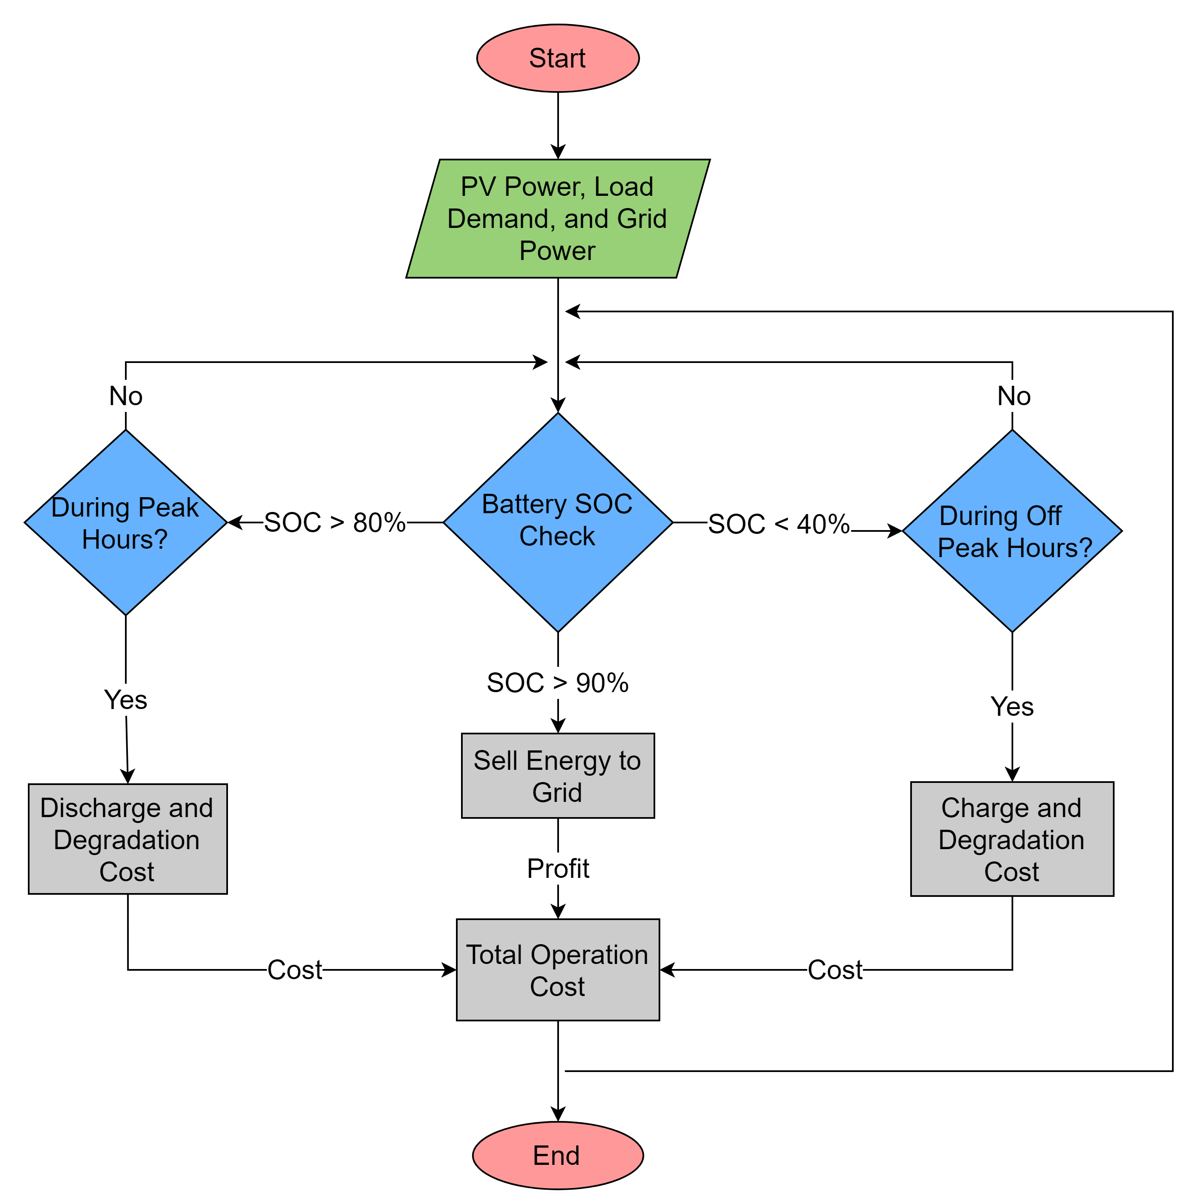
Flowchart
for Microgrid
Operation
Scheme

Slide 33
Microgrid Operation Cost
Fixed Operation Cost | Variable Operation Cost | Replacement Battery Cost | Power Sold to Grid | Total Operation Cost
$257.58 | $119,917.54 | $24244.513 | -$2148.40 | $142272.23
The Table above shows the Operation Cost of the Microgrid for an entire day

Slide 34
Agenda
Introduction/Background
Statement of Work
Emergency Diesel Generator
Component Modeling ​
Sizing Microgrid ​
Microgrid Operation Cost
Summary
Derek Castaneda
Christian Flores
Devyn Cordero/ Carlos Rodezno
/Jonathan Monroy/ Derek Castaneda
Christian Flores
Felix Abel
Felix Abel
Felix Abel

Slide 35
Summary
Our Microgrid's PV and Battery was sized to meet the demand of the System.
Microgrid Operation Scheme is dependent on both time and state of charge of our battery.
Our Microgrid is dependent on a Battery ,a PV array to charge our battery and is grid connected to meet the demand when the PV and Battery do not meet the demand of the system.
In order to test how the microgrid will react when put into islanded mode, an emergency diesel generator and governor were used to see how quick the grid's frequency will stabilize when disconnected.

