Slide 1

Space Debris Deorbiter
California State University, Los Angeles
Department of Mechanical Engineering
May 6, 2021
James Cook
Maya Horii
Jasmine Lopez-Gutierrez
Gustavo Munoz
Victor Ramirez
Emily Silva
Edgar Herrera
Sponsor
Ted Nye
Advisor

Slide 2
Agenda
Introduction/Background Emily
System Engineering/Overview Maya
Spacecraft Victor
Debris Capture System James
Deorbit System Gustavo
Propulsion System Jasmine
Conclusion Emily

Slide 3
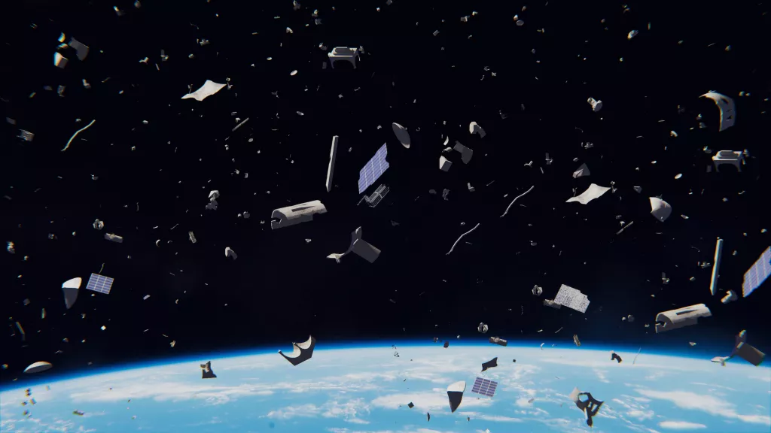
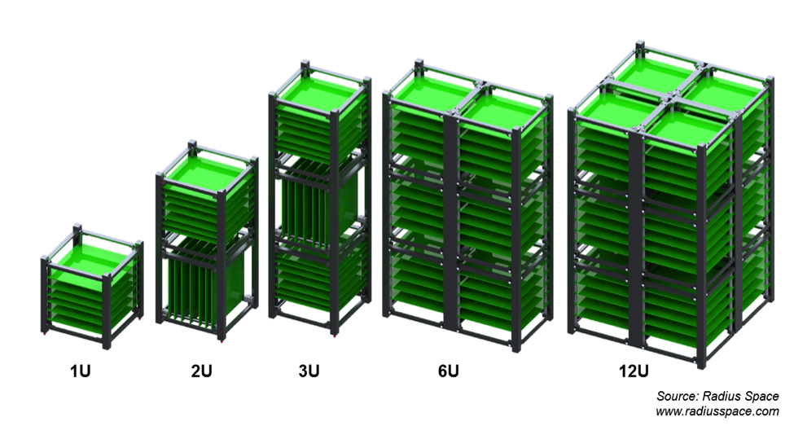
Environment in space
Illustration of Debris
Illustration of Small Satellite Configurations
Sources: Live Science and talk Satellite

Slide 4
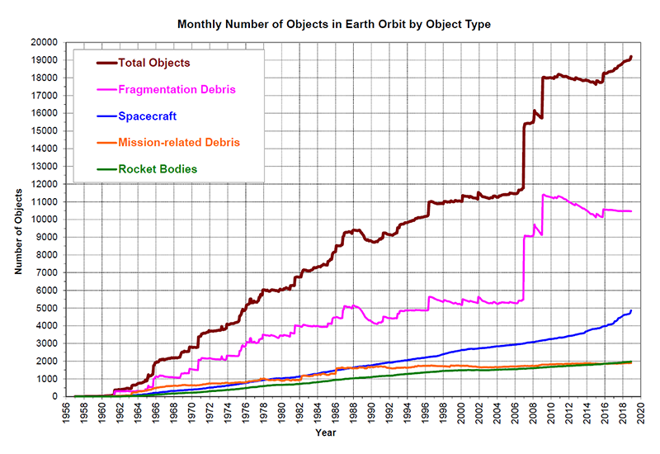
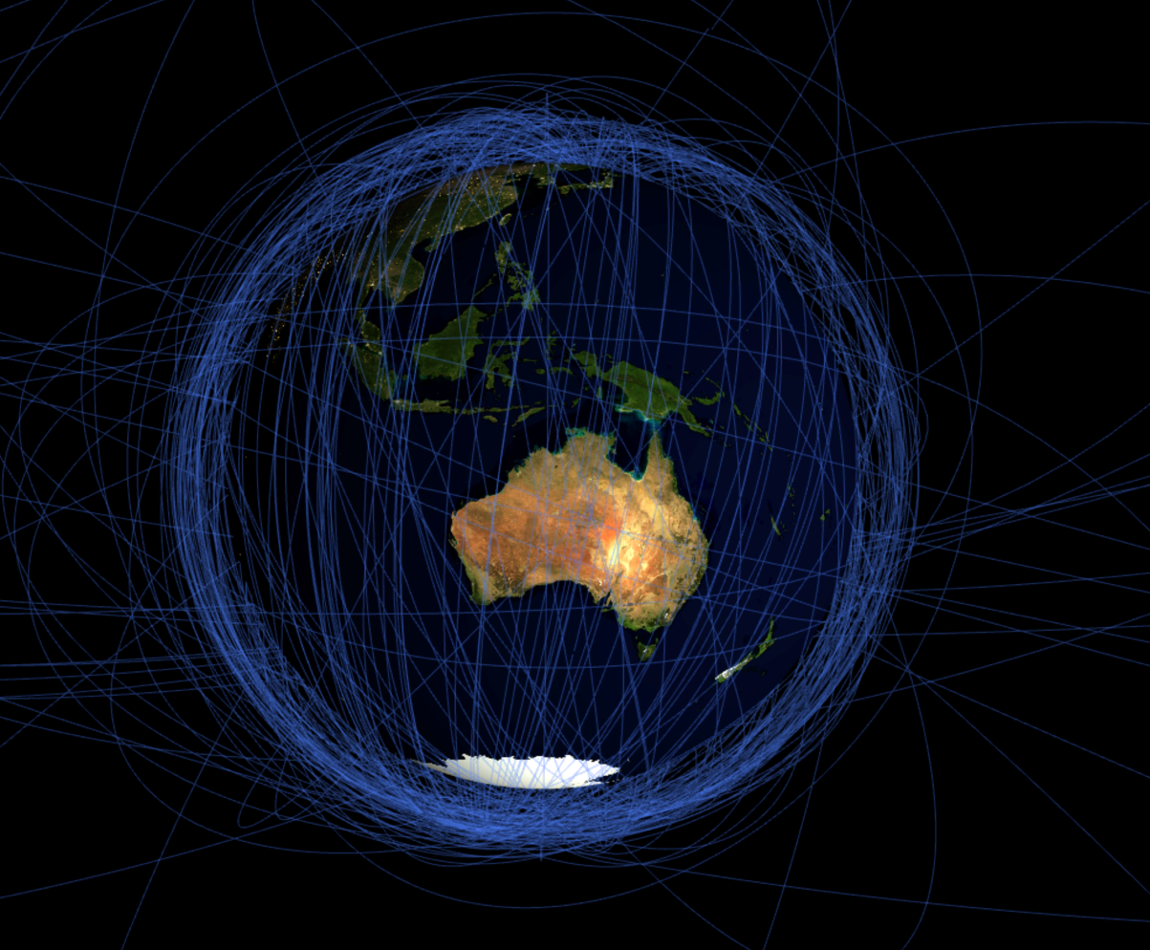
Over 20,000 pieces of debris in low Earth orbit (LEO)
20000
Iridium-Cosmos Collision
15000
Anti-Satellite Test
Number of Objects
10000
5000
0
1960
1970
1980
1990
2000
2010
2020
Year
Illustration of Debris Orbits
Number of Objects in LEO Larger Than 10cm
Sources: Stuff in Space and NASA
Notes:
NASA LEGEND Model: https://orbitaldebris.jsc.nasa.gov/modeling/legend.html

Slide 5
Objective
To develop a small satellite (SmallSat) that is capable of capturing and deorbiting debris from low Earth orbit

Slide 6
Requirements were met except for one
Requirement | Value | Capability | Method of Verification
Size of SmallSat | ≤ 60.1 cm diameter, 594.4 cm height | 20cm*20cm*30cm | Design and Analysis
Mass of SmallSat | ≤ 257 kg | 22.8 kg | Analysis
Time to Deorbit | ≤ 25 years | ≤ 16.2 years (0° to 80° inclination) | Analysis
Power | 48 Watts | 97.3 Watts | Design and Analysis
Weight of Debris | 1 kg ≤ M ≤ 12kg | 1 kg | Analysis
Size of Debris | 10 cm ≤ Size ≤ 60cm | 10 cm * 10 cm * 10 cm | Analysis
Vacuum to Sustain | 10^-6 Torr | Complies | Analysis
Temperature Range | -30°C ≤ T ≤ 30 °C | Complies | Analysis
Launch Load | 15 g in each orthagonal axis, non-simultaneously | Complies | Analysis
Number of Debris | ≥ 2 pieces | 1 piece | Design and Analysis
Notes:
Am I supposed to leave the ESPA class requirements? Do I add derived requirements
https://www.unoosa.org/documents/pdf/spacelaw/sd/IADC-2002-01-IADC-Space_Debris-Guidelines-Revision1.pdf

Slide 7
Agenda
Introduction/Background Emily
System Engineering/Overview Maya
Spacecraft Victor
Debris Capture System James
Deorbit System Gustavo
Propulsion System Jasmine
Conclusion Emily

Slide 8
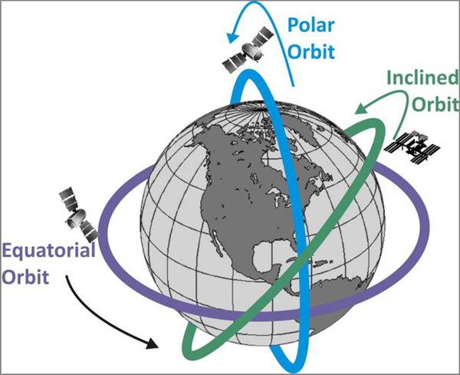
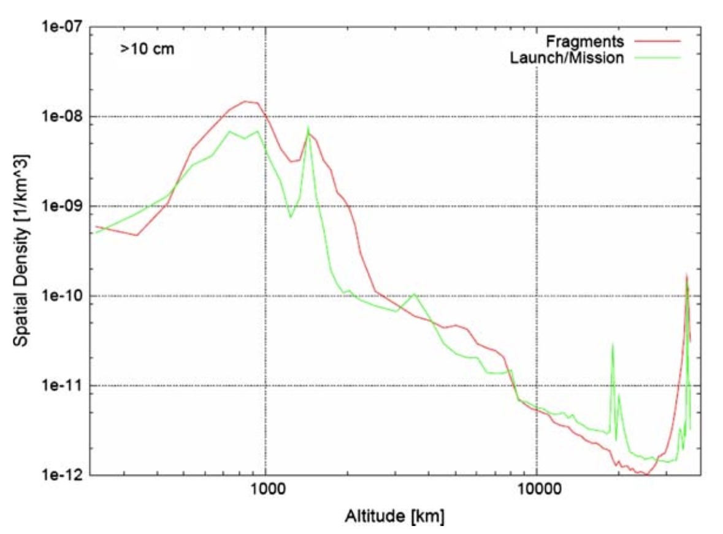
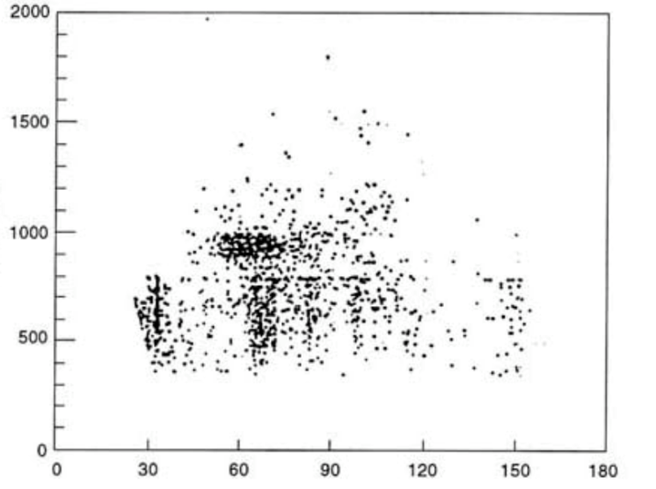
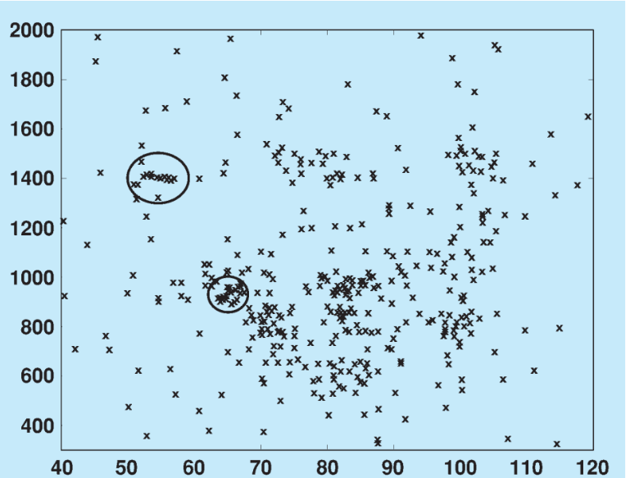
Most Debris in 700-1000km Altitude, 30-90° Inclinations
End of LEO
Altitude (km)
Altitude (km)
2000
Debris Distribution by Altitude
(T. Schildknecht, January 2007)
Inclination (°)
Inclination (°)
Debris Distribution by Orbit Inclination
(National Academy Press, 1995) (D. Mehrholz et. al, February 2002)
Notes:
Mass and AMR distributions also in 11-20-2020, inclinations ones w links from 10-30-2020
T. Schildknecht, “Optical surveys for space debris,” The Astronomy and Astrophysics Review, vol 14, pp. 41-111, January 2007.
[4] “Orbital Debris: A Technical Assessment,” National Academy Press, Washington D.C., 1995.
[5] D. Mehrholz et. al, “Detecting, Tracking and Imaging Space Debris,” EESA Bulletin, vol 109, pp. 128-134, February 2002.

Slide 9
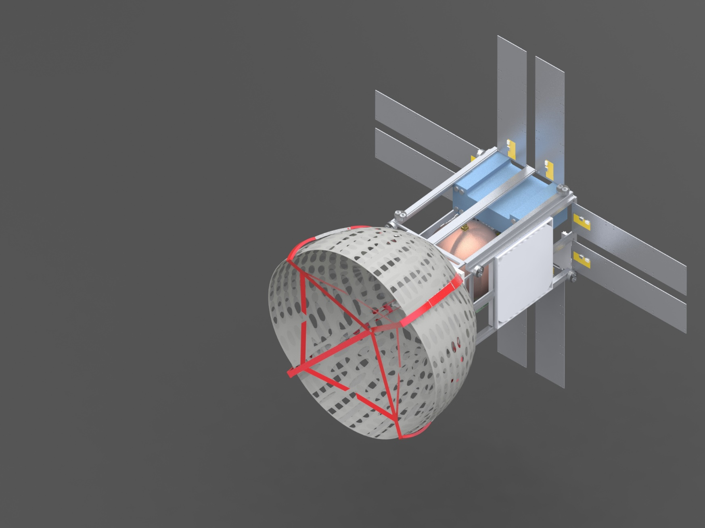
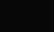
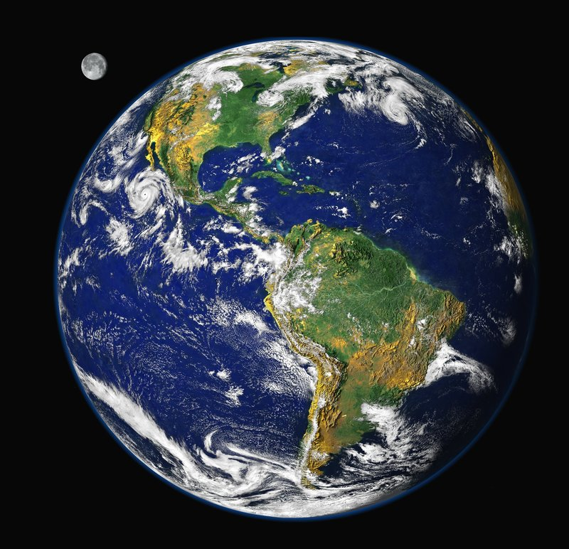



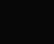
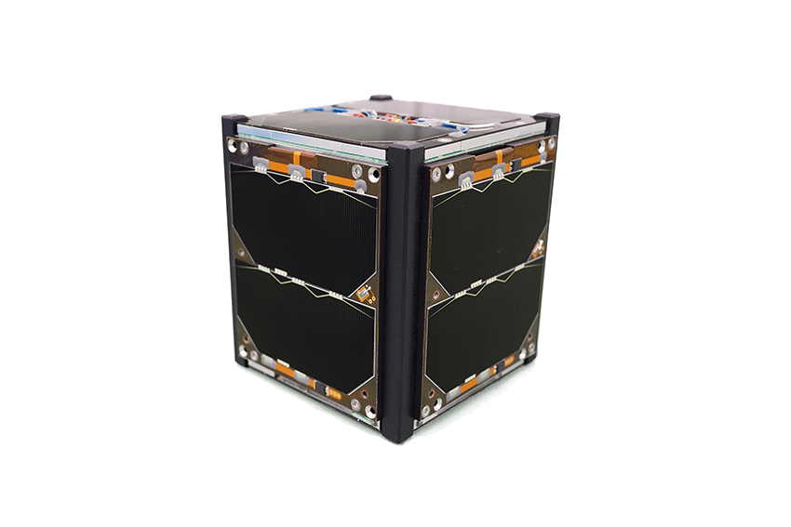
Mission Overview
Debris Capture Satellite
Ground Communications Receiver
Debris

Slide 10
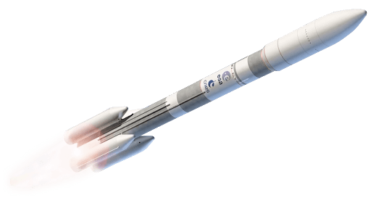



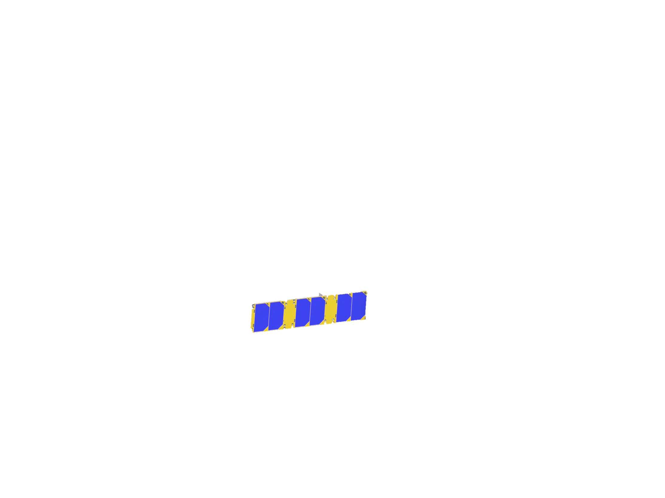


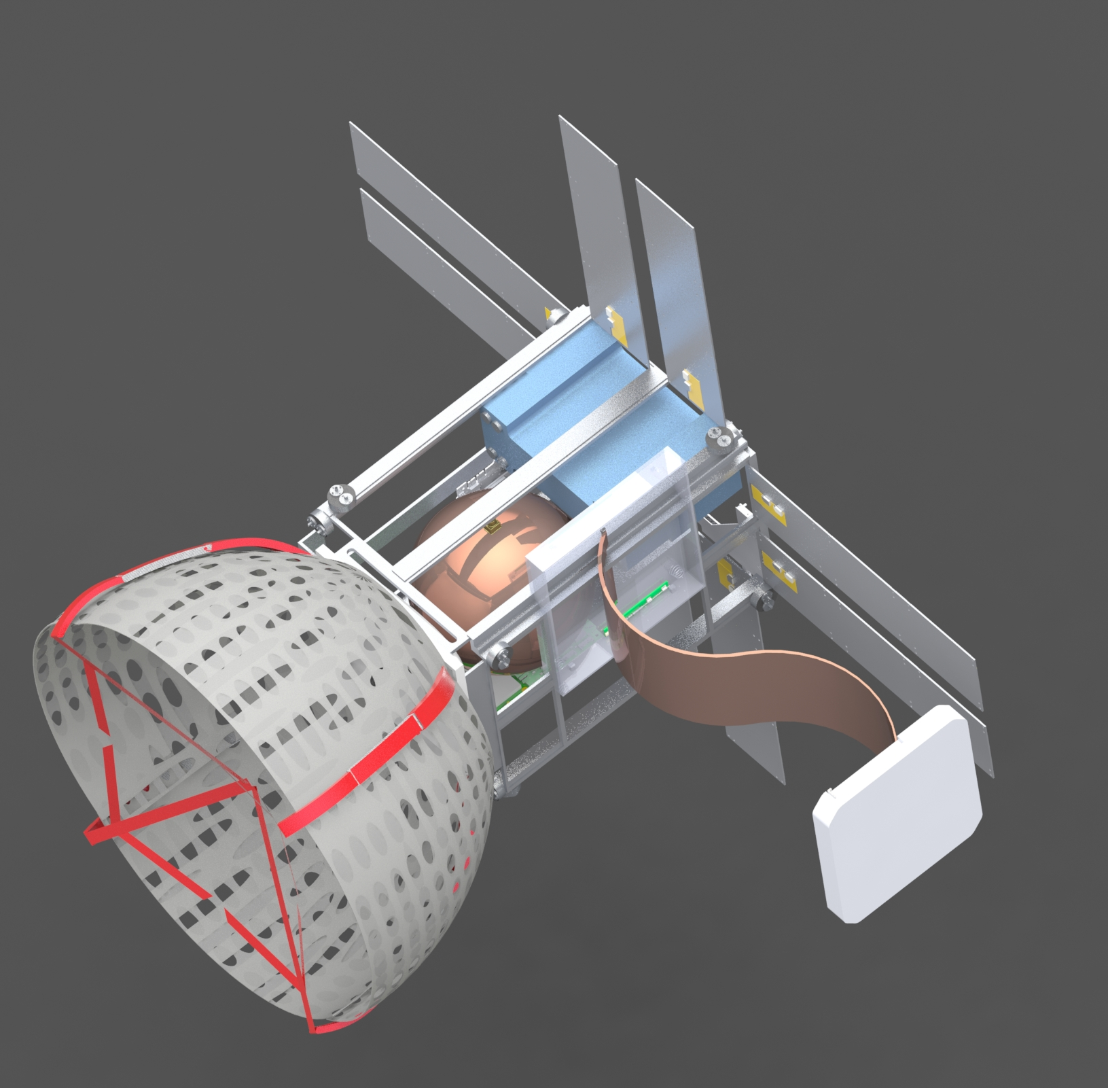



Concept of Operations
Drop off satellite near debris
Approach and align with the debris
Use sensors to analyze debris
Deploy weighted boom
Attempt capture and determine success
Deploy deorbit method, determine success
Notes:
https://collection.maas.museum/object/141107
Debris image

Slide 11
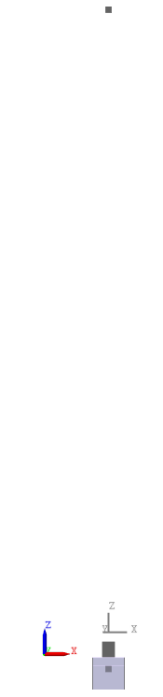
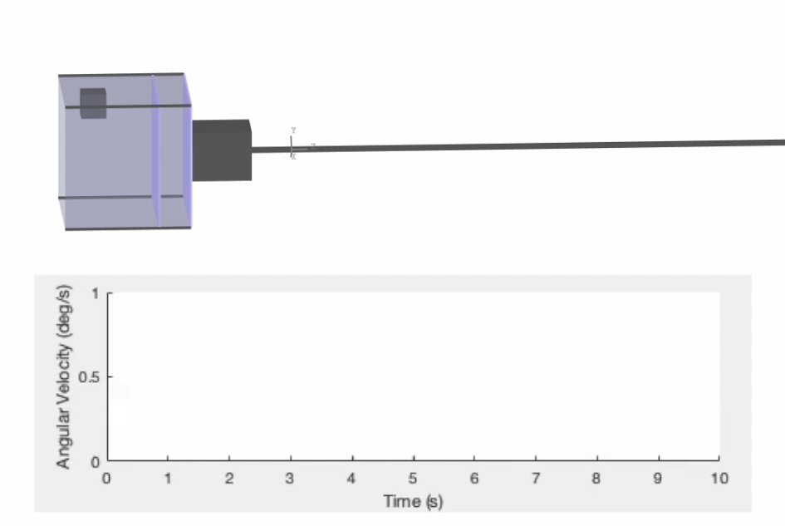

We Can Capture Debris at Collision Speeds of 11.9mph
Adding a weighted boom allows for collision speeds up to 5.3 m/s (11.9 mph):
1kg Weight
10m Boom
CubeSat
Impact at 5.3 m/s, Offset 20cm in Y-Dir
CubeSat with Boom Diagram

Slide 12
Agenda
Introduction/Background Emily
System Engineering/Overview Maya
Spacecraft Victor
Debris Capture System James
Deorbit System Gustavo
Propulsion System Jasmine
Conclusion Emily

Slide 13
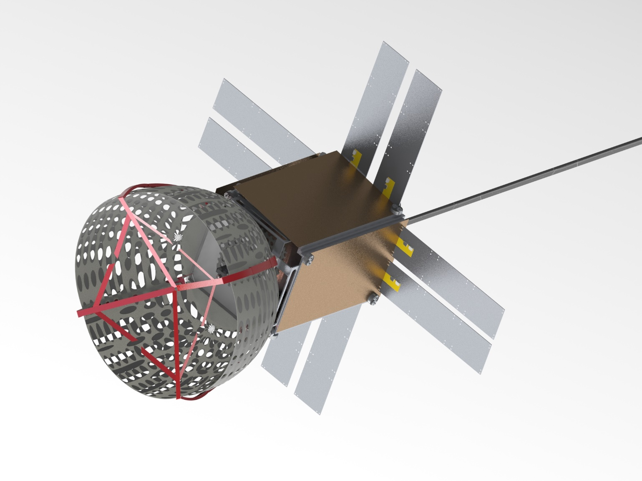
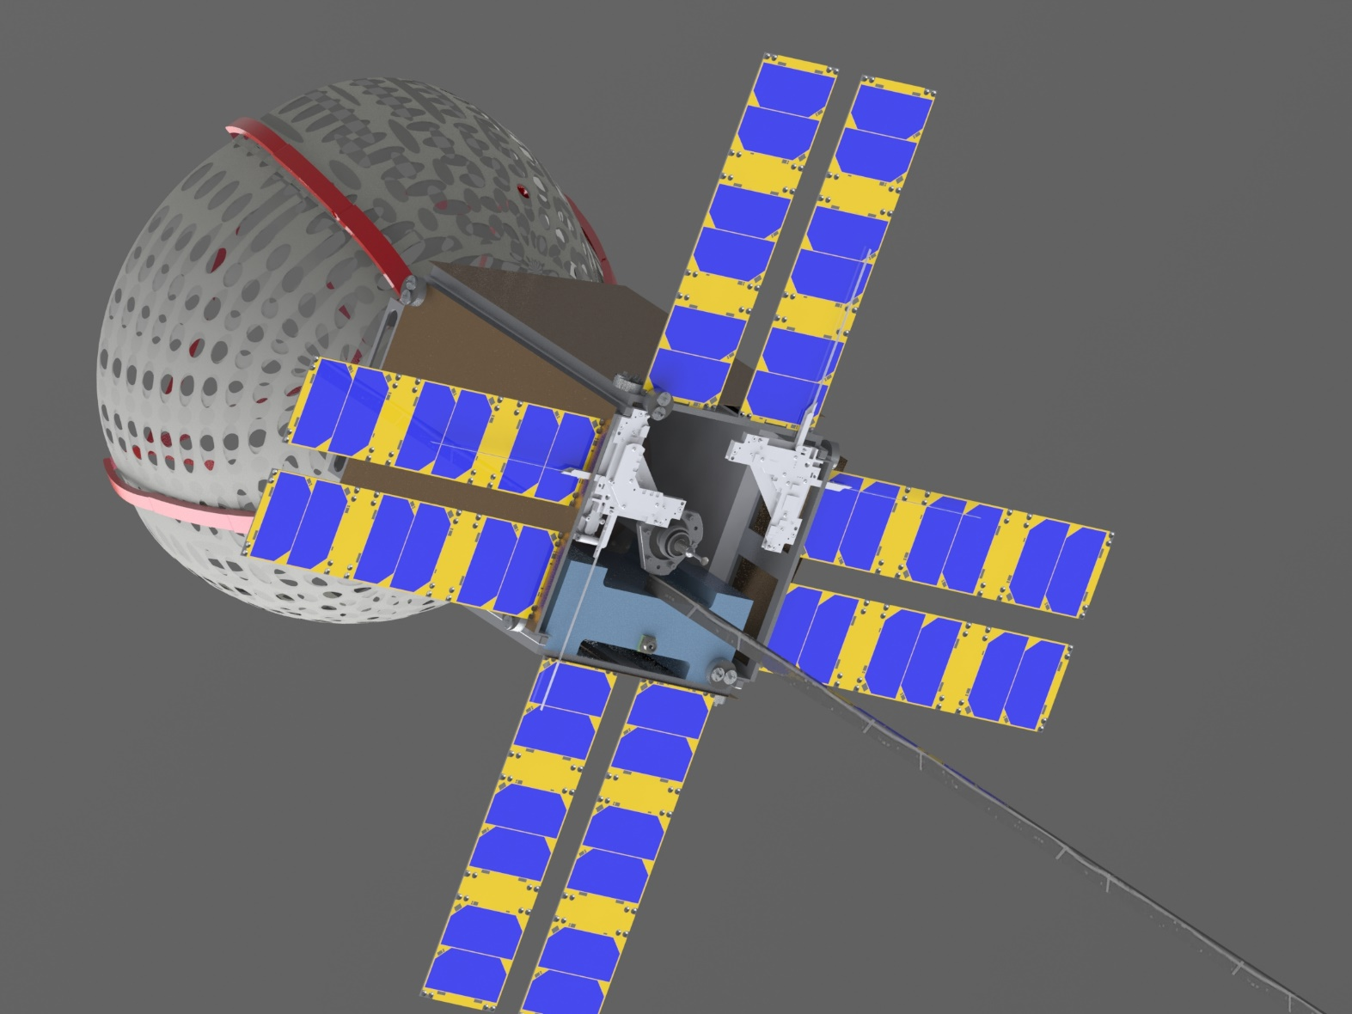
Spacecraft Deployed
12U Structure
Stabilizing Boom
Antenna System
340mm
214 mm
214 mm
Debris Capture Mechanism
Delta V Thruster

Slide 14
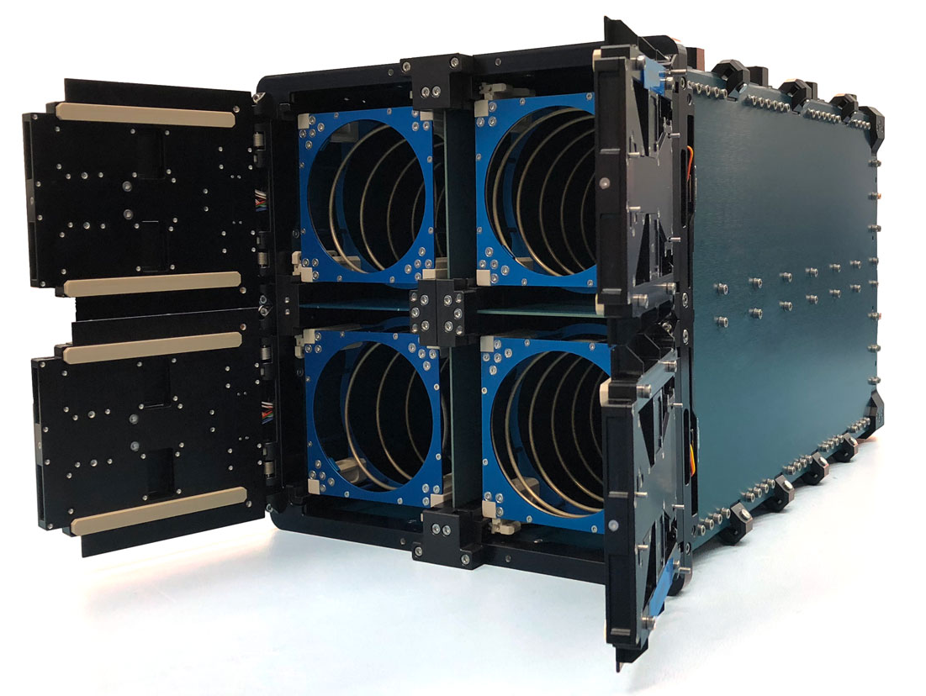
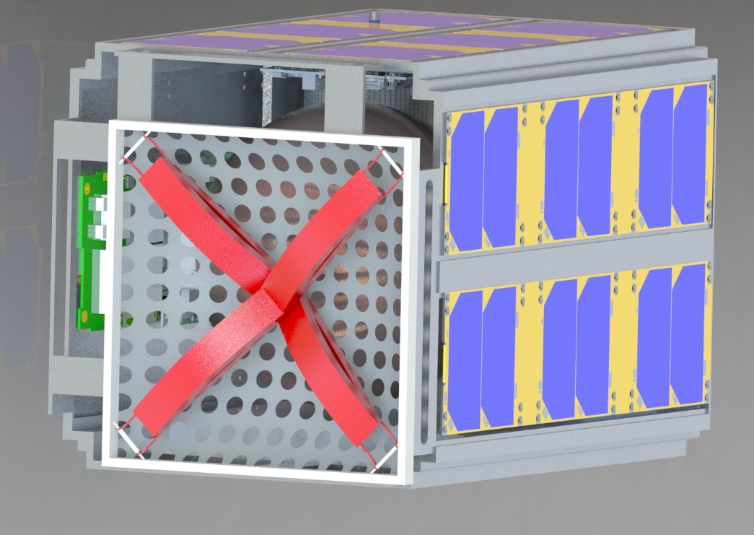
Spacecraft Deployed From ISIS Dispenser
Spacecraft uses an ISIS 12U/16U Dispenser to deploy into orbit from launch vehicle

Slide 15
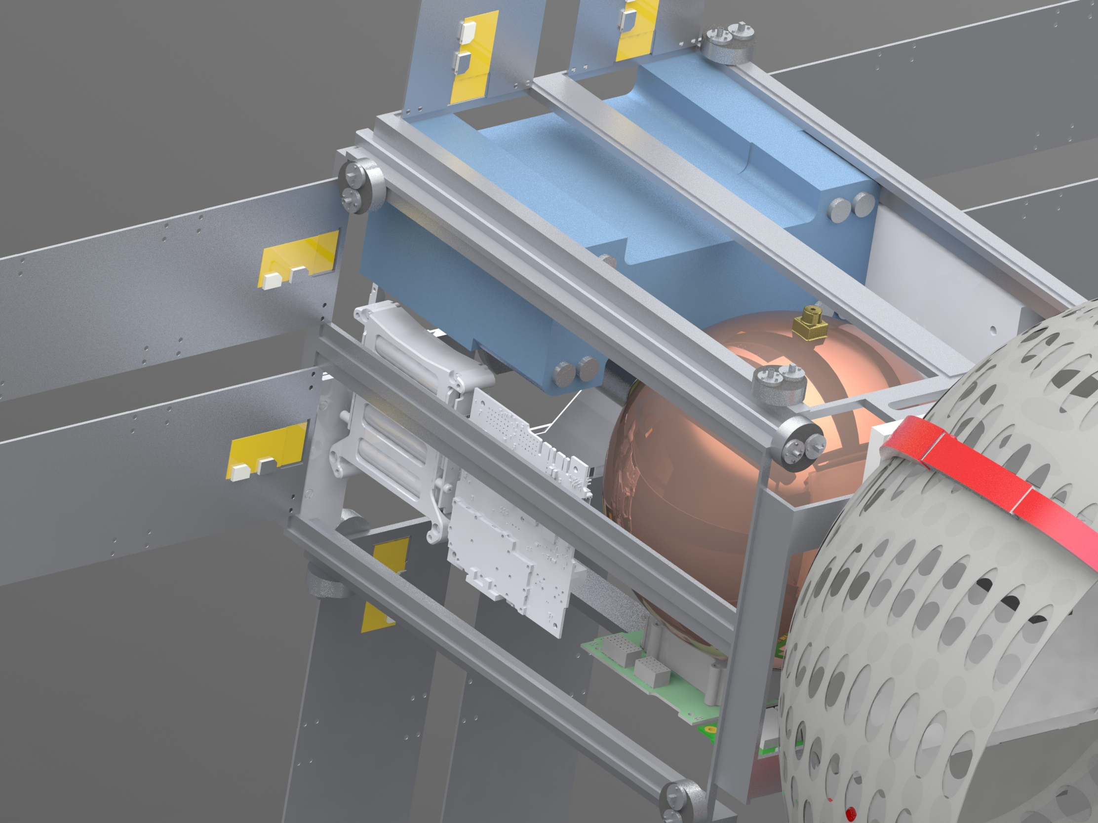
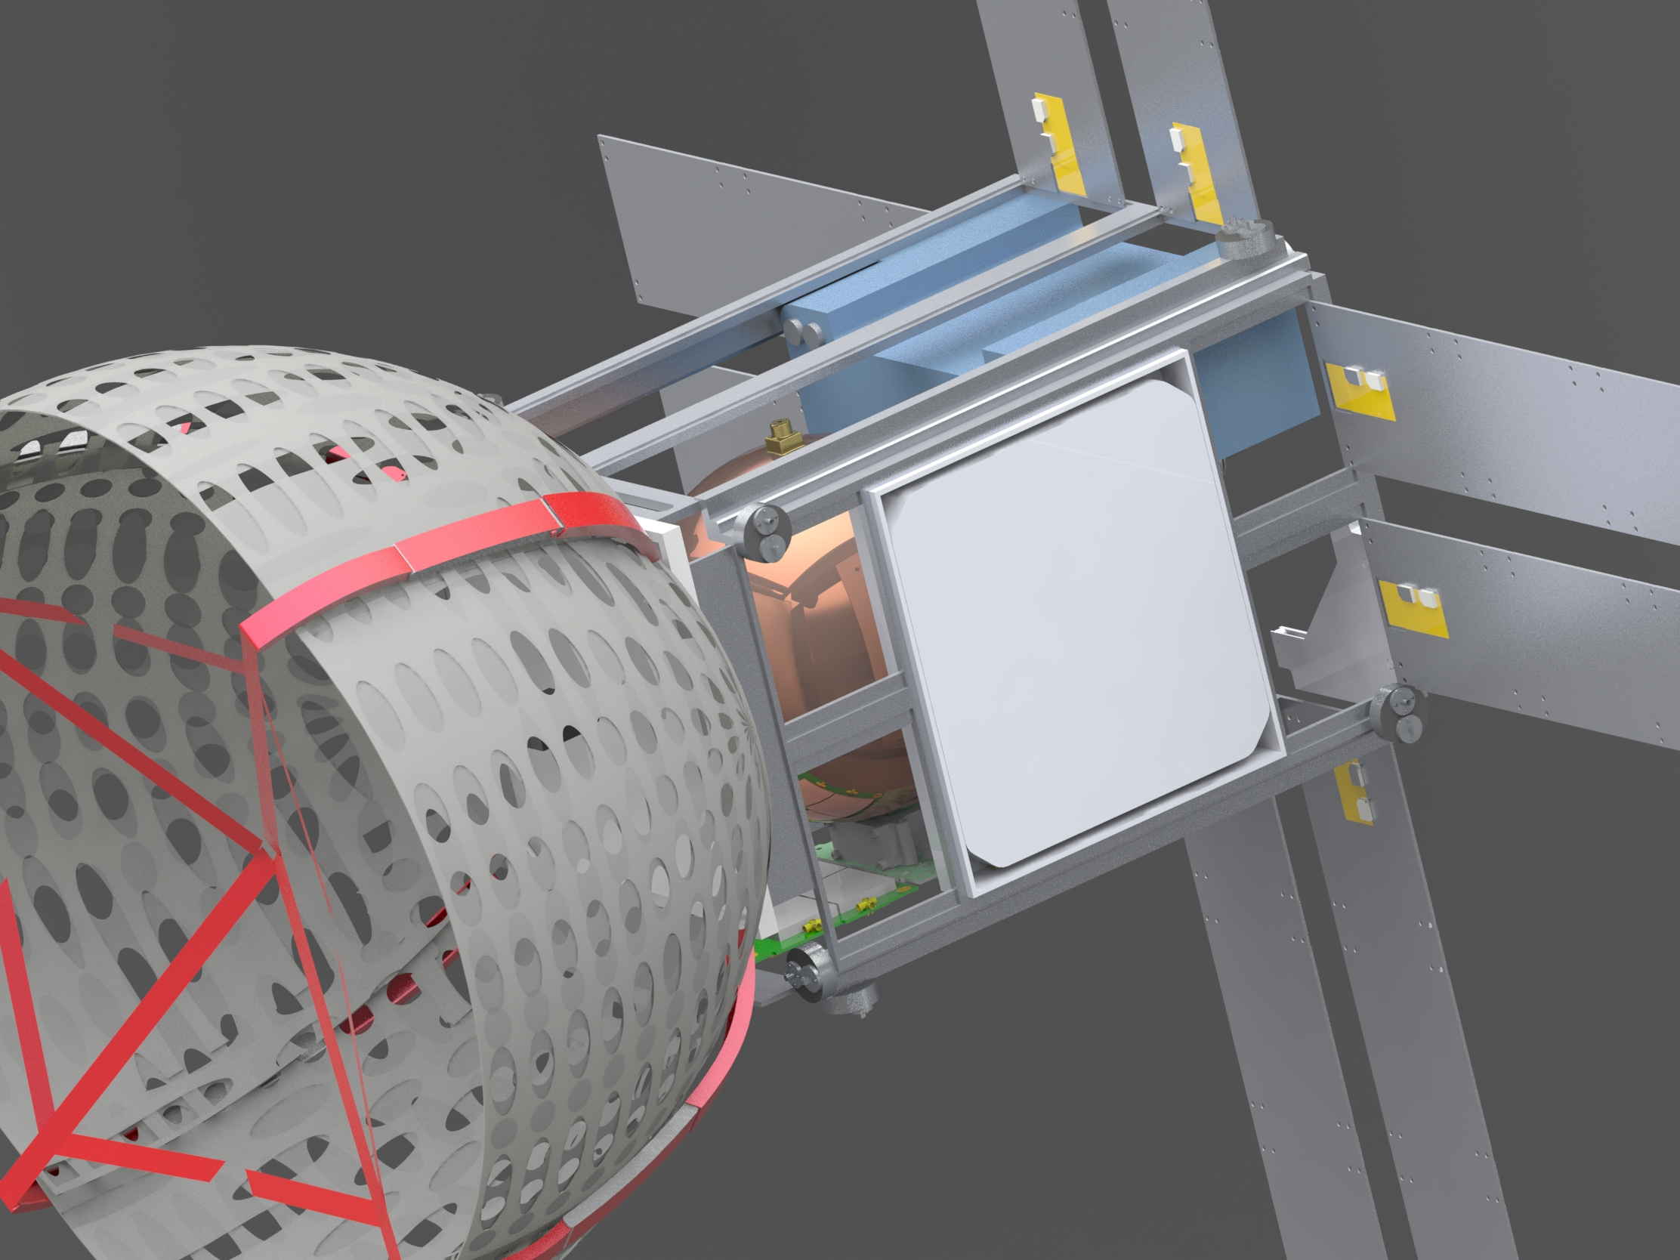
Spacecraft Interior
Propulsion System / Fuel Tank
Electrodynamic Tether (Undeployed)
Communication/Data Handling System
Power/ Battery System

Slide 16
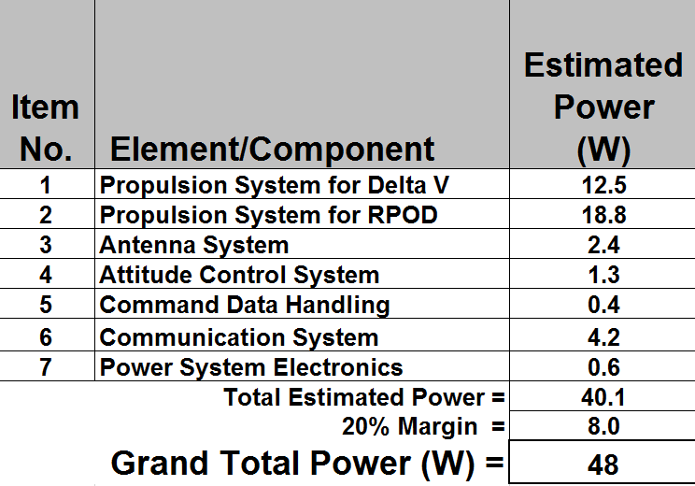
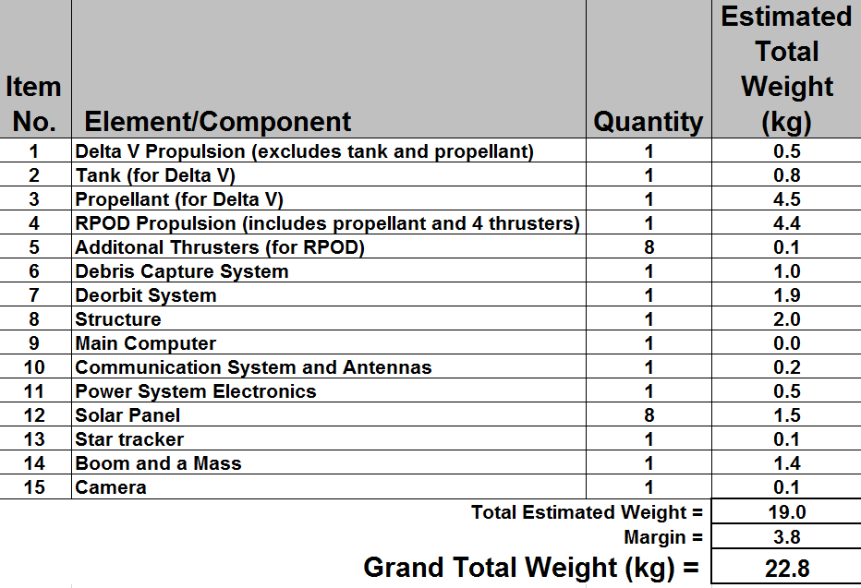
Mass and Power Meet Requirements

Slide 17
Agenda
Introduction/Background Emily
System Engineering/Overview Maya
Spacecraft Victor
Debris Capture System James
Deorbit System Gustavo
Propulsion System Jasmine
Conclusion Emily

Slide 18
Capture Mechanism – Rigid Net (Catcher's Mitt)
Design ​ | Stowed Volume | Weight | Capture Object Size | Maneuverability | Power​ | Complexity (1-5) | Technology Readiness Lvl.​
Rigid Net | 2U​ | <1kg | 16U | Can be rotated if still attached to cubesat | .05-1 W​ | 2 | 4
Net | 1.5U | <6kg​ | 12U | Not maneuverable once released from CubeSat | 15W​ | 1 | 8
Boom w/ Adhesive | 2.5U | <2kg​ | 6U | Moderate Maneuverability | 20W​ | 1 | 4
Harpoon | 1U | <2kg​ | 3U | Not maneuverable once released from CubeSat if cable is used | 15W | 2 | 7
Cage | 9U​ | <10kg | 3U-6U | Highly maneuverable | 60W​ | 4 | 2
Boom w/ Grabber Claw | 6U (est.)​ | <5kg​ | 3U-6U | Less maneuverable | 40W+​ | 1 | 3

Slide 19
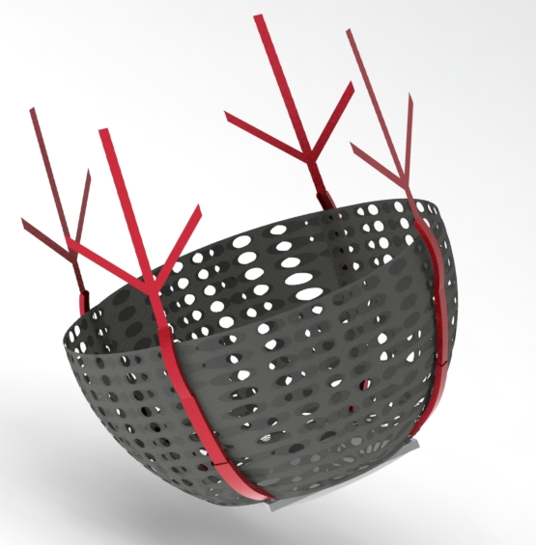
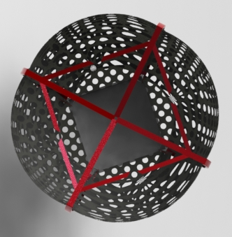
Capture Mechanism – Deployed State
Carbon fiber stems released on deployment to keep debris in net
Arms set to open position until debris is inside net
50cm
40cm
4 sets of 3-tiered Carbon Fiber arms curved to maximize capture volume
4 individual net sections
Capture mechanism top view

Slide 20
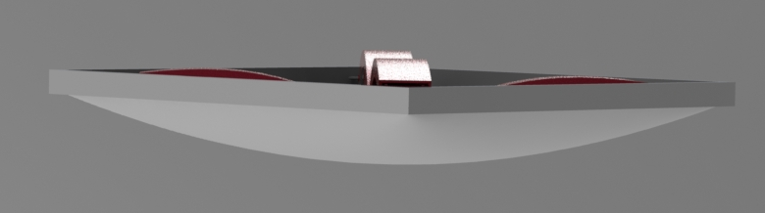
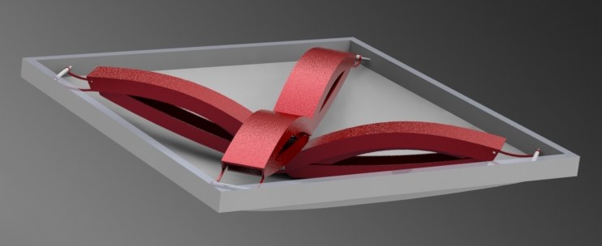
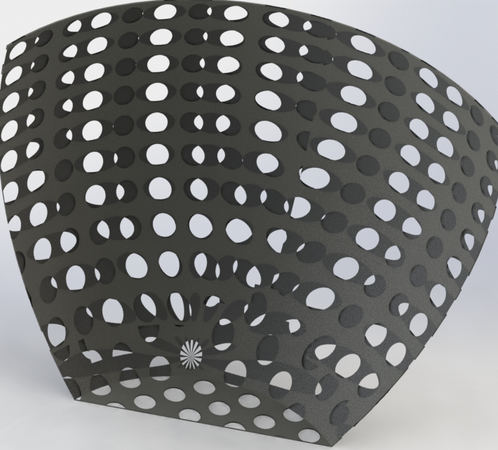
Capture Mechanism – Stowed State
When SmallSat is released from ISIS platform the arms undergo a passive spring deployment.
Arms and stems folded within each other. Arms are spring loaded and held down by platform door.
0.2cm
20 cm
Section of net will fold into storage structure with arms
Stowed capture mechanism Isometric view w/ top made transparent

Slide 21
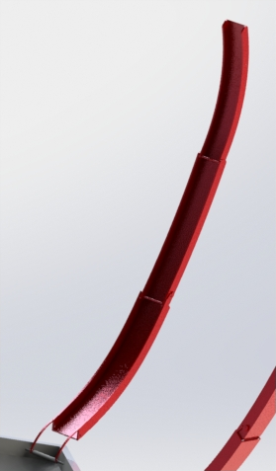
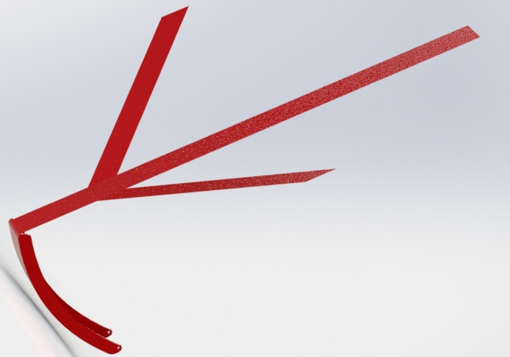
Capture Mechanism – Deployment using Springs & Hinges
Est. Force(N) | Min. Torque(N-m) | Est. Torque (N-m) | Spring Constant (N-m/deg) | Preload (N)
1.8 | 0.36 | 0.72 | 0.00514 | 0.9
Necessary torque was calculated to find spring constant. It was concluded to use same constant for all springs.
Spring deployment modeled in Solidworks at each joint. Mass of net was factored into calculations
Example of "door" hinge set in closed position.

Slide 22
Agenda
Introduction/Background Emily
System Engineering/Overview Maya
Spacecraft Victor
Debris Capture System James
Deorbit System Gustavo
Propulsion System Jasmine
Conclusion Emily

Slide 23
Electrodynamic Tether was Chosen
 | Deorbit Time | Size | Mass | Power | Active/Passive | Spacecraft Complexity (1-5) | Risk of Failure (1-5) | TRL
Electrodynamic Tether | 25 years | 0.6U | 0.8 kg | 0.9W – 25.2 W | Passive | 2 | 3 | 7
Drag Sails | 25 years | 2U (25m^2) | 10 kg (est.) | N/A | Passive | 3 | 2 | 9
Solar Sails | 8 months | ~1U (10m^2) | 4.2 kg | N/A | Active | 4 | 2 | 7
Propulsion Systems (Green Alt. Propellant) | 5 months | 4U | 0.7 kg | 10 W | Active | 4 | 3 | 9
Laser Beam | 18 years | 12U (est.) | 900 kg | 100 KW | Active | 5 | 5 | 1 (est.)
Ion-Beam​ | 700km to 500 km in 150 days | 12U (est.) | 5 kg | 3.3kW | Active | 5 | 5 | 1 (est.)

Slide 24
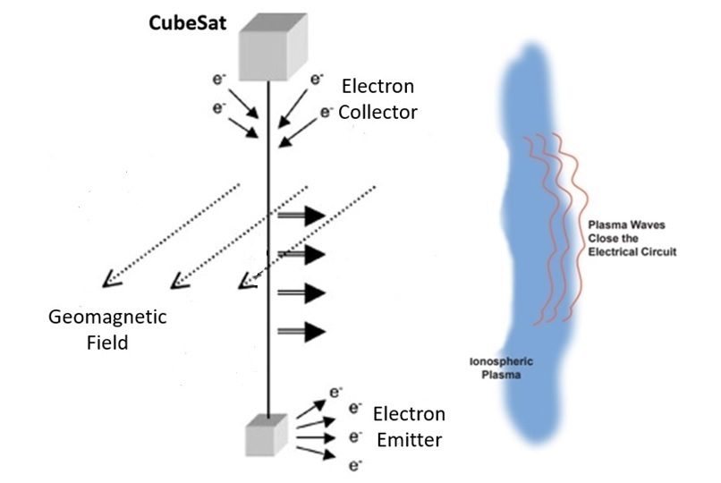
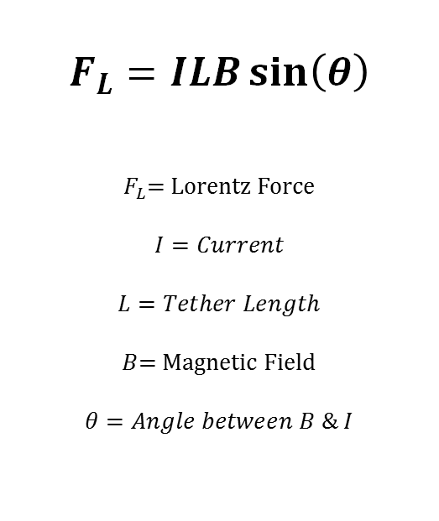
How an Electrodynamic Tether works
$$F_{L}=ILB\sin\left(θ\right)$$
$F_{L}$= Lorentz Force
$$I=Current$$
$$L=Tether Length$$
$B$= Magnetic Field
$$θ=Angle between B \& I$$
Flight Direction
Lorentz + Drag Force
End Mass

Slide 25
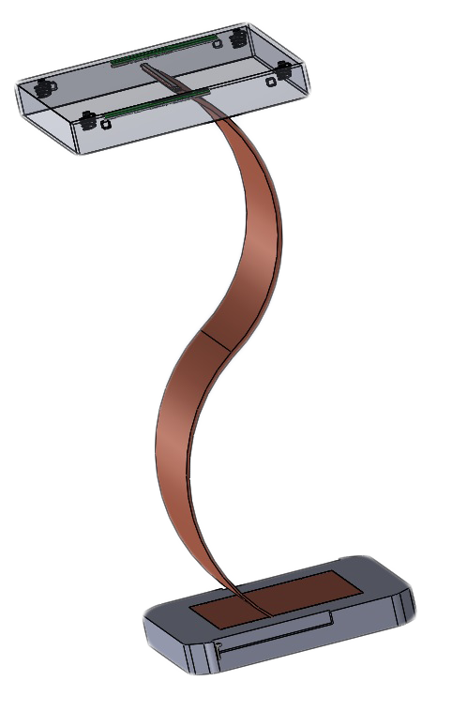
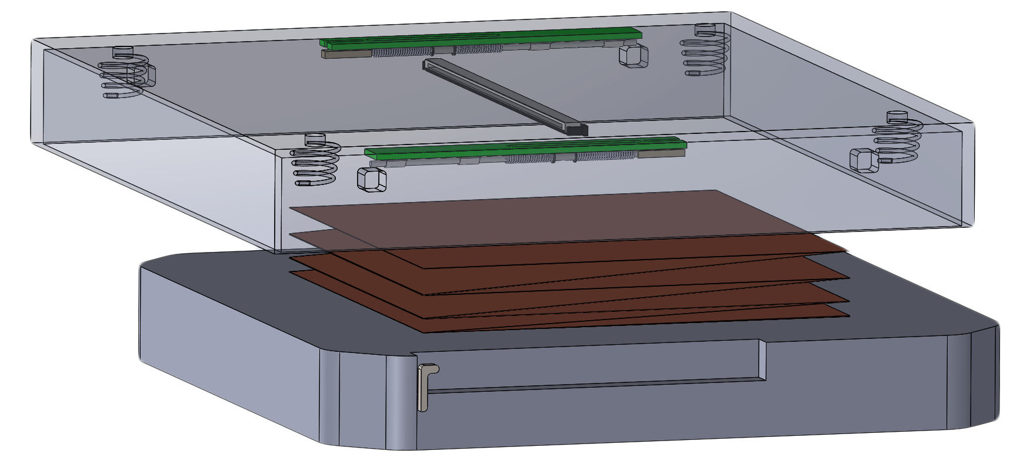
Stowed and Deployed Tether
180 mm
200 mm
26 mm
100 m
Electrodynamic Tether in Accordion Fold
End Mass

Slide 26
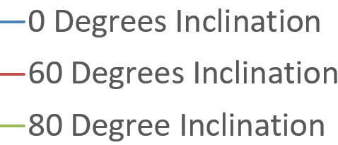
Tether easily meets 25-year deorbit requirement
25-year requirement
- - - - - - - - - - - - - - - - - - - - - -
3 years
8.2 years
16.2 years

Slide 27
Agenda
Introduction/Background Emily
System Engineering/Overview Maya
Spacecraft Victor
Debris Capture System James
Deorbit System Gustavo
Propulsion System Jasmine
Conclusion Emily

Slide 28

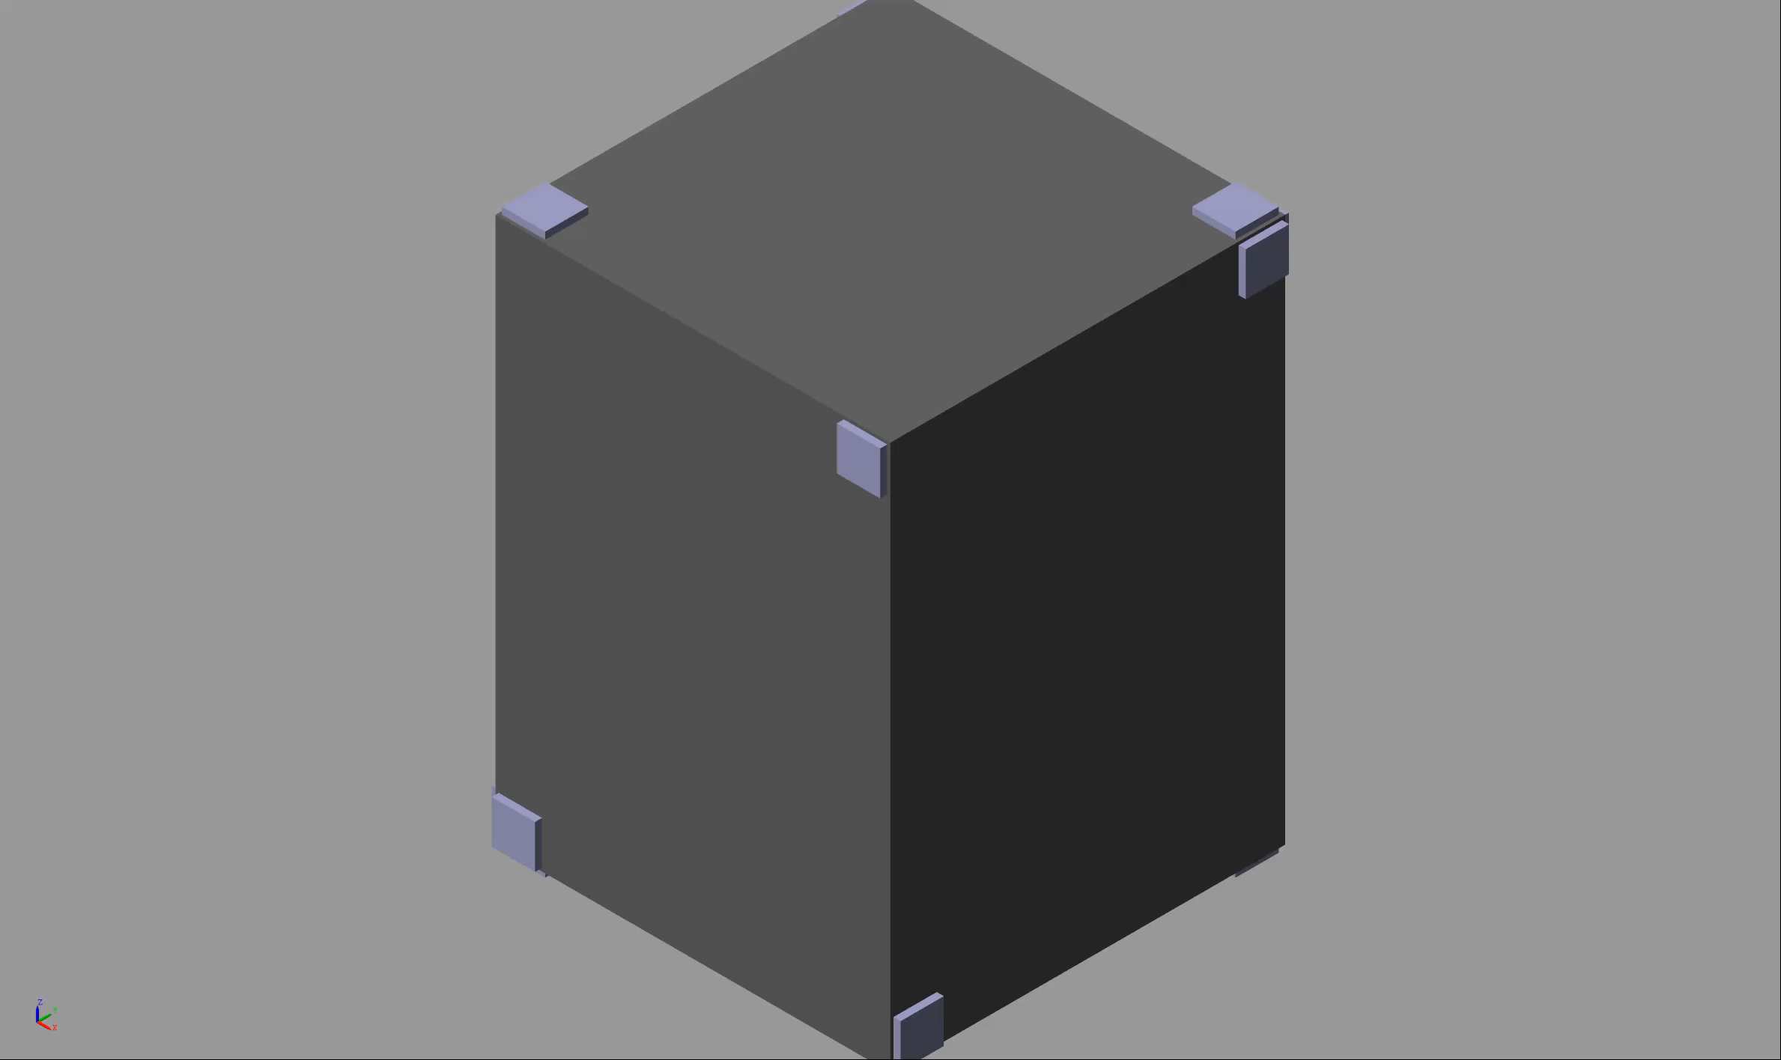
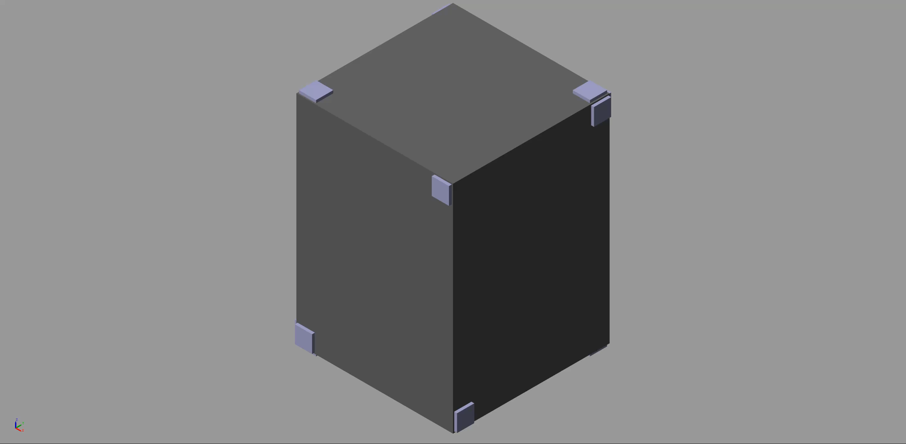



Propulsion System
Propulsion System Functions:
Major Delta-V (Used for Large Altitude Changes)
Rendezvous Proximity Operations and Docking (RPOD) (Used for Capture)
Major Delta-V
Translational Motion along z-axis
Pitch Motion along y-axis
RPO movement
RPO movement
28

Slide 29
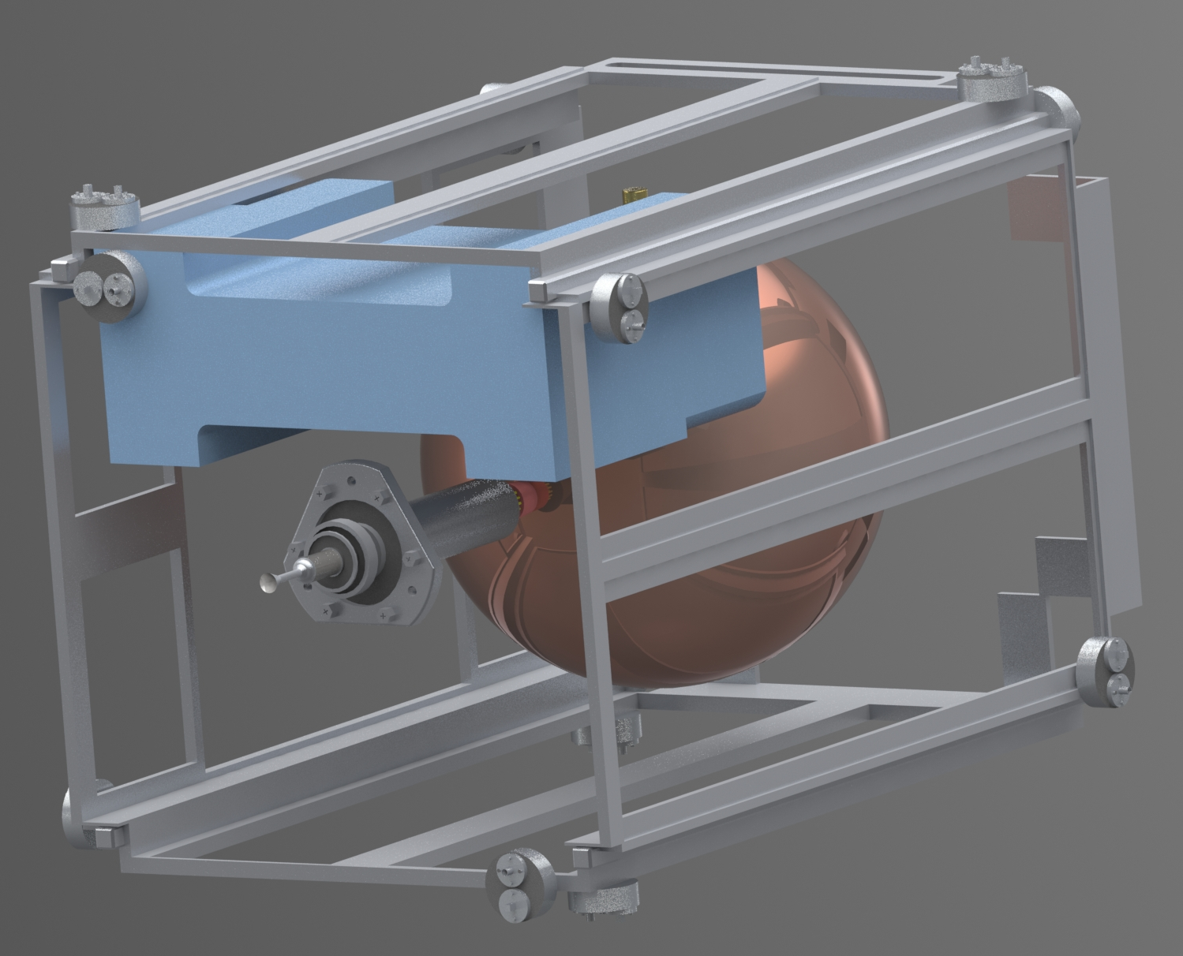
Hybrid Design: Cold Gas and Green Propellant
Cold Gas: Modified MarCo MiPS (RPOD)
Green Propellant: ECAPS (Major Delta V)
Modified MarCo MiPS
12 RCS 25mN thrusters
Modified MarCo MiPS
Control Unit w/ Propellant Tank
ECAPS
1N HPGP Thruster
ECAPS
Propellant Tank
29

Slide 30
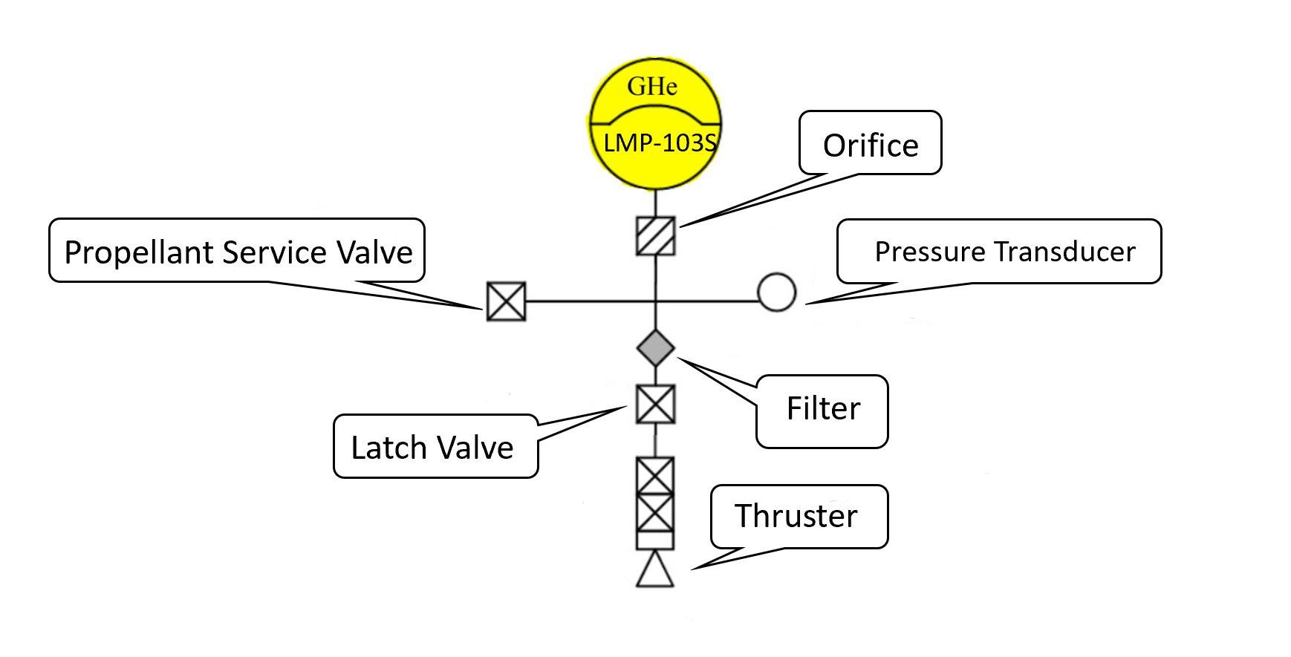
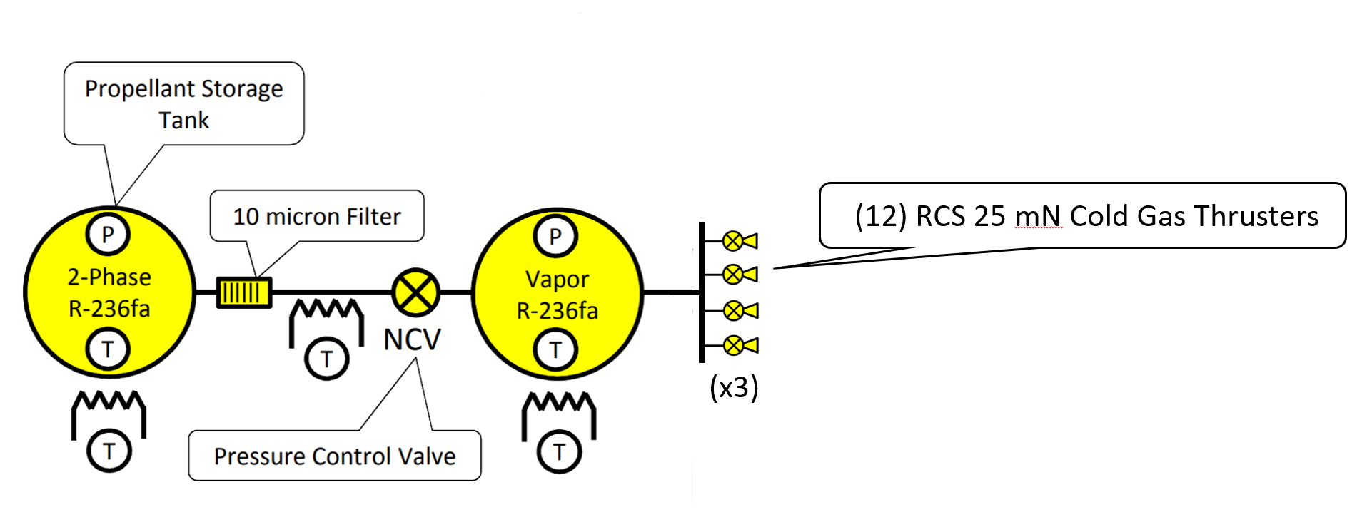
Propulsion System Schematics
RPO movement
RPO movement
ECAPS Propulsion Schematic
Modified MarCo MiPS Propulsion Schematic
30

Slide 31
Agenda
Introduction/Background Emily
System Engineering/Overview Maya
Spacecraft Victor
Debris Capture System James
Deorbit System Gustavo
Propulsion System Jasmine
Conclusion Emily

Slide 32
Conclusion
Designed a 12U SmallSat that meets almost all project requirements.
Gained exposure to design and simulation tools
  MSC Adams
  SolidWorks
  Simscape
Coordinated as a remote team to deliver a project.

Slide 33
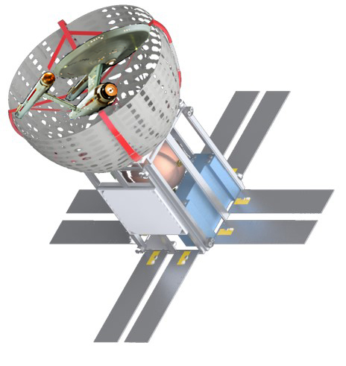
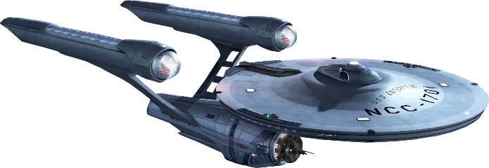

Slide 34
Appendix

Slide 35
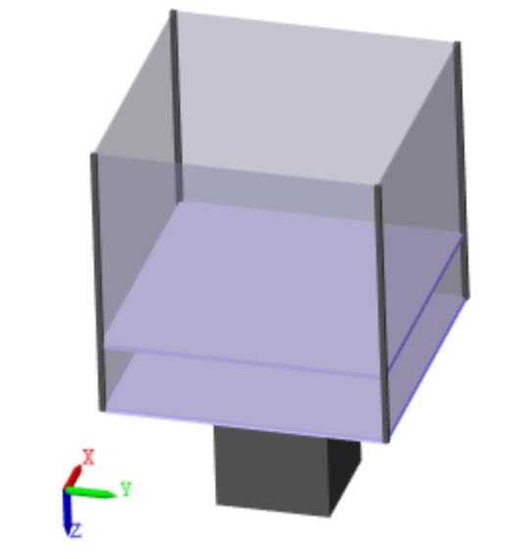
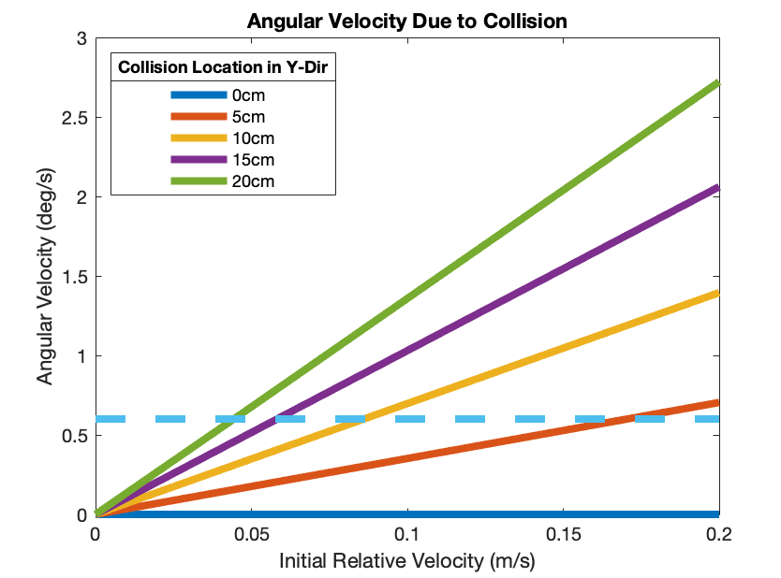
Original Design Spun on Impact
0cm
5cm
10cm
15cm
20cm
Maximum Slew Rate
For these cases, 0.04 m/s (0.89 mph) is maximum relative velocity between debris and CubeSat

Slide 36
Spin Reduction Options
Option | Active or Passive? | Mass | Volume | Initial Relative Velocities Enabled | Cons
Weighted Boom | Passive | 1.15 kg | 0.2 U | 5.3m/s (11.9mph) | Could fail through snapping
Reaction Wheels | Active | 1.7 kg | 1.2U | 5.1m/s (11.4 mph) | Requires added sensors, use of propulsion system
Propulsion | Active | 0.2kg | 0.2U | 5m/s (11.2 mph) | Requires added sensors
Notes:
Reaction wheel from here: http://oak-aero.com/userfiles/1167/images/NewSpace-Systems/NewSpace-DS-Reaction-Wheel-1.pdf
Actually 1.55kg and 1U, but that’s for a one direction reaction wheel, would need to add gyroscope, sensors
Sensors: https://www.cubesatshop.com/product/nss-magnetometer/ + small boom estimate
Magnetometers would require estimating location and magnetic field, adding layer of complexity and opportunity for failure since it’s an active system

Slide 37
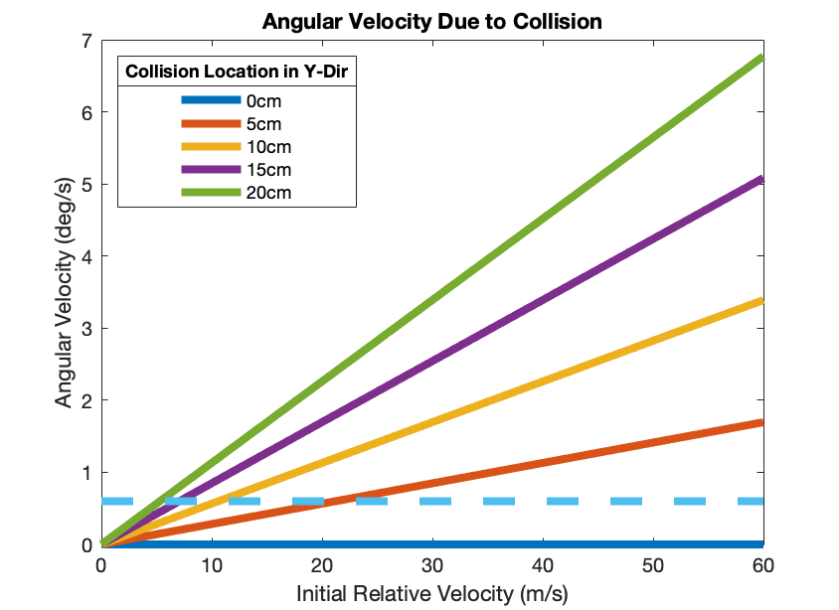
A weighted boom reduces spinning
1kg Weight
10m Boom
Maximum Slew Rate
CubeSat
Now 5.3 m/s (11.9 mph) is maximum relative velocity between debris and CubeSat

Slide 38
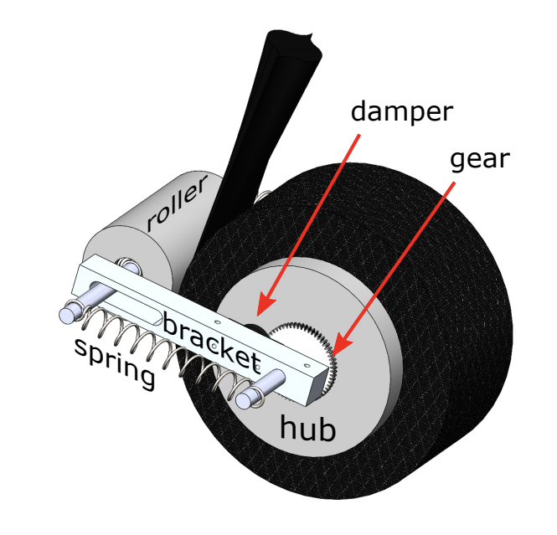

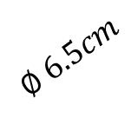
Boom Design
Carbon fiber collapsible tube mast design
Undeployed: 7.5cm*4cm*5cm = 0.15U
Deployed: 10m long
Weight: 150g
$$∅ 6.5cm$$
$$∅ 4cm$$
Collapsible Tube Mast Boom Design (Firth, MUSE Mechanism)

