Slide 1
My Lecture Capture
Example File

Slide 2
Slide Animation
Flip Lecture Recipe
Student
Prepared
for Class
Learner
Control
Reflection/
Accountability
Multimedia
+
Internet
+
+
=
Pictures
Text
Sound
Video
Narration
Anything on Screen
Youtube
Canvas
Watch outside of class
View Multiple Times
Fast Forward
Rewind
Assign a pre-class activity as follow up to flip lecture that helps frame the in-class activity
Notes:
And so what distinguishes eLearning from say multimedia based learning?
Well elearning does typically use multimedia, but the content is delivered via the Internet, and the learner has a lot of control over the content.
For lecture capture for example.
We would use visual, on screen text, narration, and really anything on screen.
We’d deliver the lecture capture via the Moodle and Youtube,
And the learner would be able to control our lecture capture by being able to watch it outside of class, multiple times, and to fast forward and rewind.

Slide 3
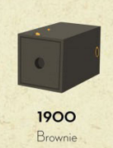
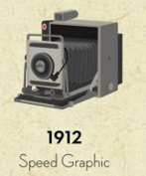
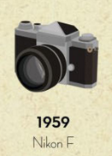
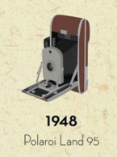
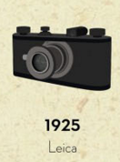

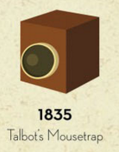
Movable Elements

