Slide 1
“Shop Local - Spend in Paramount”
A Case Study With The City of Paramount
Ariana Romero, Belinda Martinez, Joshua Amberg
MPP 687

Slide 2
Paramount: A city of Diversity
Total Population of 55,023 residents
Over 75% of residents are Hispanic/Latino
77% of Paramount residents are native speakers of a non-native language
The diversity of Paramount opens up new opportunities for connection with the community

Slide 3
Revamping Paramount’s Buy-Local Program
“Purchase It In Paramount”: An old economic development P.R. campaign that need renovation
“Shop Local - Spend in Paramount”: A new campaign with a Facebook page launching in early 2018
Our Purpose: Provide creative ideas to raise awareness of the program
Our Team: We worked with Mr. Christopher Callard (Public Information Officer) and Mr. Kevin Chung (Assistant City Manager)

Slide 4
Our Journey
Sept 22: Received assignment
Sept 28: Team formation
Oct 8: 1st Skype meeting
Oct 31: Visited Paramount and met with city staff
Nov 10: 2nd Skype meeting
Nov 15: Preliminary draft submitted to Belinda
Nov 17: Preliminary draft sent to Paramount
Nov 26: Final Skype meeting
Nov 28: Proposal finalized

Slide 5
Areas for Improvement
Informational material was not provided in Spanish even though 75% of residents are Hispanic/Latino
A lack of collaboration with other entities such as the Paramount Chamber of Commerce
Reservations about the word “Spend” in the title “Shop Local – Spend in Paramount”

Slide 6
Recommendations Focused on Community, Business, and Social Media
Community Outreach
  Create local pride and provide frequent reminders to consumers of the benefits of shopping locally
Business Outreach
  Inform businesses of the program and demonstrate how it benefits them
Social Media Outreach
  Increase awareness and access by building a strong base of followers

Slide 7
Community Outreach
Host culturally representative events that complement Paramount’s unique diversity and distribute informational flyers at these events
  Blessing ​of ​the ​Animals ​(March-April), Dia ​del ​Niño ​(April ​30), Latino ​Heritage ​Month/Taste ​of ​Mexico ​Food ​Festival ​(Sept-Oct), Dia ​De ​Los ​Muertos ​(November), International ​Day ​Fair, Tamales ​Competition
Collaborate with Paramount Unified School District to host a Logo/Slogan Competition
Linguistic Access: Provide a design that reflects the unique diversity of Paramount

Slide 8


Diverse Designs for the new program

Slide 9
BUSINESS Outreach
Collaborate with the Paramount Chamber of Commerce to inform businesses of new opportunities for promotion of their stores
Host a “Paramount Biz Awards Event Night”
  Categories such as “Paramount’s Best Kept Secret” or “Environmental Hero”
Introduce punch cards or VIP coupons to incentive consumers to shop locally

Slide 10
Social Media Outreach
Three goals: Promote local businesses, educate residents, and provide easy access
Promote local businesses by building a strong base of followers and featuring coupons and special deals
Educate residents with mission statement outlining the benefits of buying locally
Secure domain name that directs to Facebook page. Have links on the City of Paramount website and the Paramount Chamber of Commerce

Slide 11
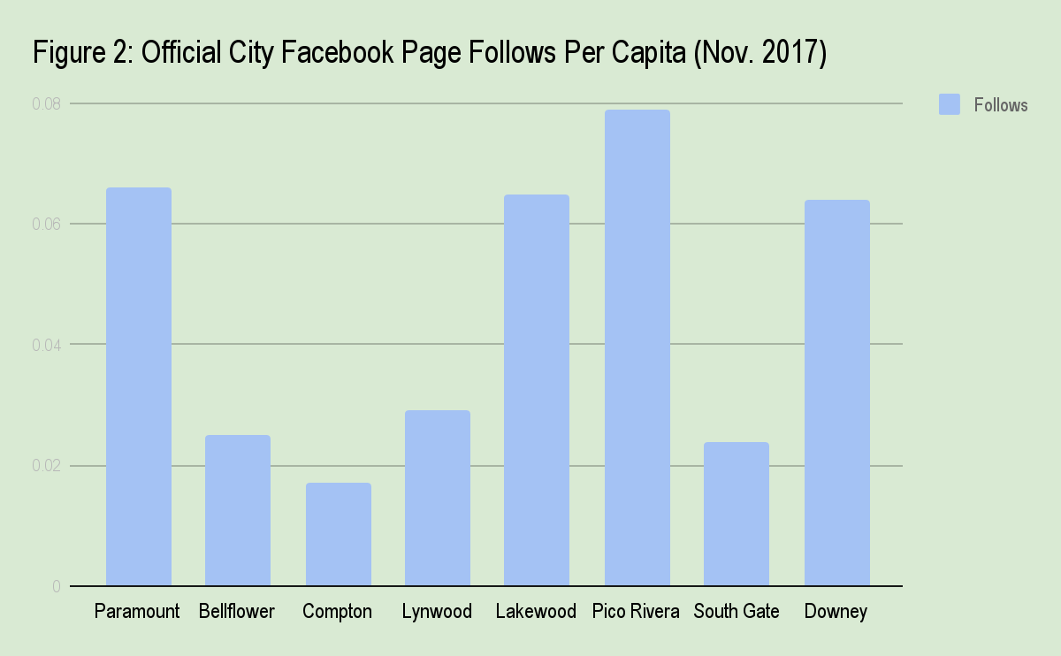
Paramount has a strong social media Presence

Slide 12

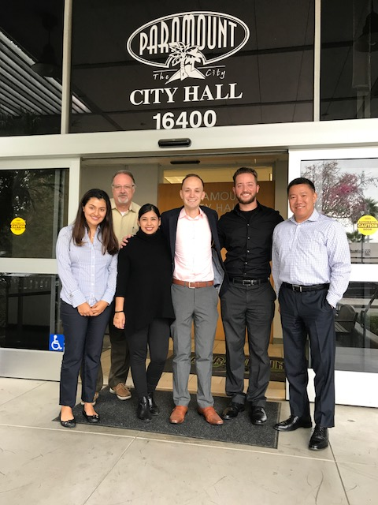
OUR team
Ariana: Initiated the project, acted as liaison, and oversaw outreach strategies for businesses and residents
Belinda: Had local knowledge which was a unique advantage, used experience with charter schools to suggest strategies for community engagement with families and individuals
Joshua: Evaluated Paramount’s social media presence in preparation for the Facebook page launch and offered recommendations for increasing access

Slide 13
Challenges
Potential Cal State versus Pepperdine scenario
Different balances between work and school
Geographic divide could make communication difficult

Slide 14
Our Approach
Multiple forms of communication
E-mail, Skype, Google Docs, and in-person meetings
Created a complementary blend that helped bridge the geographic divide

Slide 15
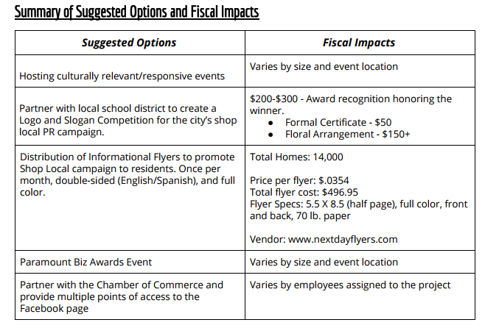
Suggestions and Fiscal Impact

Slide 16
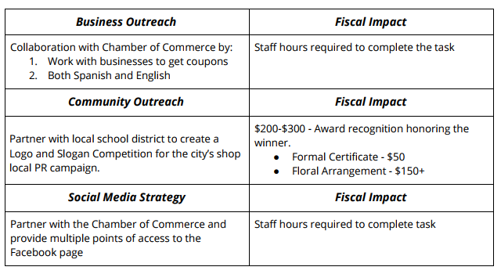
First steps for the city

Slide 17
FINAL Steps for us
Submitting the final proposal to Paramount this week
Hope to present to the City Council in December or January
Final assessments: Look at sales of local businesses next year, look at number of Facebook followers, look at attendance of events

