Slide 1
Combinatorial Games
Silvia Heubach
Department of Mathematics
NSS Retreat, May 25, 2017
Notes:
Hello, I am Silvia Heubach from the Department of mathematics and I will tell you about Combinatorial games. Humans have played games for a long time, as a way of socializing. More importantly, according to a cultural historian,
// games were the starting point for complex human behavior such as language, law, philosophy, art and war.

Slide 2
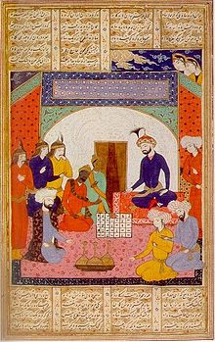
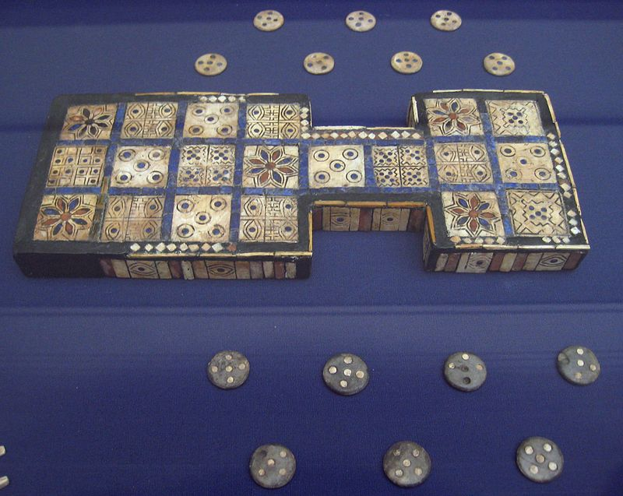
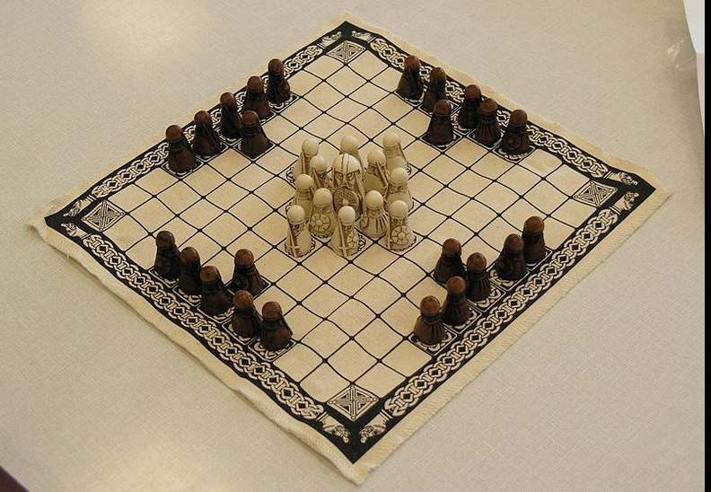
Games are an integral part of all cultures
Royal Game of Ur, southern Iraq, about 2600-2400 BCE
Hnefatafl – Northern European, from about 400 BC – 1200 AD
Indian Ambassadors present Chaturanga to Khosrau I, from "A treatise on chess", 14th century
Notes:
More importantly, according to a cultural historian,//
games were the starting point for complex human behavior such as language, law, philosophy, art and war. The particular games I study are combinatorial games, which includes chess and the game of NIM.

Slide 3
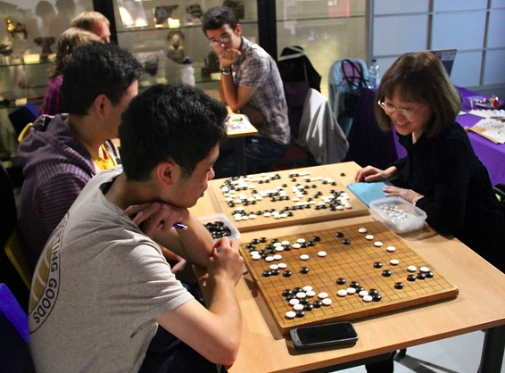

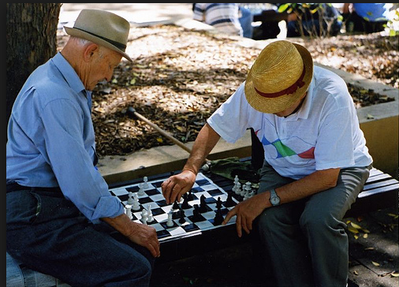
Main Question:
Who wins from a given position, assuming both players play optimally?
Notes:
Combinatorial game theory asks and tries to answer the important question: In a two-player game, who can win from a given position, assuming that both players play optimally?
// In combinatorial games, there is no randomness involved, that is, no spinners or dice.

Slide 4

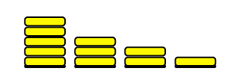
Combinatorial Games
Two-player game
No randomness is involved
Both players have complete information
Typically, the last player to move wins.
Notes:
In combinatorial games, there is no randomness involved, that is, no spinners or dice. Both players have complete information – no hidden cards, everything is out in the open. Typically, the last player to move wins.
//An example of a combinatorial game is NIM

Slide 5
The Game of NIM
Pick one of the stacks
Remove at least one of the tokens of that stack
Last person to make a move wins
NIM was completely analyzed by C. Bouton in 1901
Notes:
An example of a combinatorial game is NIM, which is played on stacks of tokens. In each move, a player selects a stack and then removes at least one token.
Bouton identified the winning strategy for NIM in 1901.
//NIM belongs to the class of impartial combinatorial games

Slide 6
Impartial Games
Only two possible outcome classes:
Losing positions
Winning positions
Characterization of positions
A losing position is one where ALL allowed moves lead to a winning position
A winning position is one where there is at least one move to a losing position.
Notes:
NIM belongs to the class of impartial combinatorial games, which has only winning and losing positions, no draws. A losing position is one where every move leads to a winning position – so no matter what you do, you’ll hand your opponent a win.
[Pause ] A winning position is one where there is at least one move to a losing position, that is, you can hand you opponent a loss IF you make the right move.

Slide 7
Impartial Games
Only two possible outcome classes:
Losing positions
Winning positions
Characterization of positions
A losing position is one where ALL allowed moves lead to a winning position
A winning position is one where there is at least one move to a losing position.
Notes:
NIM belongs to the class of impartial combinatorial games, which has only winning and losing positions, no draws. A losing position is one where every move leads to a winning position – so no matter what you do, you’ll hand your opponent a win.
[Pause ] A winning position is one where there is at least one move to a losing position, that is, you can hand you opponent a loss IF you make the right move.

Slide 8
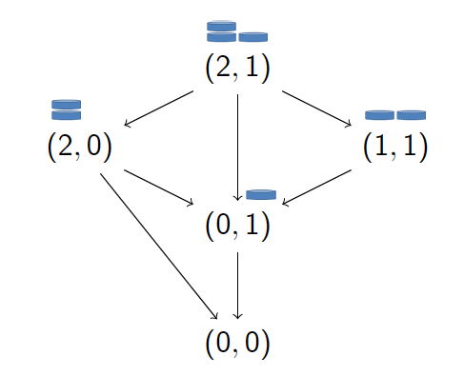
Game Graph
Notes:
To determine whether the NIM position (2,1) is winning or losing, we first map out all the possible moves in a game graph. Vertices represent positions, and arrows point to the positions one can move to.

Slide 9
Recursive Procedure
W
W
Winning position - at least one move to a losing position.
L
Terminal positions are Losing positions
Notes:
First we label positions starting from the terminal position, which is losing because there are no moves.
Then we label (0,1) and (2,0) as winning because they have a move to a losing position
Next we label (1,1), which is losing because the only move is to a winning position.
Finally we label (2,1) as winning because there is a move to a losing position.

Slide 10
Recursive Procedure
Losing position - ALL allowed moves to winning positions
W
W
L
W
Winning position - at least one move to a losing position.
L
Terminal positions are Losing positions
Notes:
First we label positions starting from the terminal position, which is losing because there are no moves.
Then we label (0,1) and (2,0) as winning because they have a move to a losing position
Next we label (1,1), which is losing because the only move is to a winning position.
Finally we label (2,1) as winning because there is a move to a losing position.

Slide 11

Finding the Pattern of the Losing Positions
Write a computer program to implement recursive procedure
Produce a list of losing positions
Stare at them and find a PATTERN that seems to describe the losing positions
Describe the pattern mathematically
Then prove that the pattern is correct
Notes:
For larger games we use a computer program to create a list of losing positions. Then CREATIVITY comes in – we need to find a pattern, describe it mathematically, and finally prove it. I will now show you results for a game that my collaborator and I created.

Slide 12
Definition of Circular Nim - CN(n,k)
n stacks of tokens arranged in a circle
Select k consecutive stacks and remove at least one token from at least one of the k stacks
Last player to move wins
k = 1 corresponds to NIM
Example: CN(8,3)
M. Dufour and S. Heubach, Circular Nim Games, Electronic Journal of Combinatorics, 20:2, (2013) P22 (26 pages)
Notes:
Circular NIM CN(n,k), is played on n stacks of tokens. In each move, a player selects k CONSECUTIVE stacks and then removes at least one token from one of the stacks. The last Player to move wins.
If only one stack is selected, then the circular arrangement does not matter – CN(n,1) is just NIM
The example shows a position with 8 stacks, where 3 consecutive stacks have been selected for play. The values indicate the stack heights.

Slide 13
Definition of Circular Nim - CN(n,k)
n stacks of tokens arranged in a circle
Select k consecutive stacks and remove at least one token from at least one of the k stacks
Last player to move wins
k = 1 corresponds to NIM
Example: CN(8,3)
M. Dufour and S. Heubach, Circular Nim Games, Electronic Journal of Combinatorics, 20:2, (2013) P22 (26 pages)
Notes:
Circular NIM CN(n,k), is played on n stacks of tokens. In each move, a player selects k CONSECUTIVE stacks and then removes at least one token from one of the stacks. The last Player to move wins.
If only one stack is selected, then the circular arrangement does not matter – CN(n,1) is just NIM
The example shows a position with 8 stacks, where 3 consecutive stacks have been selected for play. The values indicate the stack heights.

Slide 14
Which CN(n,k) Games are Solved?
CN(1,1)
CN(2,1) | CN(2,2)
CN(3,1) | CN(3,2) | CN(3,3)
CN(4,1) | CN(4,2) | CN(4,3) | CN(4,4)
CN(5,1) | CN(5,2) | CN(5,3) | CN(5,4) | CN(5,5)
CN(6,1) | ? | CN(6,3) | CN(6,4) | CN(6,5) | CN(6,6)
CN(7,1) | ? | CN(7,3) | CN(7,4) | ? | CN(7,6) | CN(7,7)
CN(8,1) | ? | ? | ? | ? | CN(8,6) | CN(8,7) | CN(8,8)
CN(9,1) | ? | ? | ? | ? | ? | ? | CN(9,8) | CN(9,9)
 | ? | ? | ? | ? | ? | ? | ?
Trivial - first player takes all tokens
Losing positions: all stack heights equal
…
…
NIM
Notes:
We found some general results:
Play on one stack is NIM
Play on all stacks is trivial - the first player wins by removing all tokens
Play on all but one stack – to win, make all stack heights the same
For the remaining cases we have only found individual solutions. The ones shown in pink have been published, and we are currently working on n = 7.
For the cases shown in yellow, we have identified patterns and are in the process of proving them.
We also tried to find a general pattern for the losing positions of CN(n comma 2), but so far have not succeeded. In general, the patterns for the losing positions become more complex as n increases. [43]

Slide 15
Which CN(n,k) Games are Solved?
CN(1,1)
CN(2,1) | CN(2,2)
CN(3,1) | CN(3,2) | CN(3,3)
CN(4,1) | CN(4,2) | CN(4,3) | CN(4,4)
CN(5,1) | CN(5,2) | CN(5,3) | CN(5,4) | CN(5,5)
CN(6,1) | ? | CN(6,3) | CN(6,4) | CN(6,5) | CN(6,6)
CN(7,1) | ? | CN(7,3) | CN(7,4) | ? | CN(7,6) | CN(7,7)
CN(8,1) | ? | ? | ? | ? | CN(8,6) | CN(8,7) | CN(8,8)
CN(9,1) | ? | ? | ? | ? | ? | ? | CN(9,8) | CN(9,9)
 | ? | ? | ? | ? | ? | ? | ?
Trivial - first player takes all tokens
Losing positions: all stack heights equal
…
…
NIM
Notes:
We found some general results:
Play on one stack is NIM
Play on all stacks is trivial - the first player wins by removing all tokens
Play on all but one stack – to win, make all stack heights the same
For the remaining cases we have only found individual solutions. The ones shown in pink have been published, and we are currently working on n = 7.
For the cases shown in yellow, we have identified patterns and are in the process of proving them.
We also tried to find a general pattern for the losing positions of CN(n comma 2), but so far have not succeeded. In general, the patterns for the losing positions become more complex as n increases. [43]

Slide 16
Which CN(n,k) Games are Solved?
CN(1,1)
CN(2,1) | CN(2,2)
CN(3,1) | CN(3,2) | CN(3,3)
CN(4,1) | CN(4,2) | CN(4,3) | CN(4,4)
CN(5,1) | CN(5,2) | CN(5,3) | CN(5,4) | CN(5,5)
CN(6,1) | ? | CN(6,3) | CN(6,4) | CN(6,5) | CN(6,6)
CN(7,1) | ? | CN(7,3) | CN(7,4) | ? | CN(7,6) | CN(7,7)
CN(8,1) | ? | ? | ? | ? | CN(8,6) | CN(8,7) | CN(8,8)
CN(9,1) | ? | ? | ? | ? | ? | ? | CN(9,8) | CN(9,9)
 | ? | ? | ? | ? | ? | ? | ?
Trivial - first player takes all tokens
Losing positions: all stack heights equal
…
…
NIM
Notes:
We found some general results:
Play on one stack is NIM
Play on all stacks is trivial - the first player wins by removing all tokens
Play on all but one stack – to win, make all stack heights the same
For the remaining cases we have only found individual solutions. The ones shown in pink have been published, and we are currently working on n = 7.
For the cases shown in yellow, we have identified patterns and are in the process of proving them.
We also tried to find a general pattern for the losing positions of CN(n comma 2), but so far have not succeeded. In general, the patterns for the losing positions become more complex as n increases. [43]

Slide 17
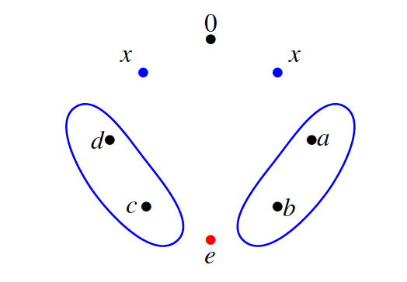
Results for n = 8: CN(8,6)
Theorem [DH]
The losing positions of CN(8,6) are given by {(0, x, a, b, e, c, d, x)| a + b = c + d = x, e = min { x, a + d }}
Notes:
For example, here is the description of the losing positions of CN(8,6). There is an empty stack surrounded by two stacks of the same height x. The heights of the circled stacks each add up to this value x. The last stack is the smaller of the value of x and the sum of d + a. Not an easy pattern to find; we do use the computer to provide and check simple pattern such as sums.

Slide 18
Results for n = 8: CN(8,6)
Theorem [DH]
The losing positions of CN(8,6) are given by {(0, x, a, b, e, c, d, x)| a + b = c + d = x, e = min { x, a + d }}
Notes:
For example, here is the description of the losing positions of CN(8,6). There is an empty stack surrounded by two stacks of the same height x. The heights of the circled stacks each add up to this value x. The last stack is the smaller of the value of x and the sum of d + a. Not an easy pattern to find; we do use the computer to provide and check simple pattern such as sums.

Slide 19

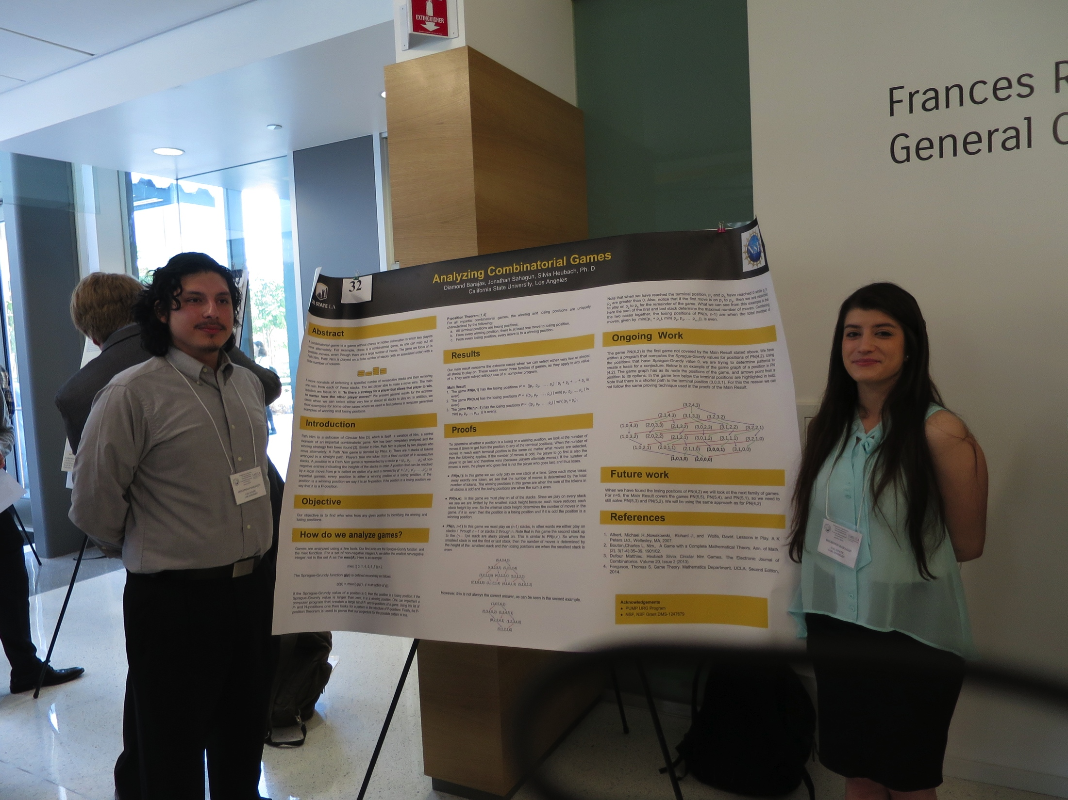
Student Research
Jonathan Sahagun & Diamond Barajas, PUMP program
Colin Bloomfield, Masters student
Worked on a variation of Circular Nim, where a fixed number of tokens has to be removed from ALL k stacks
Currently working on the game creation operator
Notes:
Combinatorial games are very accessible for student research. I have worked with two undergraduates, Jonathan and Diamond, on a variation of Circular Nim.
My graduate student Colin is working on the game creation operator, another line of research in combinatorial games.

Slide 20
THANK YOU!
Image citation
By Firdausi - http://history.chess.free.fr/sources.htm, Public Domain https://commons.wikimedia.org/w/index.php?curid=13374161
Royal Game of Ur, southern Iraq, about 2600-2400 BCE, By BabelStone (Own work), CC0, https://commons.wikimedia.org/w/index.php?curid=10861909
Hnefatafl reconstruction, By Matěj Baťha - Own work, CC BY-SA 3.0, https://commons.wikimedia.org/w/index.php?curid=25070387
http://www.britgo.org/node/4812
https://en.wikipedia.org/wiki/Mancala#/media/File:Bao_players_in_stone_town_zanzibar.jpg
Notes:
Thank you for listening! Let’s play!

