Slide 1
Distinguishing Public Presentation Confidence and Competence of Undergraduate Business Majors
Dr. Nina O’Brien
Department of Management
Department of Communication Studies
2nd Annual Assessment Faire
California State University Los Angeles
April 12, 2017.

Slide 2


Motivation
Notes:
Academics and professionals alike agree that oral communication and presentation skills are highly valuable.
These skills are linked to academic achievement, success in job placement, more rapid promotion and professional success for individuals and those who employ them, but students spend significantly less time practicing and refining their spoken communication compared with written communication. Research on business school students’ skills in this arena consistently find significant room for improvement

Slide 3


Disentangling two constructs
Notes:
The ability to deliver effective oral presentations is related to two constructs: confidence and competence, but most assessments of business school students don’t distinguish these, which I think is highly problematic because the two are deeply intertwined.
Sometimes, an apprehensive communicator is hard to distinguish from an incompetent communicator, because both end up being ineffective, but for different reasons. As well, evaluation of communication is very subjective, and place a high social value on confidence and extraversion, so we often privilege style over substance when evaluating speakers.
To what degree do students demonstrate public speaking confidence on entering BUS 3050?
To what degree to students demonstrate public speaking confidence on completing BUS 3050?
To what degree do students demonstrate public speaking competence on entering BUS 3050?
To what degree to students demonstrate public speaking competence on completing BUS 3050?
What si the relationship between the two

Slide 4
BUS 3050: Business Communication
Notes:
Required upper division course of all majors in the college of business and economics
It is responsible for a huge number of the soft skills required by the AACSB
Not the only place where students give presentations but it is the only class in the B school that offers instruction in this arena so it’s a good forum for embedded assessment.

Slide 5
Participants
Notes:
8 sections of BUS 3050 students have been evaluated, but these results are for 5 of those sections
159 students, about half of whom were male
About 80% of students were seniors – this is largely an artefact of it being a bottleneck class
27% of students were accounting majors
22% of students were management majors
21% marketing
11% each computer information systems and finance & law
1.5% econ and stats
4% non cbe majors

Slide 6
Procedures
Embedded Assessment (IRB approved)
Pre- and post-evaluations of Public Speaking Anxiety
Formal Instruction (4 hours, 10%)
Modelling
Performance and evaluation (14 hours, 35%)
Notes:
Fully 45% of class time in some way focused on presenting

Slide 7
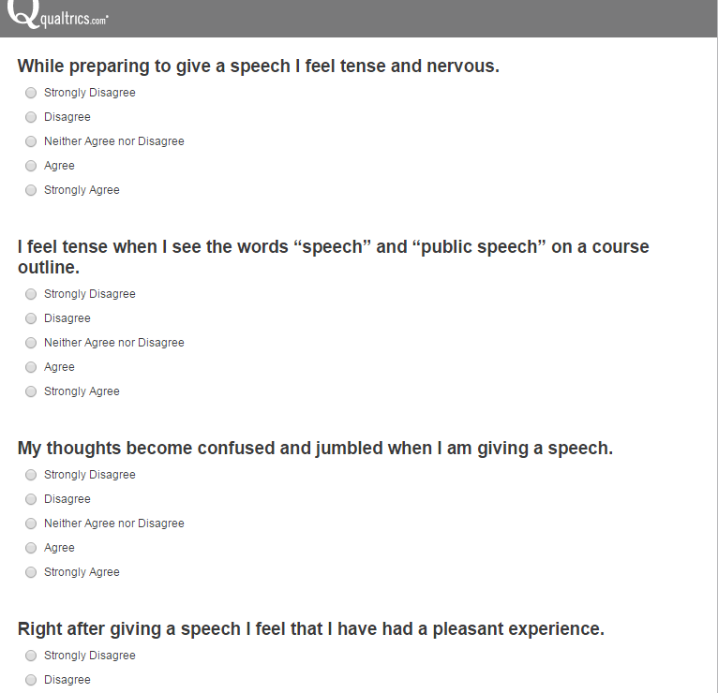
Instruments: PRPSA-34
High = 131 – 170
Moderate = 99-130
Low = 34-98
Notes:
Reliability alpha = .951
34 item scale
Questions like …
Gives you a score between 34 and 170
National mean is about 114 with an sd of about 17 points

Slide 8
Tests of confidence
PRE TEST
POST TEST
Average: 108.44
H = 24 (15.1%)
M = 66 (41.5%)
L = 44 (27.7%)
Average: 90.09
H = 5 (3.1%)
M = 50 (31.4%)
L = 91 (57.2%)
Paired Samples t-test
t (122, df 121) = 11.006
p < .001
Notes:
So that’s good news!

Slide 9
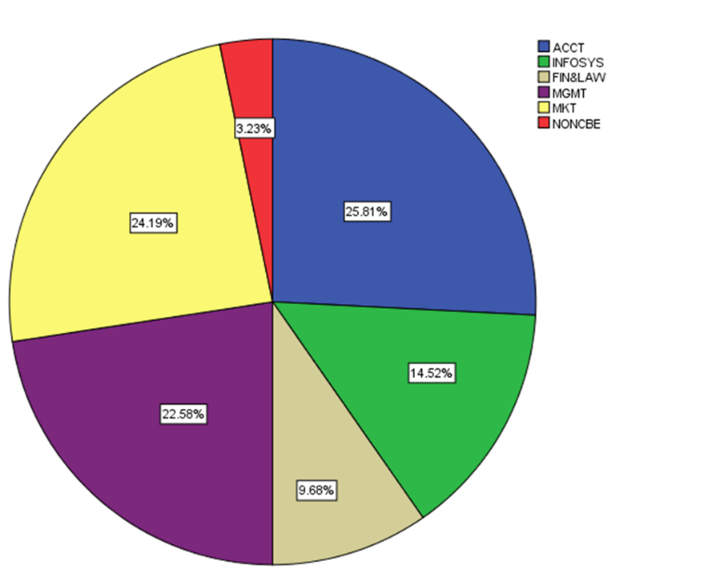
Differences by major
ANOVA
POST HOC
F (134, df 127, 6) = 2.341, p. < .05
Marketing
vs
Accounting
Notes:
We also wanted to see whether a student’s major made a difference – the results of an ANOVA showed that major within the business degree made a difference, and further analysis showed that marketing majors were among the most confident and accounting majors the least

Slide 10
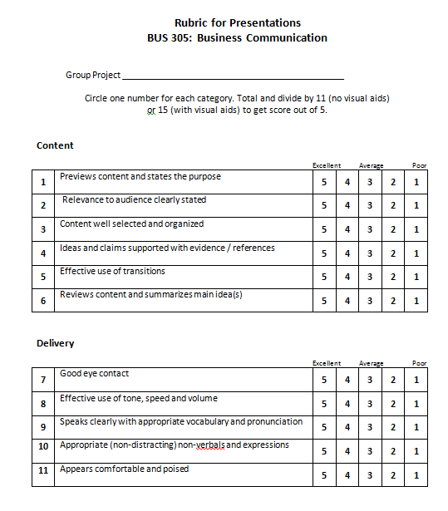
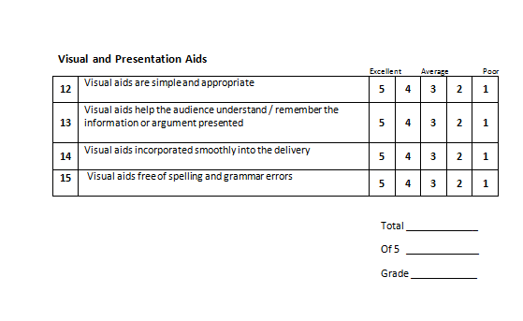
Instruments: Speaking Performance
Notes:
Rubrics for PS evaluation are really varied – there’s little consistency.
Colleagues at the National Communicaiton Association are working on validating a rubric which might serve to provide some consistency, but even then, as I mentioned earlier, PS assessment very subjective.
Score out of 10 roughly translates to letter grades for classroom assessment purposes

Slide 11
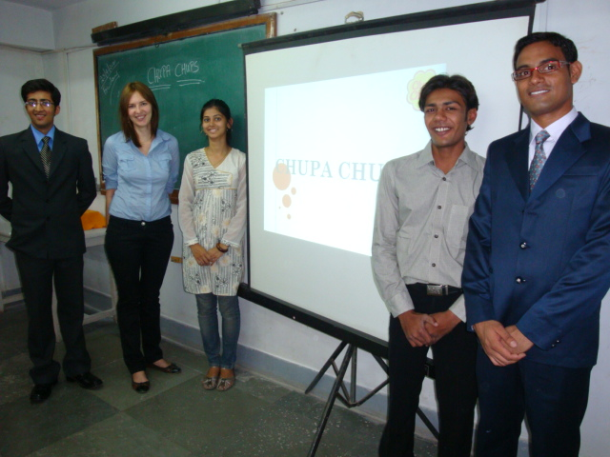
Performance in Groups
Presentations of 5-7 m. at mid and end of term
Rubric evaluated score and extensive written feedback after first presentation
Visual aids for second presentation only
Notes:
38 student groups presented over the observation period

Slide 12
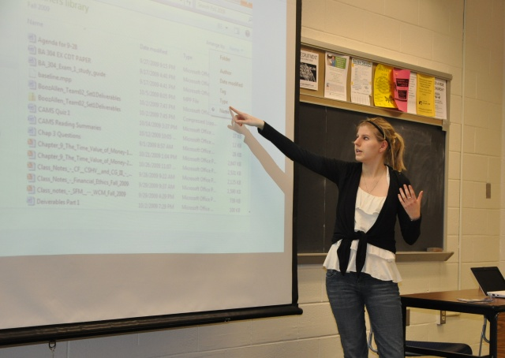
Individual Performance
3-5 m. on career goals and qualifications
Last Presentation
Simple visual aids
Same rubric
Notes:
Something like an elevator pitch

Slide 13
Group Competence Scores
midterm
End of term
Average = 8.47 (sd .59)
Range = 6.5-9.4
Issues:
Awkward non-verbals
Lack of support for claims
Average = 8.57 (sd .48)
Range = 6.8 – 9.8
Issues:
Poor visual aids
Lack of support for claims
Paired Samples t-tests
p > .05
Notes:
We compared scores at the group and individual levels, as well as compared group and individual competence scores – no significant difference or improvement in competence.
No significant differences across majors either

Slide 14
An interesting revelation: The Basic Course
PRPSA PRE
n 117, t = -48.85, p<. 001
PRPSA POST
n 117, t = -39.67, p<. 001
COMPOSITE COMPET.
n 117, t = -80.90, p<. 001
GROUP COMPET.
n 117, t = -78.01, p<.001
INDIVIDUAL COMPET.
N 117, t = -57.12, p<.001
Notes:
All students entering the university are required to take (or substitute) a lower-division basic course in oral communication which is offered by my other department – Comm Studies. Over 1,000 students receive instruction in presentation skills every semester by adjunct faculty and graduate students who themselves receive more than 30 hours of initial training and 2 hours a week of ongoing training throughout each semester
As a post-hoc analysis I tested the relationship between the grade students received in the basic course and the other outcome variables and found they were all significant:

Slide 15
Discussion
Assessment tool
Rubric development and validation
Evaluator consistency
Emphasis
technical skills vs confidence
differs by major
Time
15 weeks enough to build confidence, but not competence?
Basic Course
Effective in reducing anxiety, developing competence, lasting effects

Slide 16
Thank you!
nobrien2@calstatela.edu
Notes:
Thanks to Laura Whitcomb and Carol Blazynski in Management and Kristina Ruiz Mesa in Communcation Studies

