Slide 1
Developing a Survey Instrument to Improve Students’ Learning
Ni Li, Ph.D
Assistant Professor
Department of Mechanical Engineering
College of Engineering, Computer Science, and Technology
California State University, Los Angeles

Slide 2
Different Survey Types
1: Pre-knowledge Survey
2: Progressive Survey
3: Post-exam Self-reflection Survey
4: Post-knowledge Survey

Slide 3


Pre-knowledge Survey
How to prepare students to be ready for class?
Syllabus?
Facts:
My previous survey questions : “I have read syllabus”.
- Only around 40% of students choose “Yes”
Syllabus should not be the only method!
Pre-knowledge Survey:
Learning objectives are framed as questions
In each question, students are asked to rate their level of confidence

Slide 4
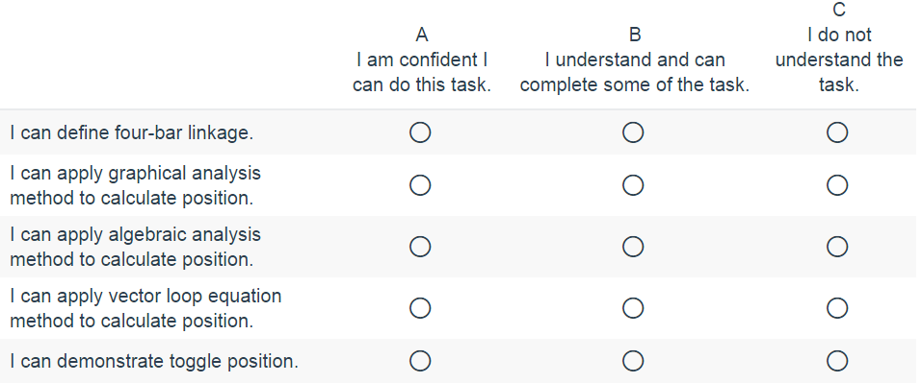
Pre-knowledge Survey
Example (ME3210: Kinematics of Mechanism)
One of class objectives: Student will have ability to analyze positions of a four-bar mechanism
Results
# of students

Slide 5


Pre-knowledge Survey
Objective
Students:
Know what will be learned in this course
Instructor:
Know students’ level and can adjust teaching contents accordingly

Slide 6
Progressive Survey
How to track students’ performance?
How to determine which contents need to be reviewed?
Progressive Survey:
Ask students questions related to key contents
In each question, students are asked to rate their level of confidence
Can use pre-knowledge survey question, or create more questions related to key class contents

Slide 7
Progressive Survey
Example (ME3200: Dynamics)
Use 0-5 to present level of knowledge and confidence
Do you know what the planar motion the rigid body is doing?
Do you know how to find IC point?
Do you know how to find the velocity of a point or the angular velocity of a rigid body?
Do you know how to find the acceleration of a point or the angular acceleration of a rigid body?
Do you know how gear works?
Do you know how to apply the equation of translational motion and rotational motion about the mass center G, rotation center O, or other point?
Do you know how to calculate moment? How to decide whether the moment is positive or negative?
Do you know how to calculate moment of inertia?
Do you know in which situation, the force does not do work?
Results
Average Score

Slide 8
Progressive Survey
Objective
Students:
Compare their learning with peers and self analyze the reasons for the outcomes
Instructor:
Know which content(s) need to be reviewed/repeated in the limited class time

Slide 9
Post-exam Self-reflection Survey
How to help students improve performance in the exam?
Facts:
Gave the students exactly same questions in the mid-term exam
- Only around average 30% of students got full credit
Post-exam Self-reflection Survey

Slide 10
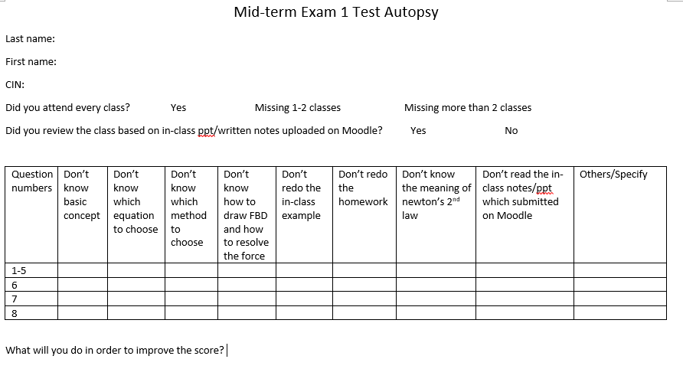
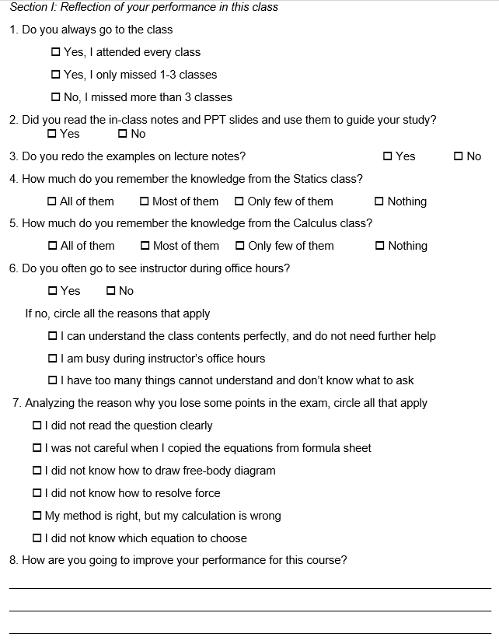
Post-exam Self-reflection Survey
Example (ME 3200: Dynamics)
Partial Results
I will read the question carefully. I will take more time to understand the concepts.
Redo Examples from homework and lecture notes.
Study with a group and go over each problem
I am going to do more practice which includes doing homework and lecture problems more than once. If I have a very concerning question I will ask my instructor.
I need to review my lecture notes and redo most of the examples so that I know which equation to choose when reading and analyzing the problem. Etc.

Slide 11
Post-exam Self-reflection Survey
Objective
Students:
Compare their reasons with peers to avoid similar mistakes
Instructor:
Can change teaching methods accordingly

Slide 12
Post-exam Self-reflection Survey
Actual data (ME 3200: Dynamics)

Slide 13
Post-knowledge Survey
How to check students’ learning efficiency?
Redo pre-knowledge survey again at the end of semester

Slide 14
Pre-knowledge Survey
Objective
Students:
Self check learning efficiency
Instructor:
Check teaching efficiency
Can analyze whether the contents are appropriate for students

Slide 15


