Slide 1
Assessing {And building} transfer
Ji Y. Son, Department of Psychology, NSS

Slide 2
“Is this on the test?” -every student ever
Truth that we must keep in mind:
They will forget almost everything.

Slide 3
What do I want my students to be able to do 6 months after my class is over?
Transfer statistics to novel situations.
Read a newspaper article and “see” the statistical ideas (even when no statistics are mentioned).
Go into a research methods class and be able to analyze data.
Consult on someone else’s data.
“Decide when” not “know how”
e.g., when to make a histogram/bar chart/scatterplot (and then google how to make one).

Slide 4
Teaching is Inherently Cultural Assessments are also Inherently Cultural
Japanese math instruction: “Slow and Sticky”
American math instruction: “Quick and Snappy”
Stevenson & Stigler (1992)

Slide 5
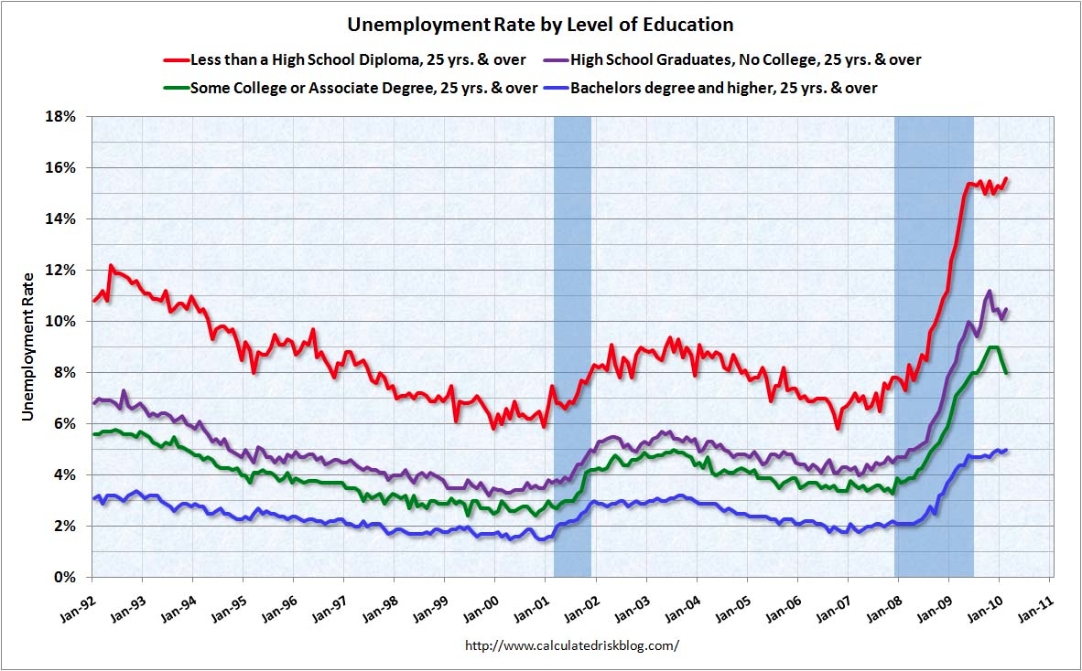
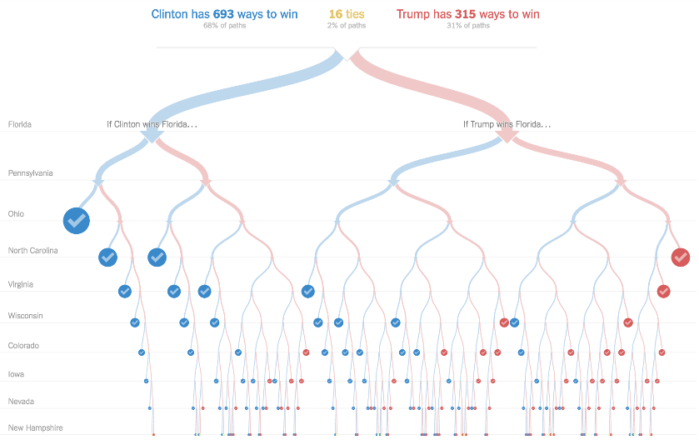
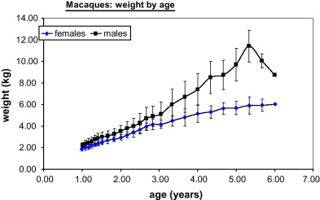
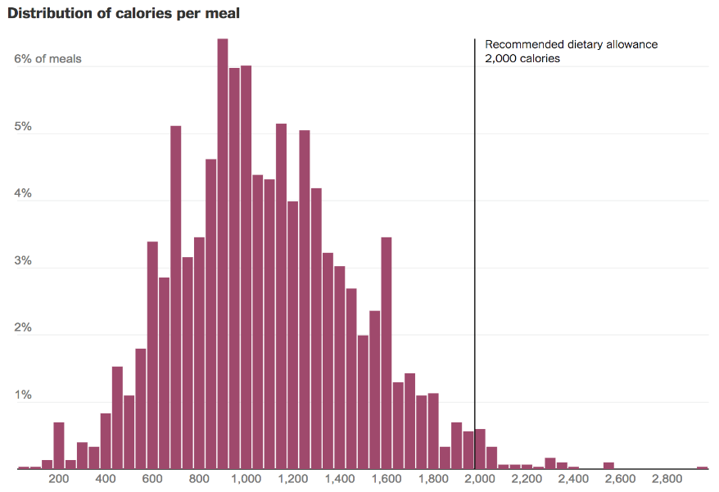
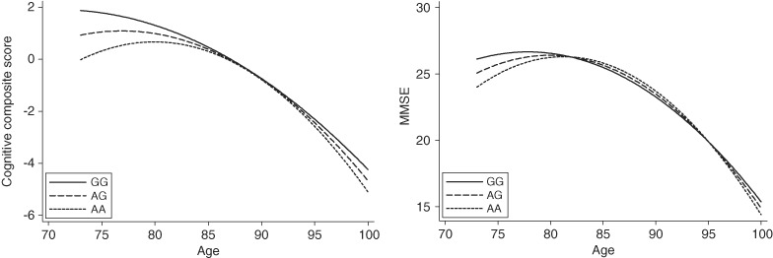

Slide 6
“You are a statistics consultant to the project summarized below.”
The Exam Contexts
Transfer statistics to novel situations
Children’s sleep and cognition
Caffeine and athletic performance
Love exercises enhancing intimacy

Slide 7
“You are a statistics consultant to the project summarized below.”
The Exam Questions
“Decide when” not “know how”
Open note, open internet (because that mimics life)
Real authentic research questions with minimal statistics guidance
How does sleep affect children’s cognitive ability?
Does caffeine enhance biking performance?
Can love be exercised?

Slide 8
“Is this on the test?” -every student ever
Testing for Transfer means Teaching for Transfer
Thank you for listening!

