Slide 1

Evaluating Real Life Integration and Application of Content Knowledge
Elina Saeki, PH.D.
Charter College of Education
Division of Special Education and Counseling

Slide 2

M.S. in Counseling, Option in School Psychology
Training + preparation for graduate students who plan to work as school psychologists in public PK-12 schools
Formative and summative assessments
Within each course
“Signature assignments”
Annual evaluations
End-of-program evaluations

Slide 3
NASP Standard #5: Effects on Student Learning
Assessment that demonstrates candidate effects on student learning.
PEDAGOGICAL AND PROFESSIONAL KNOWLEDGE, SKILLS, AND DISPOSITIONS: COMPREHENSIVE, PERFORMANCE-BASED ASSESSMENT OF CANDIDATE ABILITIES EVALUATED BY FACULTY DURING INTERNSHIP.
Assessment that demonstrates candidates' knowledge, skills, and dispositions are applied effectively in practice.

Slide 4
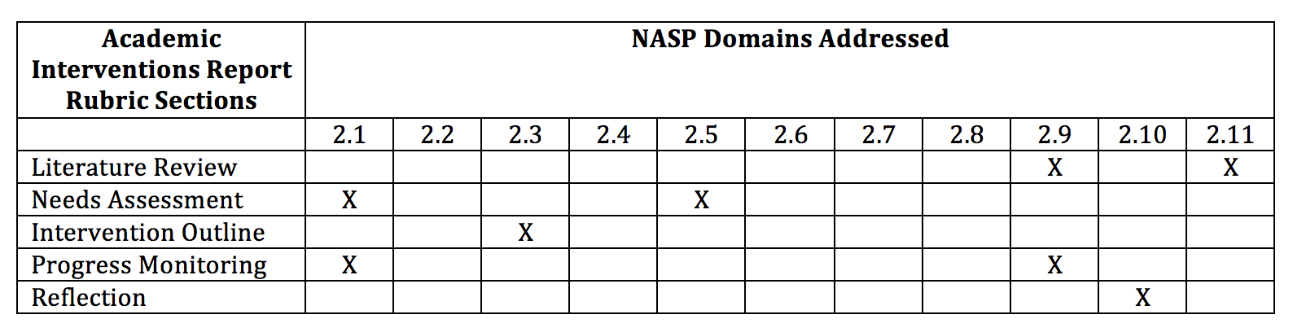
Signature Assignment: Academic Intervention Project
Performance-based assessment in an academic domain for P-12 students
Notes:
1: Data based decision making
2: Consultation and collaboration
3: Effective instruction and development of cognitive/academic skills
4: Socialization and development of life skills
5: Student diversity in development and learning
6: School and systems organization, policy development, and climate
7: Prevention, crisis intervention, and mental health
8: Home/school/community collaboration
9: Research and program evaluation
10: School psychology practice and development
11: Information technology

Slide 5
Academic Interventions Project Guidelines
Required final product:
Literature review: What is the background literature on the problem being addressed? What are effective interventions based on research literature? Cite your sources, using scientific journal articles and book chapters. NREPP (www.nrepp.samhsa.gov) and What Works Clearinghouse (ies.ed.gov/ncee/wwc/) also have a searchable list of academic (and other) interventions, with links to the research base.
Needs assessment: Review the student’s cumulative file and documented background information to select and/or develop your academic intervention. Consider the impact of biological, social, and cultural factors on academic performance and appropriateness of interventions. Obtain informed consent from parent(s) and assent from student(s) if necessary. Include teachers in needs assessment by considering teacher nomination and referral of at-risk students.
Intervention outline: Describe the academic intervention selected, including the overarching objectives of the intervention, session dates, topics and content covered, materials used, and evaluation instruments used. Describe if it is an ongoing intervention or developed and lead based on the needs of the students to support.
Progress monitoring: Describe your evaluation procedures and results. Collect weekly data on the student(s) progress during the intervention. Use data to generate charts/graphs that demonstrate your impact on the target academic skill. Specifically, calculate effect sizes to evaluate the magnitude of effect of the intervention on the target student. Use a single subject evaluation technique, including collection of baseline, treatment, and post-treatment data. How were data used to inform treatment planning?
Reflection: Reflect on the implementation of your academic intervention. What were the sessions like, what went well, what would you do different in the future, how did your target student(s) responded to the intervention, and how do you see the intervention being maintained by the school staff in the future?

Slide 6
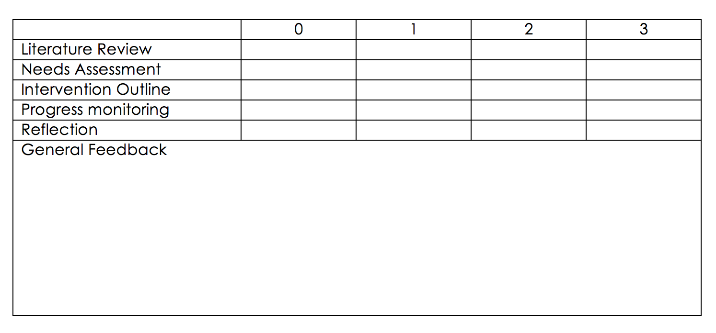
Rating Rubric
Your Faculty Supervisor will rate the overall assignment for quality.
0 – Unsatisfactory: Demonstrates substantial lack of competency (redo)
1 – Fair: Demonstrates minimal competency but lacks some important components (redo)
2 – Good: Demonstrates ability consistent with competent school psychology practice (pass)
3 – Excellent: Demonstrates commendable ability (pass)

Slide 7
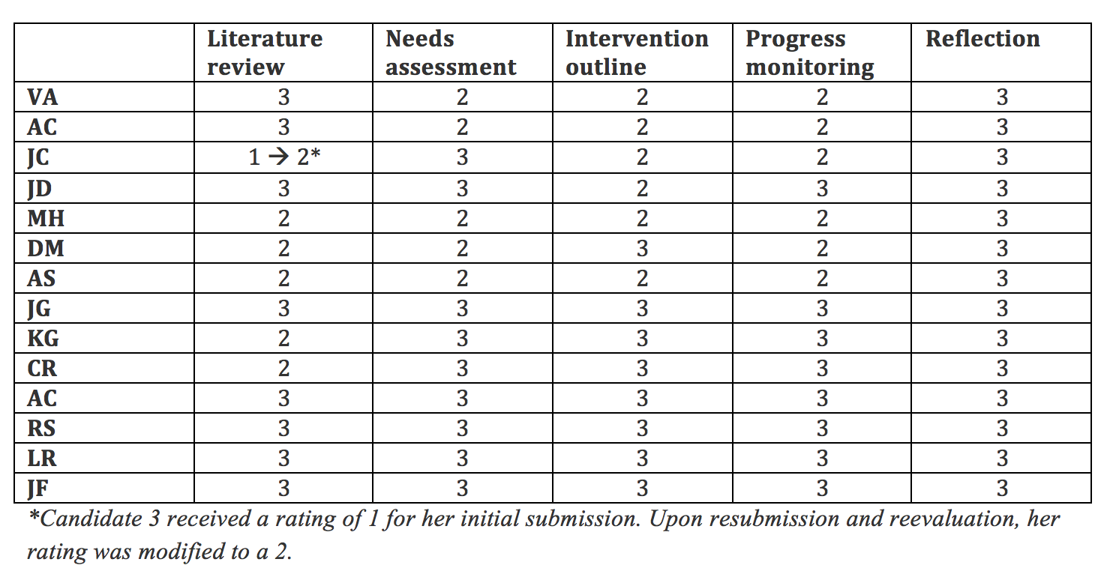
Disaggregated Student Data

Slide 8
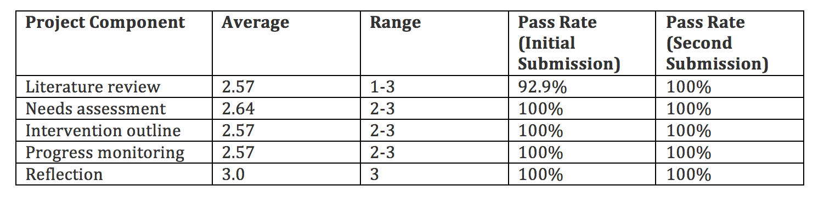
Aggregate Student Data

Slide 9

Thank you!
esaeki@calstatela.edu
Notes:
50 MINUTES

