Slide 1
Artificial Intelligence and Data Science for Air Pollution Prediction and Visualization
Members: Larry Gutierrez, Micky Chan, Eric Chan, Peter Gatsby, Jose Landa
Advisor: Mohammad Pourhomayoun
Sponsors: NASA and LA City

Slide 2
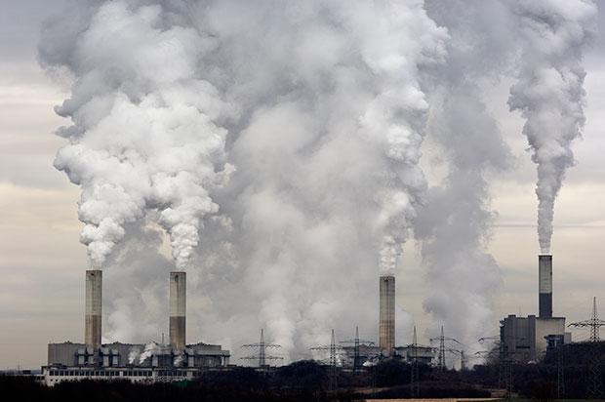
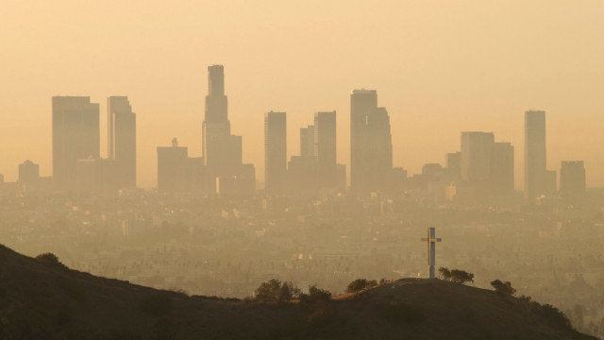
Definitions
Air pollution is a mix of particles and gases that can reach harmful concentrations
Most prevalent types of air pollution is smog (ground-level O3) and soot (PM)
Others include black carbon (BC), nitrogen oxides (NO and NO2), and sulfur dioxide (SO2)
Most common causes of air pollution:
Transportation, factories, power plants incinerators (PM)
Burning fuel such as diesel, wood, carbon (BC)
Transportation (NO and NO2)
Combustion and fossil fuels (O3)
Coal, metal extraction and smelting, ship engines (SO2)

Slide 3
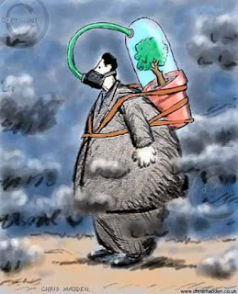
Significance
Air pollution is detrimental to human health and to the planet as a whole
Biggest environmental risk for early death and is responsible for 5 million premature deaths
Capable of impacting mental health, productivity, and stock market performance
Primary cause of heart disease, lung cancer, respiratory diseases
Los Angeles Air Quality Index (AQI) varies from 32(good) to 64(moderate)
Los Angeles ranks as one of the worst cities in terms of air pollution with highest measured values in PM2.5 (soot) and O3 (smog).
Effects of Soot/Particulate Matter:
PM10 - cause nasal and upper respiratory health issues
PM2.5 - Capable of penetrating the lungs and bloodstream, worsen bronchitis, lead to heart attacks, or hasten death
PM2.5 - exposure can impair brain development

Slide 4

Significance
Effects of Smog/Ozone
Short term exposure - can irritate the eyes, throat, skin, and lungs and cause chest pain
Long term exposure - lead to decreased lung function and cause chronic obstructive pulmonary disease
Can intensify symptoms of allergies and asthma and is capable of triggering asthma attacks
Effects of Black Carbon
Long term exposure - higher risk of heart attacks and stroke
Associated with asthma and a variety of types of cancers
Effects of Nitrogen Oxides
Can lead to development of asthma and bronchitis and a higher risk of heart disease
Effects of Sulfur Oxide
Can cause eye irritation, worsen asthma and increases susceptibility to respiratory infections

Slide 5
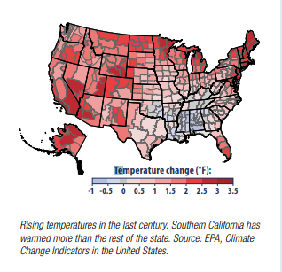
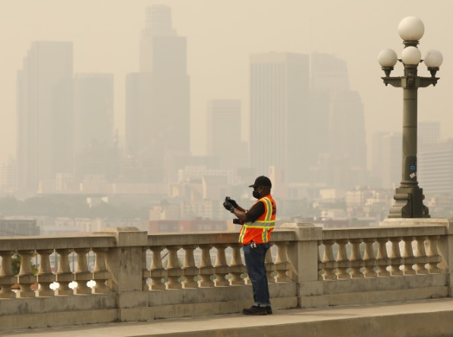
Air Pollution in Los Angeles
Los Angeles County remains on of the most polluted regions in the nation
It does not meet the U.S. EPA’s national air quality standards for several pollutants.
Changes in weather can impact local air quality
Sunlight, wind speed and direction, temperature, and pressure condition
Picture provided by LA times, Taken Sep 10, 2020
Notes:
@Peter https://www.iqair.com/us/usa/california/los-angeles to be able to talk more about this section
Air Pollution is an enormous health hazard for everyone in Los Angeles, and it continues to get exponentially worse every year.
It puts those who have respiratory illnesses at risk, and it continues to hurt people’s daily life.
The US Environmental Protection Agency identifies Los Angeles as not meeting its air quality standards for several pollutants. So, how does this affect us?
Well, it affects our entire ecosystem, our environment. An increase in Air Pollution will further accelerate the climate change taking place here in Los Angeles.
There is an abundant amount of scientific research articles that show the direct correlation between air pollution and climate change, likewise for Air Pollution and health.
High temperatures and droughts are likely to increase the severity and frequency of wildfires, which will negatively impact our air quality.
Many states in the west of the US, especially California, are prone to wildfires.
2020 was just an example of how bad these fires can get. The August complex Fire was the worst wildfire in California to date and emitted a tremendous amount of pollutants in the air.
Los Angeles County remains on of the most polluted regions in the nation.

Slide 6
Significance (Cont)
Asthma Statistics in LA County
1 in 11 children (9% of population) have asthma
Asthma rates have gone up in last decade
Black children(25%), Hispanic children(8%), non-Hispanic White children(7%), Asian/Pacific Islander(4%)
1 in 14 adults (6% of population) have asthma
non-Hispanic Blacks(10%), non-Hispanic Whites(8%), Hispanics and Asian/Pacific Islander(5%)
Cardiovascular Disease Statistics in LA County
Per 100,000 population, heart disease accounts for around 150 deaths
Notes:
http://www.asthmacoalitionla.org/#:~:text=Los%20Angeles%20County%3A,children%20(9%25)%20have%20asthma.&text=About%201%20in%2014%20adults%20(6%25)%20have%20asthma
Air Pollution in Los Angeles has a negative impact on people’s lives and causes respiratory illness affecting both children and adults .
Exposure to air pollutants is a concern in urban areas, like Los Angeles, because of the highly dense populations exposed to air pollution and the high number of emission sources.
Respiratory and Cardiovascular diseases caused by air pollution is one of the most critical health problems worldwide.
Ambient air pollution (AAP) and particulate matters (PM) have been closely associated with adverse health effects such as respiratory disease and cardiovascular diseases. Previous studies have examined the adverse health effects associated with short- and long-term exposure to AAP and outdoor PM on respiratory disease.
Children who live in economically disadvantaged areas with high traffic density may be particularly susceptible to asthma exacerbation from air pollution exposure.
Here are some statistics from LA County. (Read Slides)

Slide 7

Goals and Purpose of Our Project
Goals:
Develop a data driven platform and web application as a dashboard to address the issues of air pollution
Develop an app that has user personalized features along with a forecast of the air pollution in their area for the next few days
Purpose:
Give users general information surrounding air pollution and its effects
Allow users with conditions such as asthma to plan accordingly based on the forecast

Slide 8





Technologies Used

Slide 9
Current State of Dashboard
Contains 3 tabs each corresponding to a different map
User features:
Legend
Able to toggle on/off datasets
Able to add additional datasets

Slide 10
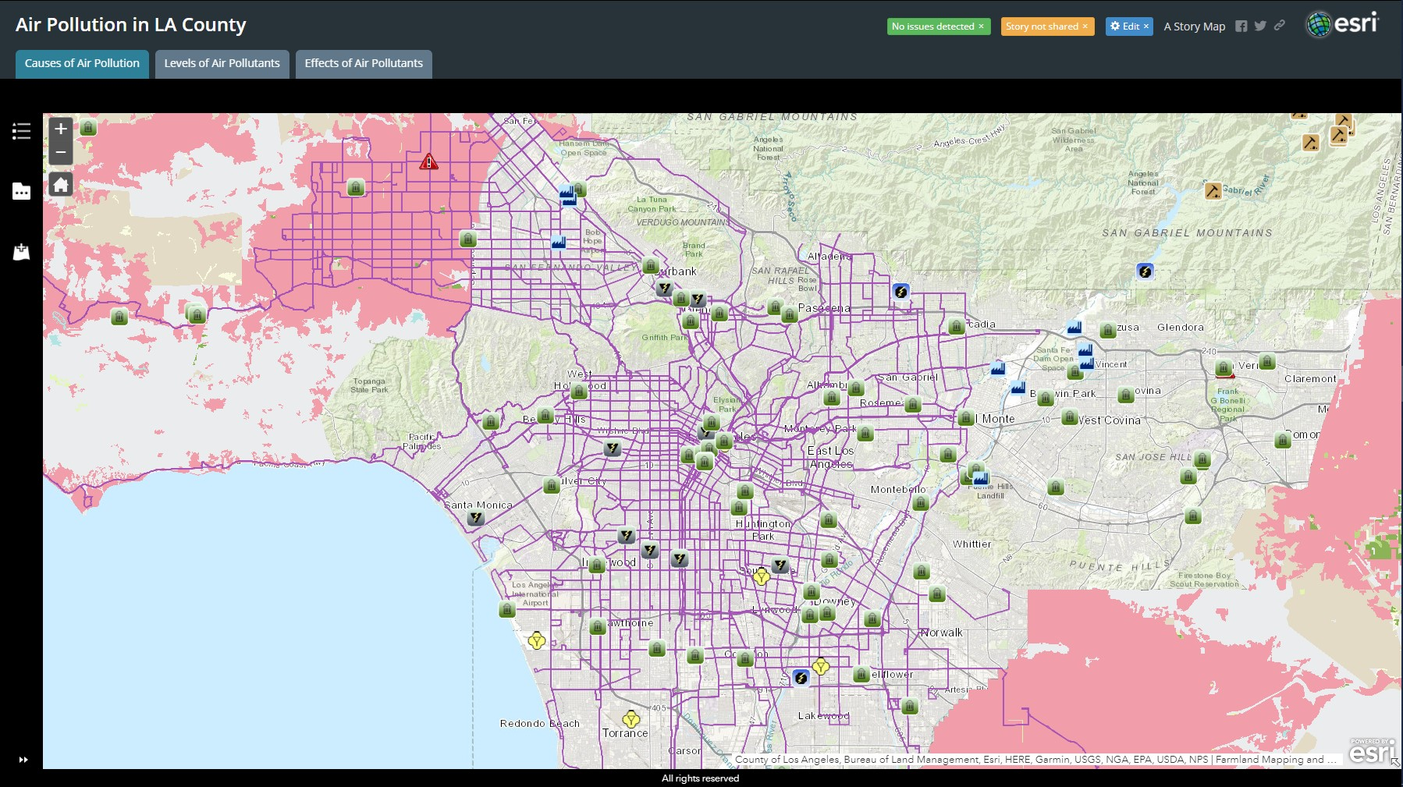

Slide 11
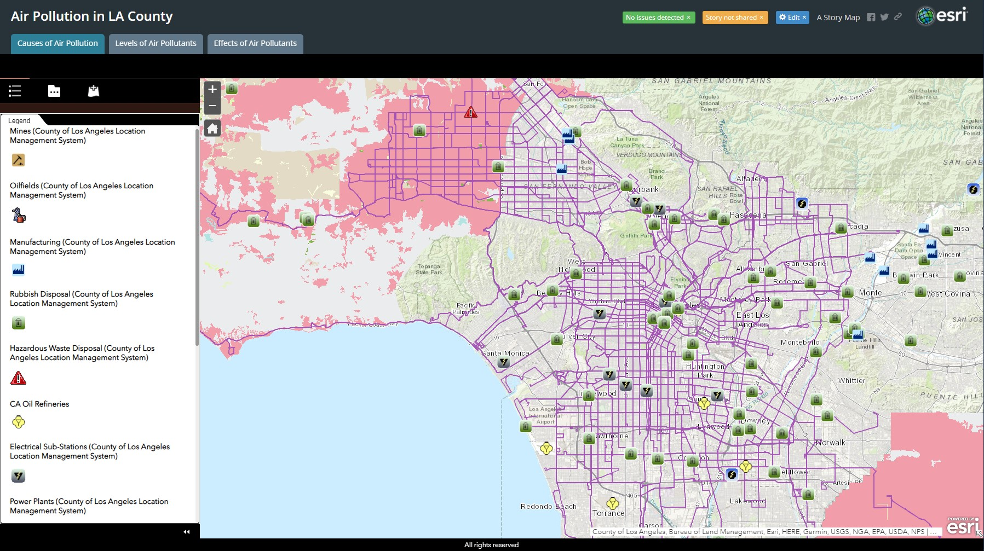

Slide 12
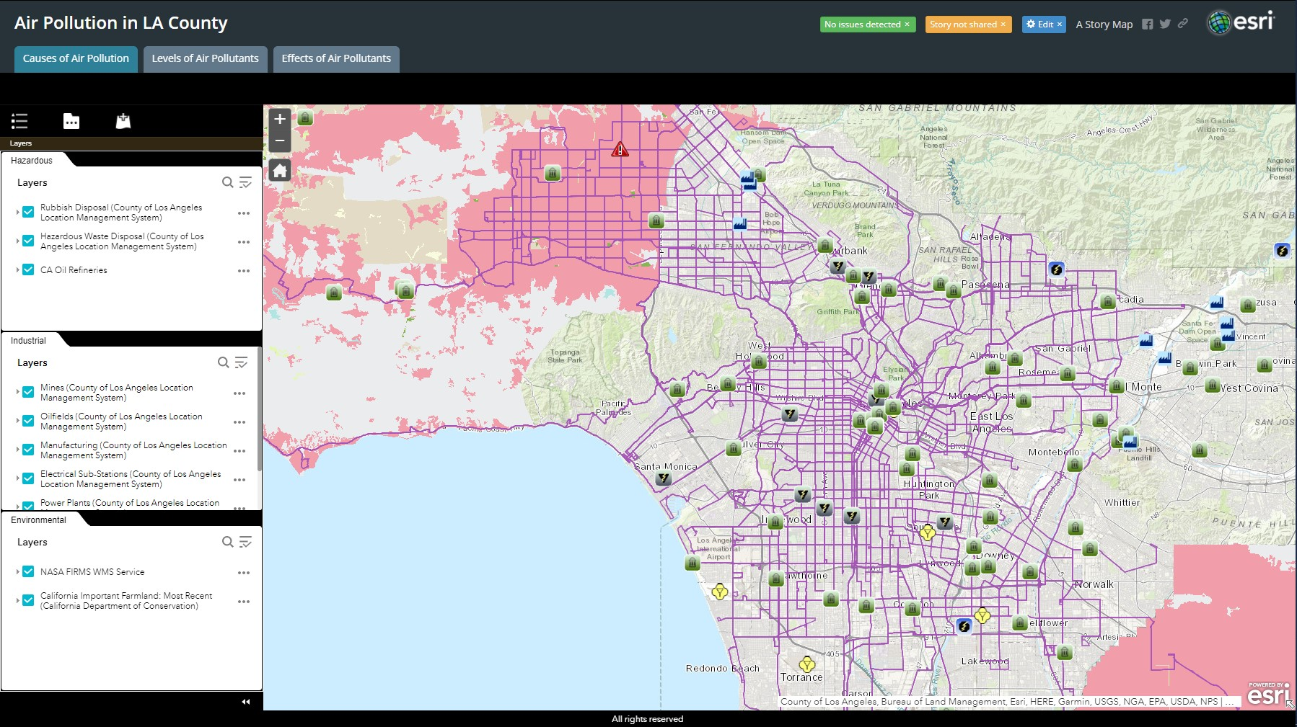

Slide 13
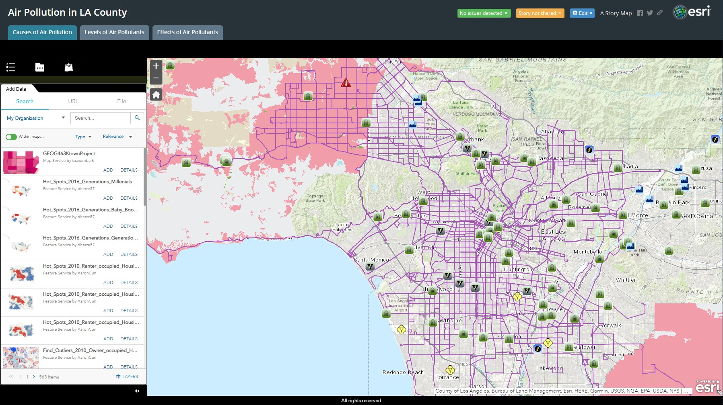

Slide 14
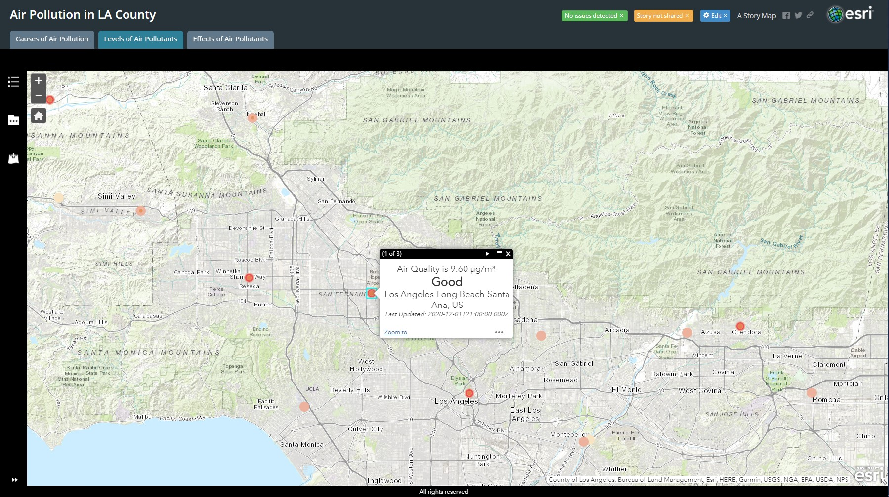

Slide 15
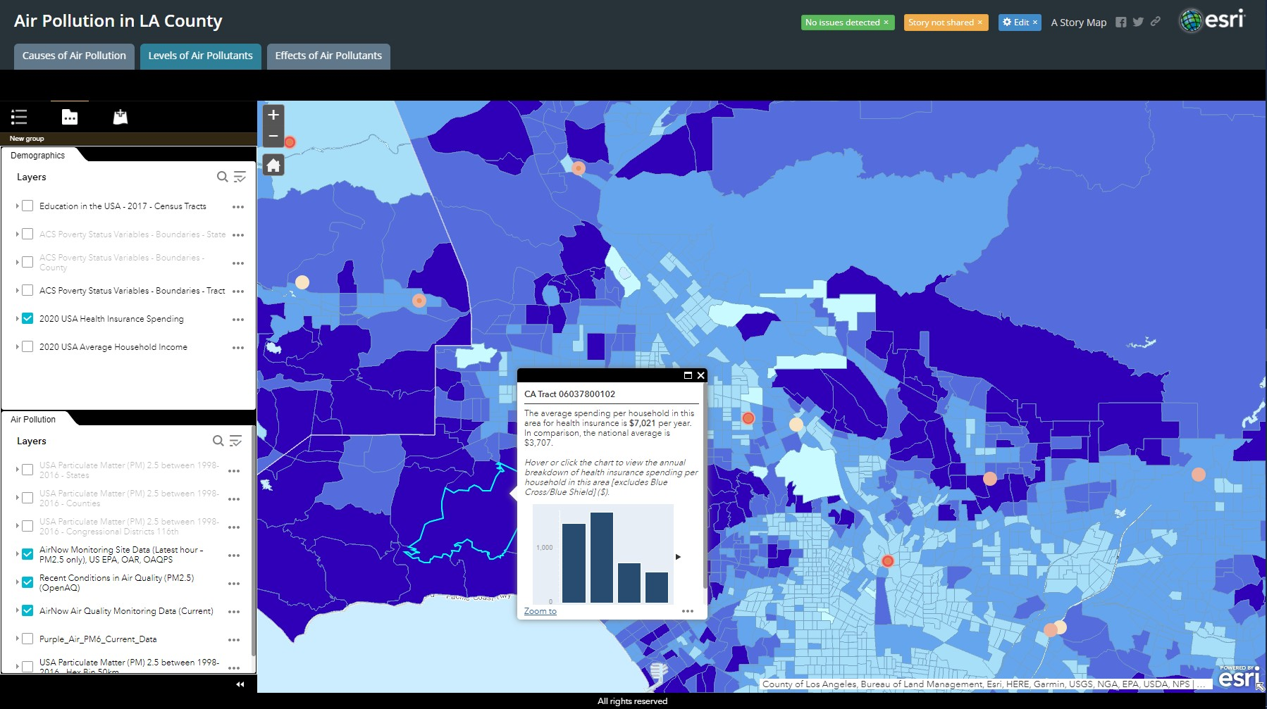

Slide 16
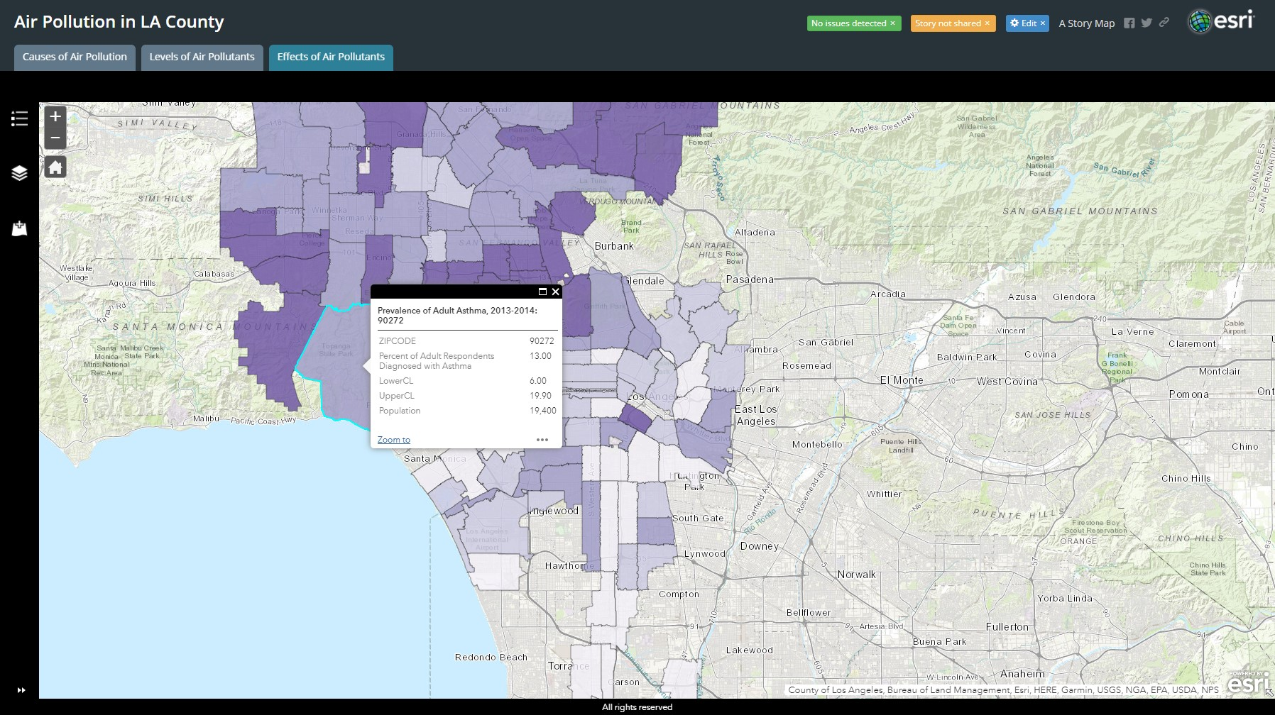

Slide 17

Mobile Application Background
Air Pollution data is not user friendly
Web Application is useful, but not always easily accessible
Android Firmware (template)

Slide 18

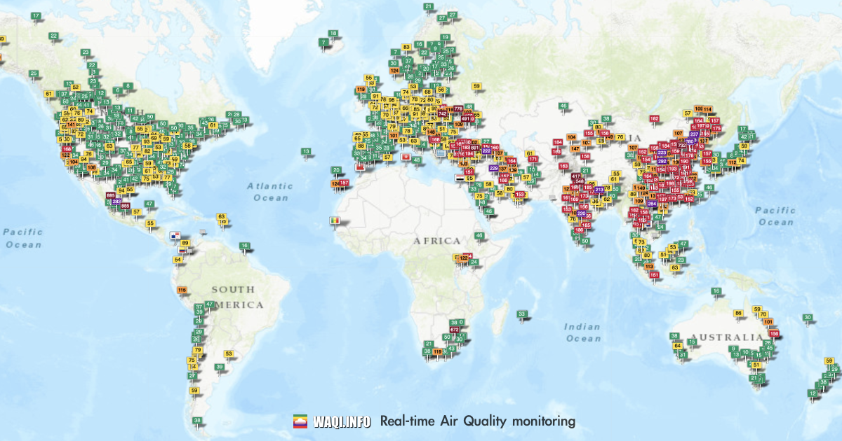
Mobile Application Purpose
Track certain air pollutant levels throughout regions
Provide varying levels of air quality pollutants using ArcGIS Database
Accurately predict air quality in the future
Convenient data access

Slide 19
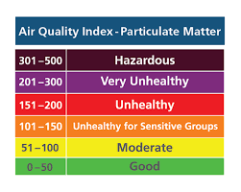
What we've done and how it helps
Create a homepage with a location search bar (work in progress)
Provide levels of Ozone using ArcGIS database
Provide levels of PM 2.5 using ArcGIS database

Slide 20

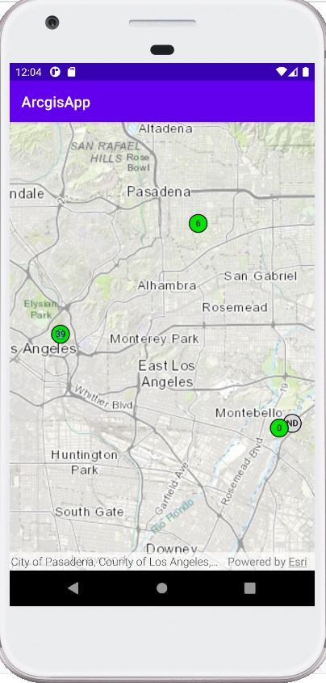
Search Page

Slide 21
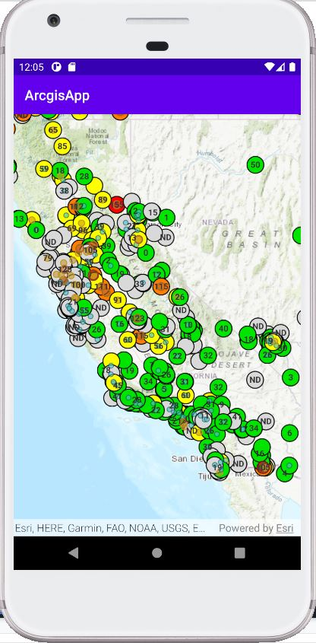
AirNow Layer
Data Layer taken from arcgis database
Focuses on tracking Ozone pollutants
Updates hourly

Slide 22
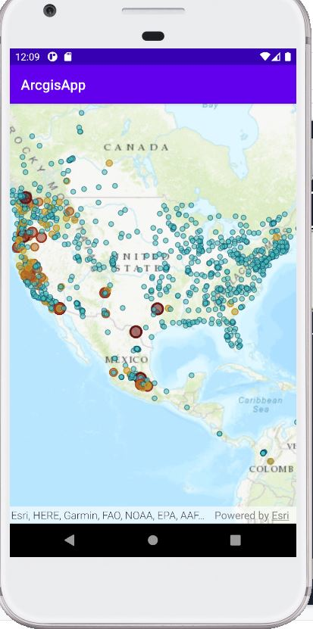
Recent Conditions of Air Quality Layer
Data layer taken from arcgis database
Focused more on PM 2.5
Updates hourly

Slide 23

Future Goals (Web Application)
Add data pertaining to levels of air pollutants and the effects of air pollution
Organize data by category
Ensure maps are easy and simple to understand
Add user-related features
Swipe function to allow for users to see correlations between data and demographics
Allow user to search for location

Slide 24


Future Goals (Mobile)
Add More GUI Elements:
Implement Location (Auto)
Buttons for the different map information types (Ozone, PM 2.5, PM 10)
Real time data(both apps)
App Data
Predictable air pollution (AI)
In Depth information guide of specific points
Possible IOS implementation

